Slide 1
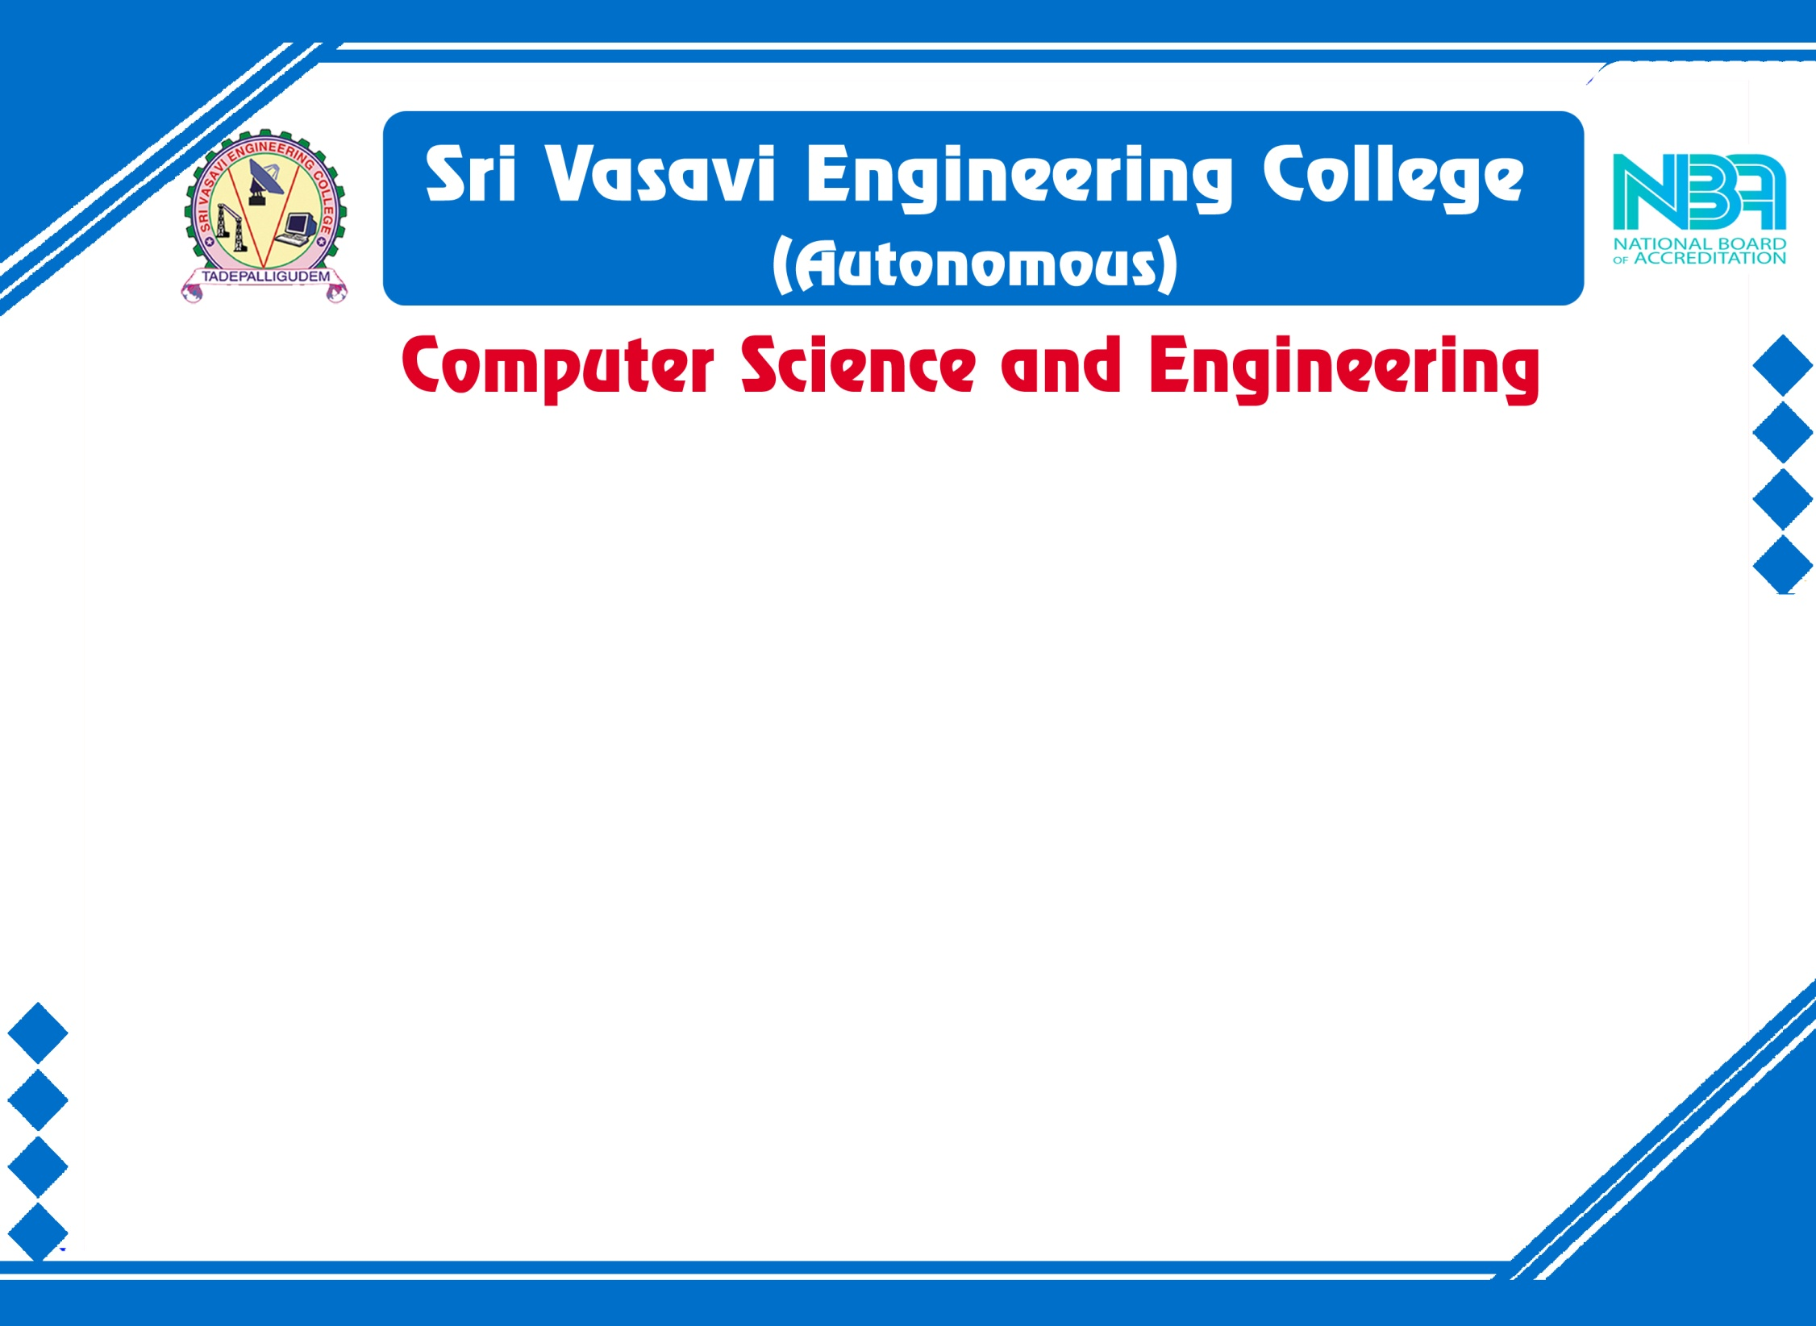
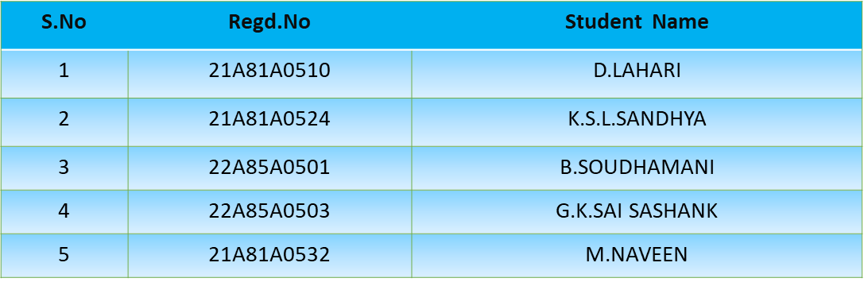
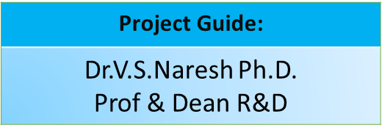
Mini Project External Review
Batch No: 6
Project Title: Sign Language Translation into Text using ML

Slide 2
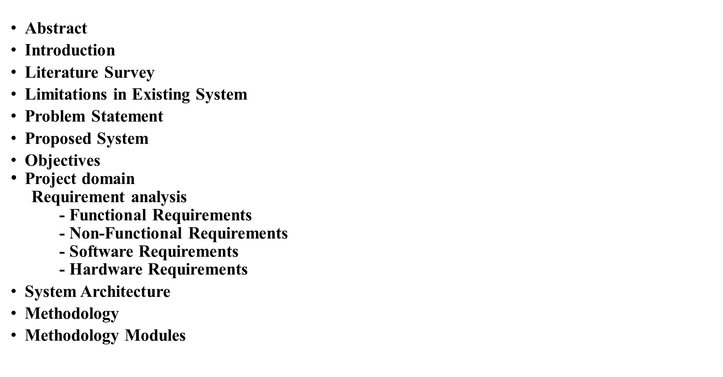
CONTENTS
Design
Implementation
Result Analysis
Attainment of objective
Conclusion
Future scope of Project

Slide 3
ABSTRACT
Nonverbal communication encompasses various methods of communication, including hand gestures or signs. Sign language is a collection of these hand gestures that enable communication, and it is commonly used by deaf-mute individuals to communicate with each other and others. However, it can be challenging for those who are not familiar with sign language to understand the gestures used.
As technology continues to advance, Gesture Recognition and Pattern Recognition have become popular fields of research. Hand gestures are an essential part of nonverbal communication and play a vital role in daily life.
To bridge the communication gap between deaf-mute individuals and others, we propose a project that involves creating a system for character classification in Indian Sign Language (ISL) or American Sign Language (ASL) using machine learning. This system aims to utilize the power of machine learning to accurately identify and classify different sign language characters, enabling better communication between deaf-mute individuals and the general population.

Slide 4
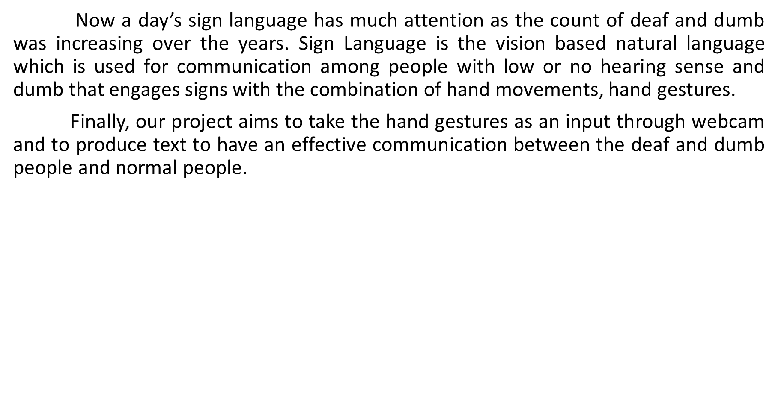
Introduction

Slide 5
Literature Survey
Sno | Author | Published year | Title | Technique
1 | Anuja Nair, Bindu V | 2013 | A Review on Indian Sign Language Recognition | Artificial Neural Networks (ANN), Support Vector Machine (SVM), Hidden Markov Models (HMM
2 | Sawat Pramada, Archana vaidya | 2013 | Intelligent Sign Language Recognition Using Image Processing | Image Processing, Artificial and Machine Concepts
3 | Swapna Johnny, S Jaya Nirmala | 2022 | Sign Language Translator Using Machine Learning | K-NN,Decision Tree Classifier, Neural Networks

Slide 6
Limitations in Existing System
The user should carry hardware with him.
The system unable to identify the signs in case of movements in gestures.
The system doesn’t give correct results in low light conditions.
User can not do any other work with flex sensors on fingers and also sensors should be placed straight.

Slide 7
Problem Statement
Generally Normal people face difficulty in understanding the language of Deaf and Dumb People. Hence there is a need of a system which recognizes the different signs, gestures and conveys the information to the normal people.
To design a real time software system that will be able to recognize ISL or ASL hand-gestures using ML techniques. This project aims to predict the 'alphabetic' gesture of the ISL or ASL system and also convert the human speech into signs. But instead of using high-end technology like gloves or kinect, we aim to solve this problem using state of the art computer vision and machine learning algorithms.
Proposed System
In the proposed system of the sign language translation, firstly we need to perform the gestures in front of the webcam so that it can capture the images and the system processes those images. After that classification is performed. Finally, we will get the final text as output of sign language.The system consists of a camera which captures a image.

Slide 8
Objectives
The main objective of the project is to provide an efficient and accurate way to convert sign language into text.
Accurate Translation: Develop machine learning models that can accurately and reliably translate sign language gestures and expressions into written or spoken language.
Real-Time Translation:Create systems that can perform translation in real-time. This involves optimizing the speed and efficiency of the translation process.
User-Friendly Interfaces: Design user-friendly interfaces and applications that allow both sign language users and non-signers to interact effectively.
Vocabulary and Grammar: Build models that can understand and interpret the vocabulary and grammar of sign languages, which can vary significantly from spoken languages.
The motivation for this project is to provide a real time interface so that signers can easily and quickly communicate with non-signers.

Slide 9
Project Domain
Our project domain is Machine Learning.

Slide 10
Requirement Analysis
Functional Requirements:
➢ Image acquisition
➢ Image Preprocessing
➢ Classification
Non- Functional Requirements:
➢ Usability
➢ Flexibility
➢ Integrity
➢ Performance

Slide 11
Requirement Analysis
Software Requirements:
➢ Operating System : Windows 10
➢ SDK: Open CV, TensorFlow
➢ Language: Python
Hardware Requirements:
➢ Camera: Good quality (Minimum 5MP)
➢ Processor: core I3 and above
➢ RAM: Minimum 8GB or higher
➢ GPU: Minimum 2GB

Slide 12
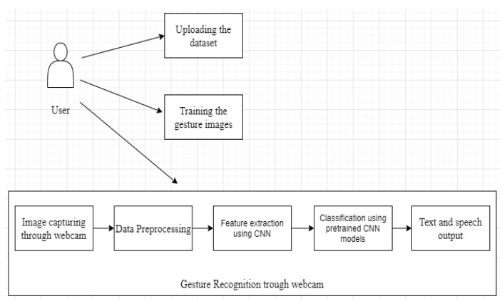
System Architecture
Text

Slide 13
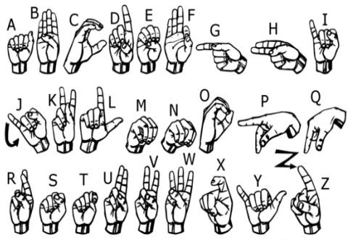
Methodology
There are several steps involved in the methodology of sign language Translation to text like gesture recognition. To recognize the sign language, firstly we need to take the input image through webcam then the image needs to be processed. Then we can extract the features from the processed image. Finally, the system recognizes the gestures, and we will get the needed result.
Dataset link:
https://www.kaggle.com/code/fromcbgtohust/asl-cnn-recognizer/input
There are 27 symbols(A-Z, blank) in
our project Dataset.

Slide 14

Methodology Modules
 Uploading and Training dataset
Data Preprocessing
Feature Extraction
Classification
Predicting the gestures

Slide 15
DESIGN
Webcam
RGB Image
Grayscale Image
Convolutional Neural Network Layer 1
Gestures Matching
To Dataset
Yes
No
Convolutional Neural Network Layer 2
Give Output Into Text
Checks for Similar Gestures
Yes
No

Slide 16
IMPLEMENTATION
Data Collection:
The dataset which was used is a subnet of a dataset
from (https://github.com/emnikhil/Sign-Language-To-Text-Conversion/tree/main/dataset)
Install all these libraries using pip command
pip install numpy
pip install opencv-python
pip install tensorflow
pip install keras
pip install spellchecker
pip install Pillow
pip install tk
pip install os-sys
pip install strings

Slide 17
IMPLEMENTATION(Contd..)
Make necessary imports
import numpy as np
import cv2
import os
import tkinter as tk
import tensorflow as tf
from keras.models import model_from_json
from spellchecker import SpellChecker
from PIL import Image, ImageTk
from string import ascii_uppercase
from keras.preprocessing.image import ImageDataGenerator
os.environ["CUDA_VISIBLE_DEVICES"] = "1"

Slide 18
IMPLEMENTATION(Contd..)
Split the dataset into testing and training set and store the sets in separate variables.
training_set = train_datagen.flow_from_directory('S:/Projects/Sign Language To Text Conversion/dataSet/trainingData',target_size = (128, 128)batch_size = 10,color_mode = 'grayscale',class_mode = 'categorical’)
test_set = test_datagen.flow_from_directory('S:/Projects/Sign Language To Text Conversion/dataSet/testingData',target_size = (128, 128),batch_size = 10,color_mode = 'grayscale',
class_mode = 'categorical')

Slide 19
IMPLEMENTATION(Contd..)
Now train and test the model using CNN algorithm and save the model
classifier = tf.keras.models.Sequential()
classifier.add(tf.keras.layers.Conv2D(filters=3,kernel_size=3,padding="same",activation="relu",
input_shape=[128, 128, 1]))
classifier.add(tf.keras.layers.MaxPool2D(pool_size=2,strides=2, padding='valid’))
classifier.add(tf.keras.layers.Conv2D(filters=32,kernel_size=3,padding="same“, activation="relu"))
classifier.add(tf.keras.layers.MaxPool2D(pool_size=2,strides=2, padding='valid’))
classifier.add(tf.keras.layers.Flatten())
classifier.add(tf.keras.layers.Dense(units=128, activation='relu’))
classifier.add(tf.keras.layers.Dropout(0.40))
classifier.add(tf.keras.layers.Dense(units=96, activation='relu’))
classifier.add(tf.keras.layers.Dropout(0.40))
classifier.add(tf.keras.layers.Dense(units=64, activation='relu’))
classifier.add(tf.keras.layers.Dense(units=27, activation='softmax’)))
classifier.compile(optimizer = 'adam', loss = 'categorical_crossentropy',metrics = ['accuracy’])
classifier.fit(training_set,epochs = 5,validation_data = test_set)

Slide 20
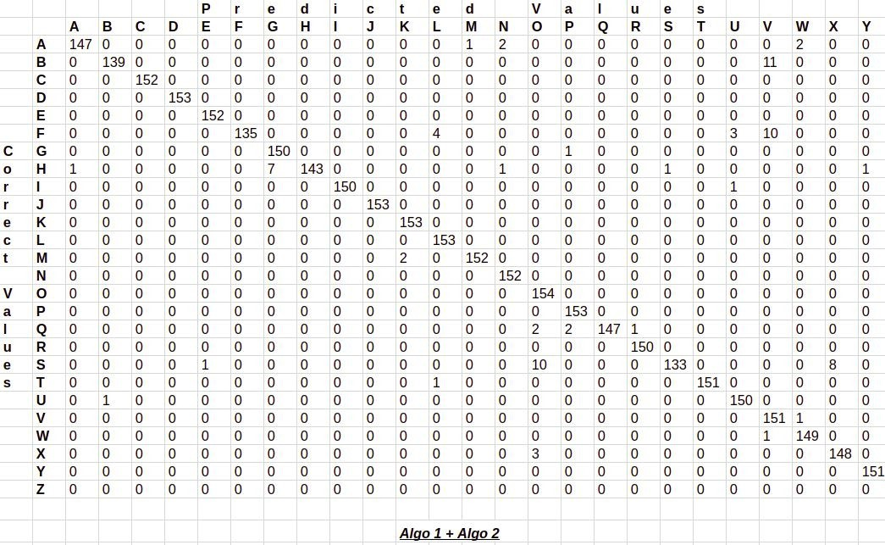
RESULT ANALLYSIS
It gives 95.8% accuracy result by using only layer 1 of the algorithm,and using the combination of layer 1 and layer 2 gives an accuracy of 98.0% result.

Slide 21
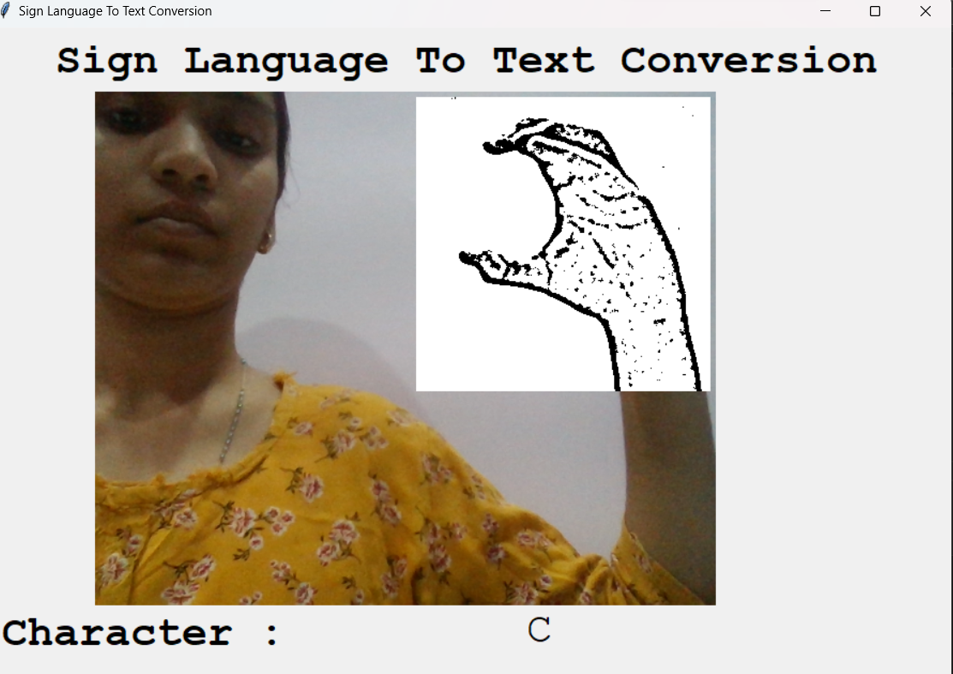
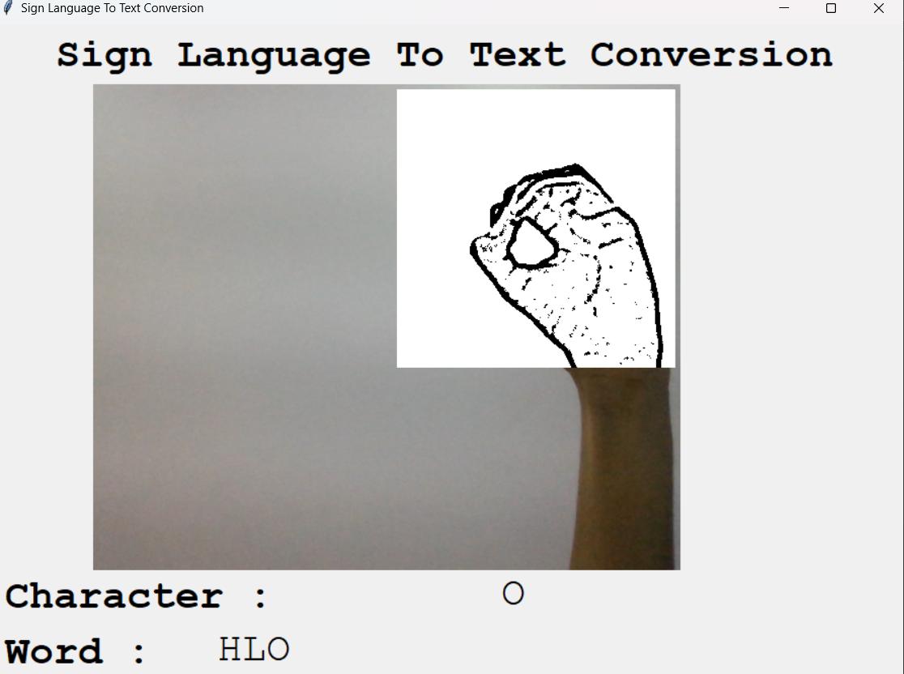
RESULT ANALLYSIS
Output:

Slide 22
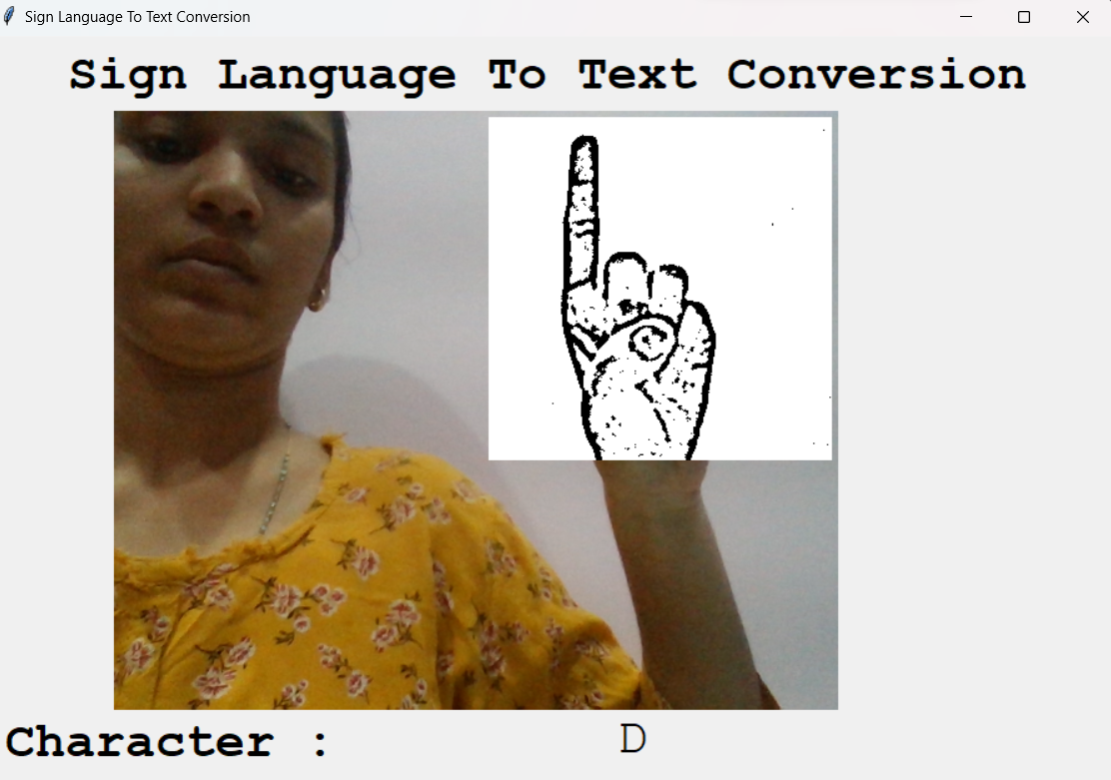
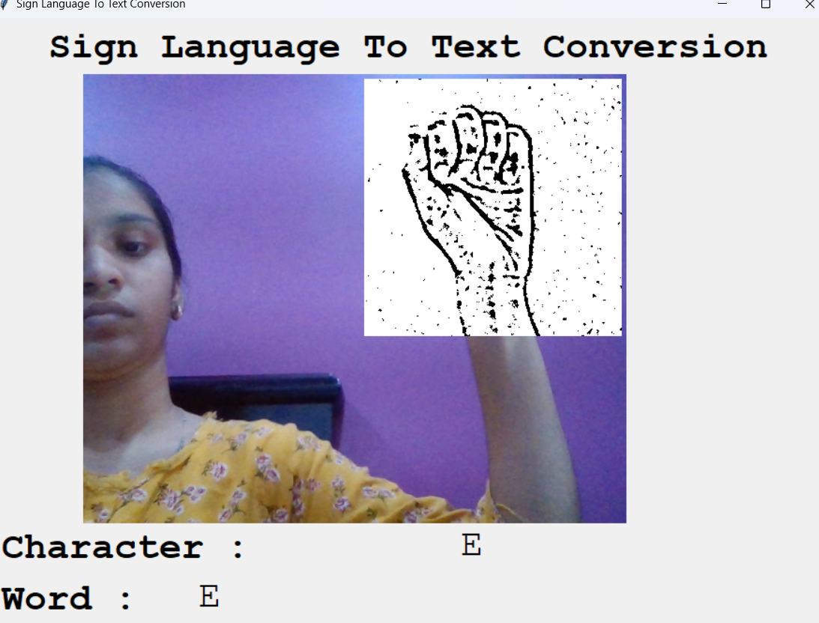
RESULT ANALLYSIS
Output:

Slide 23
ATTAINMENT OF OBJECTIVE
It recognizes and translates hand gestures into text, providing a clear and accurate way to understand and communicate through sign language
We attained 98% accuracy, it improved our prediction after implementing two layers of algorithms
This gives us the ability to detect almost all the symbols provided that they are shown properly, there is no noise in the background and lighting is adequate.

Slide 24
CONCLUSION
To Conclude, this project is a simple recognition of sign language and convert them into text. This System Consists of Web camera which is used to capture the gestures. The Signs are processed for feature extraction. The features are compared with testing database to calculate the sign recognition. Eventually, recognized hand gesture is converted into text . This system provides an opportunity for deaf and dumb people to easily communicate with normal people.

Slide 25
FUTURE SCOPE
➢ To increase the performance and accuracy, the quality of the training dataset used should be
enhanced.
➢The project can be further extended by achieving better results even in darker environments where hand
movements are clearly not visible.
➢ This project can also enhance and implement speech emotion recognition as well as speech recognition.
➢ This project can be enhanced by being built as a web/mobile application for the users to conveniently
access the project.

Slide 26


