Slide 1
PROJECT TITLE: Examination Time Table Generation System (PSCS139)
PIP104 University Project-II
Final Review
Batch Number:45
Roll Number | Student Name
20211CSE0059 | L.Rachana
20211CSE0090 | M.Srinivas
20211CSE0091 | B.Lakshman
20211CSE0152 | G.Lahari
Under the Supervision of,
Dr.Pamela Vinitha Eric
Professor
School of Computer Science and Engineering
Presidency University

Slide 2
Introduction
Objective: Explain the purpose of generating examination timetables to avoid scheduling conflicts and optimize resources.
Problem Statement: Examination scheduling involves ensuring that no student has overlapping exams while making efficient use of rooms, invigilators, and time slots.
Importance: Proper scheduling ensures a smooth examination process, prevents student stress due to overlapping exams, and avoids logistical problems for institutions.

Slide 3
Literature Review
Previous Research:
Review studies that discuss manual vs. automated timetable generation.
Discuss common issues such as student clashes, room capacity constraints, and invigilator availability.
Algorithms in Use:
Constraint Satisfaction Problem (CSP): A widely used approach that ensures constraints like no exam overlap are strictly followed.
Genetic Algorithms: Mimics the process of evolution to generate multiple solutions and selects the most optimal one.
Heuristic Approaches: Focuses on finding fast, approximate solutions, often used when time is a constraint.

Slide 4
Proposed Method
The proposed system will integrate constraint programming and genetic algorithms to generate conflict-free, optimized examination timetables. The system will automate the process while handling various dynamic constraints such as student schedules, room availability, and teacher allocations. It will feature a user-friendly interface to allow administrators to input data and generate timetables with minimal effort.

Slide 5
Architecture Diagram
Data Input
Processing Unit (Scheduling Algorithm)
Database (Time Table)
User Interface (Admin,User)
Output

Slide 6
Modules
Data Collection Module:
Handles the collection and processing of student, subject, and room availability data.
Constraint Solver Module:
Applies constraint programming and genetic algorithms to resolve scheduling conflicts.
Timetable Generation Module:
Generates the final timetable based on input constraints and optimization results.
User Interface Module:
Allows the user to input constraints, review timetables, and export results.

Slide 7
Hardware and Software Details:
Hardware:
High-performance computer with multi-core processor.
Server for hosting the system in large-scale institutions.
Software:
Programming Language: Python
Scheduling Libraries: OR-Tools, Pulp
Database: MySQL
Frontend: HTML, CSS
Tools: Power BI for report generation (optional).

Slide 8
Objectives
Automate the generation of examination timetables by accounting for various scheduling constraints.
Minimize exam conflicts for students taking multiple subjects.
Ensure scalability for large educational institutions with dynamic scheduling needs.
Reduce human intervention and errors in timetable creation.

Slide 9
Methodology
Step 1: Collect and input data (student enrollments, subjects, available rooms, etc.).
Step 2: Apply constraint-based algorithms (CSP) or evolutionary approaches (Genetic Algorithms)
to find the best-fit timetable.
Step 3: Check for conflicts, room capacity, and invigilator availability.
Step 4: Adjust timetable based on soft constraints (such as minimizing consecutive exams).

Slide 10
Timeline of Project
Phase 0
Problem discussion and finalize features for time table generation.
Phase 1
Data collection for schedules, rooms, invigilators, and other resources.
Phase 2
Developing and implementing the time table generation algorithm.
Phase 3
Testing and presenting the system.

Slide 11
Expected Outcomes
A functioning examination timetable generation system that reduces clashes.
Improved efficiency in room and resource allocation.
Minimized manual errors and increased scheduling accuracy.
Reduced stress for students with a balanced exam schedule.

Slide 12
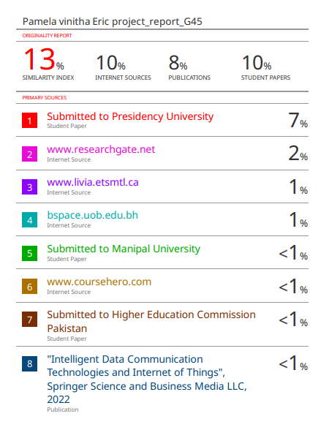
Plagiarism

Slide 13

SDG Mapping

Slide 14
Conclusion
Examination timetable generation is a complex but essential process for academic institutions.
Automated systems using CSP or genetic algorithms can efficiently handle constraints and generate
optimal timetables.
The project aims to streamline the scheduling process, reduce conflicts, and enhance the overall
examination experience.

Slide 15
References
Smith, J., & Johnson, L. (2020). Automated Scheduling Algorithms for Educational Institutions. Insights on constraint-based scheduling and its limitations in handling dynamic environments.
Doe, M. (2019). Optimization Techniques for Timetable Scheduling. Overview of genetic algorithms in timetable generation.
Lee, H. (2021). Constraint Programming in Academic Timetables. Analysis of constraint programming as a popular technique for timetable generation.
Patel, S., & Kumar, N. (2022). Genetic Algorithms in Timetable Generation. Discussion on how genetic algorithms can optimize scheduling for large institutions.
Brown, R. (2021). AI-Based Systems for Educational Timetabling. Exploration of AI techniques in automating the scheduling process.

Slide 16
References
Gonzalez, F. (2020). Rule-based Scheduling Systems: Advantages and Limitations. Description of simple rule-based systems and their lack of flexibility.
Chen, M. (2019). Graph-based Scheduling for Educational Institutions. Using graph theory for conflict resolution in timetables.
Nakamura, T. (2021). Hybrid Algorithms for Scheduling. Review of hybrid methods combining AI and genetic algorithms for better performance.
Taylor, S. (2020). Spreadsheet-based Scheduling vs. Automated Systems. Comparison of traditional methods like spreadsheets with automated systems.
Jones, A. (2018). Evolution of Scheduling Systems for Academic Institutions. Historical development and evaluation of automated scheduling systems.

Slide 17
Thank You

