Slide 1

^{Project Phase-1 Review}
^{On}
Precision diagnosis by integration of transfer learning for colorectal polyp detection and classification
Presented
By
Dinakar Manupudi 1NT22AI400
Keshav 1NT21AI032
Lahari Y 1NT21AI034
Shreyas 1NT21AI054
Bachelor of Engineering (AI&ML)
Under the Guidance of:
Dr. Zabiha Khan
Associate Professor

Slide 2
Contents
Introduction
Objectives
Literature Survey
Problem Statement
Existing System
Proposed system
Methodology
Implementation
Results and Discussion
Conclusion
References

Slide 3
Introduction
Colorectal cancer is a major health issue, being the third most common cancer worldwide. Colorectal cancer is a disease in which cells in the colon or rectum grow out of control.
Polyps are the abnormal growth of tissues that look like tiny mushroom stalks and are most prevalent in the colon. Polyps are benign or harmless but can become malignant if not detected in early stage.
It is common for polyps to be overlooked during a colonoscopy procedure due to their small size and visual characteristics often leading to missed diagnoses or misclassifications.
Detecting polyps early can prevent the progression to colorectal cancer, but traditional colonoscopy methods can be prone to human error.
Current methods can miss small or hidden polyps, leading to missed diagnoses, highlighting the need for more advanced solutions.
AI and medical imaging advancements offer a more accurate and reliable way to detect polyps, reducing errors in manual procedures.

Slide 4
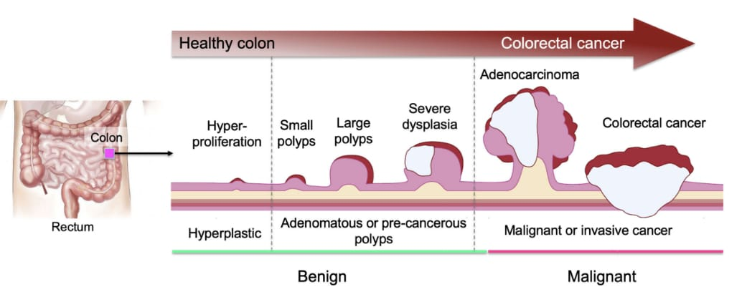
Phases of growth of polyp into colorectal cancer

Slide 5
Objectives
To develop an AI-based system for accurate detection and classification of colorectal polyps.
To support early diagnosis of colorectal cancer and reduce manual diagnostic errors.
To enable real-time detection for integration with endoscopic tools.

Slide 6
Literature Survey
Title | Author | Summary | Methodology | Research Gap
Colorectal polyp detection and Comparative evaluation based on deep learning approaches | YAO-TIEN CHEN AND NISAR AHMAD | YOLOV4 is a high-performing object detection model, notably efficient for colorectal polyp detection. This architecture allows YOLOV4 to achieve high accuracy, especially in detecting adenomatous and hyperplastic polyps with enhanced confidence scores YOLOv4 achieved the highest accuracy in detecting and classifying polyps, showing promising results for medical applications. | Faster RCNN SSD | Enhancing the detection of smaller and less distinguishable polyps and expanding the dataset to include more diverse cases
Deep Poly: Deep Learning-Based Polyps Segmentation and Classification for Autonomous Colonoscopy Examination | MD SHAKHAWAT HOSSAIN 1,2, (Member, IEEE), MD. MAHMUDUR RAHMAN3 | The proposed method focused on detecting polyps and their potential threats It uses vit for segmenting polyps and for classifying them based on risks. It outperformed other segmentation methods | Vit model | Focus on enhancing the classification accuracy for polyps of various sizes and types. The model has to work with other endoscopy images, such as those from gastroscopy, and testing it in diverse environments.
Colonic Polyp Detection in Endoscopic Videos With Single Shot Detection Based Deep Convolutional Neural Network | MING LIU1, JUE JIANG2, AND ZENAN WANG 3 | The paper addresses the challenge of detecting colonic polyps in endoscopic videos utilizing a Single Shot Detector (SSD) framework The proposed SSD method achieved high detection accuracy, outperforming other methods in detection speed and yielding competitive results in precision and recall, particularly with the Inception V3 model. This method offers a real-time, efficient solution for polyp detection. potentially enhancing CRC diagnostics | Inceptionv3 | Expanding the dataset with more varied clinical cases, particularly those that present challenges like small or flat polyps, is essential

Slide 7
Literature Survey
Title | Author | Summary | Methodology | Research Gap
Automatic Polyp Detection Using Microwave Endoscopy for Colorectal Cancer Prevention and Early Detection | ALEJANDRA GARRIDO 1, ROBERTO SONT 1, | The paper presents a novel microwave endoscopy system designed to integrate microwave imaging with optical colonoscopy, aiming to enhance colorectal cancer prevention and early detection. It can generate an alarm when a polyp is detected, helping address the 22% miss rate of traditional colonoscopies | Microwave imaging system | The ability to detect polyps of various sizes and shapes, particularly flat or sessile polyps, needs investigation It is required to test the system in preclinical triais, focusing on real human models
A comprehensive study on colorectal polyp with resunet++ ,conditional random field | KHALED ELKARAZLE VALLIAPPAN RAMAN | The model is evaluated across multiple datasets, showing that the method achieves strong segmentation performance The model's potential to generalize across different datasets, especially in detecting hard-to-find polyps | Random Field and Test-Tune Augmentation | Should focus on further enhancing the generalizability of the ResNet model by exploring more diverse datasets and testing in real-time clinical environments.

Slide 8
Problem Statement
Colorectal cancer is a leading cause of cancer-related deaths, and early detection of polyps is critical for effective treatment. Manual identification during colonoscopy is time-consuming and error-prone, requiring automated, reliable solutions. This project aims to develop a system using YOLOv8 and transfer learning to accurately detect and classify polyps, improving diagnostic efficiency and accuracy.

Slide 9
Existing System
Existing systems for colorectal polyp detection primarily rely on manual analysis of endoscopic images by medical professionals, which is time-consuming and prone to human error. Some AI-based tools exist but often lack real-time processing capabilities, high segmentation accuracy, or adaptability to different image qualities. Additionally, traditional systems may not integrate advanced deep learning models like transformers or offer explainable outputs for clinical use. existing systems for colorectal polyp detection mainly utilized traditional CNN-based models such as Faster R-CNN, SSD (Single Shot Detector), and YOLOv3/v4. These models provided decent object detection capabilities but often lacked precision in segmenting small or flat polyps and struggled with real-time performance in clinical settings. Additionally, older models required more computational resources and were less effective in handling variations in polyp shape, size, and texture.

Slide 10
Proposed System
This proposed system leverages transfer learning with the YOLOv8 algorithm to detect colorectal polyps quickly and accurately while minimizing training time. By fine-tuning pretrained YOLOv8 on a specialized dataset, the system can efficiently identify and localize polyps in colonoscopy images in real-time. Additionally, the system assesses the likelihood of each detected polyp being cancerous by classifying it based on its features (e.g., size, shape, texture). This risk prediction aids in identifying high-risk polyps for early intervention, supporting timely and informed clinical decisions. Together, the rapid detection and risk assessment provide a comprehensive tool for improving outcomes in colorectal cancer prevention and treatment.

Slide 11








Methodology
Data collection & dataset organization
Model initialization
Data Preprocessing
Set up yolov8 environment
Freeze Initial Layers
Transfer learning integration
Model Configuration
Data input formatting
Fine tune final layers
Model training
Polyp detection
Generation of bounding boxes with confidence scores
deployment
Model evaluation and testing
Polyp classification

Slide 12
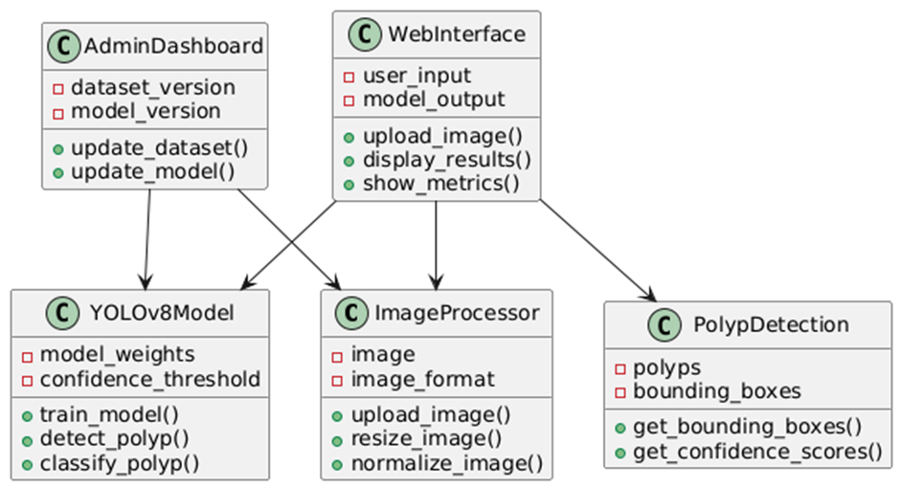
Class Hierarchy Diagram

Slide 13
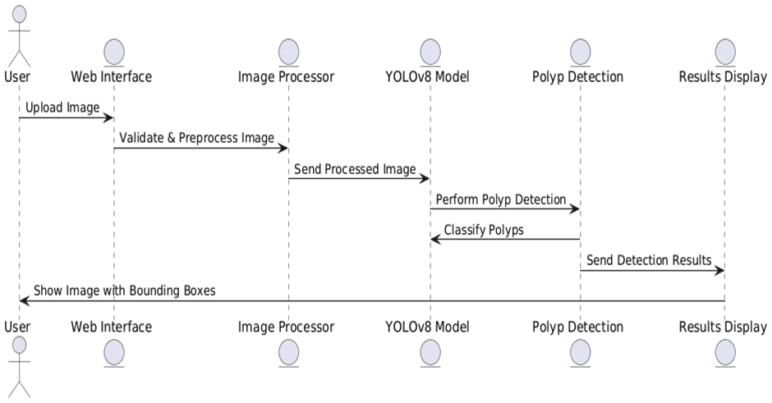
Sequence Diagram

Slide 14
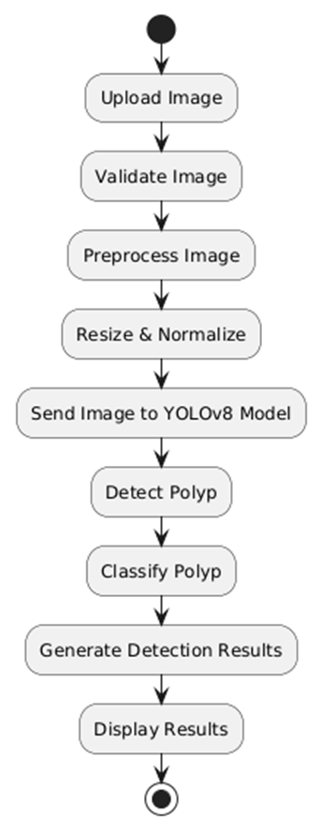
Activity Diagram

Slide 15
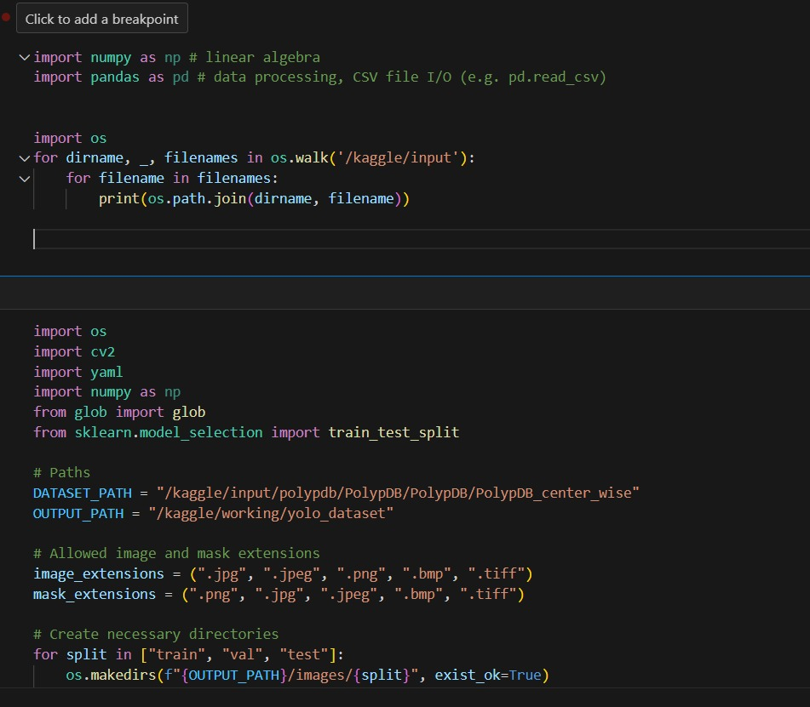
Implementation

Slide 16
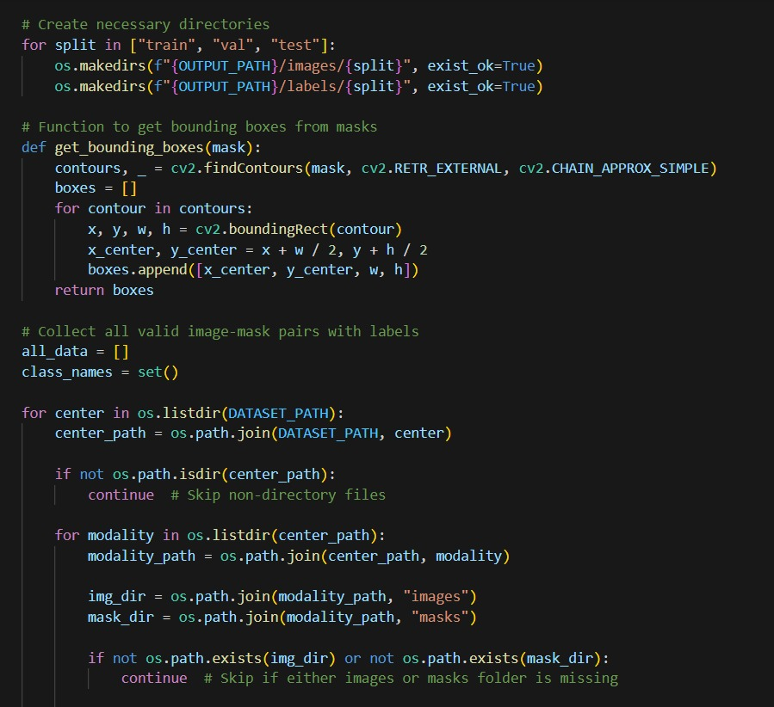
Implementation

Slide 17
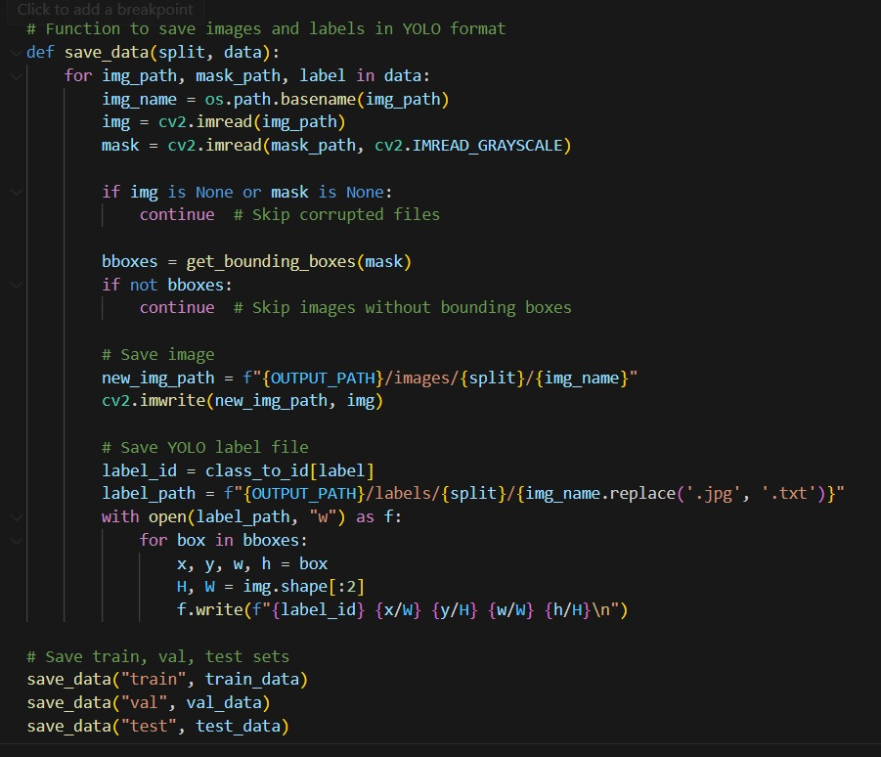
Implementation

Slide 18
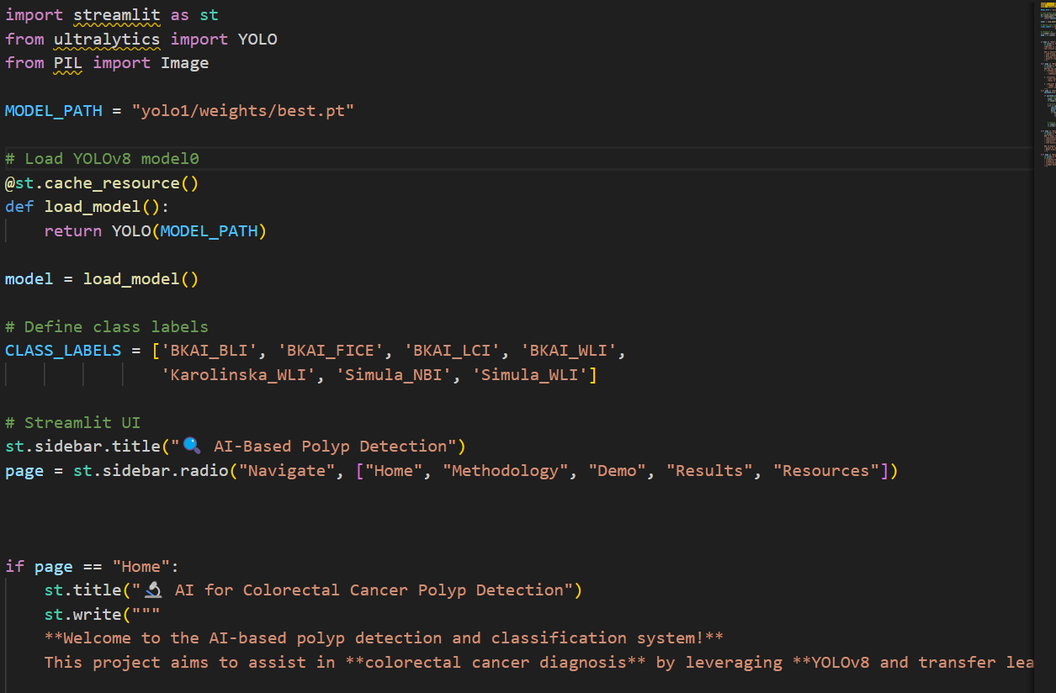
Implementation

Slide 19
Results and Discussions
Improved Detection Accuracy Outcome :Enhanced precision and recall for polyp detection, including small and subtle polyps that are often missed by conventional methods.
Enhanced Classification of Polyps Outcome: High classification accuracy in distinguishing between benign, precancerous, and malignant polyps.
Assessment of Cancer Risk Outcome: Provide a likelihood assessment of whether a detected polyp may develop into cancer.

Slide 20
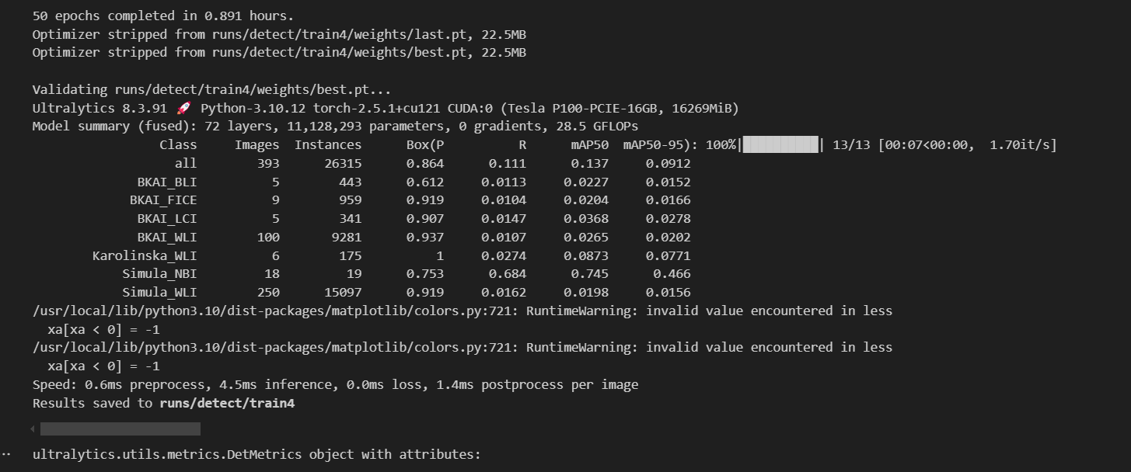
Results

Slide 21
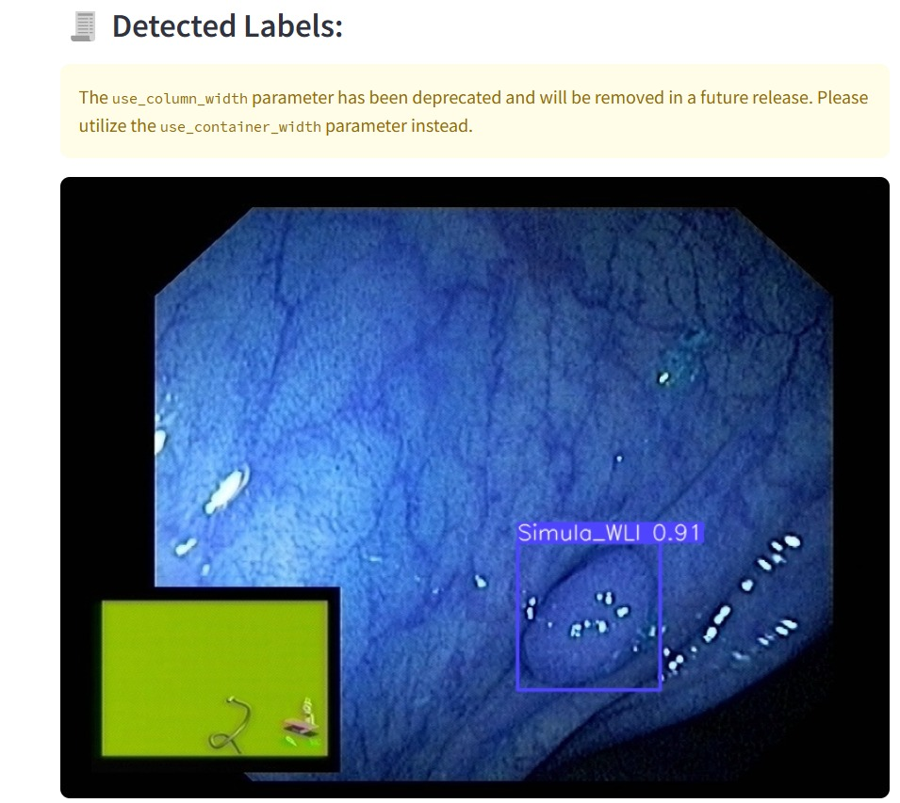
Results

Slide 22
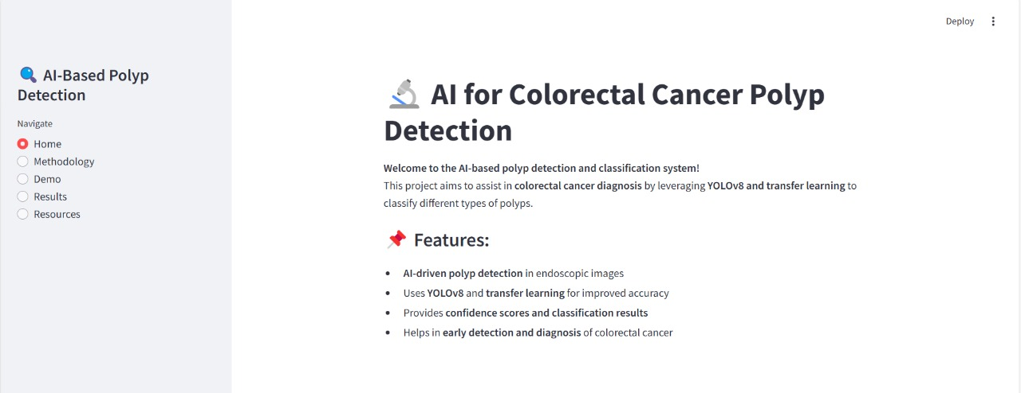
Results

Slide 23
Conclusion
This project successfully demonstrates the application of deep learning and computer vision to address one of the most critical challenges in modern healthcare the early detection and accurate classification of colorectal cancer polyps.
By utilizing the YOLOv8 object detection algorithm, enhanced through transfer learning on domain-specific medical datasets, the system achieves efficient and reliable detection of polyps in colonoscopy and endoscopy images.
A key strength of the project lies in its deployment-ready architecture, with a Streamlet-based web interface that allows seamless image uploads, real-time detection, and visual output that includes bounding boxes, classification labels, and confidence scores.
The system is further supported by robust performance metrics such as accuracy, precision, recall, and F1-score, ensuring transparency and aiding in clinical decision-making.

Slide 24
References
Luo, R., & Bocklitz, T. (2023). An in-depth analysis of transfer learning techniques applied to colorectal cancer detection. Informatics in Medicine Unlocked, 40, 101292.
Ohata, E. F., Chagas, J. V. S. D., Bezerra, G. M., Hassan, M. M., de Albuquerque, V. H. C., & Filho, P. P. R. (2021). A novel method utilizing transfer learning for classifying histological colorectal cancer images. The Journal of Supercomputing, 1-26.
Khan, A., Brouwer, N., Blank, A., Müller, F., Soldini, D., Noske, A., et al. (2023). Transfer learning-based ensemble models for computer-assisted diagnosis of lymph node metastases in colorectal cancer. Modern Pathology, 36(5), 100118.
Kassani, S. H., Kassani, P. H., Wesolowski, M. J., Schneider, K. A., & Deters, R. (2022). Comparative evaluation of deep transfer learning models for colorectal cancer histopathology segmentation. International Journal of Medical Informatics, 159, 104669.
Ragab, M., Mahmoud, M. M., Asseri, A. H., Choudhry, H., & Yacoub, H. A. (2023). Development of an optimized deep transfer learning model for colorectal cancer detection and classification. Computers, Materials & Continua, 74(2).

Slide 25
Thank You

