Slide 1



SheBuilds
HACKX 2025
Team Name: SheBuilds Institution: U.V. Patel College of Engineering, Gujarat
Problem Statement Title- Crowdsorced Civic Issued
Reporting and Resolution System
Theme: Clean and Green Technology
Team Members:
Lahar Solanki (Team Leader) – laharsolanki1107@gmail.com
Muskan Isarani – isaranimuskan12@gmail.com
Moksha Parikh – parikhmoksha2005@gmail.com
Hiral Madhu – hiralkhatri257@gmail.com

Slide 2

SheBuilds
Problem Statement
Background:
Potholes, garbage, water leaks, and damaged streetlights are issues in the city that take a negative impact on traffic, satisfaction of the poblic, security, and hygiene.
Current Challenges:
The municipal complaint procedures are slow, complicated, and confusing.
Over 38% of the complaints remained pending, as Swachh Survekshan 2024.
Non-provision of feedback makes individuals more likely to refrain from submitting problems.

Slide 3
SheBuilds
Problem Overview
Everyday Civic Issues
Potholes, garbage piles, broken streetlights, and water leaks are common in cities.
These issues affect the cleanliness, safety, and daily life of citizens.
Reporting Problems
Citizens don’t have an easy or single platform to report issues.
Complaints made in person or by phone are often ignored or delayed
Lack of Transparency
Once a complaint is made, citizens can’t track the progress or status.
This creates frustration and mistrust between citizens and authorities.
Government Challenges
Local departments don’t get real-time data about civic issues.
Issues are not prioritized or mapped properly, leading to slow response.
Overall Impact
Dirty, unsafe, and poorly maintained city areas.
Low citizen engagement and weak accountability

Slide 4
SheBuilds
Our Solution:
We suggest a web app (In future mobile app) that enables people to report civic issues with location and images. Users receive real-time status updates and complaints are automatically assigned to authorities. Authorities are able to effectively track issues, analyze trends, and plan maintenance.
Technologies:
Frontend: HTMl , CSS,JS
Backend: Paython(in future)
Database: MongoDB
Maps: Google Maps API
NagarUjjawal

Slide 5
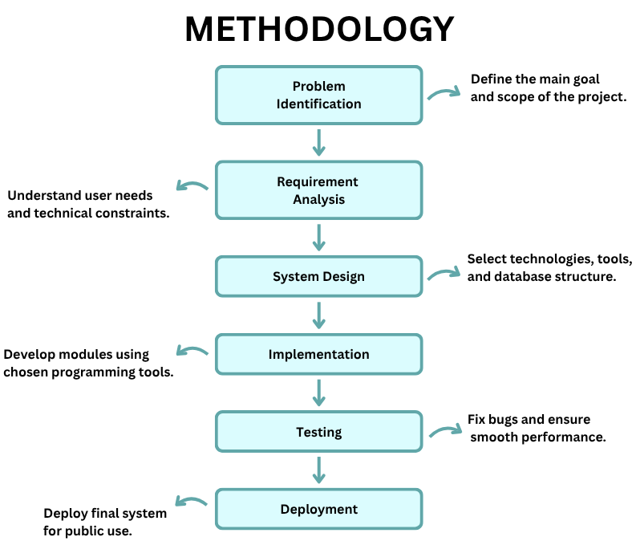
SheBuilds

Slide 6
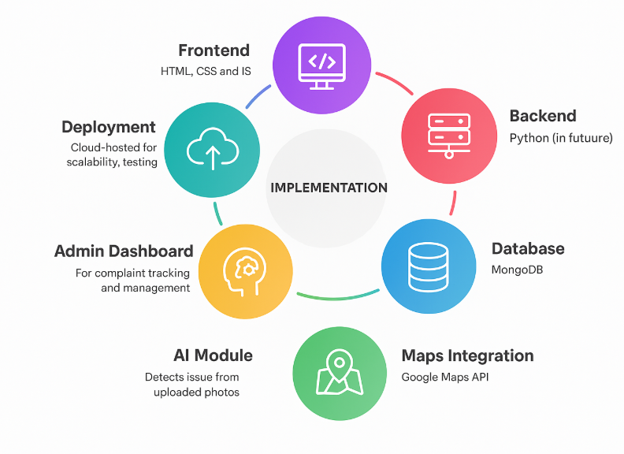
SheBuilds

Slide 7
SheBuilds
Key Features:
One-Tap Reporting | Real-time Tracking
Photo, GPS, and notes for precise details. | Stay updated on complaint status.
Smart Admin Dashboard | AI-Powered Detection
Authorities can assign, track, and resolve issues efficiently | Automatically detects issue type from uploaded photos.
Transparency and Notification
Citizens get instant updates when issue status changes.

Slide 8

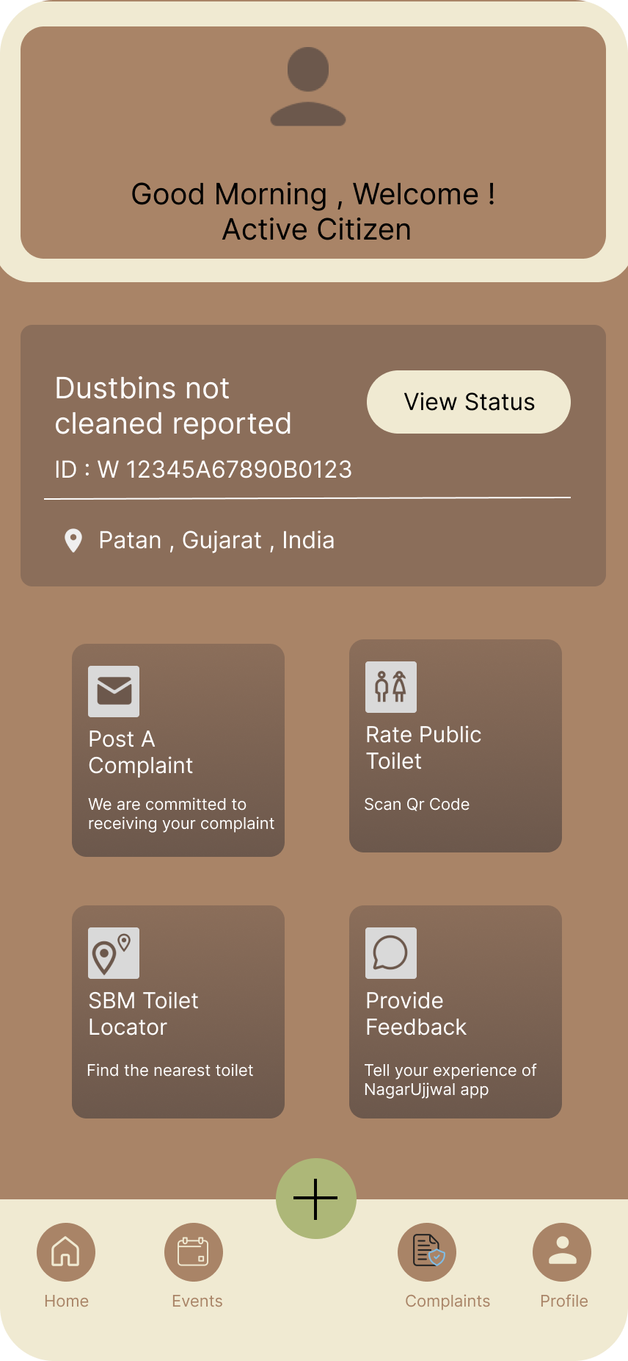
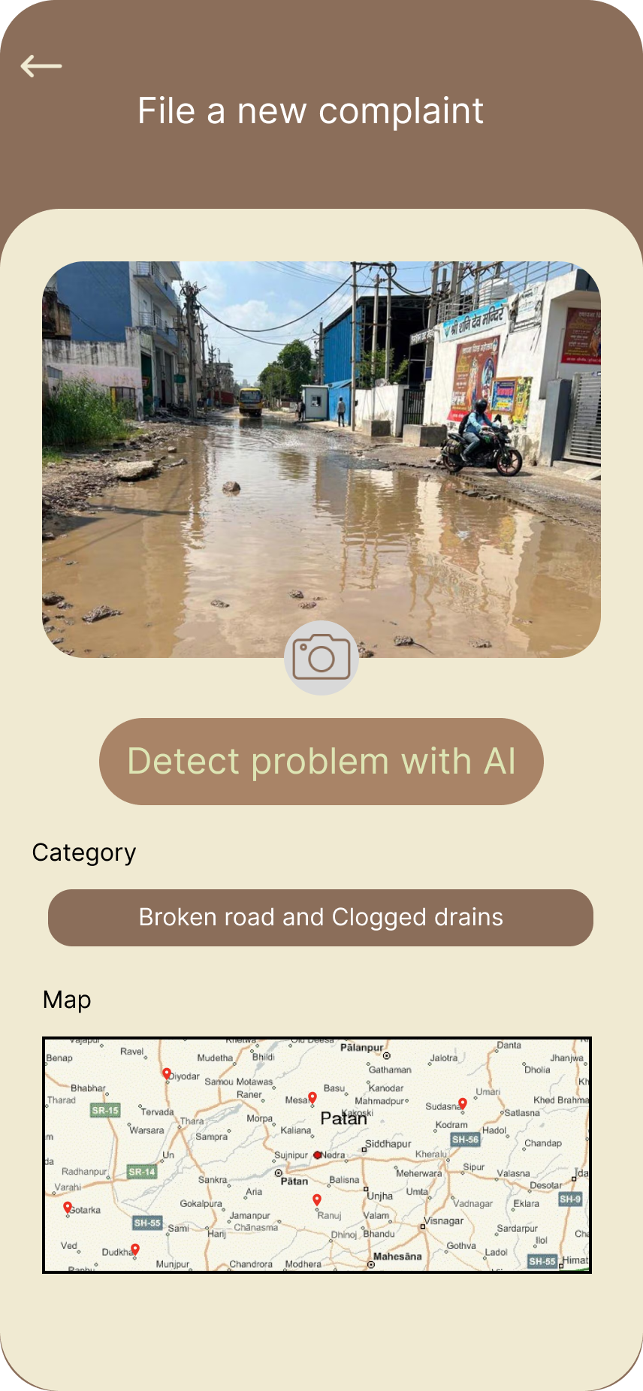
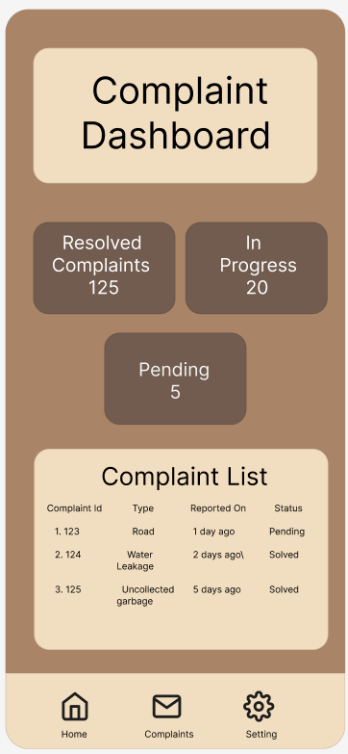
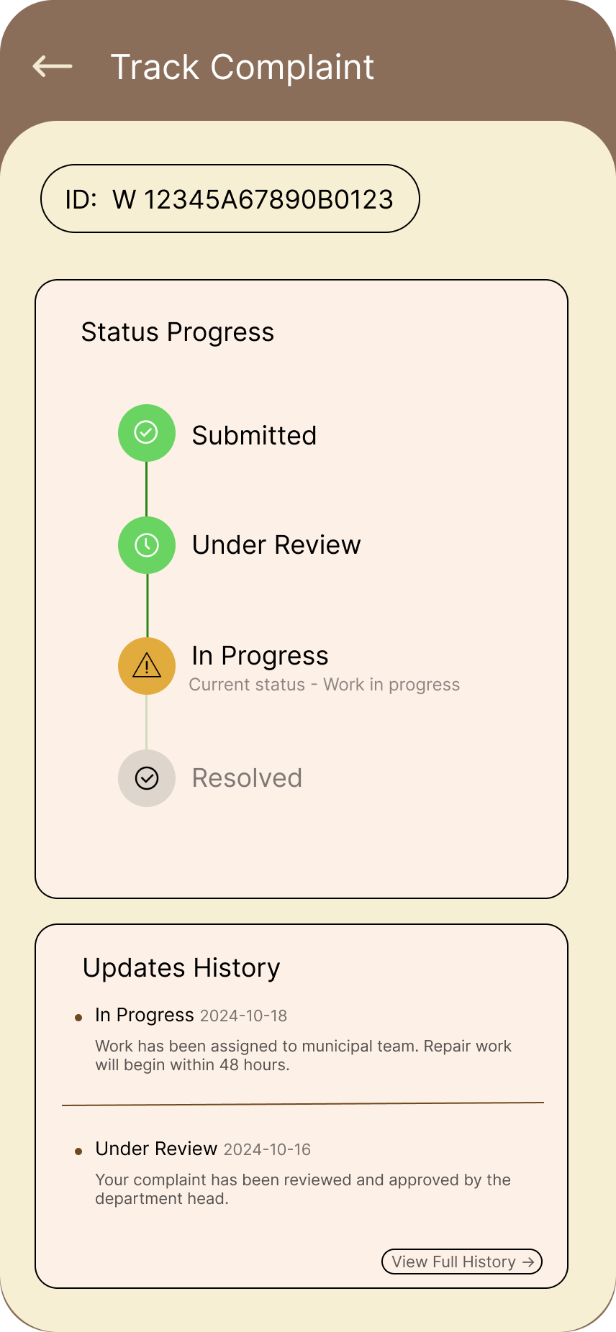
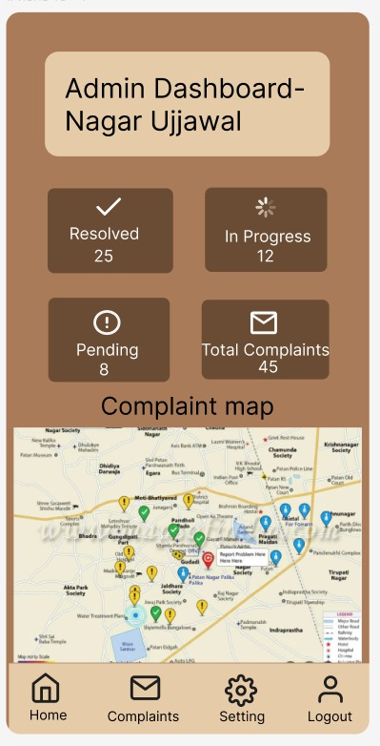
SheBuilds
Figma Designs

Slide 9
SheBuilds
Impact:
Responsibility, transparency, and civic engagement are all augmented by a centrally located, technology-driven solution.
Authorities can take action appropriately based on data-driven findings.
It enhances the lives in the city by being a patron for causes like the Swachh Bharat Mission and the Smart City Mission.
Scope:
Separation of civilians and civic authorities leads to improper governance of the city.
Decentralized, technology-based Cumulative Register can enable reporting, tracking, and timely redressal of complaints.
Scalability and replication potential in other cities.

Slide 10
SheBuilds
Thank You

