Slide 1
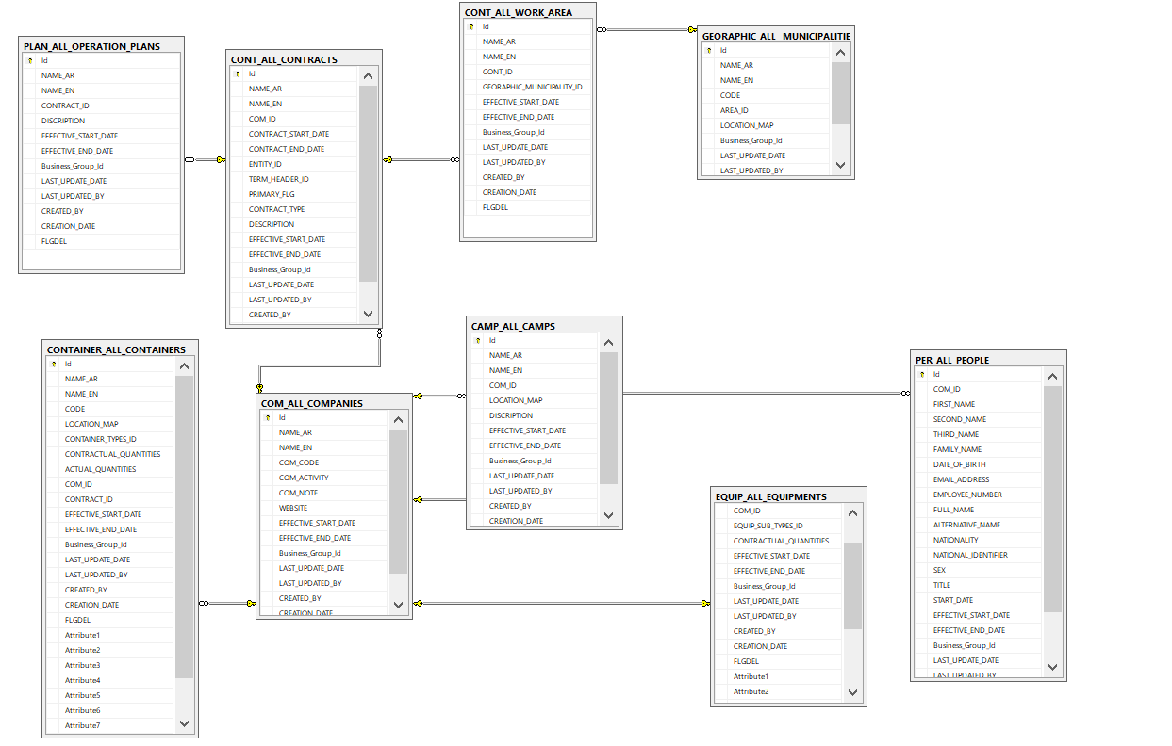
DSS ERD Diagram

Slide 2
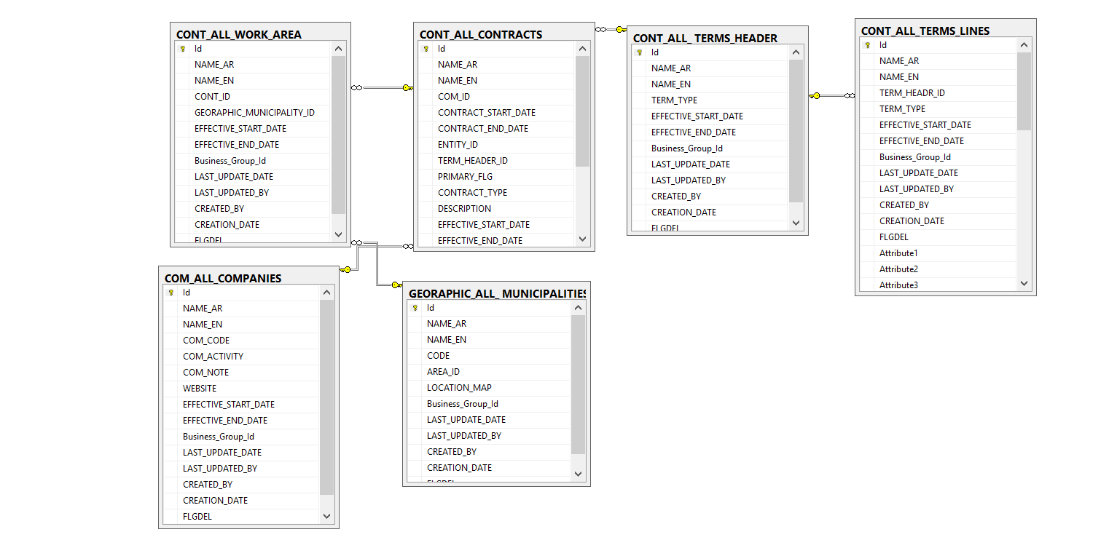
DSS ERD Diagram (Contract)

Slide 3
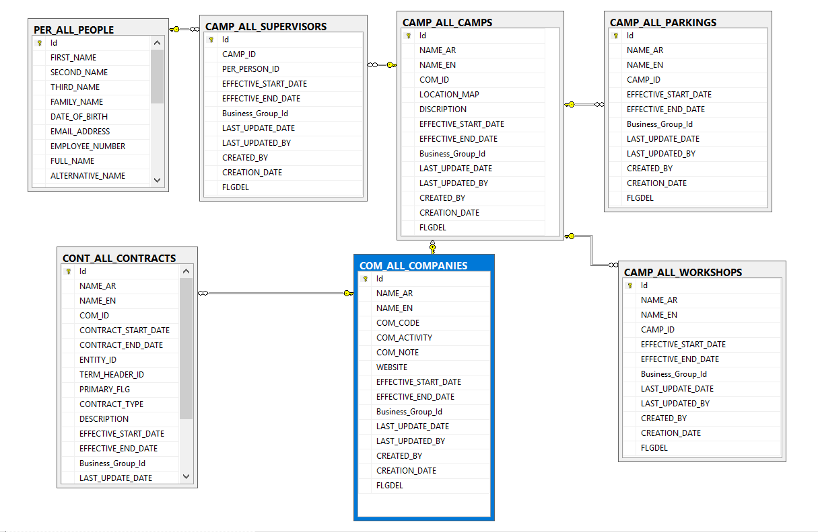
DSS ERD Diagram (Camp)

Slide 4
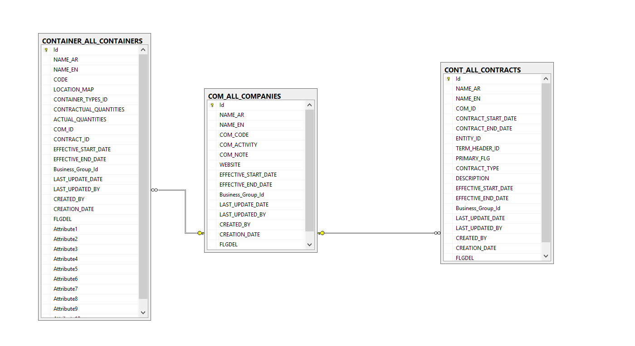
DSS ERD Diagram (Containers)

Slide 5
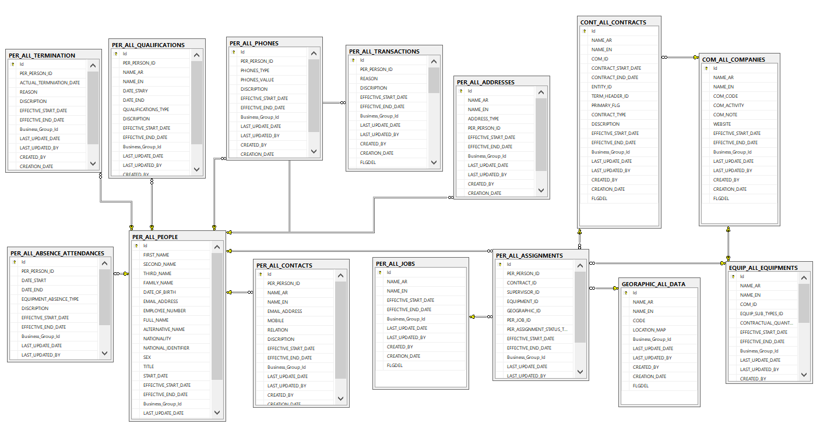
DSS ERD Diagram People)

Slide 6
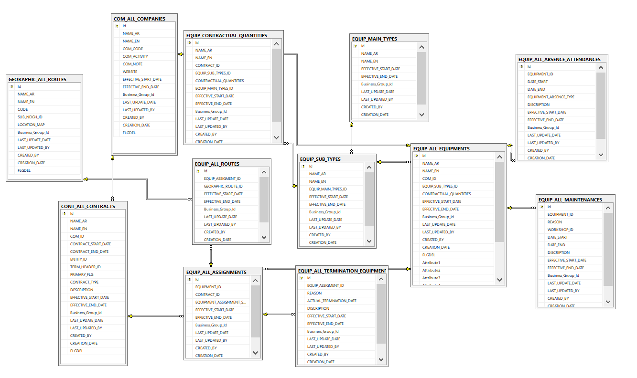
DSS ERD Diagram Equipment

Slide 7
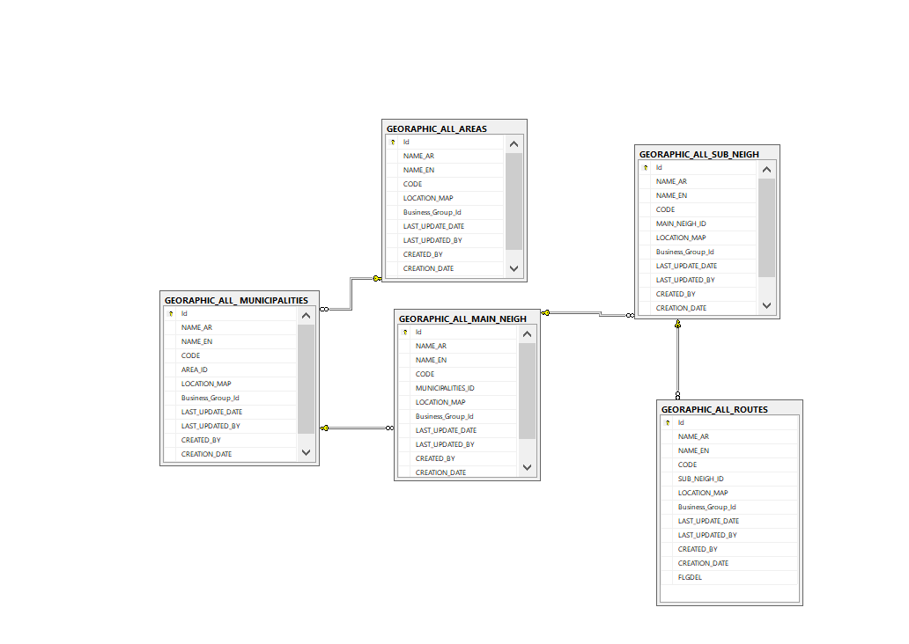
DSS ERD Diagram Geographic

Slide 8
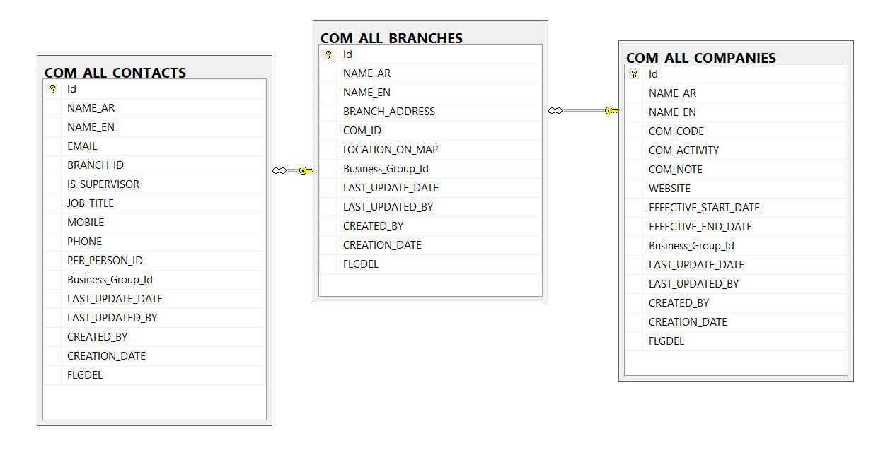
DSS ERD Diagram Company

