Slide 1

FinSight Lanka Data Analysis & Strategic Insights
Prepared by : DLB WIJESEKARA
Prepared For : Dialog Finance/FinSight Management Board
Date : 18 October 2026

Slide 2
Introduction & Executive Summary
Transforming Financial Data into Strategic Insights
Data-Driven Financial Analytics:
    FinSight Lanka applies advanced data analytics to evaluate customer financial behavior, credit exposure, and overall portfolio health.
Evaluating Portfolio & Credit Risks:
    Focuses on key risk metrics—such as the Debt-to-Savings ratio—to detect high-risk borrowers and prevent potential defaults early.
Optimizing Channel Performance:
    Analyzes customer acquisition across different channels (Agent, Branch, Digital, and Referral) to maintain a balance between growth and credit quality.
Strategic Business Impact:
    Provides actionable recommendations to strengthen liquidity, mitigate credit risk, and optimize customer lifetime value.

Slide 3
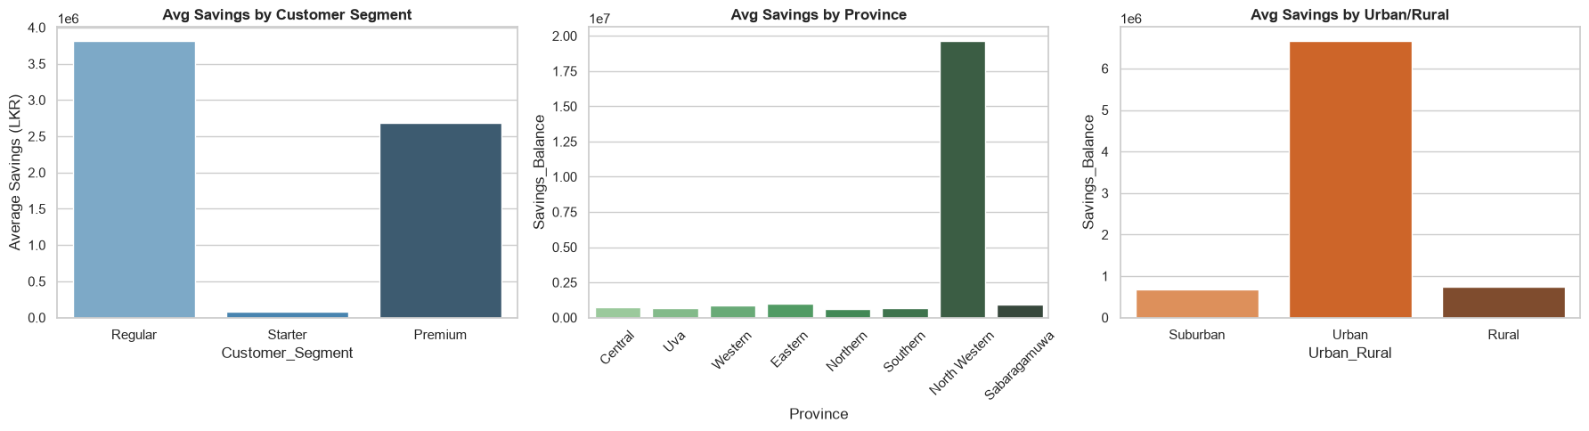
Average Savings Balance Analysis
where 1e6=10⁶ (1 Million)

Slide 4
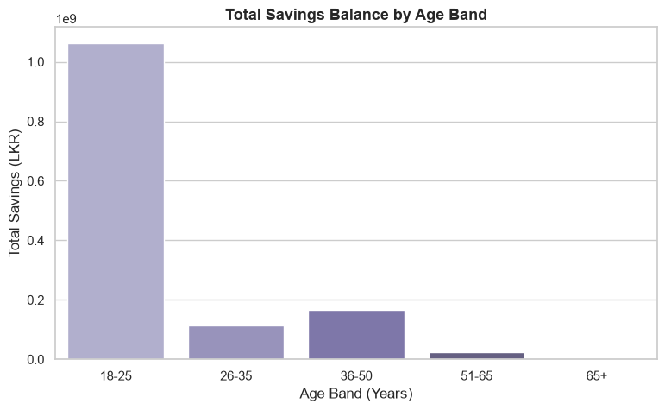
Savings Distribution by Age Band
where 1e9=10⁹ (1 Billion)

Slide 5
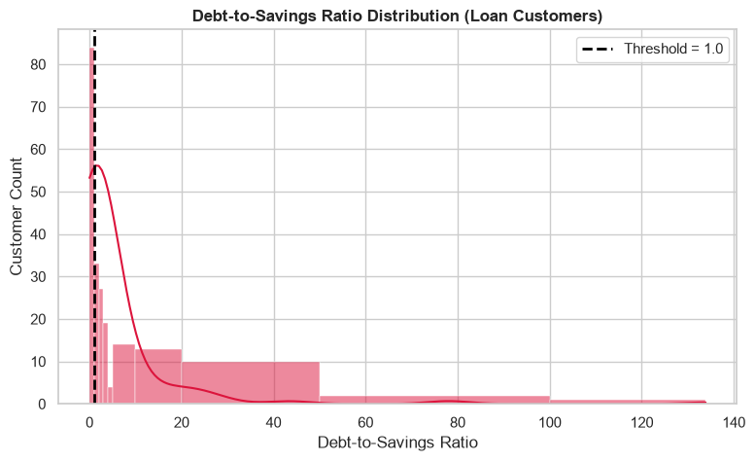
Debt-to-Savings Ratio Analysis

Slide 6
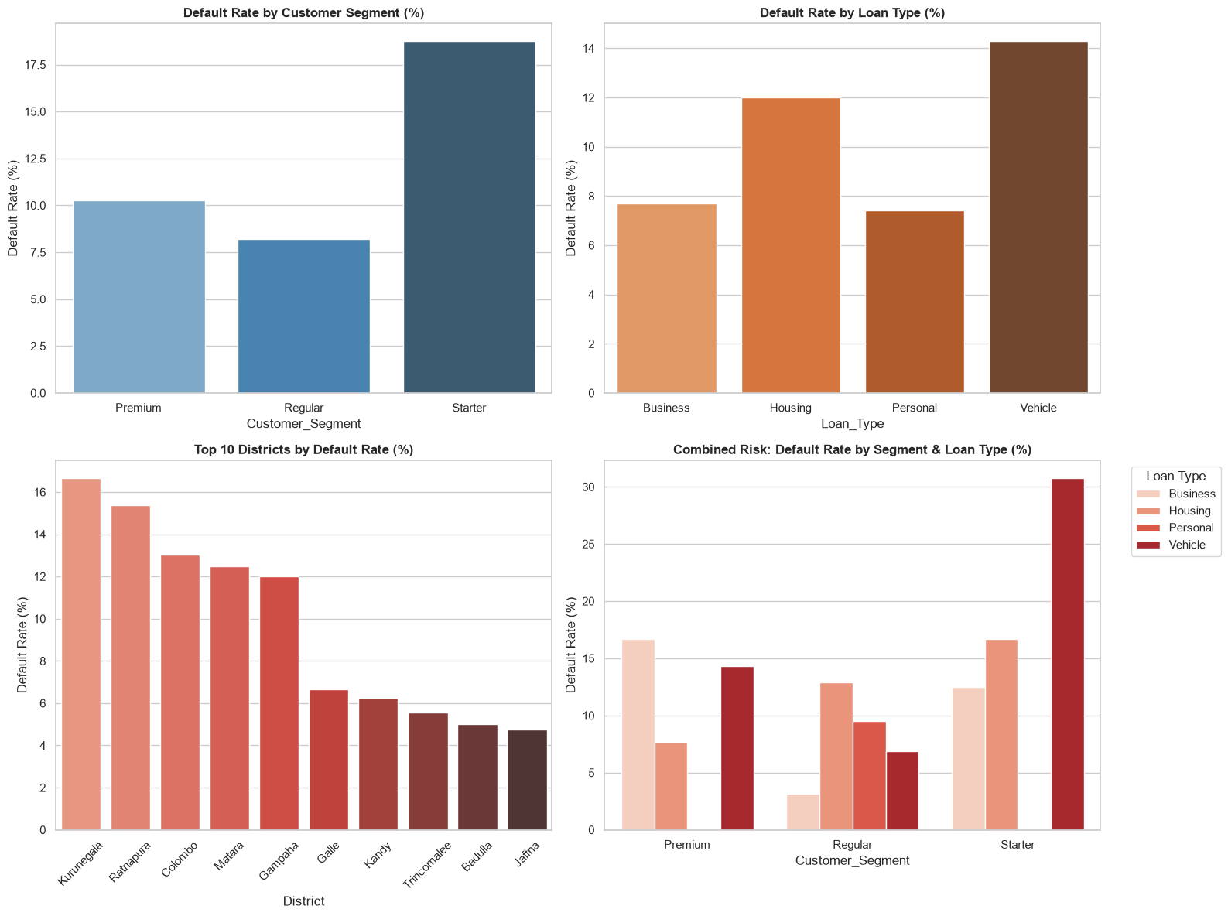
loan default rates across Segment, District, or Loan Type

Slide 7
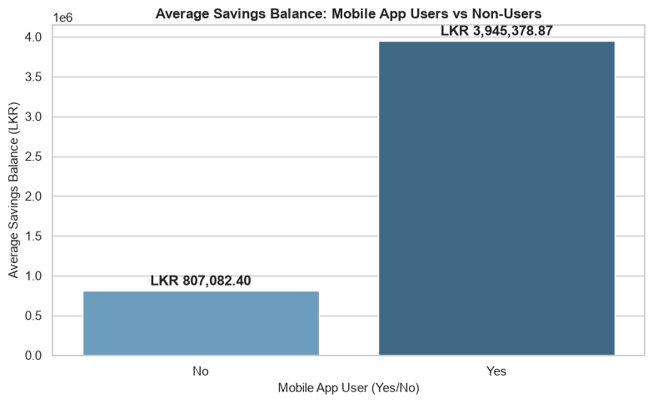
Savings Balance Comparison: Mobile App Users vs Non-Users
where 1e6=10⁶ (1 Million)

Slide 8
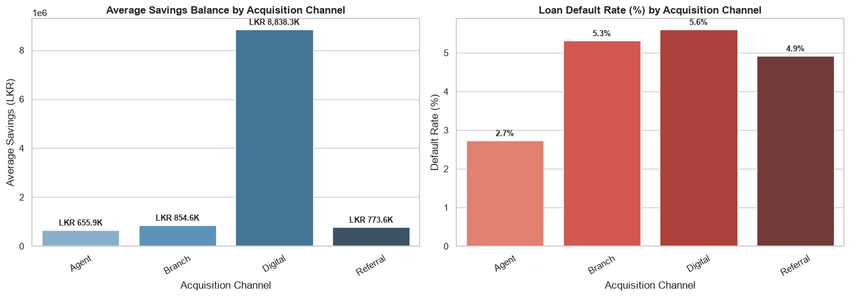
Acquisition Channel Performance Summary
where 1e6=10⁶ (1 Million)

Slide 9
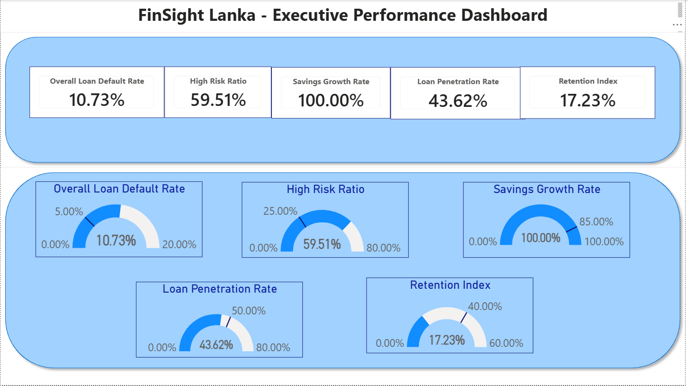

Slide 10
Strategic Recommendations
1. Refine Underwriting Criteria for Digital Channel Onboarding:
Action: Maintain aggressive digital marketing to capture high-value savings (LKR 8,838.3K avg), but tighten credit scoring/underwriting for digital loan applicants to reduce its 5.6% default rate.
Business Rationale: Protects high deposit inflows while curbing default risk down towards the 2.7% benchmark observed in Agent channels.
2. Implement Proactive Credit Risk Mitigation & Target High-Risk Segments:
Action: Introduce structured savings-linked credit products and proactive risk monitoring for borrowers exceeding leverage thresholds.
Business Rationale: Directly targets lowering the High-Risk Ratio from 59.51% towards the 25% target, reducing potential loan loss provisions and securing portfolio quality.
THANK YOU!

