Slide 1
CARDIFF METROPOLITAN UNIVERSITY • ICBT CAMPUS • CSE6035
MindCare
Emotion Recognition & Mental Support System Using AI Voice Assistant
Haputhanthirige Thushara Lahiru Kavishal (Lahiru Kavishal)
Student ID: st20360354 Reg No: KG/BSCSD/16/41
Supervisor: Dr. T.S.A. Gunawardena
• BSc (Hons) Software Engineering
Final Dissertation Defense (PRES1) • August 2026

Slide 2
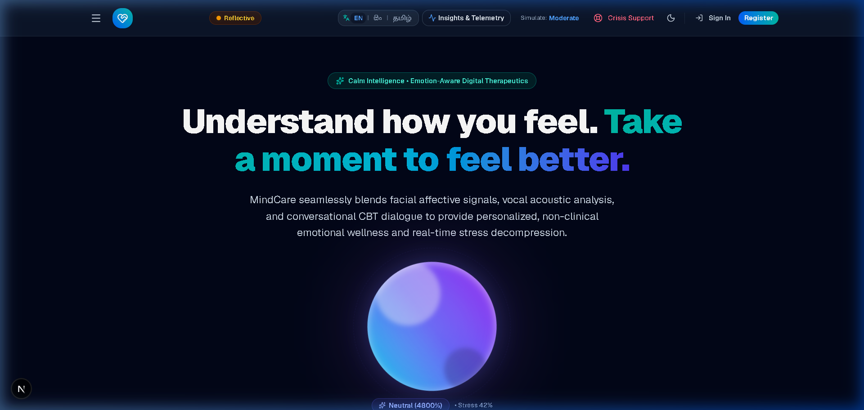
Introduction & Problem Statement
MENTAL HEALTH CRISIS & CLINICAL DEFICIT
1 in 4 individuals globally affected by mental health disorders (WHO, 2022).
76% in LMICs receive zero professional treatment or support.
Sri Lanka: 14.6 suicides per 100k; only 0.2 psychiatrists per 100k.
Deep cultural stigma suppresses traditional in-person help-seeking.
CORE TECHNICAL & USABILITY PROBLEM
Existing digital tools are monolingual (English) and text-heavy.
Typing emotional descriptions imposes cognitive friction during panic.
Traditional chatbots lack real-time non-verbal affective awareness.
Figure 1: MindCare Trilingual Landing Interface
Proposed Solution: A low-barrier, trilingual (EN / SI / TA) wellness companion integrating real-time facial and speech emotion recognition for non-clinical guided support.

Slide 3
Literature Review & Research Gap
01 • UNIMODAL SENSING
02 • SENSOR FUSION
03 • AI GOVERNANCE
04 • LOCALIZATION
Environmental Sensitivity
Multimodal Fusion
Conversational AI Safety
Multilingual Accessibility
FER is sensitive to lighting & posture (Dinges et al., 2005); SER degrades under ambient noise; text increases friction during panic (Suri et al., 2026).
Combining visual and vocal channels enhances stability (Zhang et al., 2022); Late Fusion provides modularity and missing-sensor resilience.
Unrestricted LLMs carry hallucination and sycophancy risks in mental health; requires constrained graph workflows (Patel et al., 2026; Voultsiou & Moussiades, 2026).
Over 90% of affective systems are English-centric (Zhu, 2023), causing performance degradation and exclusion in South Asian (Sinhala/Tamil) contexts.
THE IDENTIFIED RESEARCH GAP
A critical lack of accessible, low-barrier systems that integrate multimodal affective sensing, native trilingual support, and constrained conversational safety within a unified non-clinical wellness platform.
Multimodal Sensing (Face + Voice)
Trilingual Support (EN / SI / TA)
Constrained CBT State Machine
Privacy-Conscious Processing

Slide 4
Aim and Research Objectives
PRIMARY PROJECT AIM
"Develop a trilingual, multimodal and privacy-conscious AI-based wellness companion capable of estimating emotional states and providing guided non-clinical support."
SPECIFIC RESEARCH OBJECTIVES
Facial Emotion Recognition
Speech Emotion Recognition
Multimodal Fusion & Stress
01
Real-time visual expression classification across 7 universal affective states via CNN.
02
Acoustic emotion estimation extracted from 40-dimensional MFCC audio features.
03
Asynchronous late fusion with polar conflict detection and stress mapping.
Stage-Aware Guided Support
Trilingual Accessibility
Privacy-Conscious Processing
04
Constrained conversational therapy using a CBT state machine and deterministic fallback rules.
05
Complete interface and speech interaction in English, Sinhala, and Tamil.
06
Temporary in-memory media processing with client-side sensor consent controls.

Slide 5
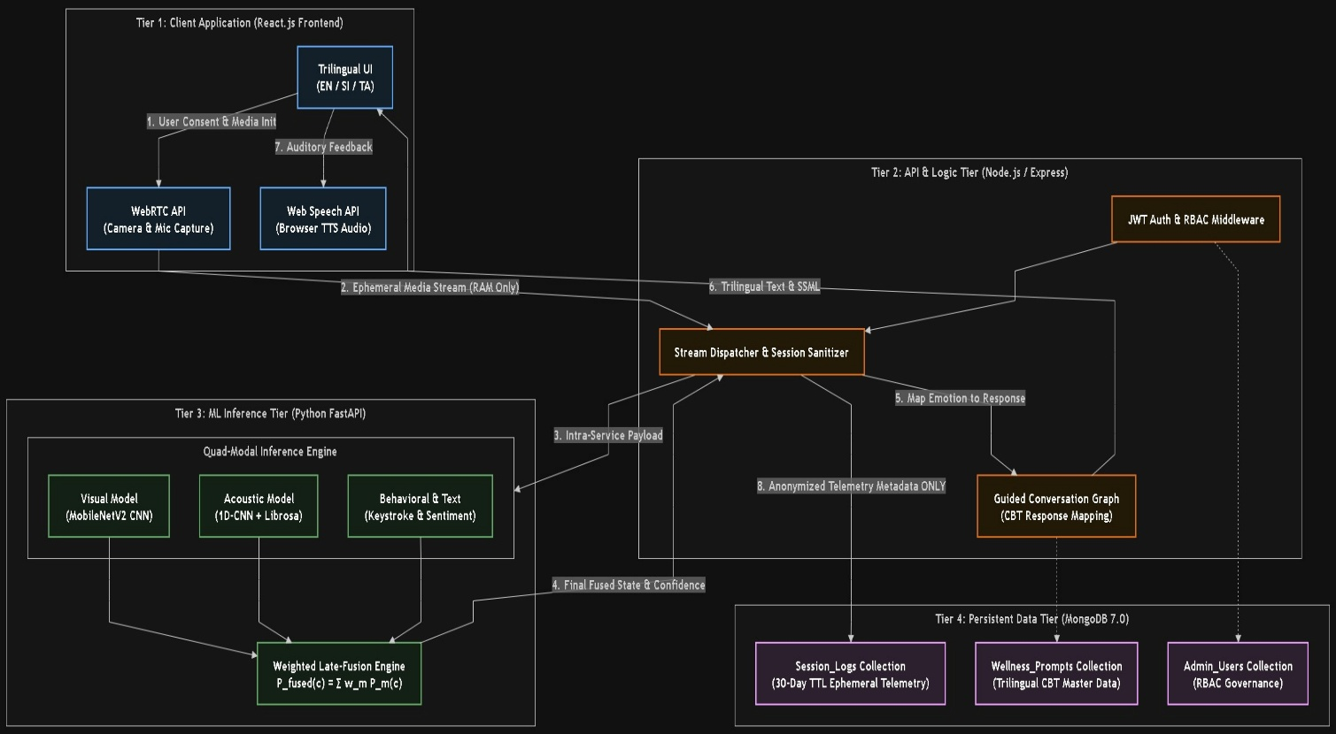
Methodology & System Architecture
TIER 1 • PRESENTATION CLIENT
Next.js & React (TypeScript): WebRTC sensor capture, dynamic trilingual UI (EN/SI/TA), real-time canvas visualization.
TIER 2 • API & ORCHESTRATION
Python FastAPI (Uvicorn ASGI): Full-duplex WebSockets, JWT authentication, non-blocking asynchronous event loop.
TIER 3 • ML & THERAPY ENGINES
TensorFlow & Librosa: Facial 2D-CNN, Speech DNN, 50/50 late fusion, Gemini Flash 3.7 constrained dialogue.
TIER 4 • DATA PERSISTENCE
SQLite 3 via SQLAlchemy ORM: User-isolated session metadata, 3-tier RBAC accounts, and cascade deletion.
Methodology: Adapted 12-Week Agile-Scrum Sprints + CRISP-DM
Figure 4: High-Level Decoupled Architecture (Thesis Chapter 5)

Slide 6
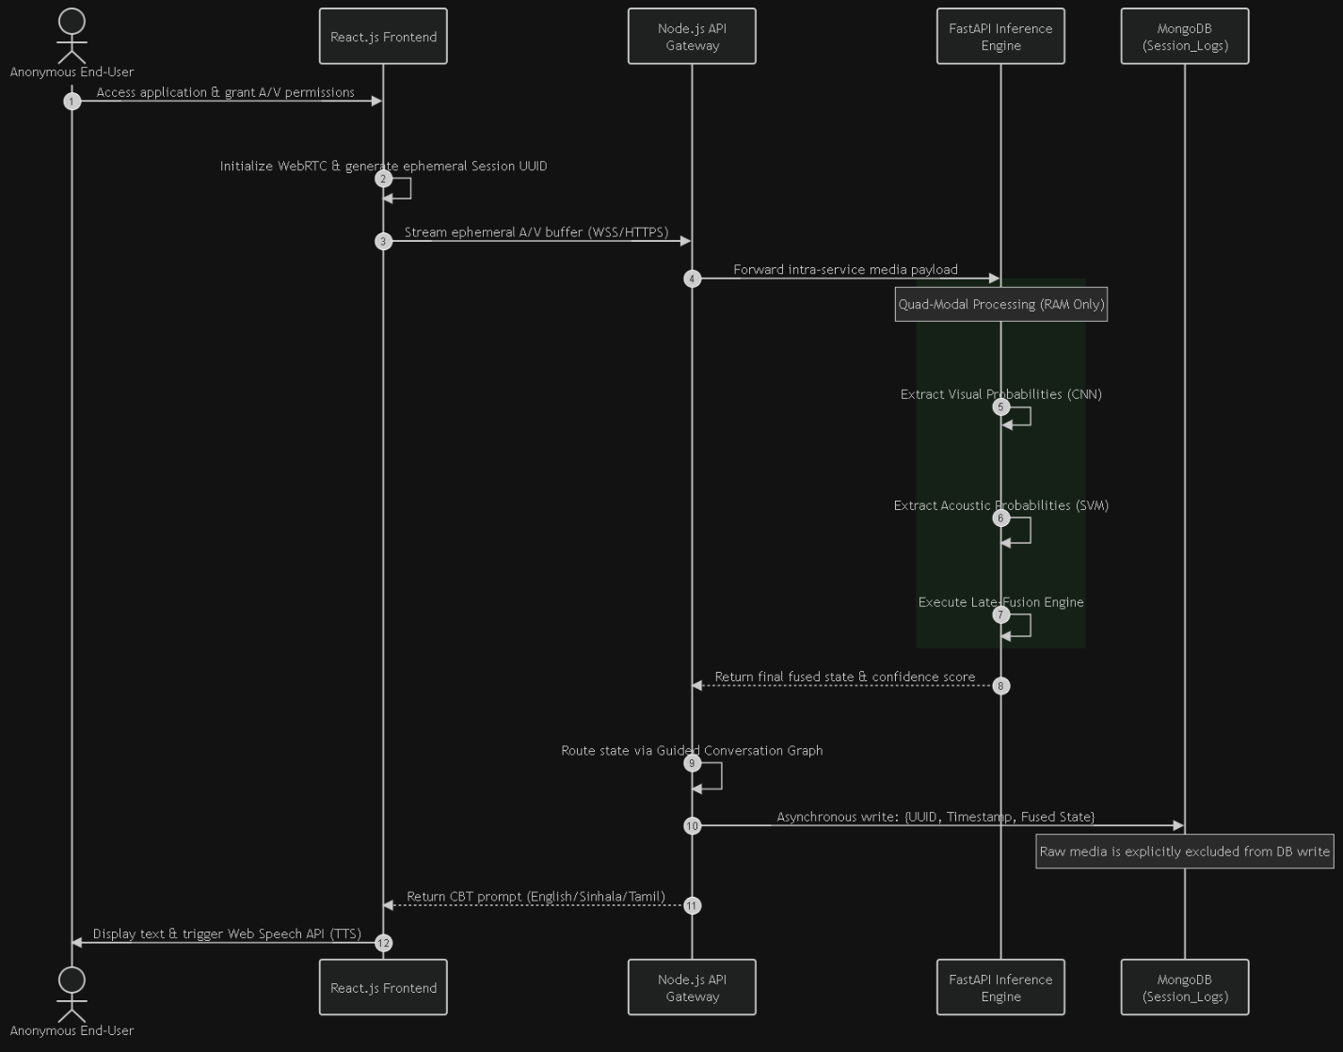
End-to-End System Workflow & Sequence
WebRTC Media Acquisition
Browser captures webcam video frames & audio chunks under user consent.
WebSocket Streaming
Bi-directional full-duplex TCP stream delivers payloads with <50ms network latency.
Parallel Worker Inference
FastAPI dispatches Facial CNN & Speech DNN via non-blocking worker threads.
Late Fusion & Conflict Resolution
Calculates 50/50 weighted state and checks for polar emotion conflicts.
Constrained CBT Dialogue & TTS
Gemini LLM generates structured therapy reply; audio is synthesized via TTS.
Non-Blocking Concurrency: isolates heavy tensor matrix multiplications, preserving a smooth 60 FPS client experience.
Figure 10: Multimodal Asynchronous Sequence Flow (Thesis Chapter 5)

Slide 7
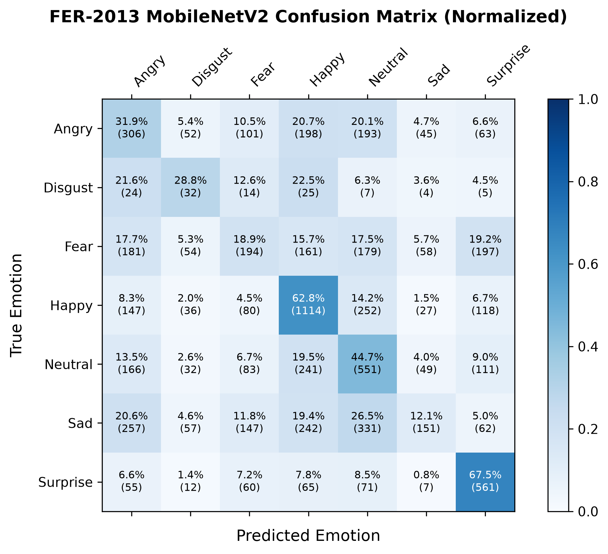
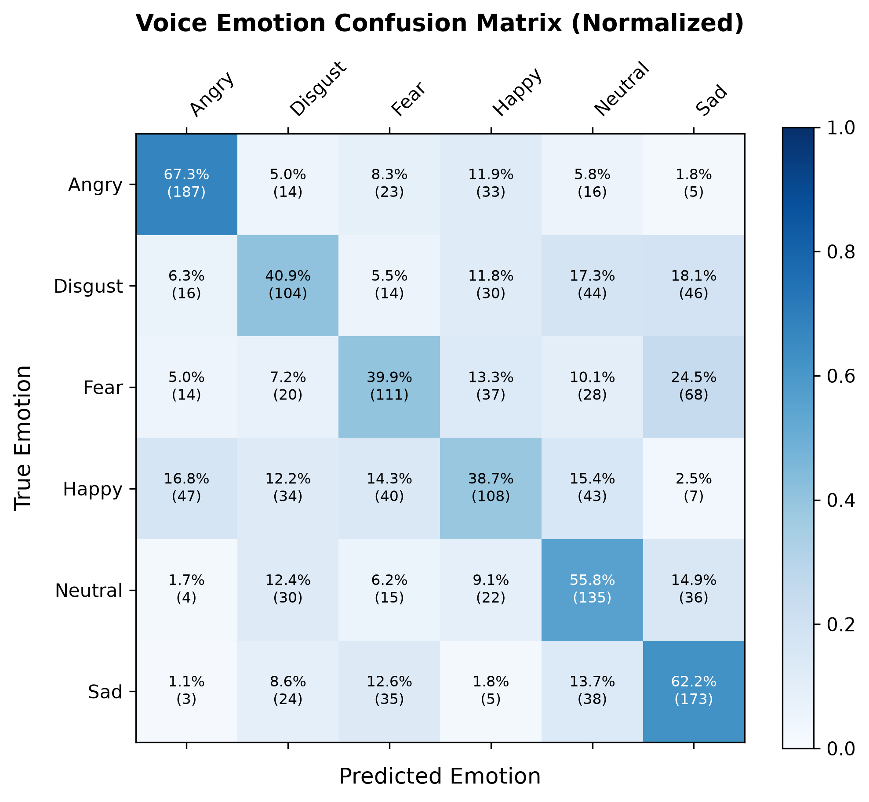
ML Implementation & Empirical Results
FACIAL EMOTION • FER-2013 (TEST N=7,178)
FACIAL EMOTION • TRANSFER LEARNING
SPEECH EMOTION • RAVDESS / TESS
61.90%
40.53%
53.60%
Baseline 2D-CNN (Production)
Fine-Tuned MobileNetV2
Baseline DNN (40 MFCCs)
Figure 2: Facial Confusion Matrix — FER-2013
Figure 3: Voice Confusion Matrix — 40 MFCCs
Empirical Finding: Baseline 2D-CNN outperformed MobileNetV2 in the observed evaluation, indicating a domain gap between pretrained ImageNet features and low-resolution (48×48) grayscale FER-2013 data.

Slide 8
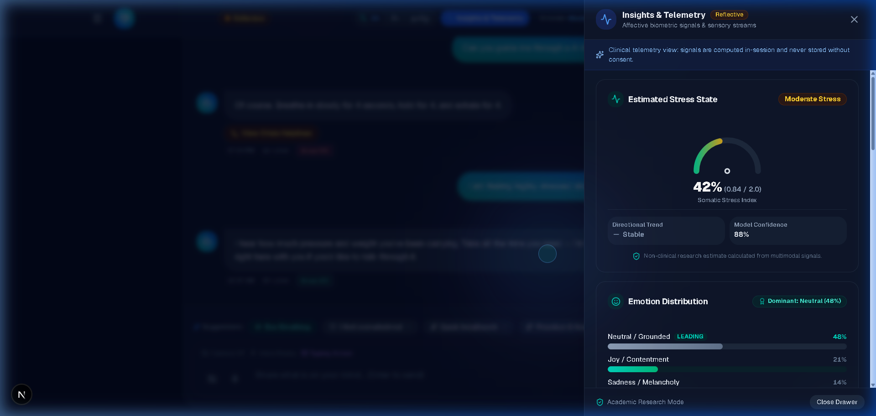
Multimodal Fusion & Stress Estimation
LATE FUSION STRATEGY & CONFLICT LOGIC
fused_prob[e] = 0.50 × P_face[e] + 0.50 × P_voice[e]
Polar Conflict Detection: Contradictory valences (e.g., Happy Face + Sad Voice) resolve to "Uncertain".
Graceful Degradation: Transparent single-modality passthrough when camera or mic is disabled.
Text-Only Fallback: Default baseline state when sensors are absent.
Figure 4: Real-Time Somatic Stress Gauge
SOMATIC STRESS INDEX WEIGHT MAPPING
Fear 0.90
Angry 0.85
Sad 0.75
Disgust 0.65
Uncertain 0.50
Surprise 0.45
Neutral 0.30
Happy 0.15
Tri-Tier Stress Levels: Low (<0.35) | Moderate (0.35–0.69) | High (≥0.70)
Figure 5: 7-Class Emotion Probability Telemetry

Slide 9
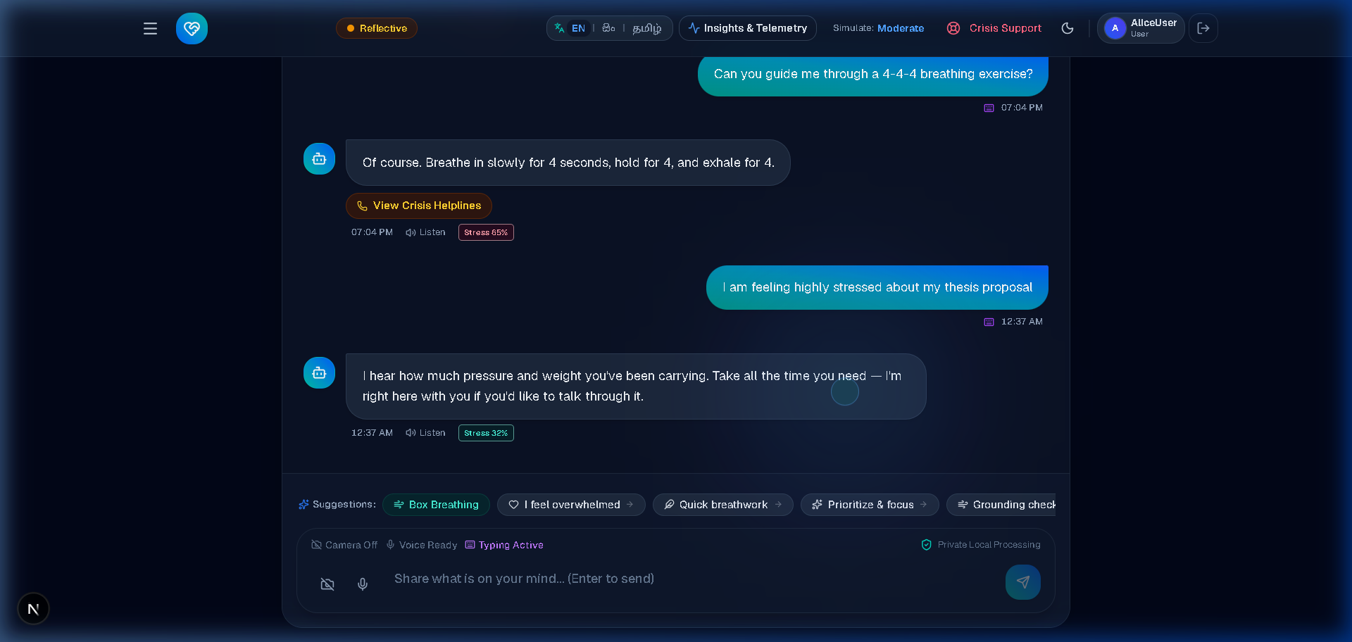
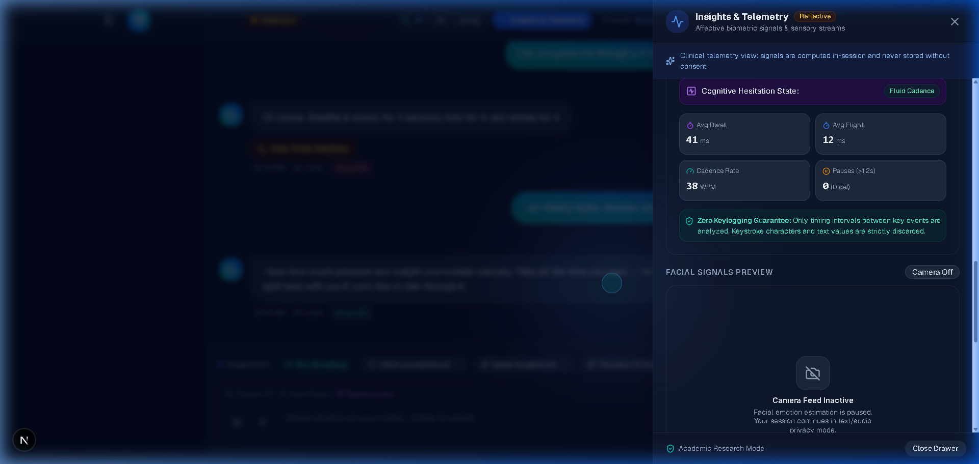
Therapy, Multilingual Support & Privacy
1. CONSTRAINED CBT THERAPY ENGINE
Empathy-First Rule: Validates feelings before suggesting exercises.
5-Stage State Machine: Crisis, Coping, Early Listening, Exploration, De-escalation.
Deterministic Local Fallback: Local rule engine if LLM exceeds 1.5s.
Strictly Non-Clinical: Guided wellness decompression only.
2. TRILINGUAL CULTURAL LOCALIZATION
Figure 6: Guided CBT Therapy Workspace
Full native UI scripts & dialogue in English, Sinhala, and Tamil.
TTS Note: Browser-native TTS; regional Sinhala/Tamil voice availability depends on host browser/OS.
3. PRIVACY-CONSCIOUS ARCHITECTURE
Temporary In-Memory Processing: Zero server-side raw video saving.
Local Privacy Masking: Client-side Gaussian blur for camera feed.
User-Scoped Storage: Isolated SQLite chat records with GDPR purge.
Figure 7: Privacy Settings & Sensor Permissions

Slide 10
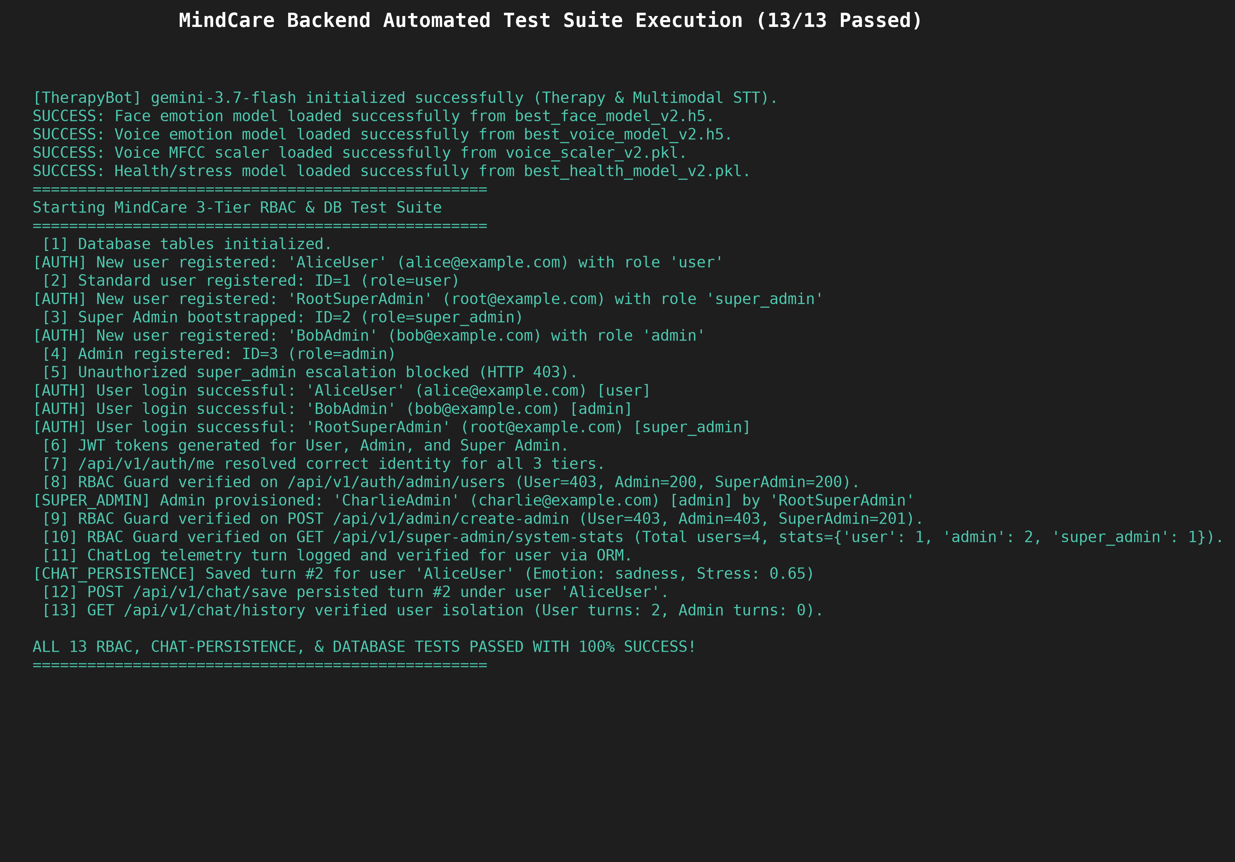
Testing & Empirical Validation
13 / 13 AUTOMATED TESTS PASSED
100% Pass Rate across Integration & Security Test Suite
VERIFIED SYSTEM CAPABILITIES
Authentication & JWT: 24h HS256 lifecycle & identity resolution (/auth/me).
3-Tier RBAC Guards: User, Admin, Super Admin 403 authorization blocks.
Database Behaviour: SQLite schema integrity & cascading deletion.
Chat Isolation: User-scoped queries preventing cross-tenant leakage.
WebSocket Reliability: Heartbeat monitor & non-blocking queues.
ML Health Checks: Facial, vocal & tabular weights loaded successfully.
Figure 8: Automated Test Suite Terminal Output
Rigorous Distinction: Automated tests validate system integration; ML accuracy is verified on held-out test partitions (FER-2013 & RAVDESS).

Slide 11
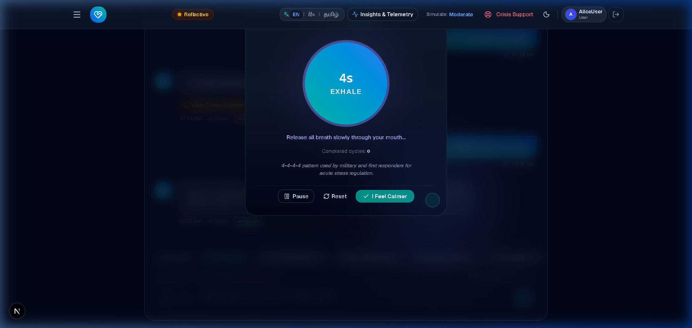
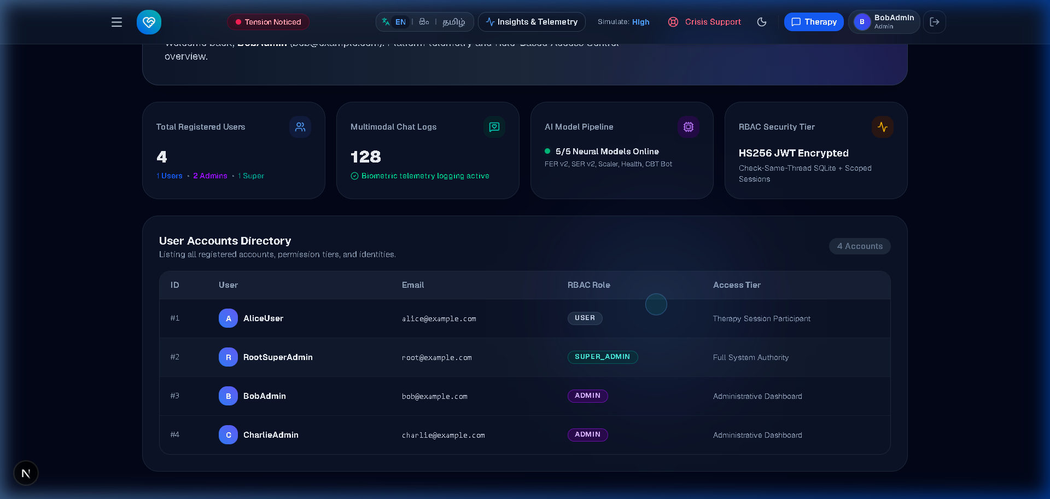
Live Artefact Demonstration
DEMONSTRATION EXECUTION FLOW
Backend Services: FastAPI & ML Active
Application Login: JWT Auth & 3-Tier Roles
Camera & Mic: WebRTC & Privacy Blur
Facial Emotion: 7-Class Visual ML
Speech Emotion: 40 MFCC Classifier
Multimodal Fusion: Stress Gauge
Figure 9: Box Breathing De-escalation
Language Toggle: EN / SI / TA i18n
Guided Support: Empathy-First CBT
De-escalation: Box Breathing Overlay
Admin Governance: RBAC & Logs
Figure 10: Admin Panel & Governance

Slide 12
Critical Evaluation: System Limitations
01 • Visual Domain Gap (FER-2013)
02 • Platform Dependency (TTS)
FER-2013 contains low-resolution (48×48) grayscale crops with ~65% human agreement ceiling. MobileNetV2 underperformed baseline CNN (40.53% vs 61.90%) due to ImageNet feature mismatch.
Browser-native neural voice synthesis in Sinhala and Tamil relies on OS-level voice pack availability, requiring cloud fallbacks on unsupported client environments.
03 • Environmental Sensitivity
04 • Evaluation Constraint & Scope
Speech emotion recognition is susceptible to background ambient noise and microphone hardware; facial classification degrades under poor illumination and head rotation.
No single unified multimodal benchmark metric exists because models were evaluated independently; system is strictly non-clinical without formal longitudinal trials.
Academic Integrity Note: Empirical limitations are presented transparently as engineering findings rather than failures; no unified multimodal accuracy is claimed without paired benchmark verification.

Slide 13
Future Work & Strategic Roadmap
PHASE 1 • DATA & TEMPORAL MODELS
PHASE 2 • ADVANCED FUSION
PHASE 3 • PHYSIOLOGICAL SENSING
Paired Datasets & Transformers
Attention-Based Dynamic Fusion
Wearable Biometric Telemetry
Train on synchronized audio-visual corpora (e.g. CREMA-D); deploy Vision Transformers (ViT) for FER and wav2vec 2.0 / LSTM for temporal speech dynamics.
Replace static 50/50 probability averaging with learned cross-attention mechanisms that dynamically weight modalities based on acoustic SNR and face visibility.
Integrate Bluetooth smart bands for non-invasive Heart Rate Variability (HRV) and Electrodermal Activity (EDA) to enhance objective stress profiling.
PHASE 4 • CLINICAL VALIDATION
Longitudinal Clinical Evaluation
Conduct an IRB-approved multi-user study in collaboration with certified psychiatrists to validate longitudinal therapeutic efficacy in Sri Lankan clinical settings.
Strategic Vision: Evolving MindCare from a non-clinical affective companion into an evidence-based digital therapeutic platform for low-resource global mental health.

Slide 14
Conclusion
KEY PROJECT OUTCOMES
Trilingual & Multimodal Companion: Developed an accessible, privacy-conscious AI-based wellness platform.
Affective Sensing: Integrated facial and speech emotion recognition to estimate emotional states.
Multimodal Late Fusion: Combined visual and acoustic probability distributions with conflict logic.
Constrained CBT Guidance: Implemented a 5-stage CBT state machine with deterministic local fallback.
Cultural Localization: Delivered English, Sinhala, and Tamil accessibility with speech interaction.
Privacy-Conscious Architecture: Enforced in-memory media processing and user consent controls.
Rigorous Verification: Validated core system functionality through 13 / 13 automated tests passed.
KEY FINDING
The empirical evaluation demonstrated the feasibility of combining multimodal emotion recognition with guided non-clinical wellness support, while also identifying limitations in individual model performance, environmental robustness and multimodal benchmark evaluation.
FINAL TAKEAWAY
MindCare demonstrates a practical foundation for an accessible, multilingual and safety-conscious AI-assisted wellness companion.

Slide 15
Thank You
Questions & Discussion
Haputhanthirige Thushara Lahiru Kavishal (Lahiru Kavishal)
Supervisor: Dr. T.S.A. Gunawardena • Cardiff Metropolitan University / ICBT Campus
Key Academic References (Thesis Chapter 2):
Zhang et al. (2022). Multimodal affective computing fusing physiological & acoustic signals. IEEE Trans. Affect. Comput.
Patel et al. (2026). Risk-constrained graph workflows for conversational mental health systems. J. Med. Internet Res.
Voultsiou, A. & Moussiades, L. (2026). Conversational agents in mental health: A systematic review. Comput. Hum. Behav.
Khubrani (2026). Multimodal stress detection using facial expression and speech dynamics. Int. J. Hum.-Comput. Stud.
Goodfellow, I. et al. (2013). Challenges in representation learning: FER-2013. ICML Workshop.
World Health Organization (2022). World Mental Health Report: Transforming Mental Health for All. Geneva.

