Slide 1
Variational Inference

Slide 2
Limitations of Deep Learning
Black Boxes
Cannot identify ‘unusual’ data
Don’t provide error bounds on predictions
Overfitting

Slide 3

Why these limitations exist
Stochastic gradient descent (SGD):
$W_{t+1}=W_{t}−lambda∗grad\left(loss\left(x_{i},l_{i},w_{t}\right)\right)$
SGD only gives us a (locally) optimal solution

Slide 4
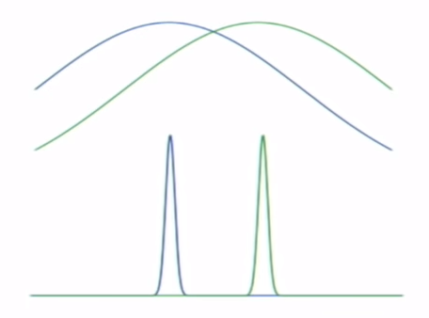
What if we had a probability distribution for w
This modification could help in several ways such as
Introduce error bars
Helps to reduce overfitting
May help detecting ‘unusual’ data

Slide 5

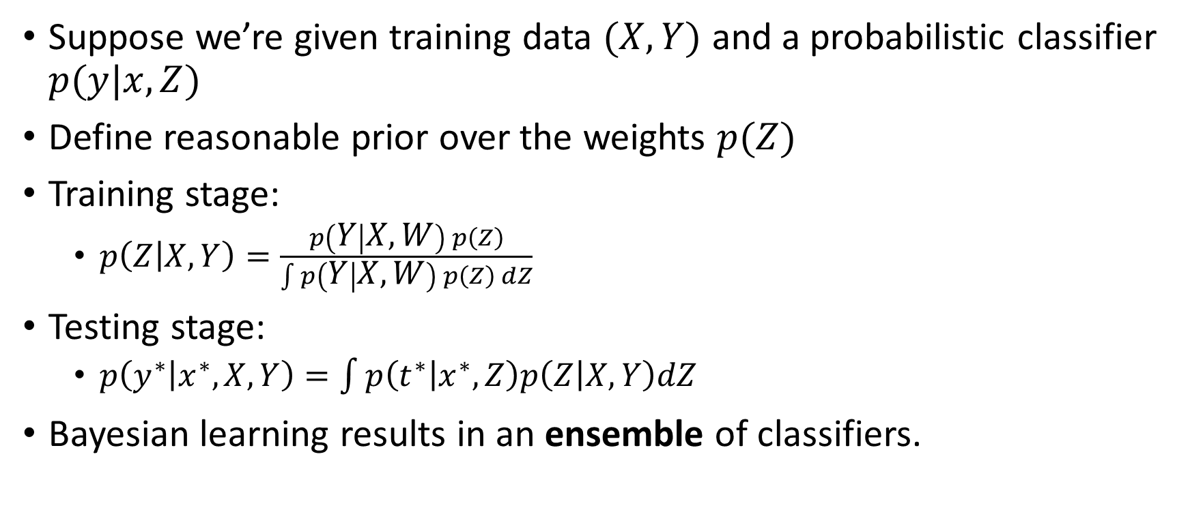
Bayesian Machine Learning
X : training data
Y : training target
Z : Model parameters (weights)
Suppose we’re given training data $(X,Y)$ and a probabilistic classifier $p(y|x,Z)$
Define reasonable prior over the weights $p(Z)$
Training stage:
$p\left(Z | X,Y\right)=\frac{p\left(Y | X,W\right) p\left(Z\right)}{\int{p\left(Y | X,W\right) p\left(Z\right) dZ}}$
Testing stage:
$p\left(y^{∗} | x^{∗},X,Y\right)=\int{p\left(t^{∗} | x^{∗},Z\right)p\left(Z | X,Y\right)dZ}$
Bayesian learning results in an ensemble of classifiers.
$p(x)$ – marginal distribution
Usually intractable

Slide 6
Solutions
Metropolis Hasting (Exact approximation)
Solution by sampling
More accurate
Take longer to compute
Variational Inference (good approximation)
Deterministic solution
Less accurate
Take less time to compute
Laplace Approximation (poor approximation)
Deterministic
Much less accurate
Takes little time to compute

Slide 7
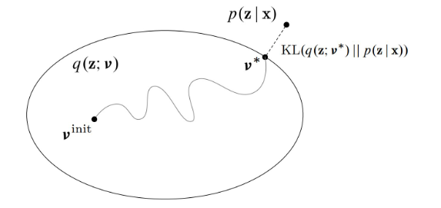

Purpose of variational inference
We create a variational distribution over the latent variables $q(z|v)$
Find the settings of $v$ so that $q$ is close to the posterior $p\left(z | x\right)$
Variational inference turns this problem into optimization
optimization
Variational family of distributions over the latent variables $q(z|v)$

Slide 8

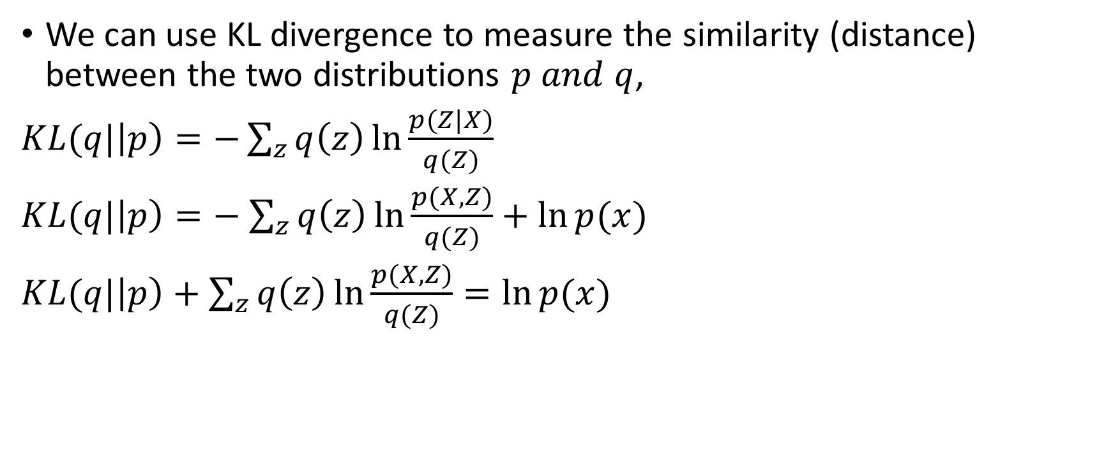
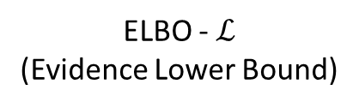
Variational Inference
We can use KL divergence to measure the similarity (distance) between the two distributions $p and q$,
$KL(q|\left|p\right)=−\sum_{z}{q\left(z\right)\ln{\frac{p(Z|X)}{q(Z)}}}$
$KL(q|\left|p\right)=−$ $\sum_{z}{q\left(z\right)\ln{\frac{p(X,Z)}{q(Z)}}}+\ln{p(x)}$
$KL(q|\left|p\right)+$ $\sum_{z}{q\left(z\right)\ln{\frac{p(X,Z)}{q(Z)}}}=\ln{p(x)}$
$$\frac{p(X,Z)}{p(X)}=P(Z|X)$$
KL
+
ELBO - $ℒ$ (Evidence Lower Bound)
=
Constant

Slide 9



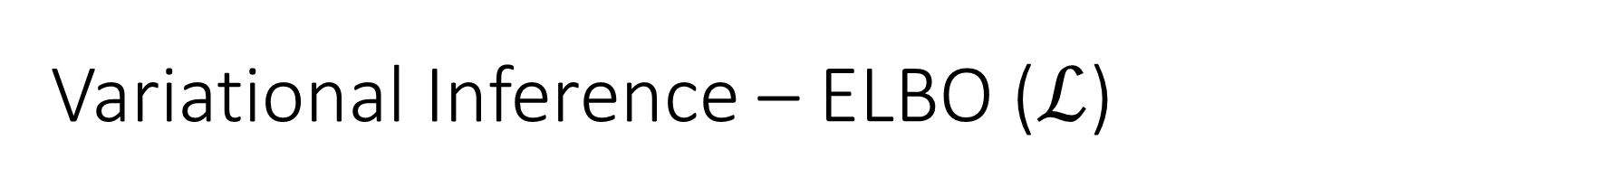


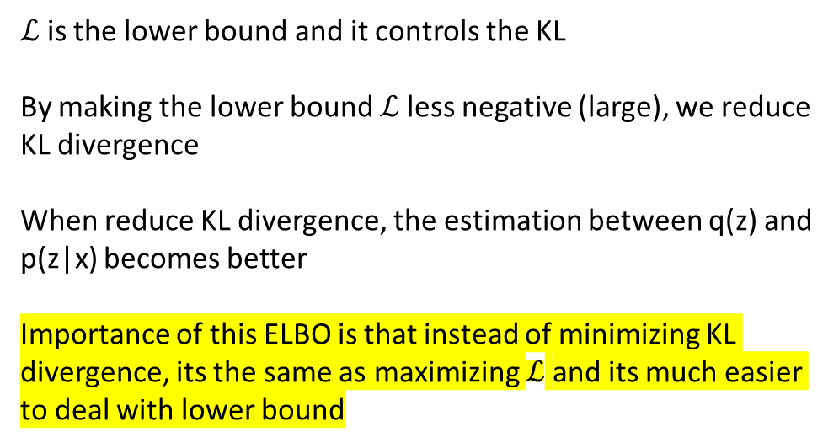
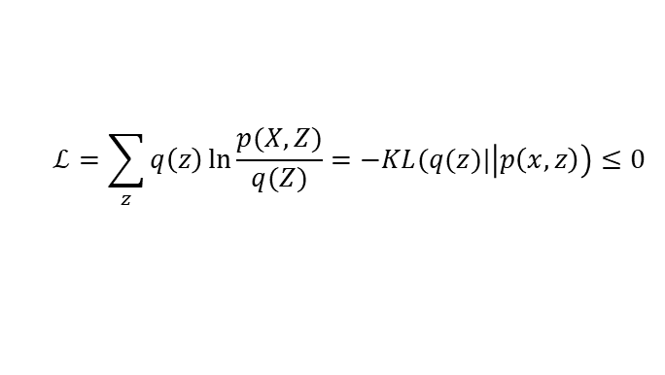

Variational Inference – ELBO ($ℒ$)
$$ℒ=\sum_{z}{q\left(z\right)\ln{\frac{p(X,Z)}{q(Z)}}}=−KL(q(z)|\left|p\left(x,z\right)\right)≤0$$
Since $0<p\left(x\right)<1$, $\ln{p(x)}<0$
Always negative
Always negative
$$\ln{p(X)}= ℒ+KL(q||p)$$
Always positive
$$KL(q|\left|p\right)≥0$$
$$ℒ=−8$$
$ℒ$ is the lower bound and it controls the KL
By making the lower bound $ℒ$ less negative (large), we reduce KL divergence
When reduce KL divergence, the estimation between q(z) and p(z|x) becomes better
Importance of this ELBO is that instead of minimizing KL divergence, its the same as maximizing $ℒ$ and its much easier to deal with lower bound
4
$$\ln{p(x)}=−4$$
0
$$KL=4$$
-4

Slide 10
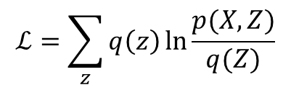
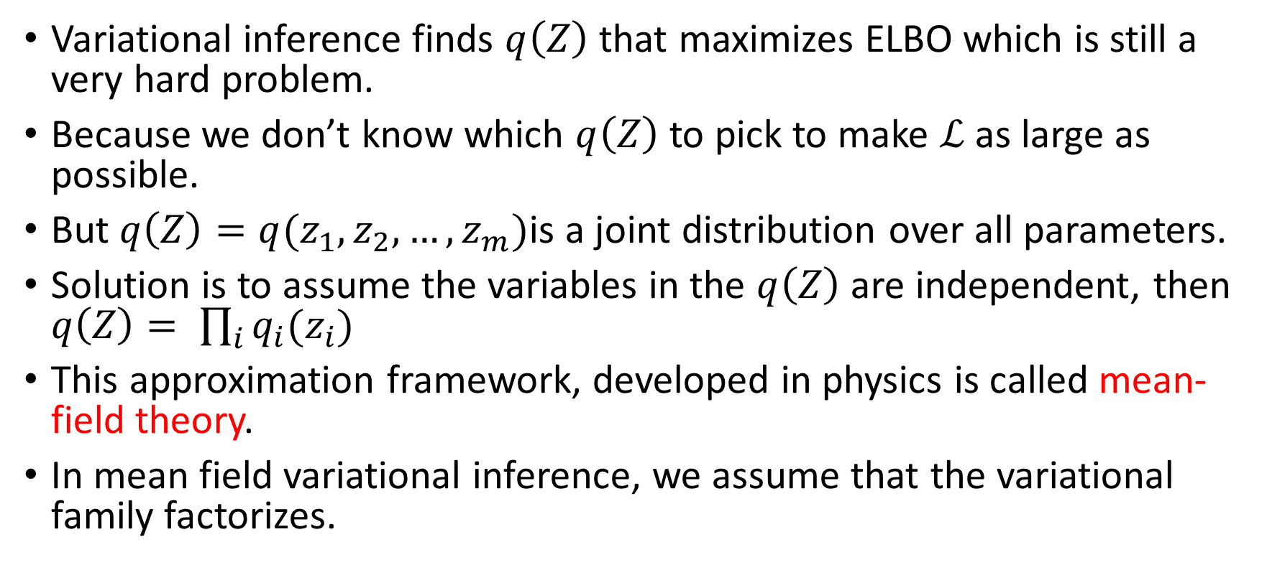
Variational Inference – Mean field
$$ℒ=\sum_{z}{q\left(z\right)\ln{\frac{p(X,Z)}{q(Z)}}}$$
Variational inference finds $q\left(Z\right)$ that maximizes ELBO which is still a very hard problem.
Because we don’t know which $q\left(Z\right)$to pick to make $ℒ$ as large as possible.
But $q\left(Z\right)=q(z_{1},z_{2},…,z_{m})$is a joint distribution over all parameters.
Solution is to assume the variables in the $q\left(Z\right)$ are independent, then $q\left(Z\right)= \prod_{i}{q_{i}(z_{i})}$
This approximation framework, developed in physics is called mean-field theory.
In mean field variational inference, we assume that the variational family factorizes.

Slide 11
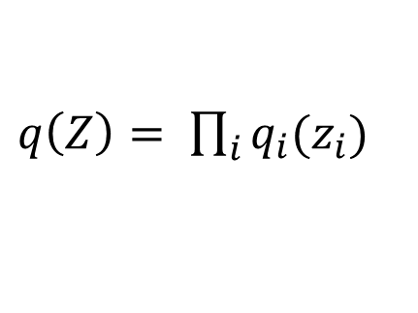
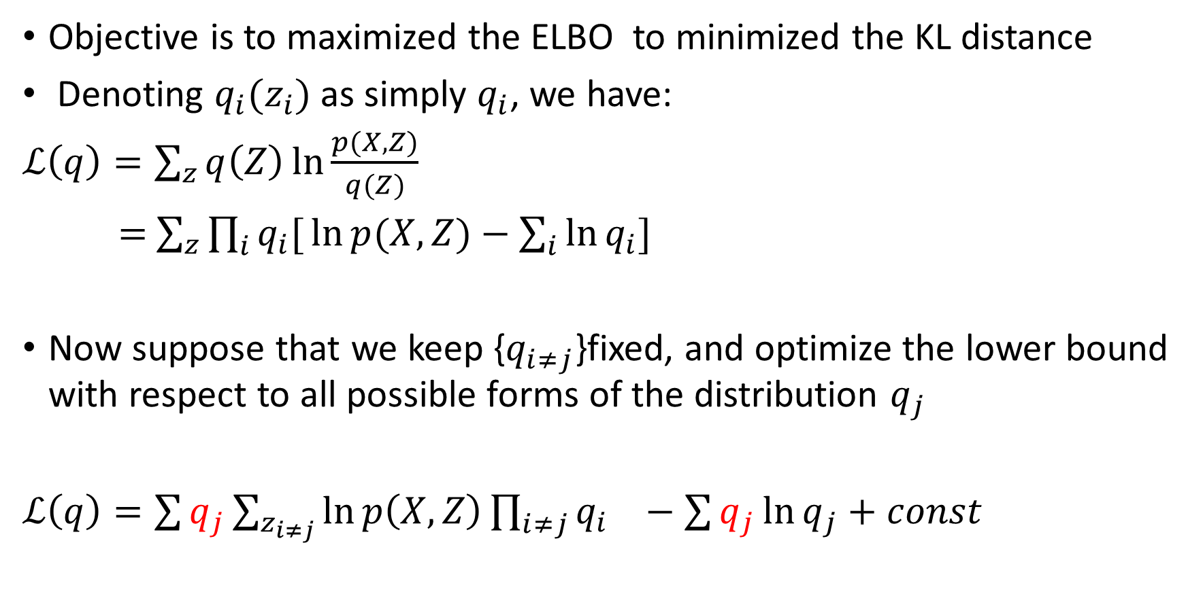
Variational Inference – Factorized Distributions
Objective is to maximized the ELBO to minimized the KL distance
Denoting $q_{i}(z_{i})$ as simply $q_{i}$, we have:
$ℒ\left(q\right)=\sum_{z}{q\left(Z\right)\ln{\frac{p(X,Z)}{q(Z)}}}$
$=$ $\sum_{z}{\prod_{i}{q_{i}[}\ln{p(X,Z)}−\sum_{i}{\ln{q_{i}}}]}$
Now suppose that we keep {$q_{i≠j}$}fixed, and optimize the lower bound with respect to all possible forms of the distribution $q_{j}$
$ℒ\left(q\right)={\sum{q_{j}\sum_{z_{i≠j}}{\ln{p\left(X,Z\right)}\prod_{i≠j}{q_{i}}}}}_{}−\sum{q_{j}\ln{q_{j}}}+const$
$q\left(Z\right)= \prod_{i}{q_{i}(z_{i})}$
$$q\left(Z\right)=q\left(z_{1}\right)×q\left(z_{2}\right)×…×q\left(z_{j}\right)×…×q(z_{m})$$

Slide 12
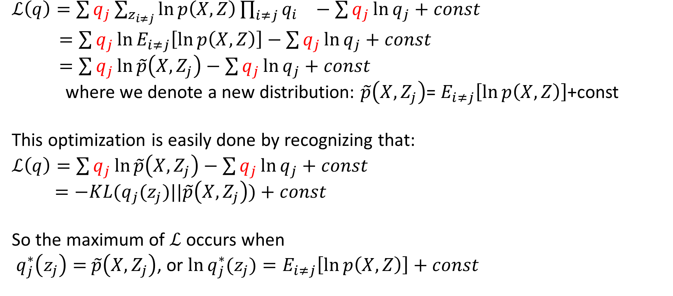
Variational Inference – Factorized Distributions
$ℒ\left(q\right)={\sum{q_{j}\sum_{z_{i≠j}}{\ln{p\left(X,Z\right)}\prod_{i≠j}{q_{i}}}}}_{}−\sum{q_{j}\ln{q_{j}}}+const$
$=\sum{q_{j}\ln{E_{i≠j}\left[\ln{p\left(X,Z\right)}\right]}}−$ $\sum{q_{j}\ln{q_{j}}}+const$
$=\sum{q_{j}\ln{\tilde{p}\left(X,Z_{j}\right)}}−\sum{q_{j}\ln{q_{j}}}+const$
where we denote a new distribution: $\tilde{p}\left(X,Z_{j}\right)$= $E_{i≠j}\left[\ln{p\left(X,Z\right)}\right]$+const
This optimization is easily done by recognizing that:
$ℒ\left(q\right)=\sum{q_{j}\ln{\tilde{p}\left(X,Z_{j}\right)}}−\sum{q_{j}\ln{q_{j}}}+const$
$=−KL(q_{j}(z_{j})||\tilde{p}\left(X,Z_{j}\right))+const$
So the maximum of $ℒ$ occurs when
$q_{j}^{∗}\left(z_{j}\right)=$ $\tilde{p}\left(X,Z_{j}\right)$, or $\ln{q_{j}^{∗}(z_{j})}=E_{i≠j}\left[\ln{p\left(X,Z\right)}\right]+const$

Slide 13
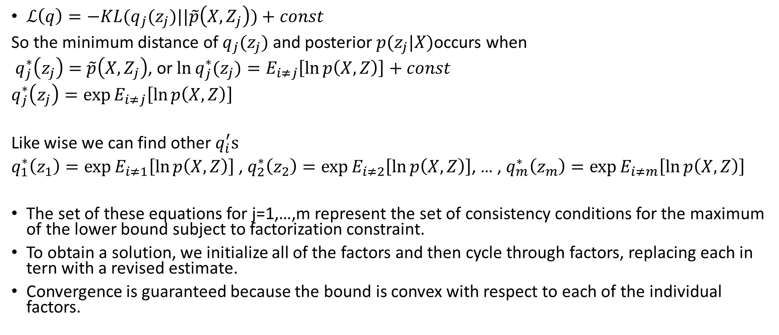
Variational Inference –Maximizing Lower Bound
$ℒ\left(q\right)=−KL(q_{j}(z_{j})||\tilde{p}\left(X,Z_{j}\right))+const$
So the minimum distance of $q_{j}(z_{j})$ and posterior $p(z_{j}|X)$occurs when
$q_{j}^{∗}\left(z_{j}\right)=$ $\tilde{p}\left(X,Z_{j}\right)$, or $\ln{q_{j}^{∗}(z_{j})}=E_{i≠j}\left[\ln{p\left(X,Z\right)}\right]+const$
$q_{j}^{∗}\left(z_{j}\right)=\exp{E_{i≠j}\left[\ln{p\left(X,Z\right)}\right]}$
Like wise we can find other $q_{i}^{′}s$
$q_{1}^{∗}\left(z_{1}\right)=\exp{E_{i≠1}\left[\ln{p\left(X,Z\right)}\right]}$ , $q_{2}^{∗}\left(z_{2}\right)=\exp{E_{i≠2}\left[\ln{p\left(X,Z\right)}\right]}$, … , $q_{m}^{∗}\left(z_{m}\right)=\exp{E_{i≠m}\left[\ln{p\left(X,Z\right)}\right]}$
The set of these equations for j=1,…,m represent the set of consistency conditions for the maximum of the lower bound subject to factorization constraint.
To obtain a solution, we initialize all of the factors and then cycle through factors, replacing each in tern with a revised estimate.
Convergence is guaranteed because the bound is convex with respect to each of the individual factors.

Slide 14
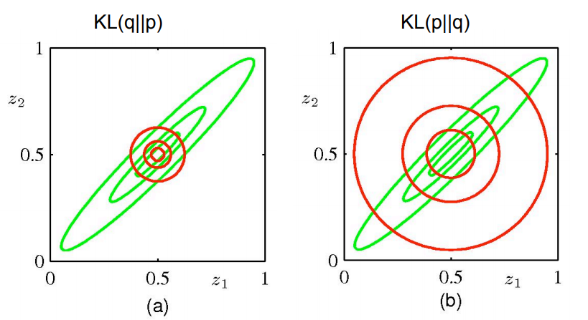
Comparison of two KLs
Approximation is too compact
Approximation is too spread

Slide 15
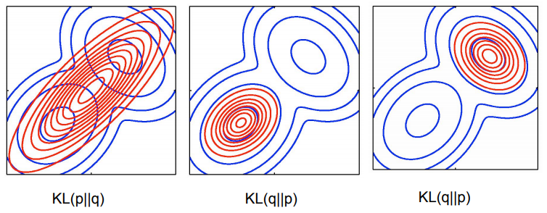
Approximating Multimodal Distribution
In practice, the true posterior will often be mutlimodal. KL(q||p) will tend to find a single mode, whereas KL(p||q) will average across all of the modes.

Slide 16
Thank you

