Slide 1
Cloud Information Accountability Framework for data sharing
Date : 26/04/2013
Members : J. Godwin
U. Vinoth Kumar
G. Yogeshwaran
Class : IV-CSE-’B’
Guide : Ms. P. Suthanthira Devi, M.E.,

Slide 2
ABSTRACT
The main objective of the project is to provide accountability for data that is shared in the cloud among different cloud service providers. This is accomplished with the help of a Cloud Information Accountability Framework that keeps track of the actual usage of the data in the cloud and ensures that any access to user’s data will trigger authentication and automated logging. To strengthen user’s control we provide distributed auditing mechanisms where the data usage logs are sent to the owner at regular intervals.

Slide 3
LITERATURE SURVEY-1
Reference: Accountability as a Way Forward for Privacy Protection in the Cloud
Author: S. Pearson and A. Charlesworth
Publication: Conf. Cloud Computing, 2009.
Technology Used: User can store data on remote servers. The data processes on cloud are often outsourced, leading to a number of issues related to accountability.

Slide 4
LITERATURE SURVEY-2
Reference: Information Accountability
Author: D.J. Weitzner, H. Abelson, T. Berners-Lee, J. Feigen-baum, J.Hendler, and G.J. Sussman,
Publication: vol. 51, no. 6, pp. 82-87, 2008.
Technology Used: CIA framework conducts automated logging and distributed auditing of relevant access performed by any entity carried out at any point of time at any cloud service provider.

Slide 5
LITERATURE SURVEY-3
Reference: Applied Cryptography: Protocols, Algorithms, and Source Code in C.
Author: B. Schneier
Publication:John Wiley & Sons, 1993.
Technology Used: Log record generation:
Log records are generated by the logger component. Logging occurs when there is some kind of access to the data. Log files are merged together and sent to the appropriate owner.

Slide 6
LITERATURE SURVEY-4
Reference: Location Systems for Ubiquitous Computing
Author: J. Hightower and G. Borriello
Publication: Computer, vol. 34, no. 8, pp. 57-66, Aug. 2001.
Technology Used: To ensure correctness of log records we verify access time, location as well as actions.

Slide 7
EXISTING SYSTEM
Conventional access control approaches are not suitable because :
Data can be outsourced by the CSP to other entities in the cloud entities can also delegate the tasks to others, and so on.
Data handling in the cloud goes through a complex and dynamic hierarchical service chain.
Service level agreement may or may not be honored.

Slide 8
PROPOSED SYSTEM
Cloud Information Accountability (CIA) framework
Provides end-to-end accountability in a highly distributed fashion.
Lightweight and powerful accountability that combines aspects of access control, usage control and authentication.
Enables the data owner to audit even those copies of their data that were made without their knowledge.

Slide 9
SYSTEM REQUIREMENTS :
HARDWARE SPECIFICATION
Processor - Intel Dual Core
Speed - 1.70 GHz
RAM - 1 GB
Hard Disk - 160 GB
Key Board - Standard Qwerty Keyboard
Mouse - Optical Mouse
Monitor - 15’’ CRT

Slide 10
SOFTWARE SPECIFICATION
Operating System - WindowsXP(Client), Ubuntu 10.10 (Server)
Application Server - Tomcat 7.0
Cloud PaaS - Red Hat OpenShift
Front End - HTML, CSS
Scripts - Shell Scripts, JavaScript
Server side Script - Java Server Pages
Database - MySQL 5.1
Database Connectivity - JDBC

Slide 11
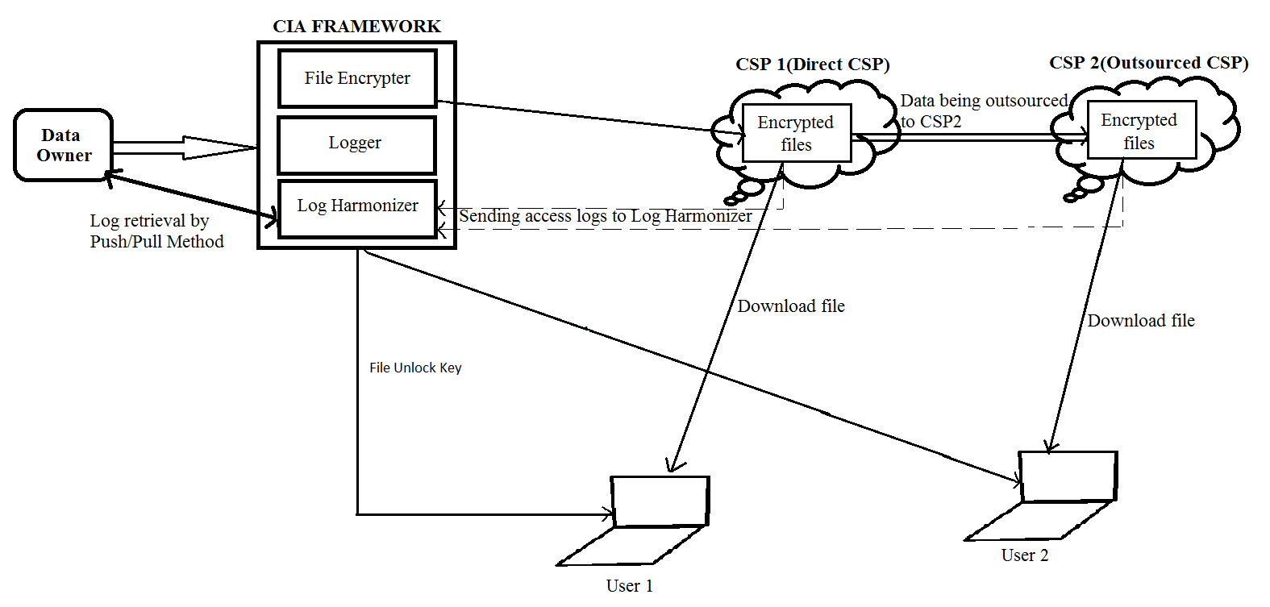
SYSTEM ARCHITECTURE

Slide 12
MODULES
The modules of this project are:
Cloud Information Accountability (CIA) Framework
Auditing Mechanisms
Logger
Log Harmonizer

Slide 13
MODULE DESCRIPTION
1. Cloud Information Accountability (CIA) Framework:
Lightweight and powerful accountability framework
Data owners can track whether or not the service-level agreements are being honored.
2. Auditing Mechanisms:
Push mode:
The push mode refers to logs being periodically sent to the data owner or stakeholder.
Pull mode:
Pull mode refers to an alternative approach whereby the user
(Or another authorized party) can retrieve the logs as needed.

Slide 14
3. Logger
The logger component is responsible for the generation of data usage logs which are eventually sent to the log harmonizer. Its main tasks include automatically logging data transactions that happen in the cloud.
4. Log Harmonizer
The log harmonizer forms the central component which allows the user access to the log files. The log harmonizer is responsible for auditing.

Slide 15
CHARACTERISTICS OF LOGS
It should verify and record the actual operations on the data as well as the time that the data have been accessed.
Log files should be reliable and tamper proof to avoid illegal insertion, deletion, and modification by malicious parties.
Log files should be sent back to their data owners periodically to inform them of the current usage of their data.

Slide 16
DES Algorithm
The main parts of the algorithm are as follows:
Fractioning of the text into 64-bit (8 octet) blocks,
Initial permutation of blocks,
Breakdown of the blocks into two parts: left and right, named G and D,
Permutation and substitution steps repeated 16 times (called rounds),
Re-joining of the left and right parts then inverse initial permutation.

Slide 17
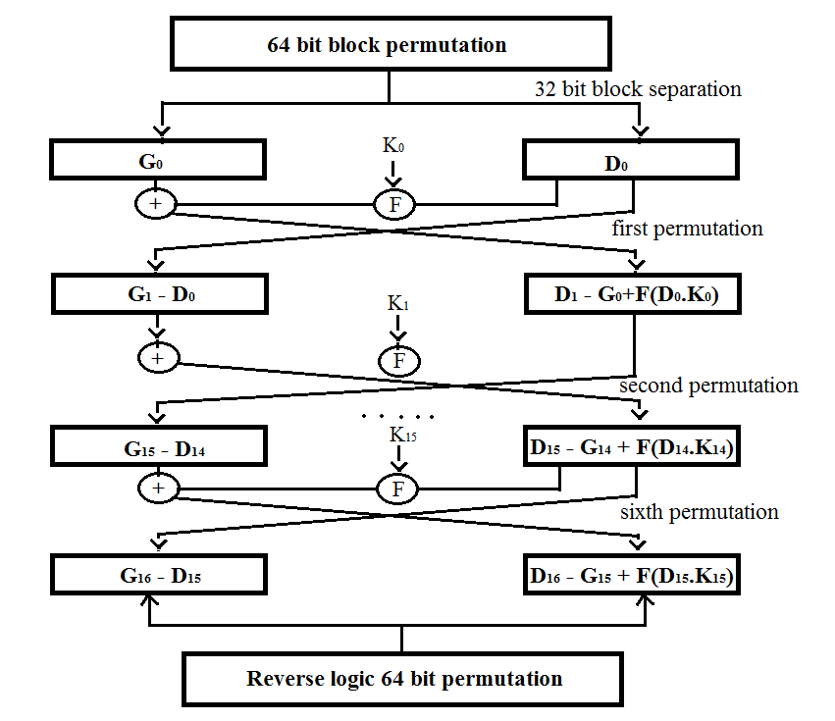

Slide 18
Push/Pull mode of log retrieval
The push mode refers to logs being periodically sent to the data owner or stakeholder
The pull mode refers to an alternative approach whereby the user (or another authorized party) can retrieve the logs as needed.
In order to implement the push we use CRON, a time based job scheduler.

Slide 19
Shell Scripts
Hourly execution script
mail -s "Usage Log" <email>@gmail.com < /var/lib/openshift/515516b35973cae68c00019f/app-root/data/cronlogs/sql.log
Minutely execution script
mysql -t -h 127.8.1.1 -u adminsWtjE3x -p8h1kTabnsNwn -D cia -e "select filename,uploadtime,downloadtime,username,cspname from ciaproperty where ownername = '<ownername>';" >/var/lib/openshift/515516b35973cae68c00019f/app-root/data/cronlogs/sql.log

Slide 20
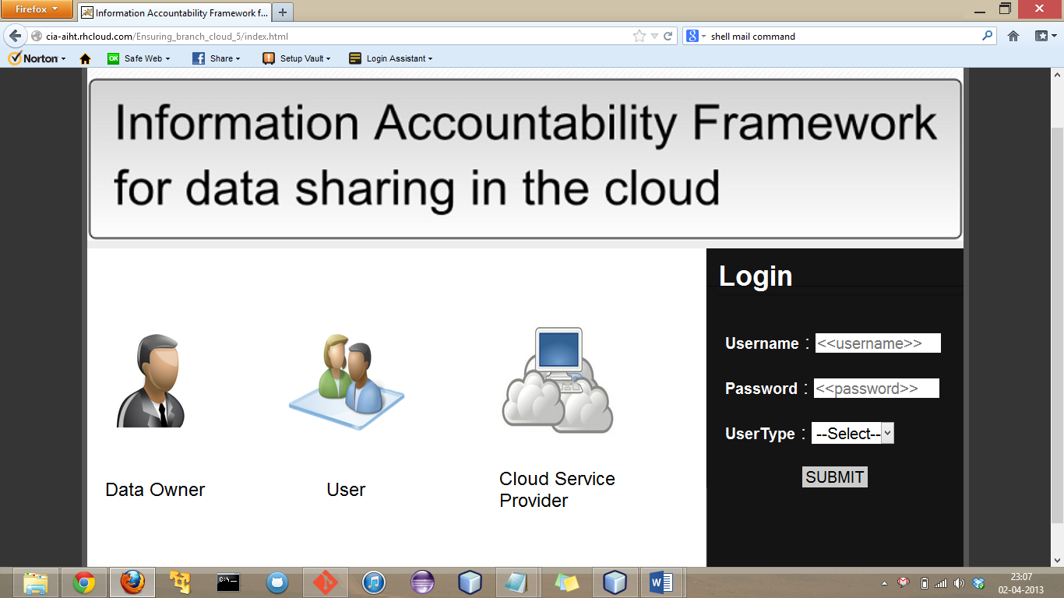
SCREENSHOTS:

Slide 21
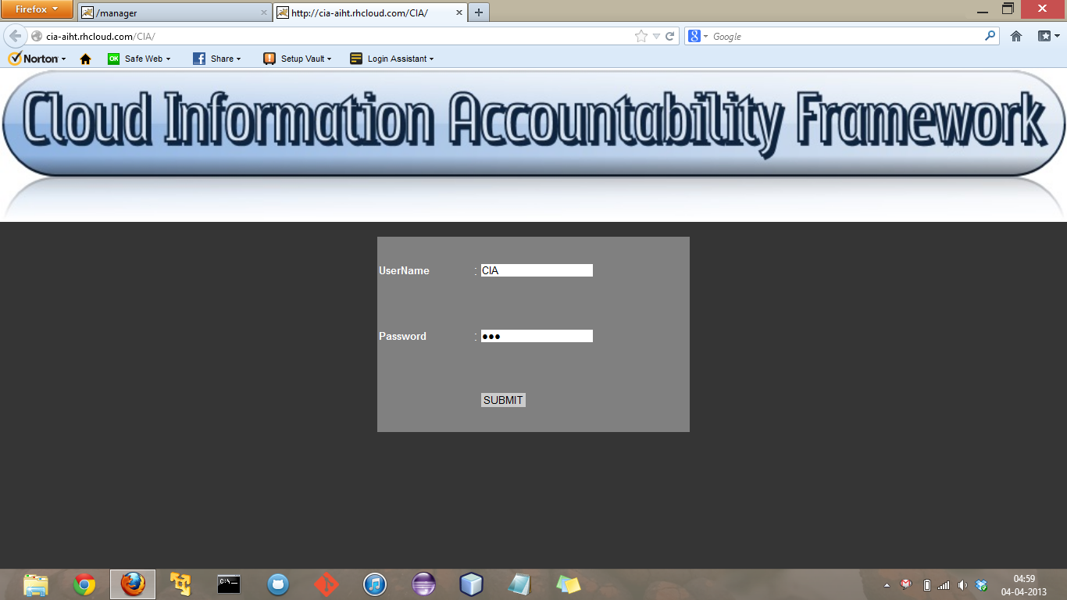
CIA Framework login screen

Slide 22
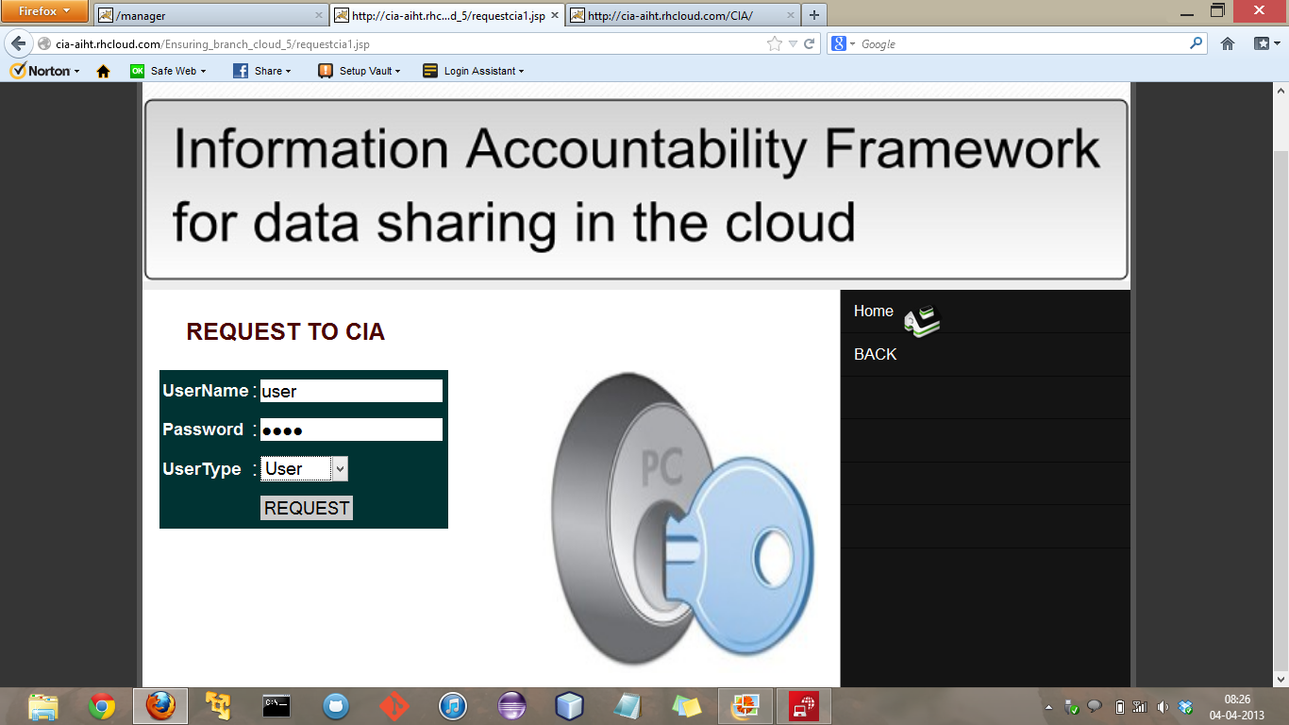
Request CIA to grant upload/download authorization

Slide 23
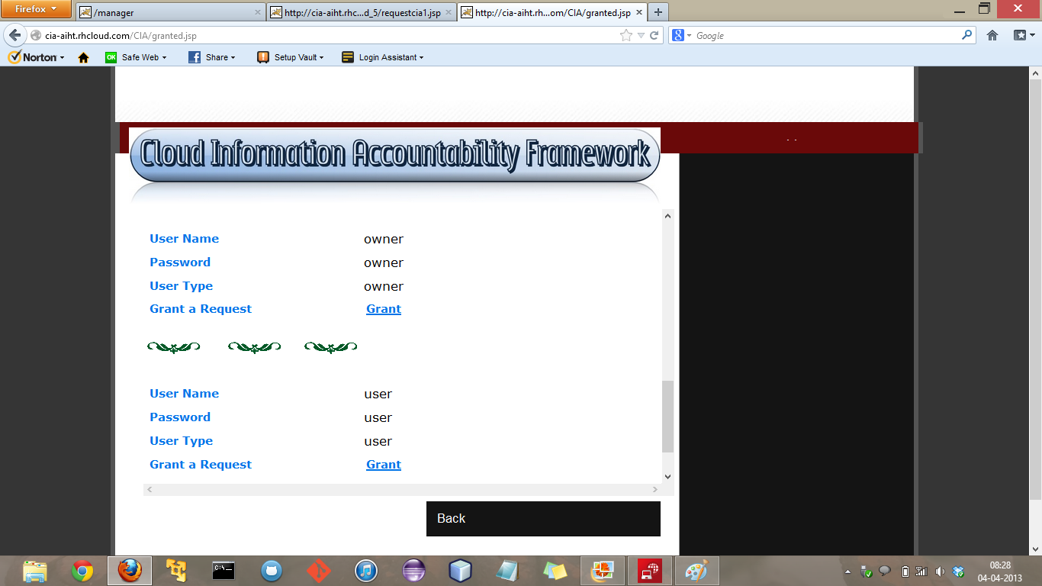
List of requests in the CIA

Slide 24
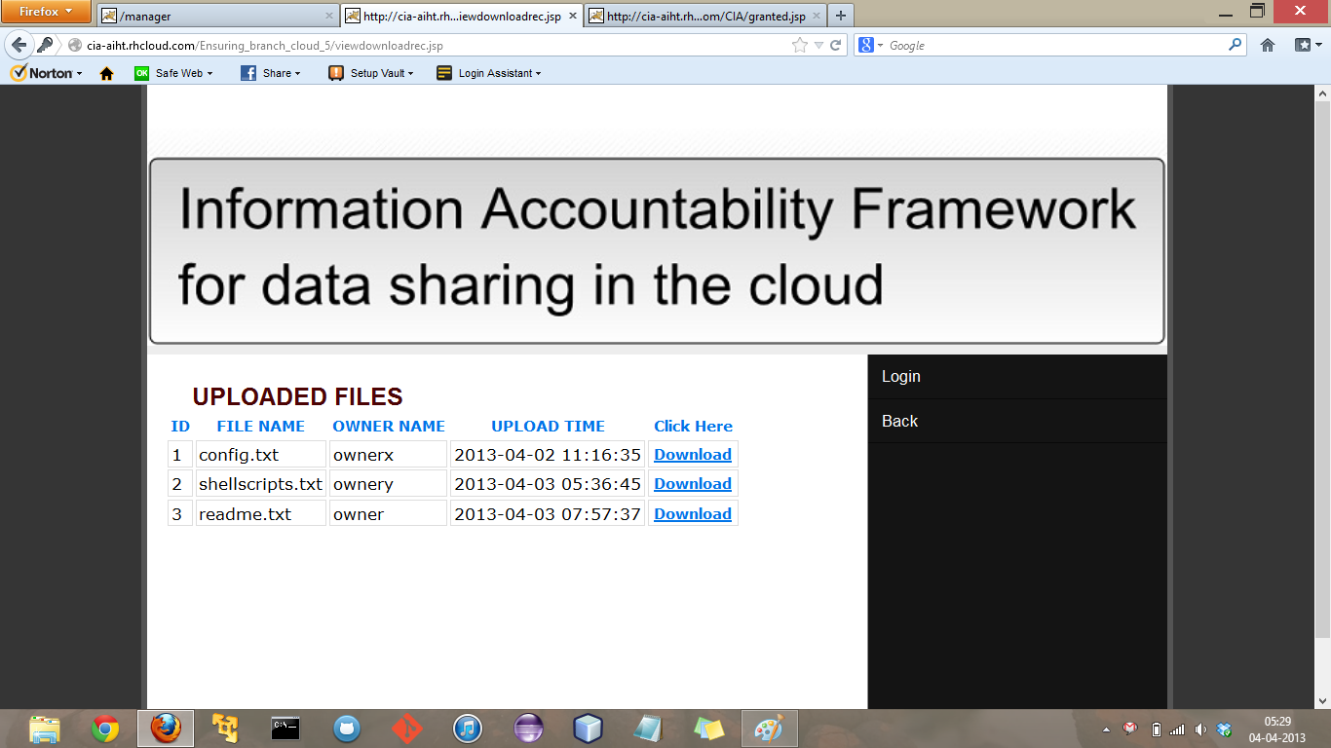
Uploaded files

Slide 25
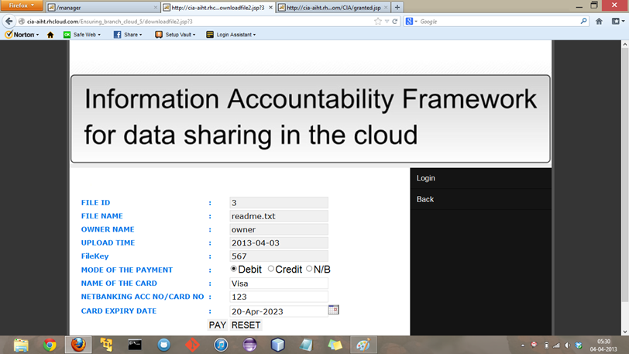
Payment screen

Slide 26
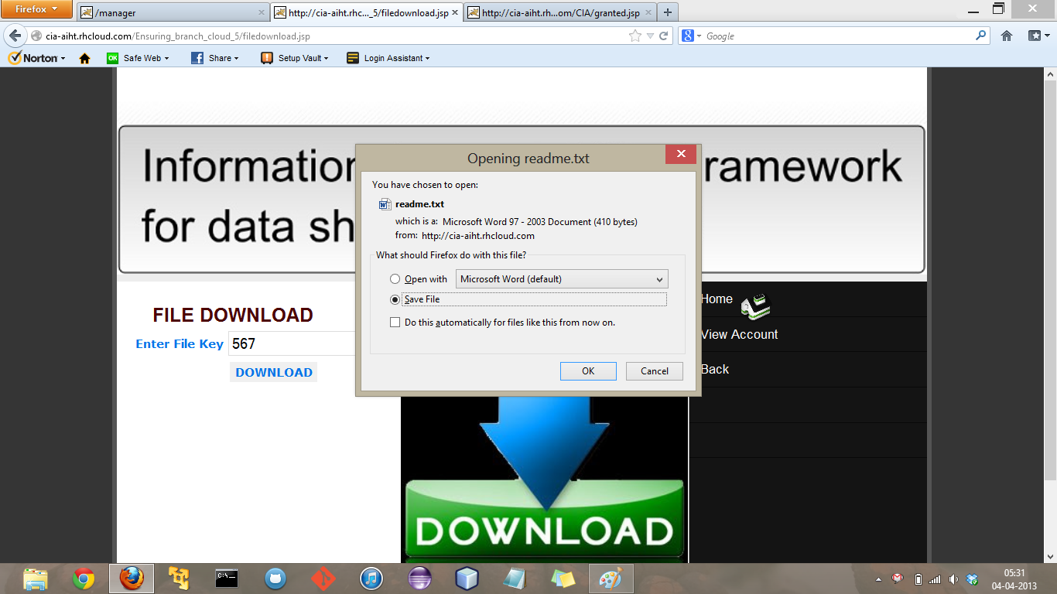
File download after entering file key

Slide 27
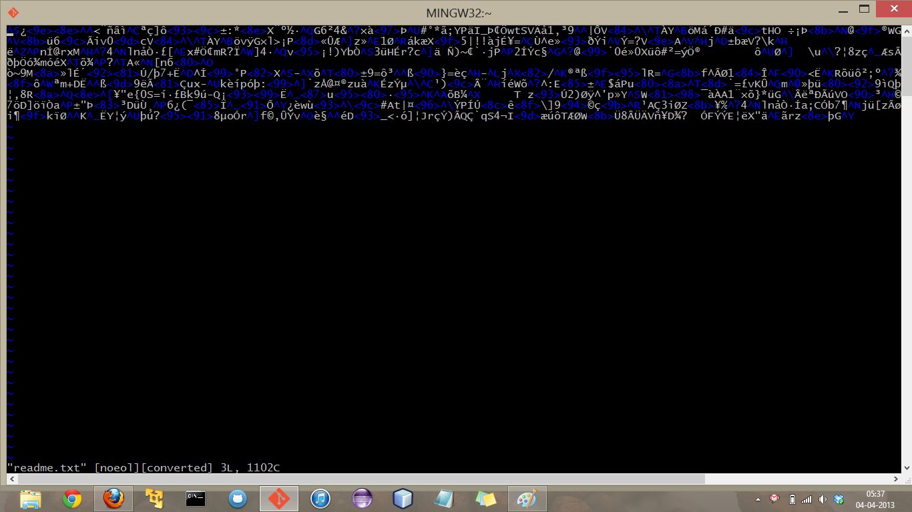
Encrypted file stored in the cloud server

Slide 28
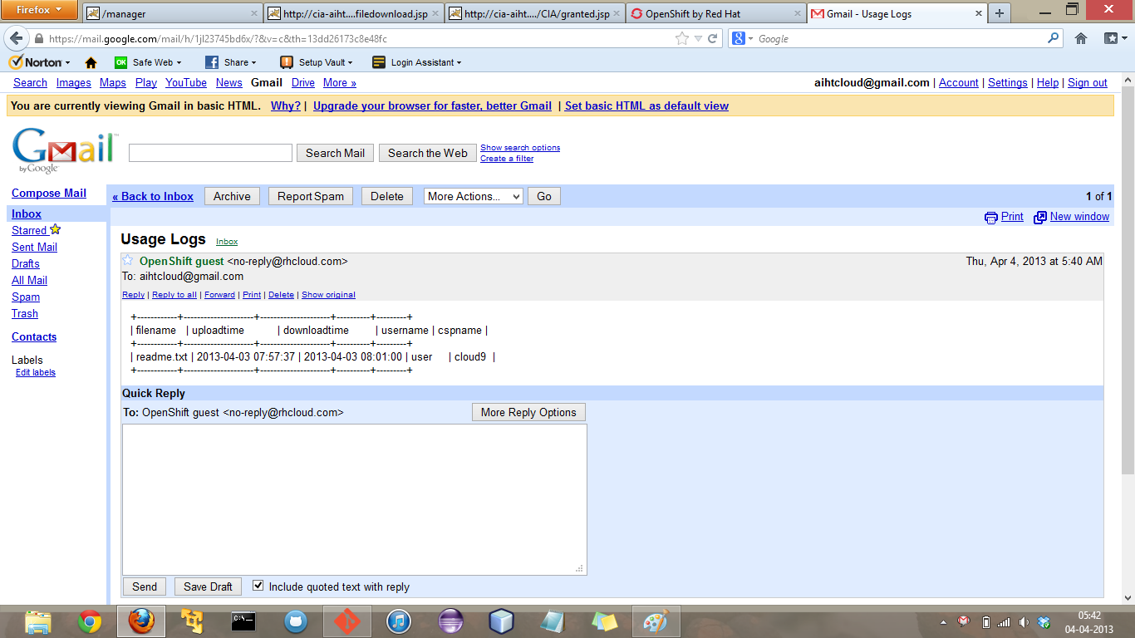
Logs received by the data owner as email

Slide 29
CONCLUSION
We proposed innovative approaches for automatically logging any access to the data in the cloud together with an auditing mechanism. Our approach allows the data owner to not only audit his content but also enforce strong back-end protection if needed. Moreover, one of the main features of our work is that it enables the data owner to audit even those copies of its data that were made without his knowledge.

Slide 30
FUTURE ENHANCEMENT
In future we plan to use a more efficient encryption algorithm with 256 bit key size such as AES for data encryption.
We also plan to create a system that verify the authenticity of the users by using phone verification.
We would like to support a variety of security, access and usage policies that would provide the data owner even more control over the data.

Slide 31
Thank You !

