Slide 1
Incompressible Navier-Stokes
Jefferson Creek

Slide 2
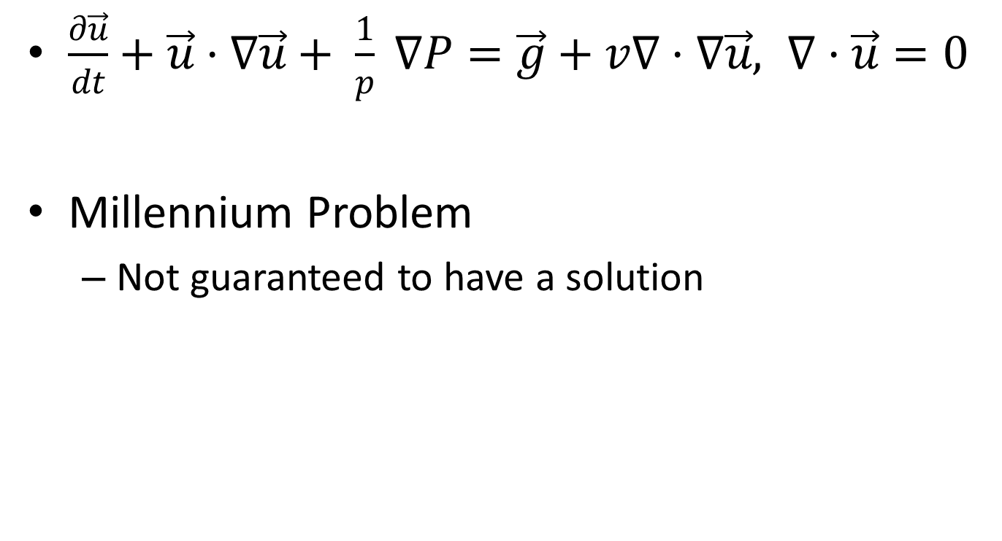
Total Equation
$\frac{∂\vec{u}}{dt}+\vec{u}·∇\vec{u}+ \frac{1}{p} ∇P=\vec{g}+v∇·∇\vec{u}, ∇·\vec{u}=0$
Millennium Problem
Not guaranteed to have a solution

Slide 3
Importance
Anything with aerodynamics
Planes
Cars
Ships
…

Slide 4

Quick Derivation from F=ma
F
$m\vec{g} −−V∇P+(Vμ)(∇·∇\vec{u})$, $∇·\vec{u}=0$
ma
$m\frac{D\vec{u}}{Dt}=\vec{F}$
➔
$\frac{∂\vec{u}}{dt}+\vec{u}·∇\vec{u}+ \frac{1}{p} ∇P=\vec{g}+v∇·∇\vec{u}, ∇·\vec{u}=0$

Slide 5

Euler Equation
However, due to numerical errors, viscosity can be removed
$\frac{∂\vec{u}}{dt}+\vec{u}·∇\vec{u}+ \frac{1}{p} ∇P=\vec{g} ∇·\vec{u}=0$

Slide 6
Sagemath
No true way to solve, must approximate
Rendered in Javascript due to large amounts of time for sage.plot.arrow.arrow to render

