Slide 1
Online Education Data Analysis and Forecast
Group 51
by
Nian Liu and Haobo Yang

Slide 2
1.Background Information
The public online class has gradually become a mainstream teaching method, but due to the large number of participants, the level gap is large, the quality of online class needs to be improved. Based on the collection and investigation of online classroom platform users' feature, this paper predicts whether users skip class. It is useful for online course platform companies to improve the quality of courses.

Slide 3
1.Background Information
KDD Cup 2015 Predict dropout rate on MOOC platforms’
Students' high dropout rate on MOOC platforms has been heavily criticized, and predicting their likelihood of dropout would be useful for maintaining and encouraging students' learning activities. Therefore, in KDD Cup 2015, we will predict dropout on XuetangX, one of the largest MOOC platforms in China. The competition participants need to predict whether a user will drop a course within next 10 days based on his or her prior activities. If a user C leaves no records for course C in the log during the next 10 days, we define it as dropout from course C.

Slide 4
2.Dataset
Count the overall distribution characteristics of users
Preprocess the original data to distinguish the distribution characteristics of users skipping class and not skipping class, Visualized the feature data to show the relationship between learning behavior and skipping class behavior in an intuitive way.
Train a classifier to predict whether a student will skip class

Slide 5
2.Dataset
All the dataset is from the KDDCUP 2015

Slide 6
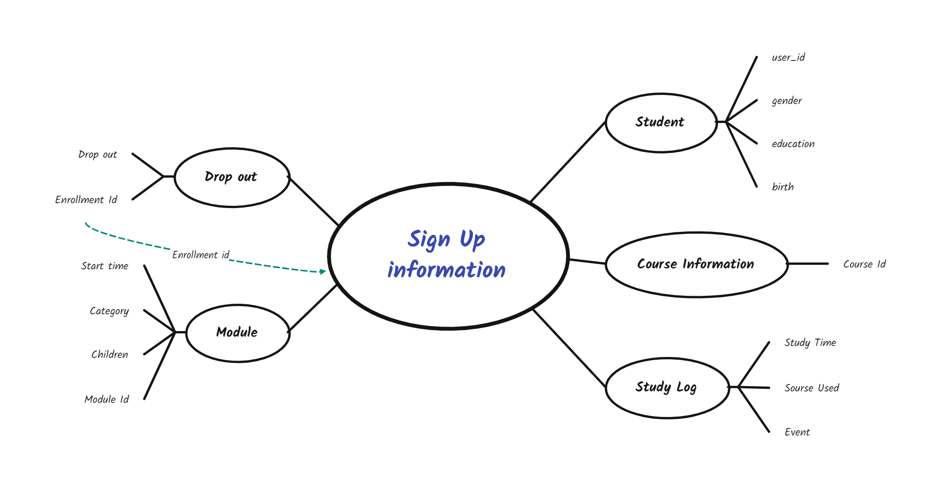
2.Dataset

Slide 7
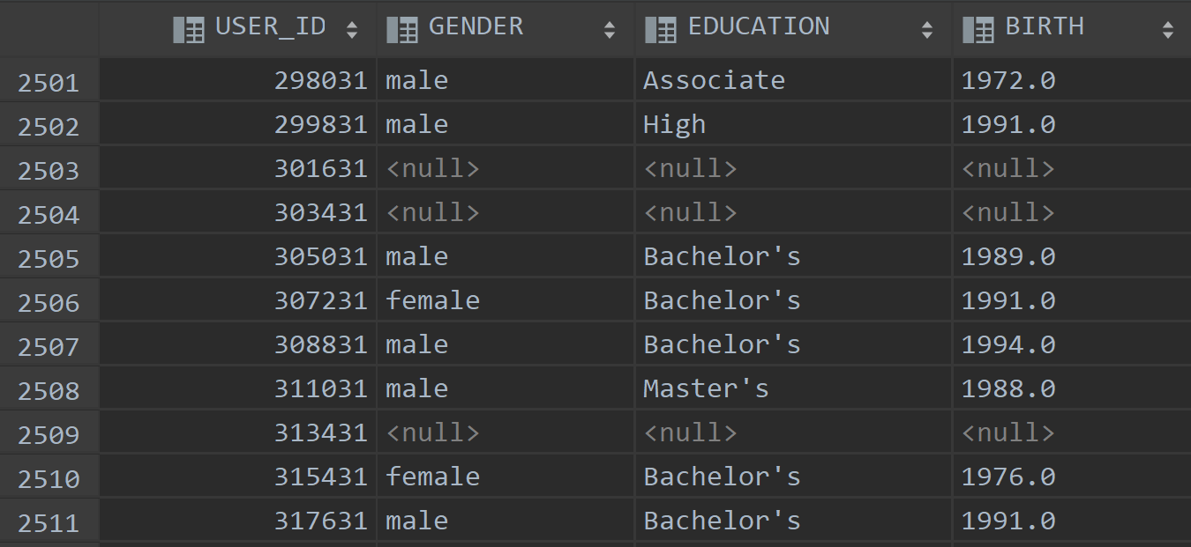
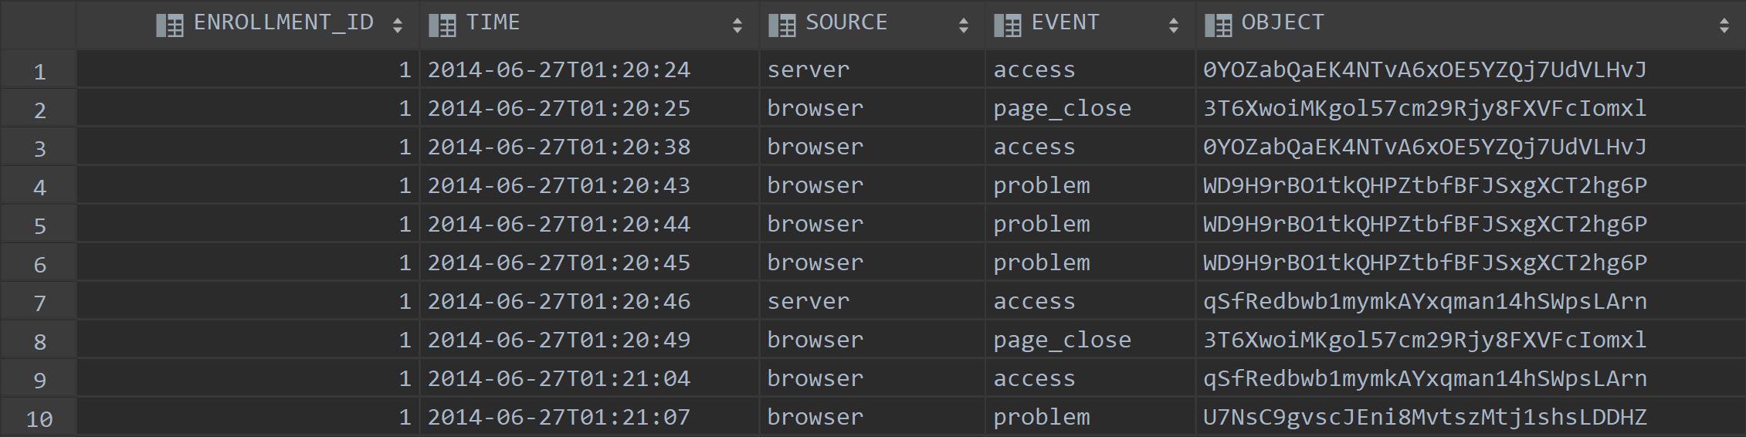
2.Dataset
Users’ information
Login_log

Slide 8
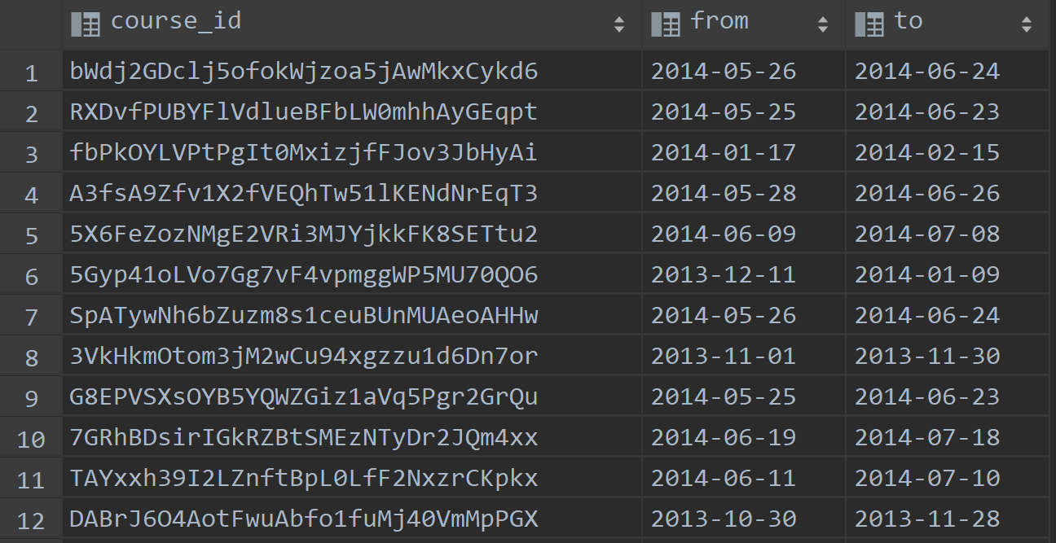
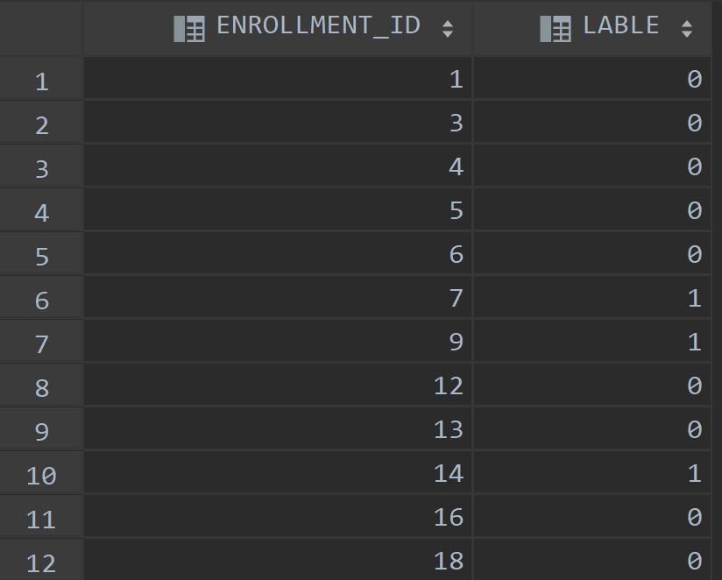
2.Dataset
Truth_train
(whether to drop)
Login_date

Slide 9
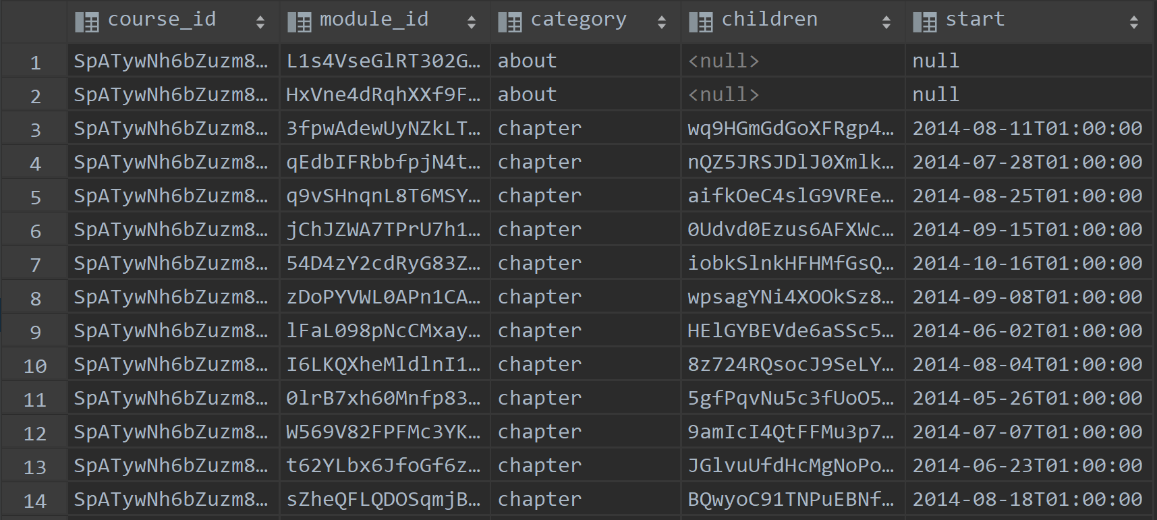
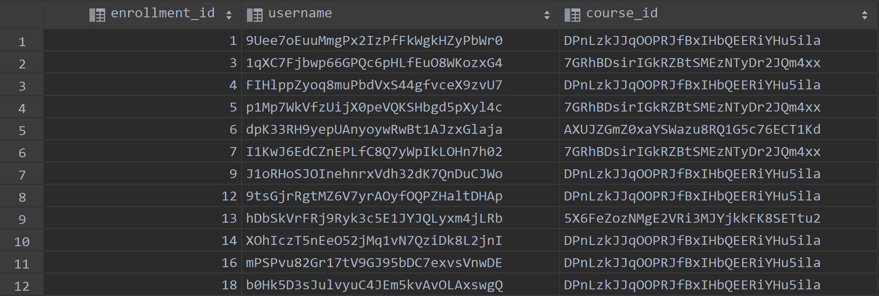
2.Dataset
Object’s information
Enrollment_train

Slide 10
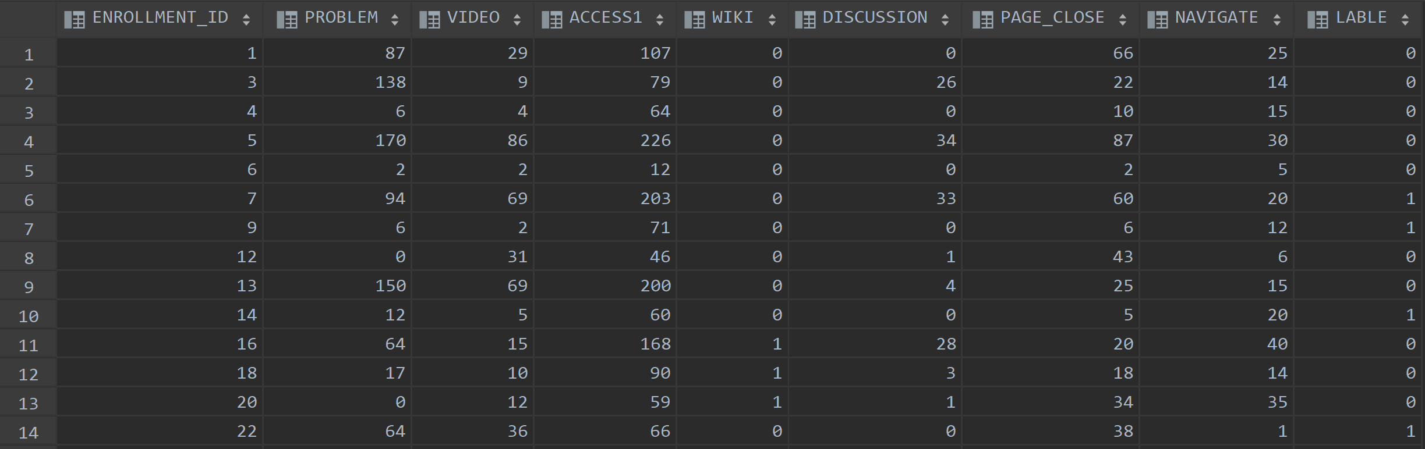
2.Dataset
Full information after preprocess

Slide 11

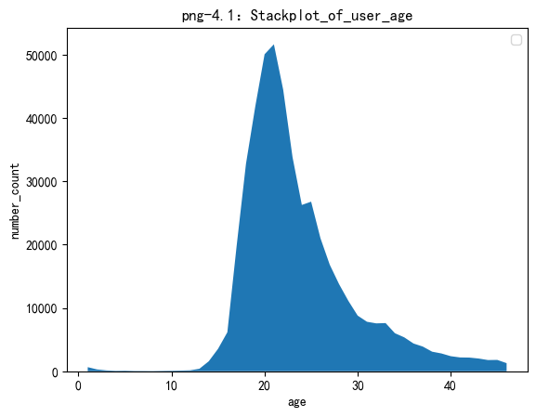
3.Graph
The distribution of the users’ age
Mainly between the 18-22

Slide 12
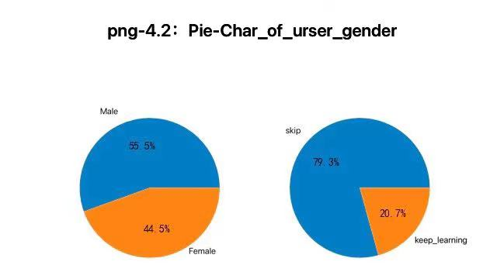
3.Graph
The amount of male and female are nearly the same.
Male students skip more classes than female.

Slide 13
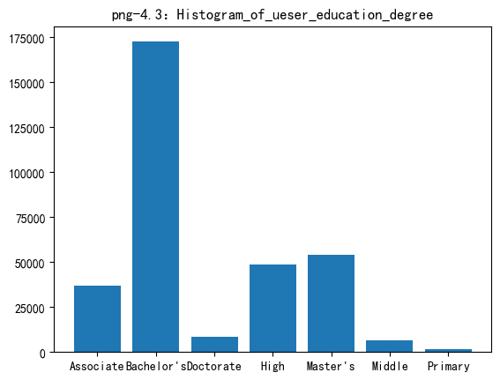
3.Graph
The main users are from university and college

Slide 14
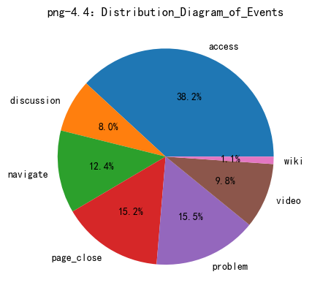
3.Graph
Access: Click into Mooc
Wiki: Go to wiki for information
Video: Check the study videos
Problem: Do the homework
Page Close: Turn down the web page
Navigate: Look other relative pages
Discussion: Discussion

Slide 15
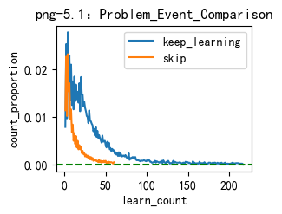
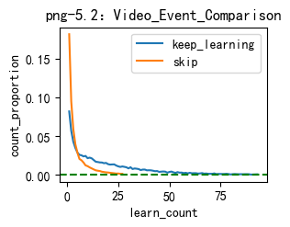
3.Graph

Slide 16
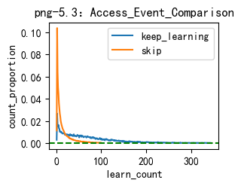
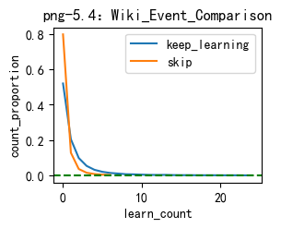
3.Graph

Slide 17
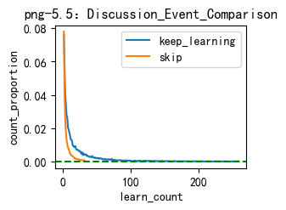
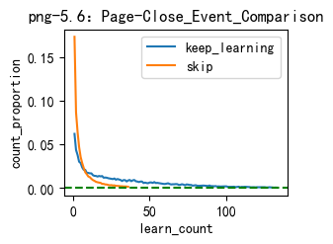
3.Graph

Slide 18
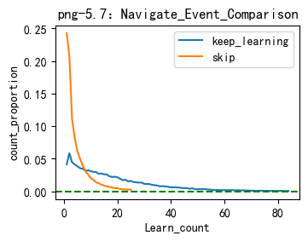
3.Graph

Slide 19
4.Link
GitHub page

Slide 20
Thanks!

