Slide 2
Dependency injection in ASP.NET Core
Dependency Injection (DI) is a software design pattern that allows us to develop loosely coupled code.
DI also enables us to better manage future changes and other complexity in our software. The purpose of DI is to make code maintainable.
The Dependency Injection pattern uses a builder object to initialize objects and provide the required dependencies to the object means it allows you to "inject" a dependency from outside the class.

Slide 3
Dependency Injection you should be familiar with the two concepts of Object Oriented Programming, one is tight coupling and another is loose coupling
Tight Coupling: When a class is dependent on a concrete dependency, it is said to be tightly coupled to that class. A tightly coupled object is dependent on another object; that means changing one object in a tightly coupled application often requires changes to a number of other objects. It is not difficult when an application is small but in an enterprise level application it is too difficult to make the changes. Loose Coupling: It means two objects are independent and an object can use another object without being dependent on it. It is a design goal that seeks to reduce the inter- dependencies among components of a system with the goal of reducing the risk that changes in one component will require changes in any other component.

Slide 4
The Error Log Management example
using System;
namespace DependencyInjection
{
public interface IErrorLogger
{
void LogMessage(Exception ex);
}
}

Slide 5
using System;
using System.Configuration;
using System.IO;
namespace DependencyInjection
{
public class FileLogger : IErrorLogger
{
public void LogMessage(Exception ex)
{
string folderPath = ConfigurationManager.AppSettings["ErrorFolder"];
if (!(Directory.Exists(folderPath)))
{
Directory.CreateDirectory(folderPath);
}
FileStream objFileStrome = new FileStream(folderPath + "errlog.txt", FileMode.Append, FileAccess.Write);
StreamWriter objStreamWriter = new StreamWriter(objFileStrome);
objStreamWriter.Write("Message: " + ex.Message);
objStreamWriter.Write("StackTrace: " + ex.StackTrace);
objStreamWriter.Write("Date/Time: " + DateTime.Now.ToString());
objStreamWriter.Write("============================================");
objStreamWriter.Close();
objFileStrome.Close();
}
}
}

Slide 6
using System;
using System.Configuration;
using System.Diagnostics;
namespace DependencyInjection
{
public class EventViewerLogger : IErrorLogger
{
public void LogMessage(Exception ex)
{
EventLog objEventLog = new EventLog();
string sourceName = ConfigurationManager.AppSettings["App"];
string logName = ConfigurationManager.AppSettings["LogName"];
if (!(EventLog.SourceExists(sourceName)))
{
EventLog.CreateEventSource(sourceName, logName);
}
objEventLog.Source = sourceName;
string message = String.Format("Message: {0} \n StackTrace: {1} \n Date/Time: {2} ", ex.Message, ex.StackTrace, DateTime.Now.ToString());
objEventLog.WriteEntry(message, EventLogEntryType.Error);
}
}
}

Slide 7
The Operation class has an interface, an IErrorLogger instance, created by the FileLogger class. In other words the Operation class object is tightly coupled with the FileLogger class.
using System;
namespace DependencyInjection
{
public class Operation
{
IErrorLogger logger = new FileLogger();
public void Division()
{
try
{
int firstNumber = 15, secondNumber = 0, result;
result = firstNumber / secondNumber;
Console.WriteLine("Result is :{0}", result);
}
catch (DivideByZeroException ex)
{
logger.LogMessage(ex);
}
}
}
}

Slide 8
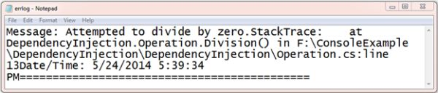
Now call your class method in your application startup class and you get a log in the text file so your start up class
using System;
namespace DependencyInjection
{
class Program
{
static void Main(string[] args)
{
Operation objOperation = new Operation();
objOperation.Division();
Console.Read();
}
}
}

Slide 9
Constructor Dependency Injection Pattern
The Constructor Injection uses a parameter to inject dependencies so there is normally one parameterized constructor always. So in this constructor dependency the object has no default constructor and you need to pass specified values at the time of creation to initiate the object.
Now create a class OperationEvent. That class has a parameter constructor. This constructor will be used to inject dependencies in the object.

Slide 10
using System;
namespace DependencyInjection
{
public class OperationEvent
{
IErrorLogger logger;
public OperationEvent(IErrorLogger logger)
{
this.logger = logger;
}
public void Division()
{
try
{
int firstNumber = 15, secondNumber = 0, result;
result = firstNumber / secondNumber;
Console.WriteLine("Result is :{0}", result);
}
catch (DivideByZeroException ex)
{
logger.LogMessage(ex);
}
}
}
}

Slide 11
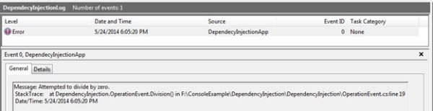
using System;
namespace DependencyInjection
{
class Program
{
static void Main(string[] args)
{
OperationEvent objOperationEvent = new OperationEvent(new EventViewerLogger());
objOperationEvent.Division();
Console.Read();
}
}
}

Slide 12
Services Lifetime in Dependency Injection
ASP.NET Core has many features introduced by Microsoft like the below which could help make applications faster and more robust:
Cross Platform so that it can run on Windows, Max and Linux
In builds support of Dependency Injection – it means there is no need to write extra code for it
Very good support of Asynchronous Programming which makes applications faster
Support of WebSocket and SingalR
There are 3 types of lifetimes supported by ASP.NET Core for the dependency injection,
Transient Service
Scoped Service
Singleton Service

Slide 13
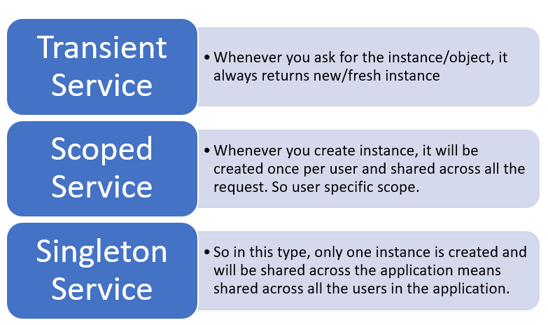

Slide 14
Transient Service
//1st Step: Create the required service
public interface IMyFirstTransientService
{
string SaysHello();
}
public class MyFirstTransientService: IMyFirstTransientService
{
public string ShowMessage()
{
return "How are you my friend? Transient";
}
}
//2nd Step: Add above created service to Service container as below
public void ConfigureServices(IServiceCollection services)
{
// .. other code
services.AddTransient<IMyFirstTransientService, MyFirstTransientService>();
//.. other code
}

Slide 15
//3rd Step: Use above created service as a dependency in the specific or required controller
public class HomeController: Controller
{
IMyFirstTransientService _myFirstTransientService;
public HomeController(IMyFirstTransientService myFirstTransientService)
{
_myFirstTransientService = myFirstTransientService;
}
}

Slide 16
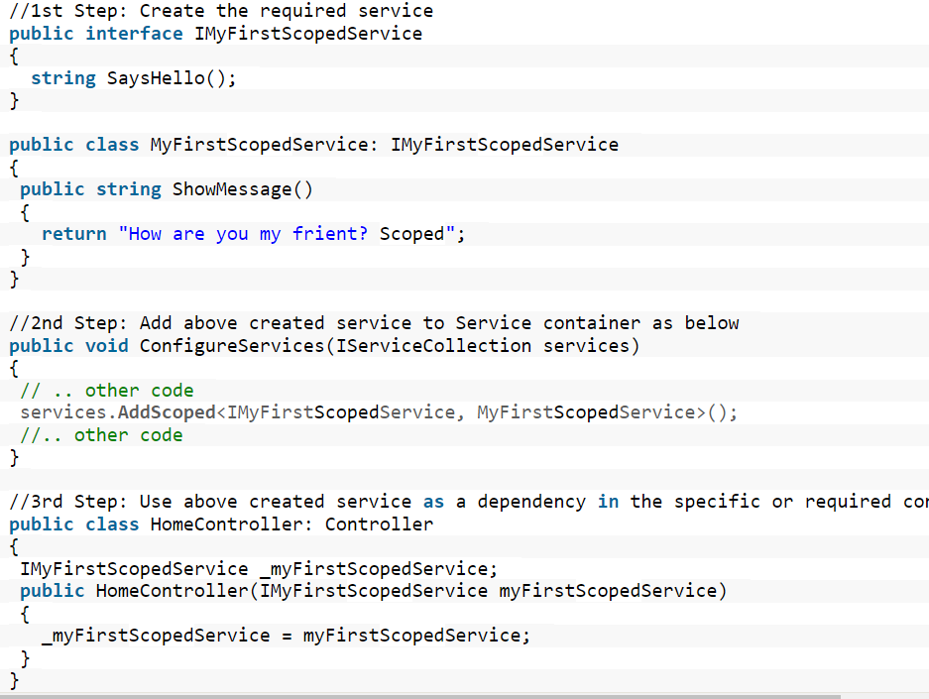
Scoped Service

Slide 17
//1st Step: Create the required service
public interface IMyFirstSingletonService
{
string SaysHello();
}
public class MyFirstSingletonService: IMyFirstSingletonService
{
public string ShowMessage()
{
return "How are you my frient? Singleton";
}
}
//2nd Step: Add above created service to Service container as below
public void ConfigureServices(IServiceCollection services)
{
// .. other code
services.AddSingleton<IMyFirstSingletonService, MyFirstSingletonService>();
//.. other code
}
Singleton Service

Slide 18
//3rd Step: Use above created service as a dependency in the specific or required controller
public class HomeController: Controller
{
IMyFirstSingletonService _myFirstSingletonService;
public HomeController(IMyFirstSingletonService myFirstSingletonService)
{
_myFirstSingletonService = myFirstSingletonService;
}
}

Slide 19
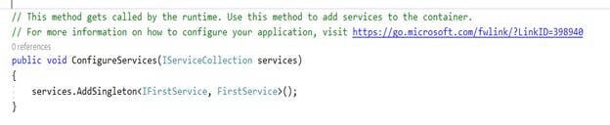
ConfigureServices This method gets called by the runtime. Use this method to add services to the container. And it takes one IServiceCollection object as an input.
Register Your Custom Services
To register services in application ConfigureService method to put an interface definition object type that will be requested from the container.
services.AddSingleton<IFirstService, FirstService>();
services.AddScoped<ArticlesService>();
services.AddTransient<ArticlesService>();

Slide 20
Need for Third party DI Engines
Dependency Injection is a simple implementation of utilizing Inversion of control (IoC).
Inversion of Control (Ioc) states that objects do not create other objects to accomplish their work. In order to create objects, they need to depend on third-party containers like Unity, Autofac and Ninject.
Advantages of Using DI
Improves code Maintainability
Code reusability
Loosely coupled
Reduce class coupling
Improves application Testing

Slide 21
Why do we go for third party Ioc Container
The inbuilt DI container is very light and does not support every feature. The Inbuilt framework is not full-fledged and it needs to be replaced with a third party container for a full DI support. ASP.NET Core is designed to replace the inbuilt container with a third-party container

Slide 22
ASP.NETcoreBuilt-in Ioc Container | AutofacIoc Container | Description
ServiceLifetime.Transientservices. AddTransient<,> | InstancePer Dependency() | A unique instance will be returned from each object request.
ServiceLifetime.Scopedservices.AddScope<,>In ASP.NET Core applications a scope is created around each server request. But it could be used as plain Scoped (non related to Http requests) if using DI out of ASP.NET Core | InstancePerLifetime Scope() | This is useful for objects specific to a single unit of work that may need to nest additional logical units of work. Each nested lifetime scope will get a new instance of the registered dependency. For example, this type of lifetime scope is useful for Entity Framework DbContext objects (Unit of Work pattern) to be shared across the object scope so you can run transactions across multiple objects.
ServiceLifetime.Scopedservices.AddScope<,>In ASP.NET Core applications a scope is created around each server request, so it will work similar to InstancePerRequest, in this case. | InstancePerRequest() | Application types like ASP.NET Core naturally lend themselves to “request” type semantics. You have the ability to have a sort of “singleton per request.”
ServiceLifetime. Singletonservices.AddSingleton<,> | SingleInstance() | One instance is returned from all requests in the root and all nested scopes
NO | InstancePer MatchingLifetime Scope() | you have the ability to “tag” or “name” the scope. A component with per-matching-lifetime scope will have at most a single instance per nested lifetime scope that matches a given name. This allows you to create a sort of “scoped singleton”
NO | InstancePerOwned() | The Owned<T> implicit relationship type creates new nested lifetime scopes. It is possible to scope dependencies to the owned instance using the instance-per-owned registrations.
NO | Thread Scope(based on lifetime scopes) | Autofac can enforce that objects bound to one thread will not satisfy the dependencies of a component bound to another thread. While there is not a convenience method for this, you can do it using lifetime scopes.

Slide 23
Command Line Arguments
Command-line arguments are helpful to provide those parameters without exposing them to everybody. When developing with .NET and C# you can get the command line arguments from your Main(string[] Args) function. Args is in fact an array containing all the strings separated by spaces entered in the command line.
Example:

Slide 24
using System;
using System.Collections.Generic;
using System.Linq;
using System.Text;
namespace ConsoleApplication
{
class CommandLineArgument
{
static void Main(string[] arguments)
{
foreach (String arg in Environment.GetCommandLineArgs())
{
Console.Write(arg);
}
Console.ReadKey();
}
}
}

Slide 25
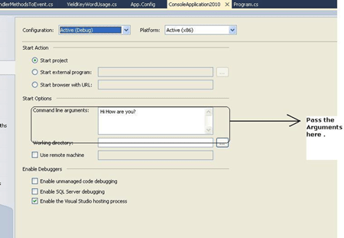
Visual Studio enables a nice feature where you can do this in the Project Properties window, on the Debug tab. Here are the steps to achieve this
Right, Click on Project from Solution Explorer and select Properties.
In the Project Properties Windows, Navigate to "Debug Tab"
You will find the text box "Command Line".

Slide 26
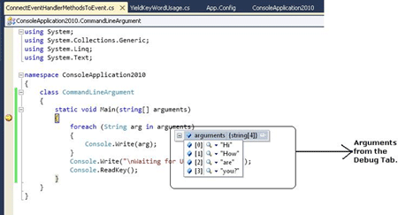
using System;
using System.Collections.Generic;
using System.Linq;
using System.Text;
namespace ConsoleApplication2010
{
class CommandLineArgument
{
static void Main(string[] arguments)
{
foreach (String arg in arguments)
{
Console.Write(arg);
}
Console.Write("Waiting for User response...");
Console.ReadKey();
}
}
}

