Slide 1
Enrichment results
2026.07.27

Slide 2
Aims
Examine whether the features learned by the model are related to known biological pathways.
 | Alphaviridae | Coronaviridae | Flaviviridae | Orthoherpesviridae | Orthomyxoviridae | Picornaviridae | Reoviridae | Retroviridae
KEGG |  |  |  |  |  |  |  | 
Reactome |  |  |  |  |  |  |  | 
GO |  |  |  |  |  |  |  | 
MSigDB |  |  |  |  |  |  |  | 
WikiPathways |  |  |  |  |  |  |  | 

Slide 3
Alphaviridae
Pathway:
Regulation of viral entry into host cell(GO)
Definition:
Any process that modulates the frequency, rate or extent of the viral entry into the host cell
Notes:
圖片來源:https://www.ebi.ac.uk/QuickGO/GTerm?id=GO:0046596

Slide 4
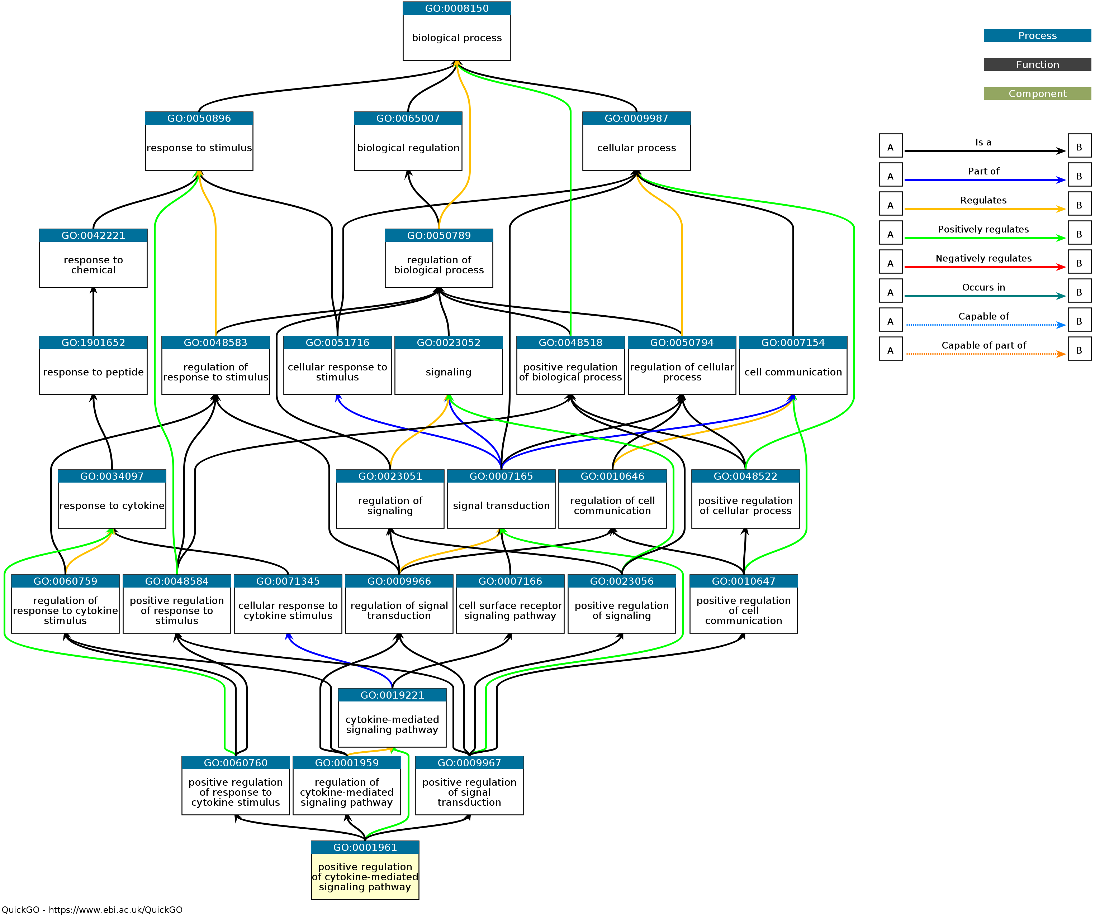
Coronaviridae(GO)
Pathway:
Regulation of viral entry into host cell
Positive regulation of cytokine-mediated signaling pathway
Definition:
Any process that activates or increases the frequency, rate or extent of a cytokine mediated signaling pathway
Notes:
圖片來源:https://www.ebi.ac.uk/QuickGO/GTerm?id=GO:0001961

Slide 5
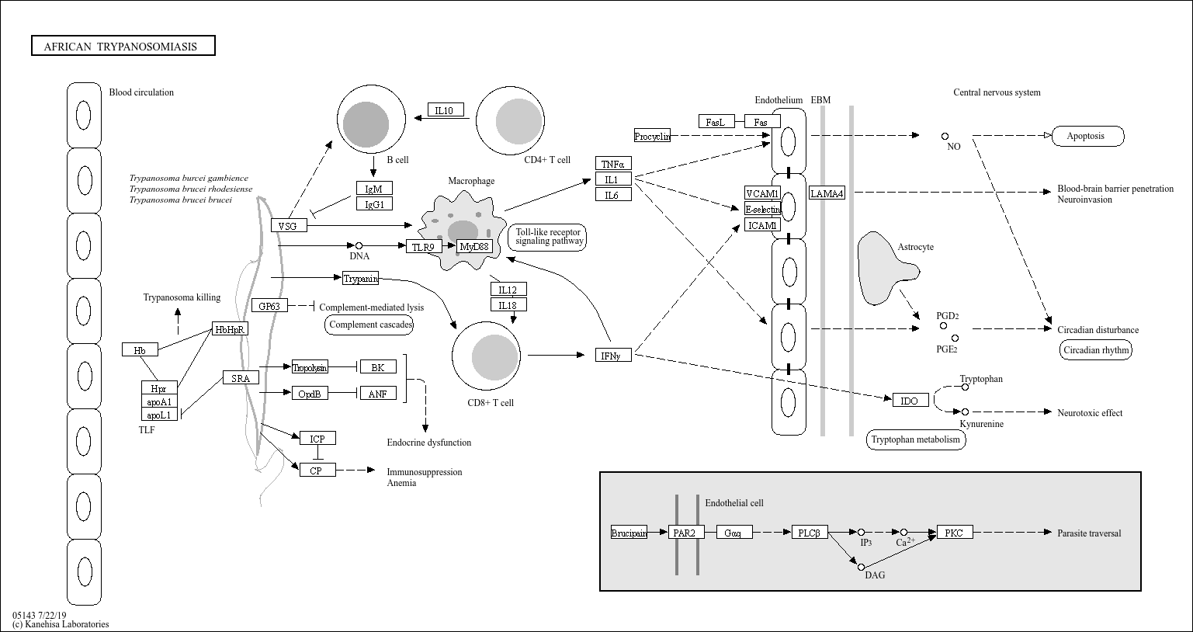
Coronaviridae(KEGG)
Pathway:
African trypanosomiasis
Description:
Trypanosoma brucei causes African trypanosomiasis (sleeping sickness) and is transmitted by tsetse flies. It can cross the blood-brain barrier and induce inflammatory cytokines such as TNF-α, IFN-γ, and IL-1, leading to neurological damage and disrupted sleep and circadian rhythms.
Notes:
圖片來源:https://www.kegg.jp/pathway/map05143

Slide 6
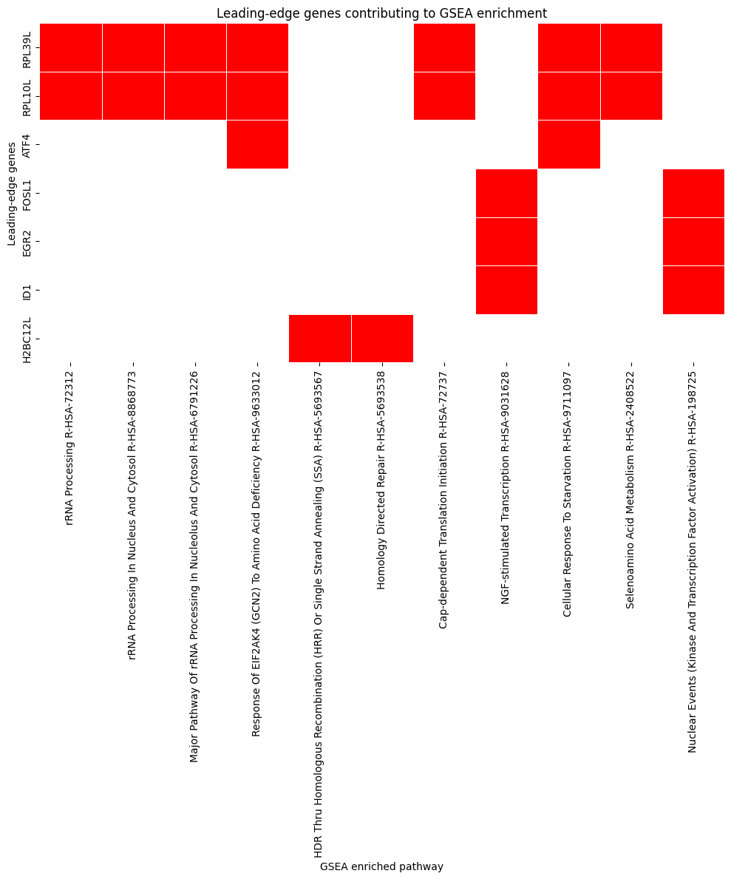
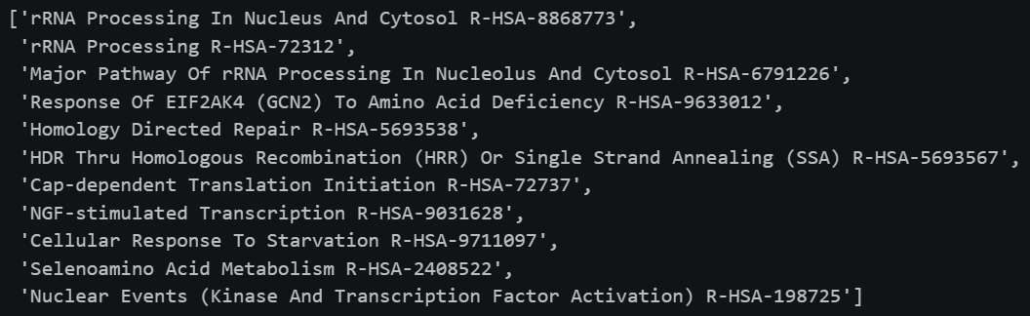
Orthoherpesviridae(Reactome)
Pathway:
Common leading_edge genes:
RPL10L and RPL39L are ribosomal protein paralogs whose specific biological functions remain unclear.
Notes:
資料來源:NCBI

