Slide 1
Progress Report
07.27

Slide 2
Aims
Aim 1:
Conducting downstream analysis—such as enrichment analysis—on gene sets identified by deep learning models.
Aim 2:
Predict unknown cell lengths using existing gene expression data and some known cell labels.

Slide 3
Aim 1

Slide 4
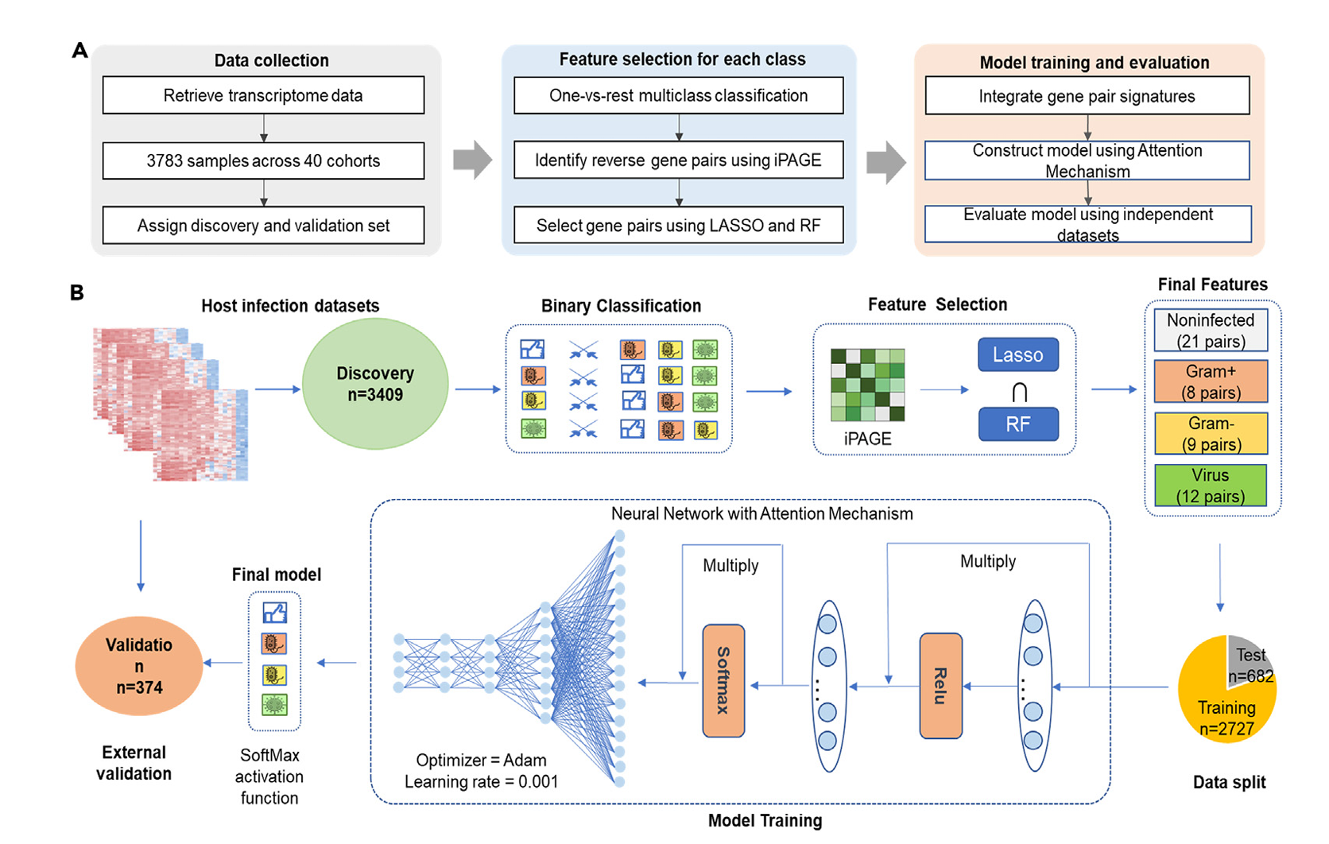
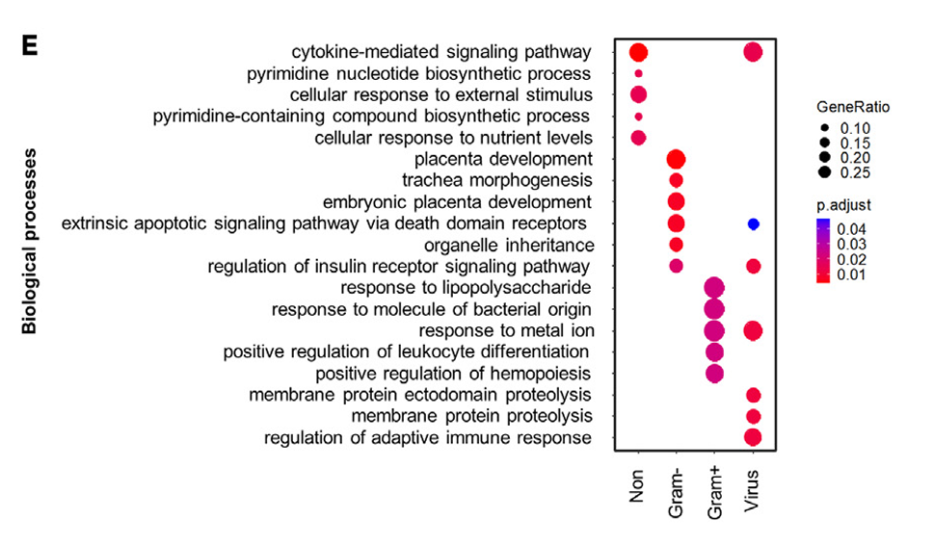
Literature Review
bvnGPS2 (Xie et al. iScience 2024)

Slide 5
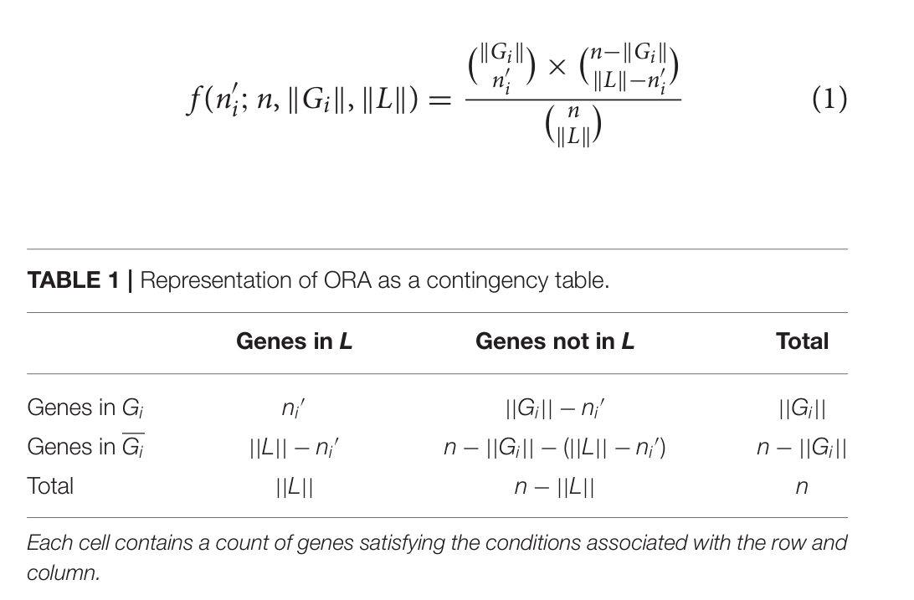
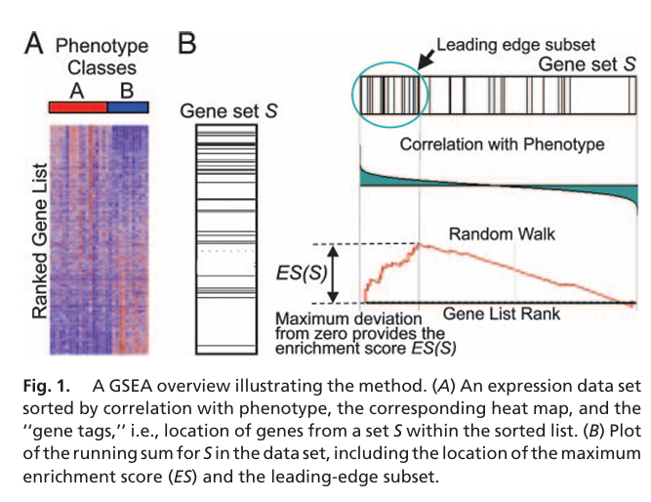
Analysis process
Remove genes with a value of 0
Dataset:
/home/bits_home02/nigelyeh/virusML/results_woControl/shap
/home/bits_home02/nigelyeh/virusML/results_woControl.immune_v1/shap
Virus families:
Alphaviridae, Coronaviridae, Flaviviridae, Orthoherpesviridae, Orthomyxoviridae, Picornaviridae, Reoviridae, Retroviridae
Data.columns:
'Gene', 'RF_mean_abs_Score', 'XGB_mean_abs_Score', 'RF_median_abs_Score', 'XGB_median_abs_Score', 'RF_Rank_byMean', 'XGB_Rank_byMean', 'RF_Rank_byMedian', 'XGB_Rank_byMedian', 'Avg_Rank_byMean', 'Avg_Rank_byMedian’
Rank the genes according to Shapley values
ORA(cutoff:top50)
GSEA
Features learned by the model and their potential biological significance
(Khatri et al., 2012)
(Subramanian et al., 2005)

Slide 6
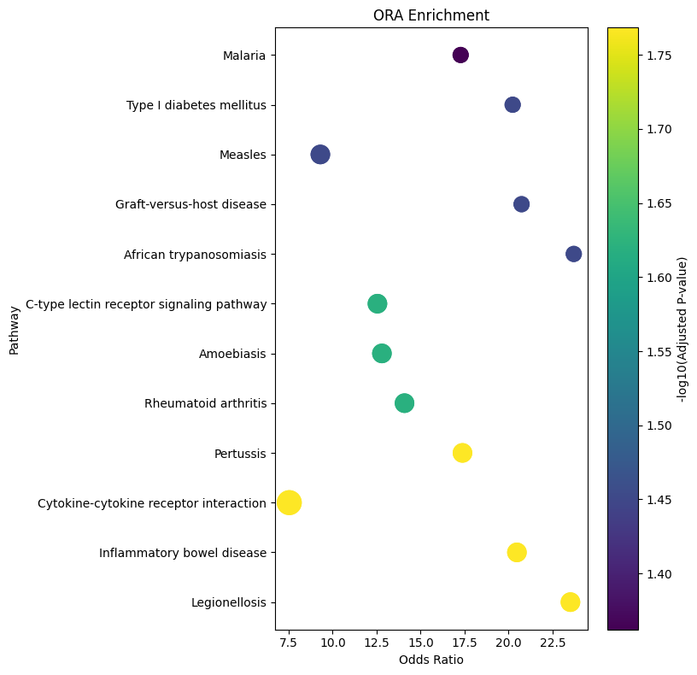
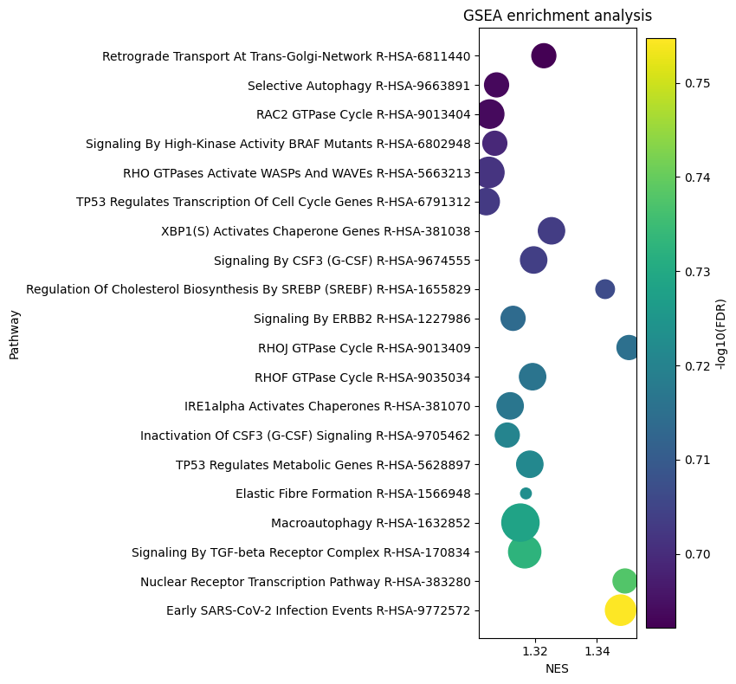
Current results
 | Alphaviridae | Coronaviridae | Flaviviridae | Orthoherpesviridae | Orthomyxoviridae | Picornaviridae | Reoviridae | Retroviridae
KEGG |  |  |  |  |  |  |  | 7
Reactome | GSEA |  | GSEA |  |  | GSEA | GSEA | 1
GO |  | ORA/GSEA | GSEA | ORA |  | 1 | ORA/GSEA | GSEA
MSigDB |  |  |  |  |  | GSEA |  | 1
WikiPathways | GSEA |  |  |  |  | GSEA | ORA/GSEA | 8

Slide 7
Aim 2

Slide 8
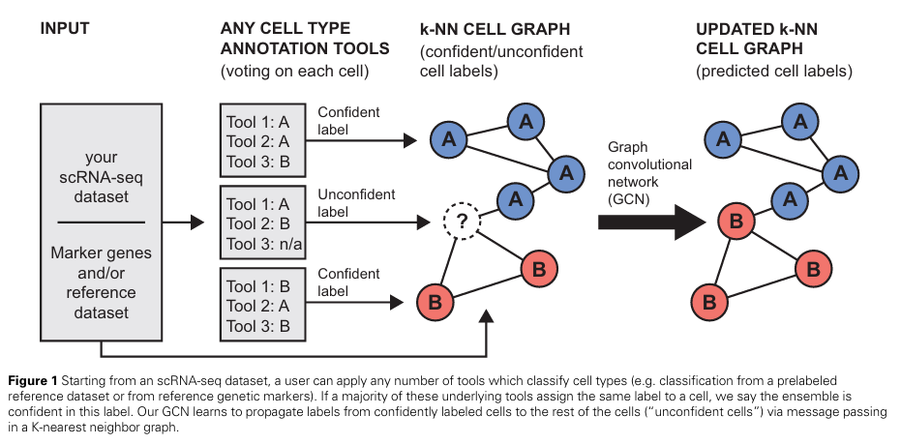
Literature Review for Aim 2
scSHARP (Lewinsohn et al. Bioinformatics 2023)

Slide 9
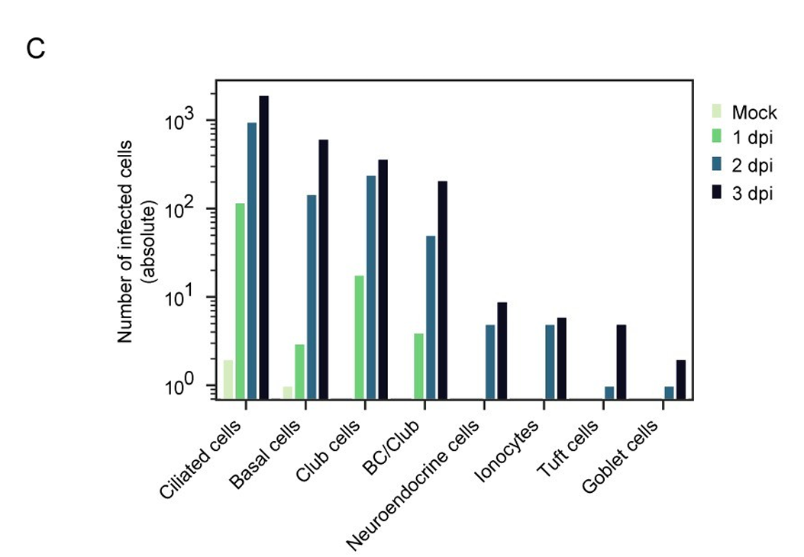
Preliminary Data Exploration
Dataset:
/home/bits_home02/nigelyeh/scRNAseq_data/Ravindra2021/GEM_processed/Ravindra2021.raw_count.stdprep.h5ad
Examine the distribution of transcript counts across cells
Select cells with high-confidence labels
Perform feature dimensionality reduction using highly variable genes
SARS-CoV-2 airway scRNA-seq analysis (Ravindra et al. PLoS Biology 2021)

Slide 10
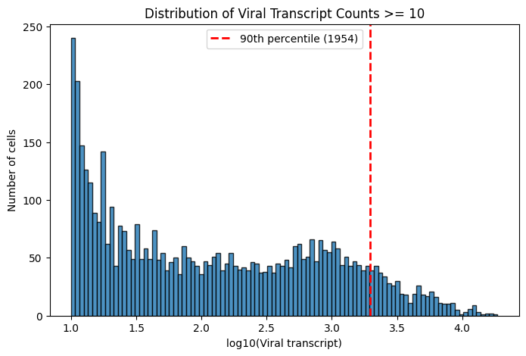
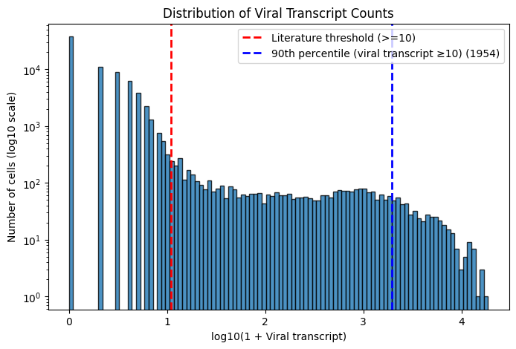
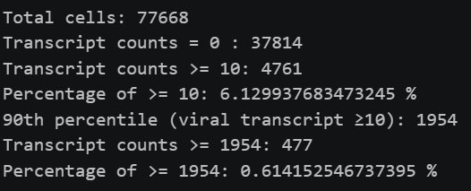
Preliminary Data Exploration
The problem of data imbalance
The number of features (genes) is too large
Split training and test sets

Slide 11
Applications of WGCNA

Slide 12
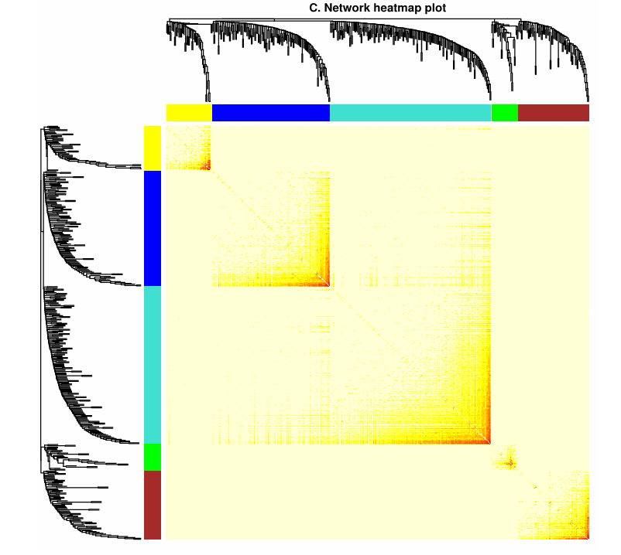
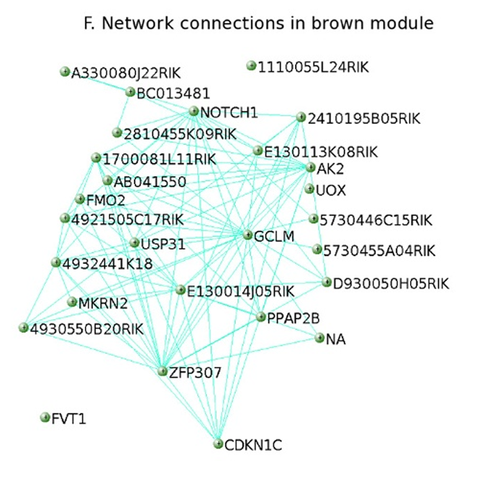
Literature Review
WGCNA (Langfelder & Horvath BMC Bioinf 2008)

Slide 13
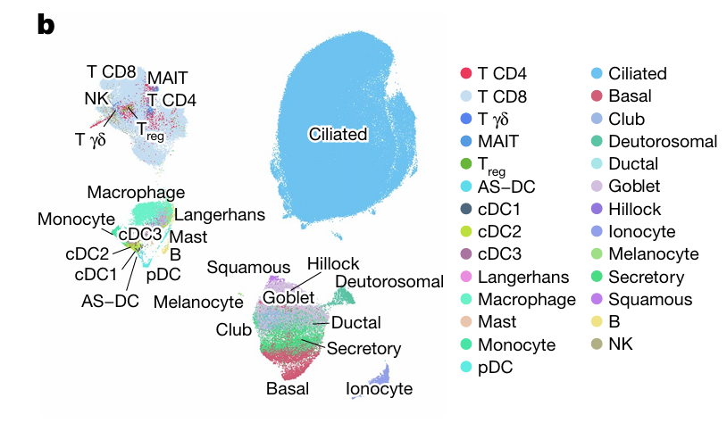
WGCNA
Dataset:
/home/bits_home02/nigelyeh/scRNAseq_data/LindeboomTeichmann2024/challenge_nasal_cellxgene_230223.h5ad
Delineating cell modules based on gene expression
Identify gene expression patterns representative of the cell module
Human SARS-CoV-2 Challenge (Lindeboom et al. Nature 2024)
Applied to the infection status of cells

Slide 14
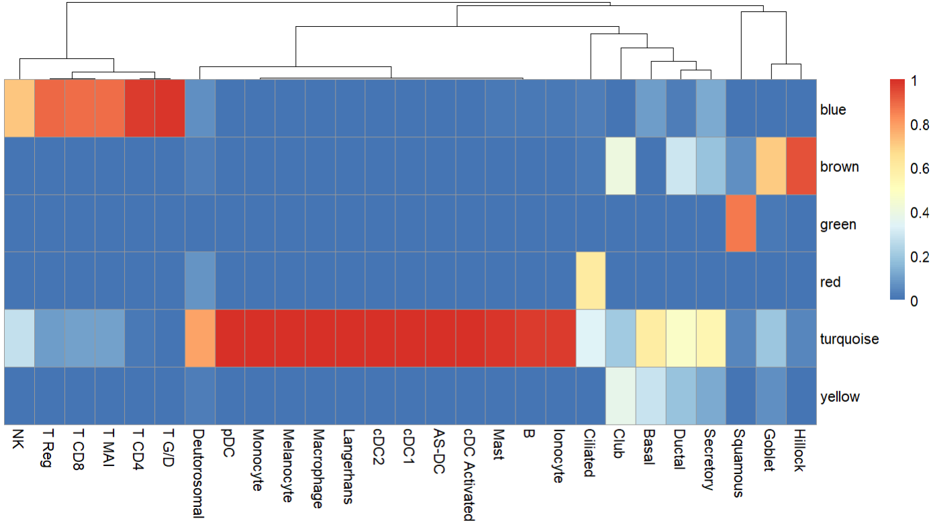
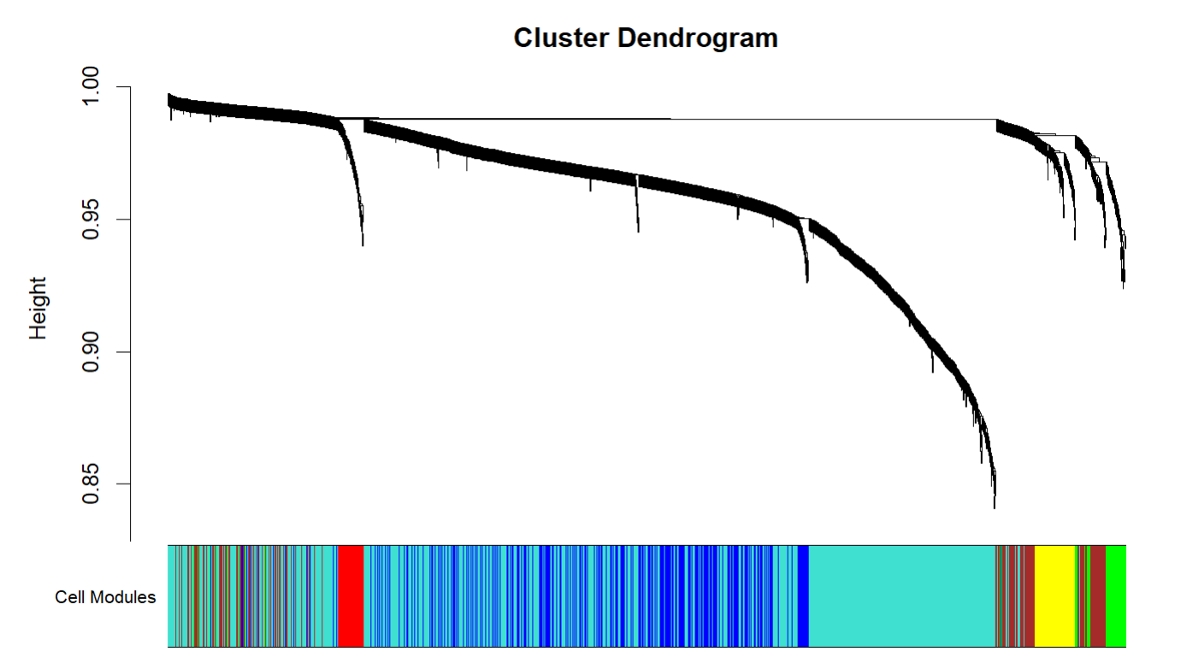
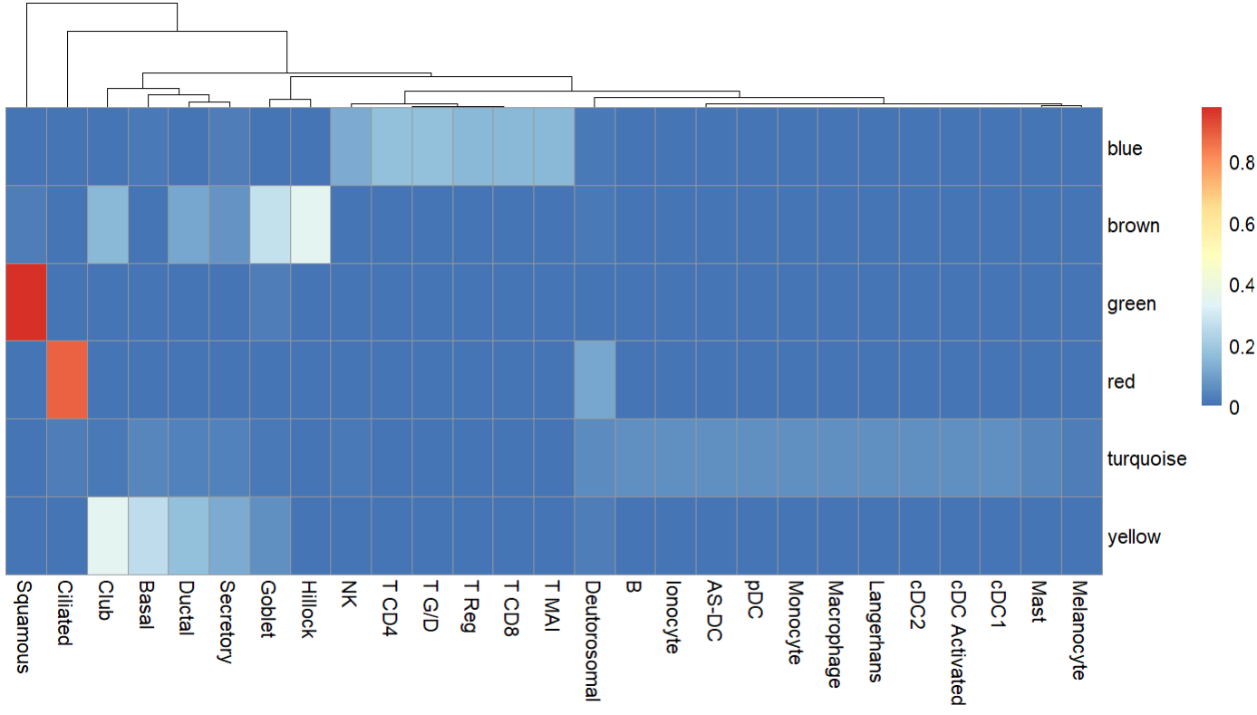
WGCNA
WGCNA does not perform well in classifying cell types

Slide 15
Future work
Aim 1:
Re-analyze after removing non-coding gene
Aim 2:
Obtain the adjacency matrix using KNN and feed it into the GCN model.
Apply WGCNA to Aim1 instead of Aim 2
GCN (Kipf & Welling ICLR 2017)

