Slide 1
Research Progress and Future Work
2026.07.27

Slide 2
Aims
Aim 1:
Conducting downstream analysis—such as enrichment analysis—on gene sets identified by machine learning models.
Aim 2:
Predict unknown cells using existing gene expression data and some known cell labels.

Slide 3
Aim 1

Slide 4
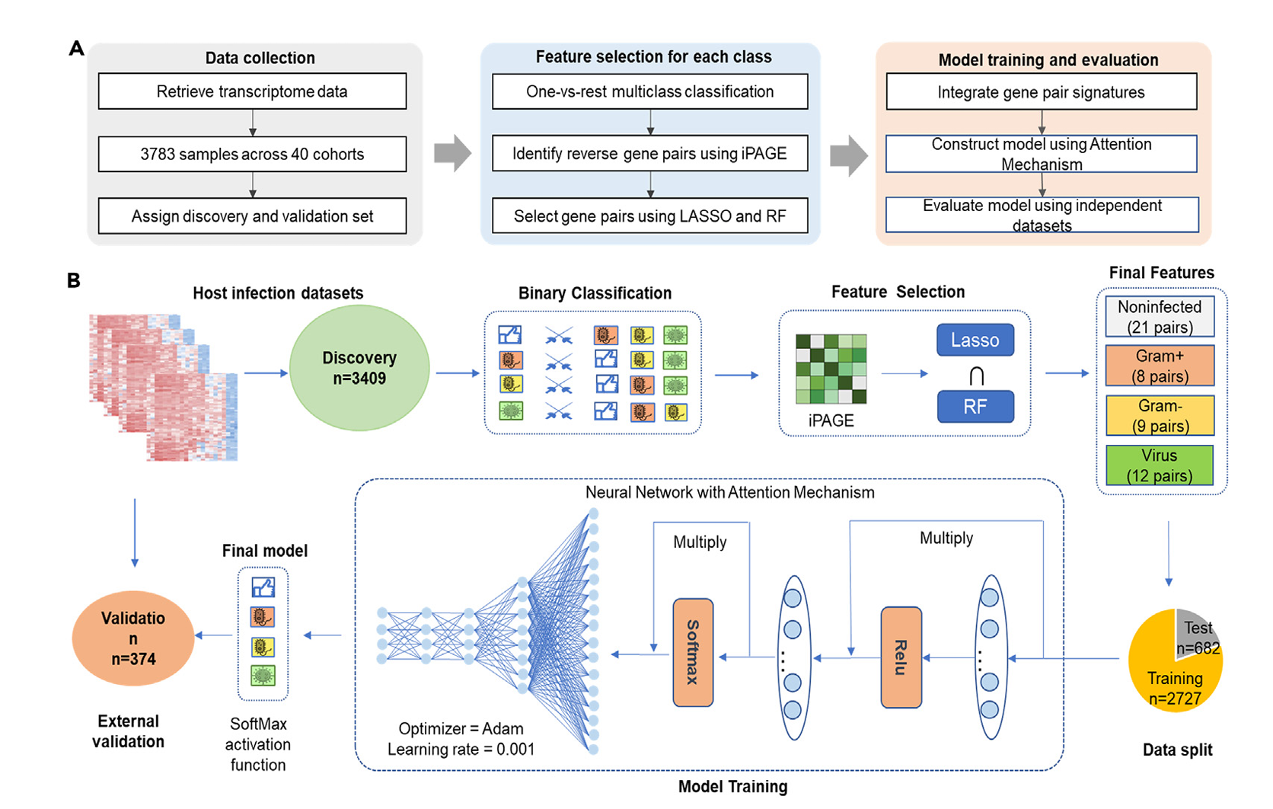
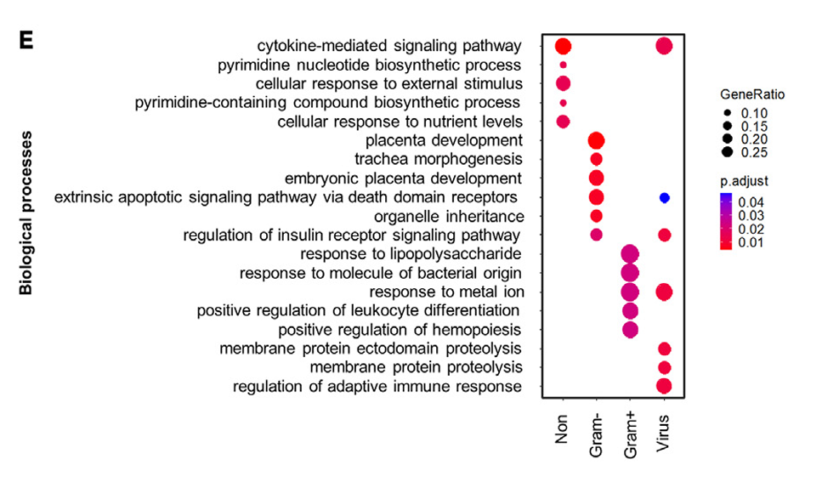
Literature Review
Conducting downstream analysis—such as enrichment analysis—on gene sets identified by deep learning models.
bvnGPS2 (Xie et al. iScience 2024)
bvnGPS2 (Xie et al. iScience 2024)

Slide 5
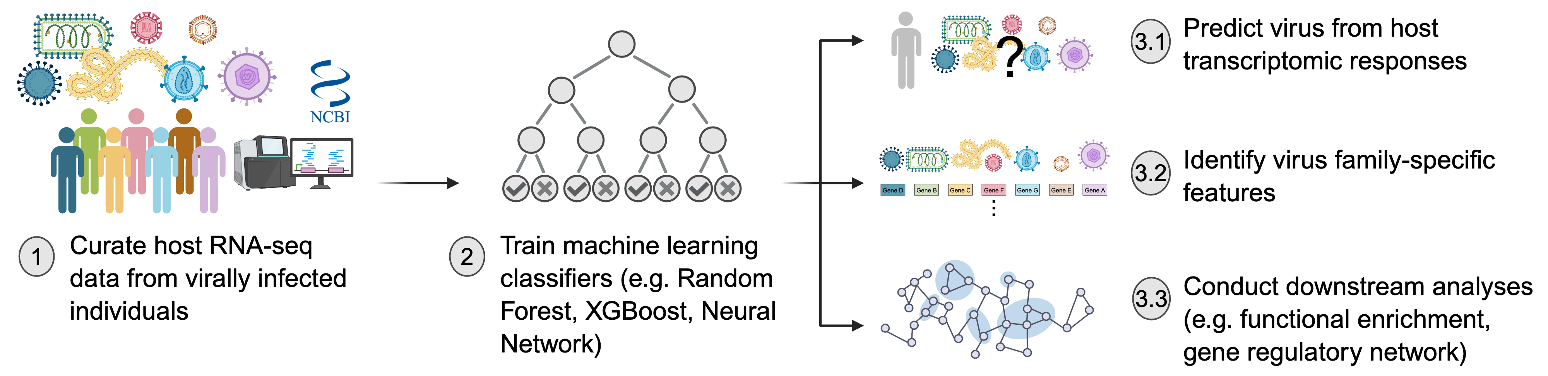
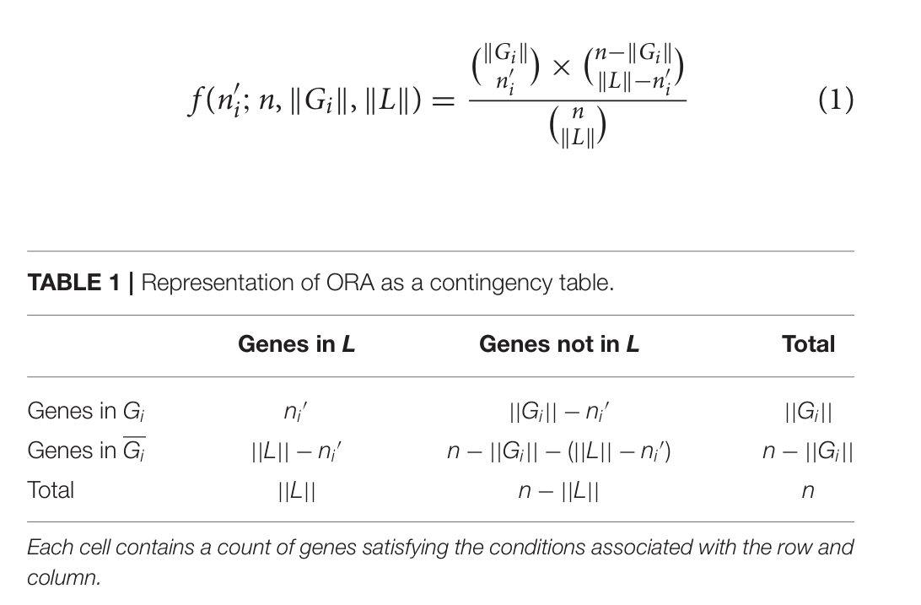
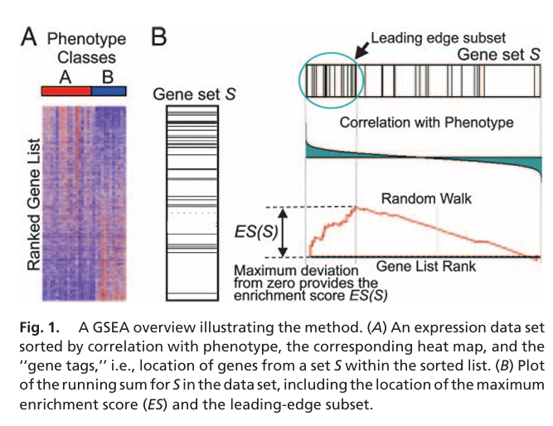
Analysis process
Remove genes with a value of 0
Rank the genes according to Shapley values
ORA(cutoff:top50)
GSEA
*Over-Representation Analysis(ORA)
*Gene Set Enrichment Analysis(GSEA)
(Khatri et al., 2012)
(Subramanian et al., 2005)
Notes:
附註全名

Slide 6
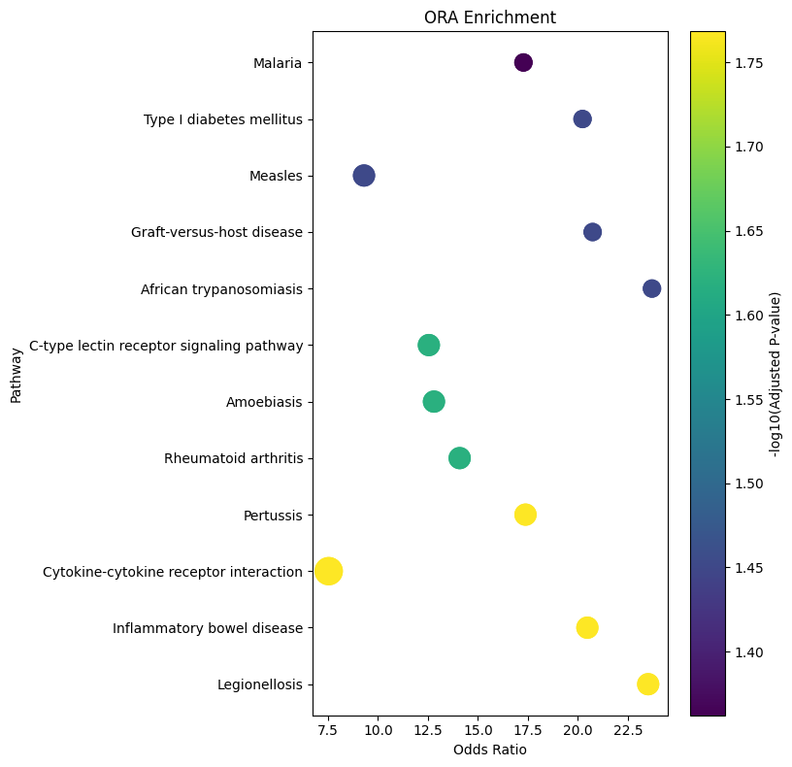
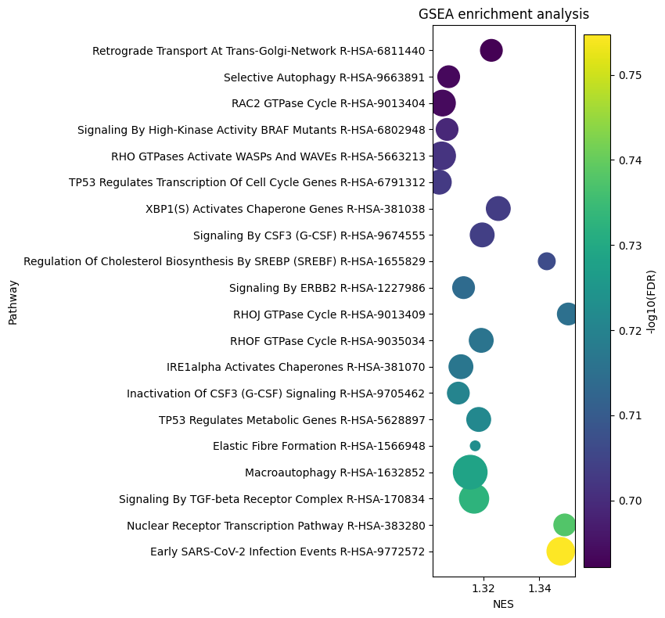
Current results(RF)
 | Alphaviridae | Coronaviridae | Flaviviridae | Orthoherpesviridae | Orthomyxoviridae | Picornaviridae | Reoviridae | Retroviridae
KEGG |  |  |  |  |  |  |  | 
Reactome | ▲ |  | ▲ |  |  | ▲ | ▲ | 
GO |  | ▲ | ▲ | ▲ |  |  | ▲ | ▲
MSigDB |  |  |  |  |  | ▲ |  | 
WikiPathways | ▲ |  |  |  |  | ▲ | ▲ | 
Not all virus families have exploitable pathways
None of the path significance levels are high

Slide 7
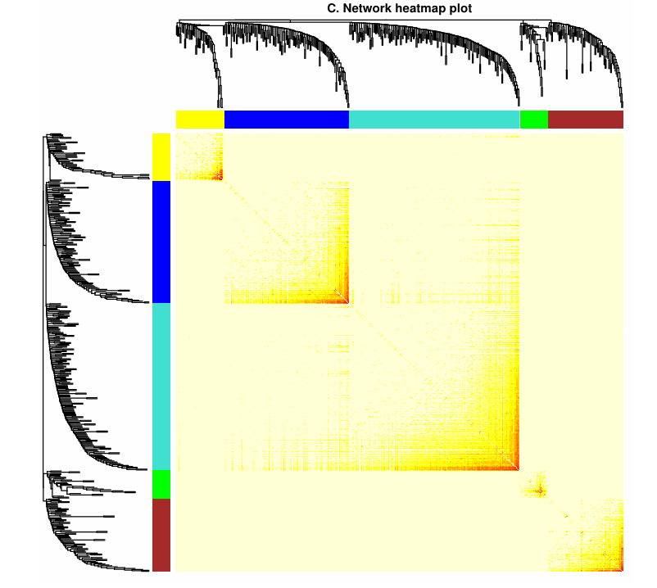
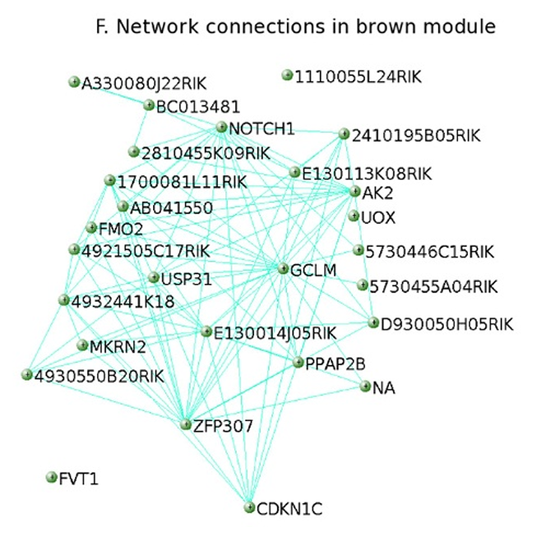
Literature Review
Identify the network relationships between genes.
WGCNA (Langfelder & Horvath BMC Bioinf 2008)
WGCNA (Langfelder & Horvath BMC Bioinf 2008)

Slide 8
Aim 2

Slide 9
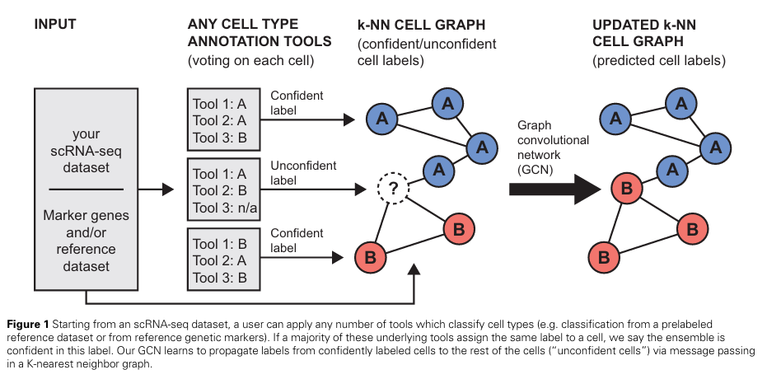
Literature Review
Predict unknown cells using existing gene expression data and some known cell labels.
scSHARP (Lewinsohn et al. Bioinformatics 2023)

Slide 10
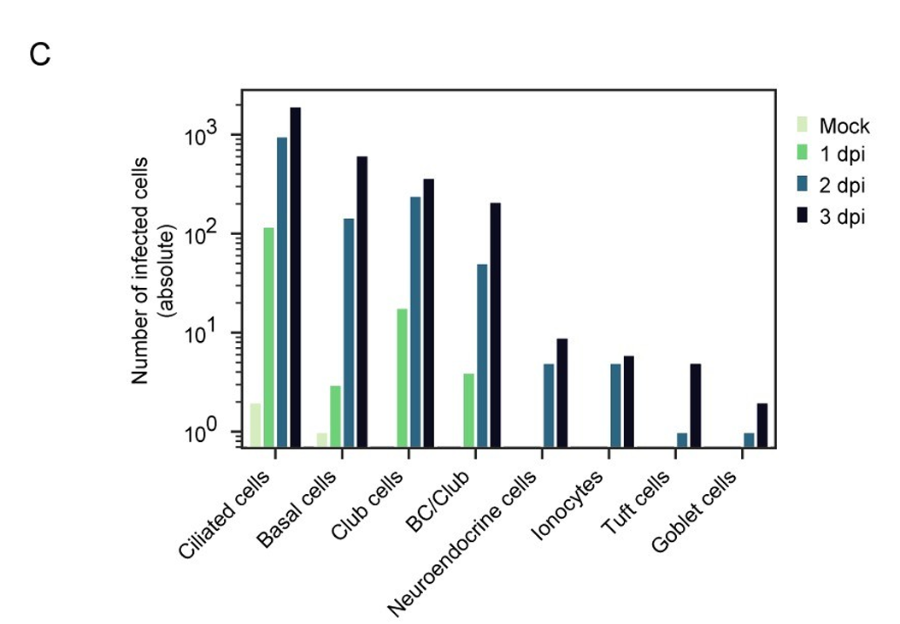
Preliminary Data Exploration
Examine the distribution of transcript counts across cells
Select cells with high-confidence labels
Perform feature dimensionality reduction using highly variable genes
SARS-CoV-2 airway scRNA-seq analysis (Ravindra et al. PLoS Biology 2021)
Notes:
Dataset:
/home/bits_home02/nigelyeh/scRNAseq_data/Ravindra2021/GEM_processed/Ravindra2021.raw_count.stdprep.h5ad

Slide 11
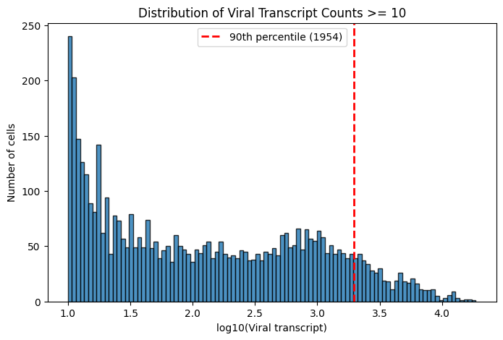
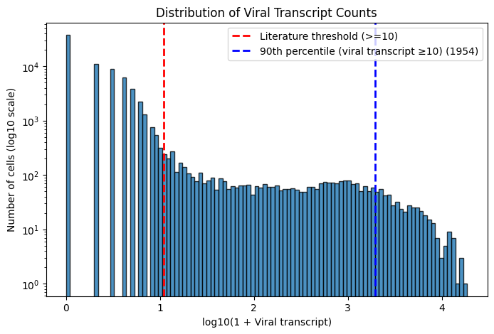
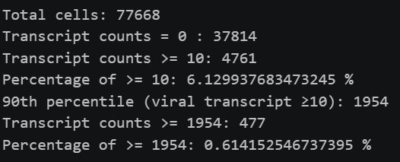
Preliminary Data Exploration
The problem of data imbalance
The number of features (genes) is too large
Split training and testting sets

Slide 12
Future work
Aim 1:
Re-analyze after removing non-coding gene
Applying WGCNA to identify gene networks
Aim 2:
Obtain the adjacency matrix using KNN and feed it into the GCN model.
GCN (Kipf & Welling ICLR 2017)
*K Nearest Neighbor (KNN)

