Slide 1
Progress Report
Aim1
07.23

Slide 2
Dataset for analysis
Dataset:
/home/bits_home02/nigelyeh/virusML/results_woControl/shap
/home/bits_home02/nigelyeh/virusML/results_woControl.immune_v1/shap
Virus families:
Alphaviridae, Coronaviridae, Flaviviridae, Orthoherpesviridae, Orthomyxoviridae, Picornaviridae, Reoviridae, Retroviridae
Data.columns:
'Gene', 'RF_mean_abs_Score', 'XGB_mean_abs_Score', 'RF_median_abs_Score', 'XGB_median_abs_Score', 'RF_Rank_byMean', 'XGB_Rank_byMean', 'RF_Rank_byMedian', 'XGB_Rank_byMedian', 'Avg_Rank_byMean', 'Avg_Rank_byMedian’

Slide 3
Aim
Conducting downstream analysis—such as enrichment analysis—on the gene sets already identified by the machine learning model
Assigning biological significance to the features learned by the model ?

Slide 4
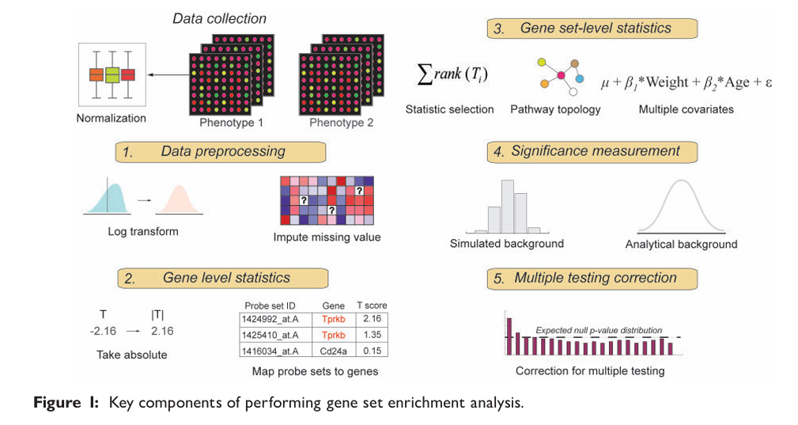
Enrichment analysis
(Hung et al., 2011)

Slide 5
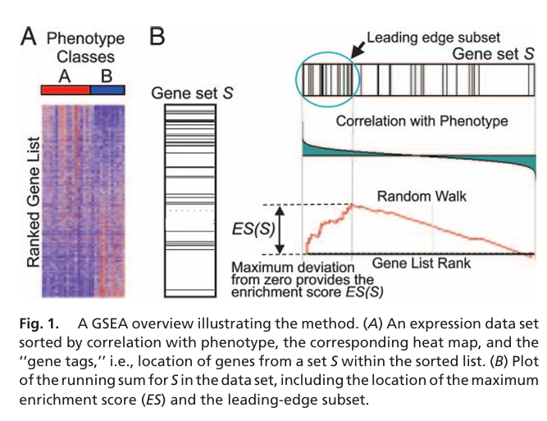
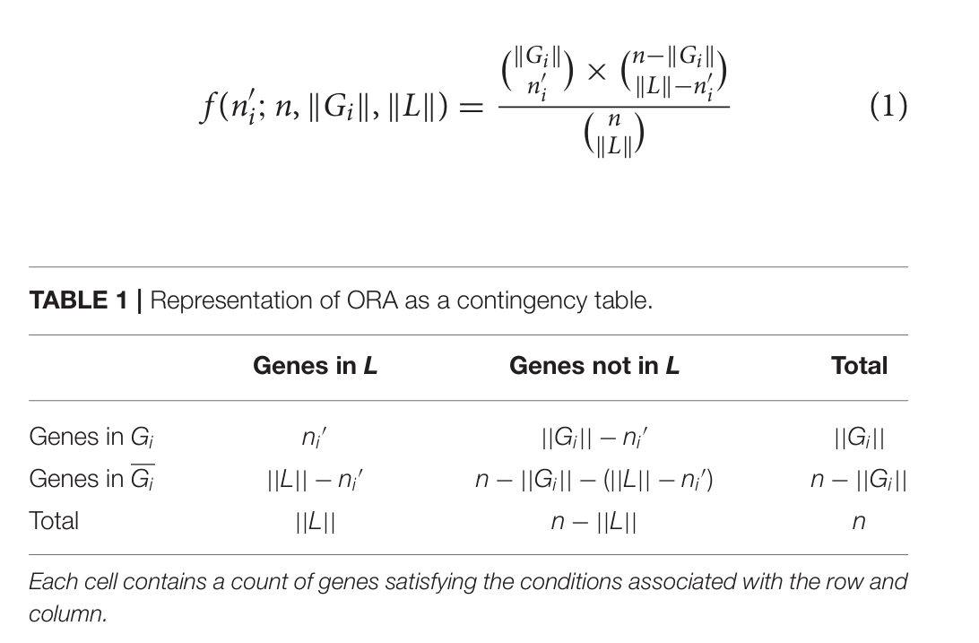
ORA & GSEA
(Khatri et al., 2012)
(Subramanian et al., 2005)

Slide 6
Biological pathways databases
Database | Description
Kyoto Encyclopedia of Genes and Genomes | A database for biological pathways, molecular interactions, and disease mechanisms
Reactome | A curated database of biological pathways and molecular reaction events
Gene Ontology Biological Process | A database that annotates genes according to biological processes
MSigDB Hallmark Gene Sets | A collection of representative gene sets describing major biological states and cellular processes
WikiPathways | A community-curated database of biological pathways

Slide 7
Analysis process (1)
Remove genes with a value of 0
Rank the genes according to Shapley values
ORA(cutoff:top50)
GSEA

Slide 8
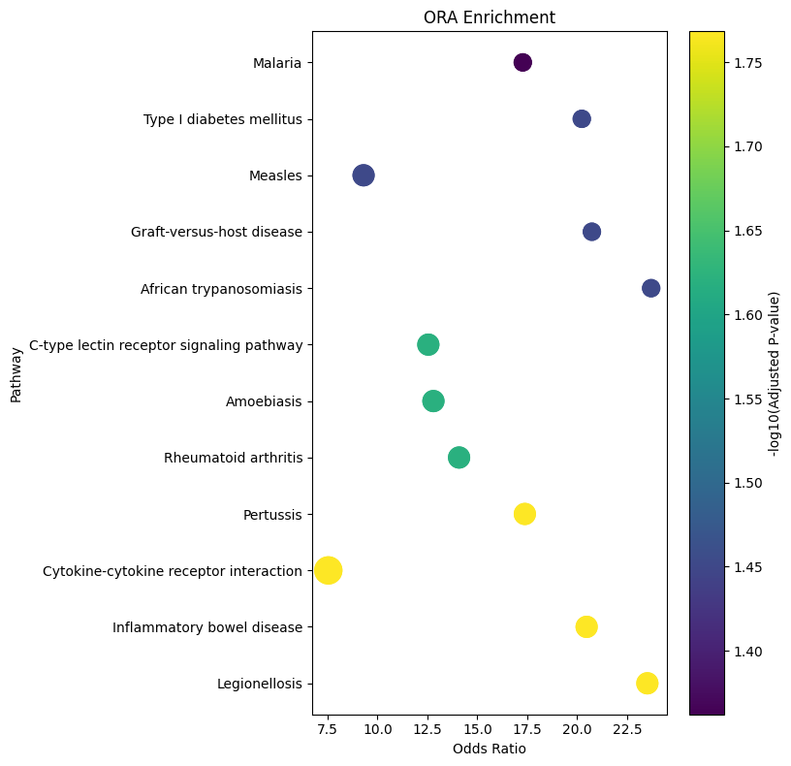
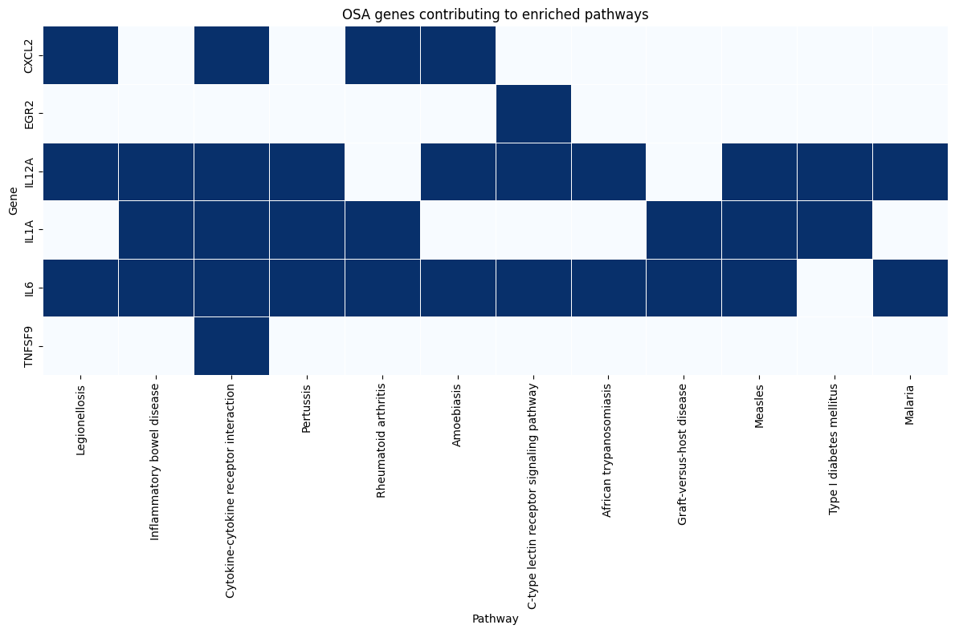
Example of ORA result
Database:
KEGG
Virus family:
Retroviridae

Slide 9
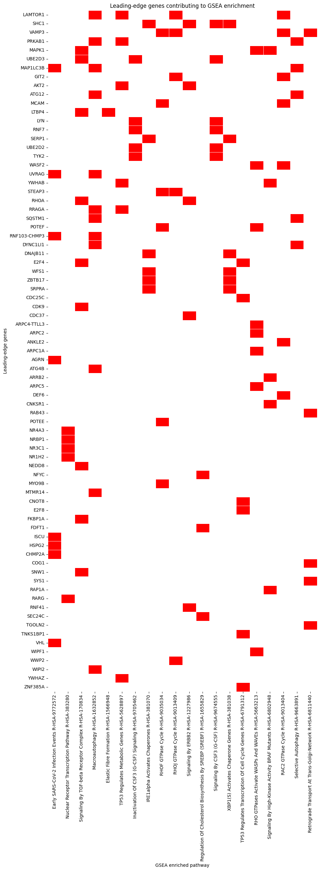
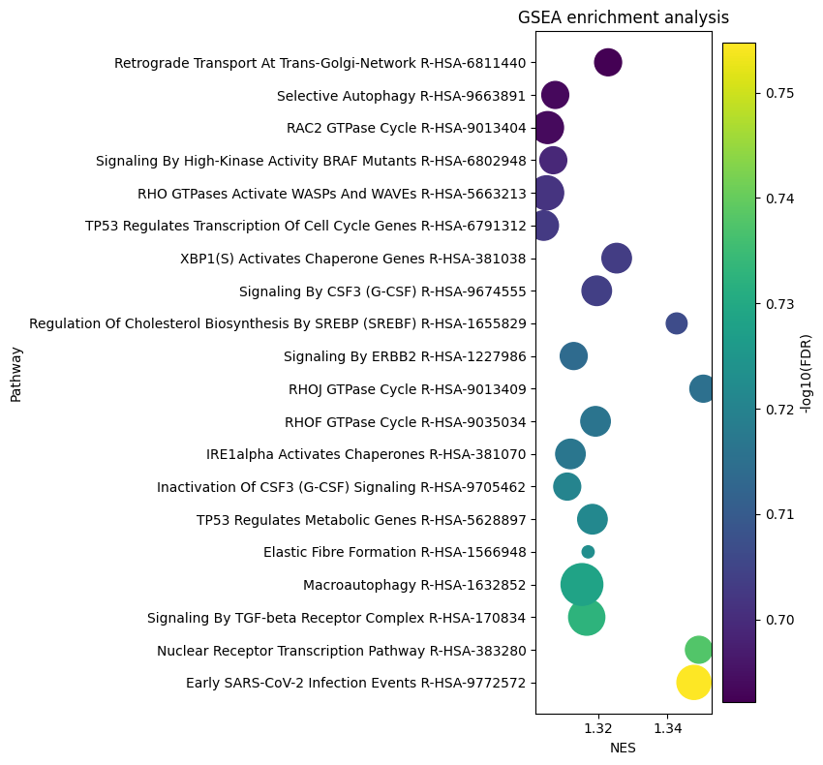
Example of GSEA result
Database:
Reactome
Virus family:
Picornaviridae

Slide 10
Purpose of analysis process (1)
Identify pathways for further exploration
Infer the biological processes in which pathways may jointly participate based on the genes shared between them

Slide 11
Analysis process (2)
ORA
GSEA
Simultaneously significant pathways
Features learned by the model and their potential biological significance

Slide 12
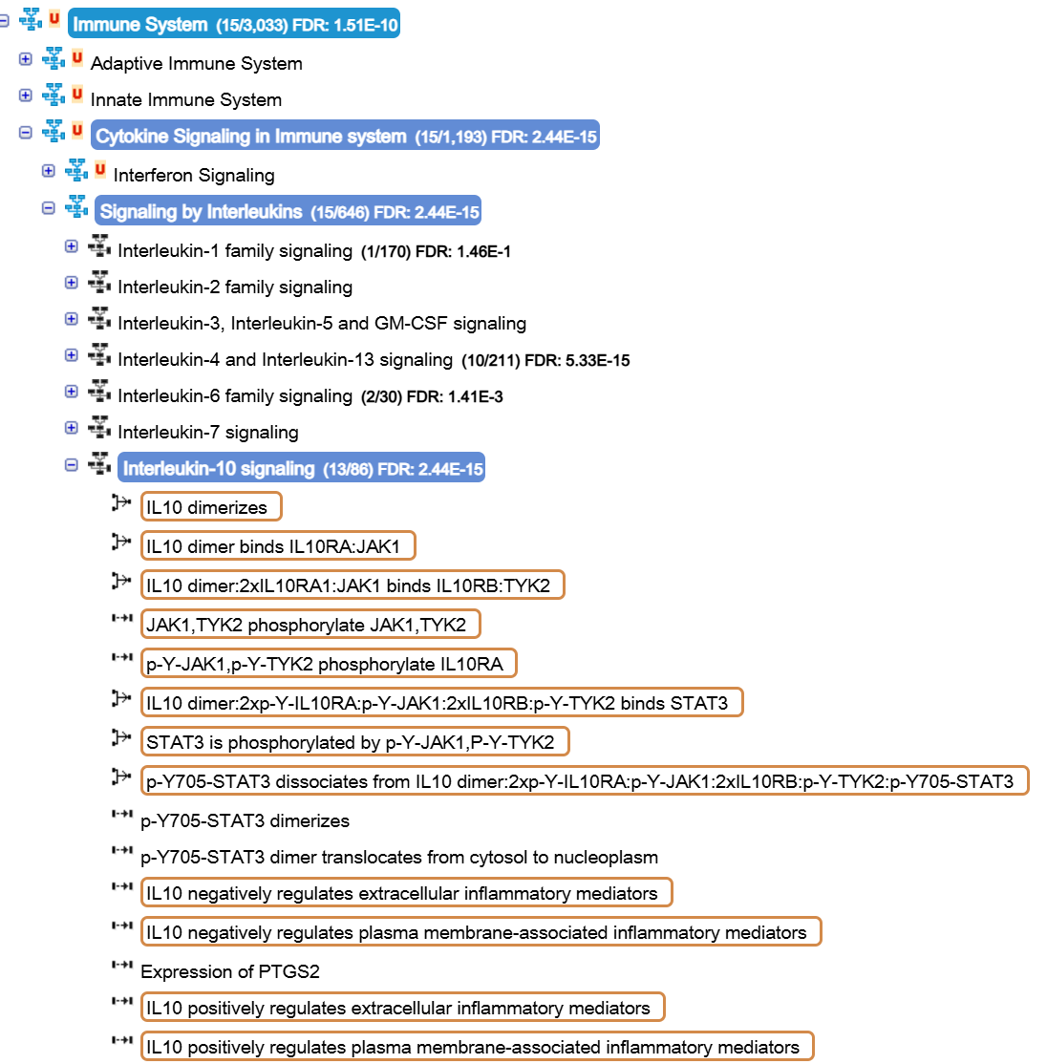
Example of biological significance
Database:
Reactome
Virus family:
Retroviridae
IL-10 signaling is an important immunoregulatory pathway that suppresses excessive inflammatory responses by inhibiting antigen-presenting cell activation and reducing pro-inflammatory cytokine production. Upon IL-10 receptor activation, JAK1/TYK2-mediated phosphorylation activates STAT3, which regulates downstream anti-inflammatory gene expression.

Slide 13
Problem of analysis process (2)
 | Alphaviridae | Coronaviridae | Flaviviridae | Orthoherpesviridae | Orthomyxoviridae | Picornaviridae | Reoviridae | Retroviridae
KEGG |  |  |  |  |  |  |  | 7
Reactome | GSEA |  | GSEA |  |  | GSEA | GSEA | 1
GO |  | OSA/GSEA | GSEA | OSA |  | 1 | OSA/GSEA | GSEA
MSigDB |  |  |  |  |  | GSEA |  | 1
WikiPathways | GSEA |  |  |  |  | GSEA | OSA/GSEA | 8

Slide 14
Problem of analysis process (2)
The gene set of Orthomyxoviridae is not enriched in any pathway
The majority of statistically significant results are concentrated in the gene set of Retroviridae
There are too many significantly enriched pathways in common, making it uncertain which one best reflects the biological significance

Slide 15
Future work
The XGBoost analysis for the dataset also needs to be completed
Systematically analyze the biological significance of the pathway
Identify the reasons why an analysis might be significant in only one instance or completely non-significant

