Slide 1
Research Progress and Future Work
08.20

Slide 2
Aim 2

Slide 3
Data information
Ravindra2021:
RNA raw count data comprising 77,668 cells and 33,539 genes.
Key fields:
‘pmito’, ‘n_genes’, ‘Viral_transcript’, ‘Condition’,

Slide 4


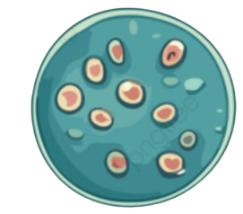

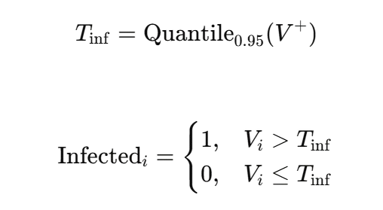


Data preprocessing
Quality Control
Cells with high-confidence labels
Pmito < 0.2
n_genes > 500
Condition != Mock
1707
Viral_transcript > Tinf
n_genes > 1000
7505
Viral_transcript = 0
n_genes > 1000
Condition = 1dpi
Min_cells= 10
* 42769 Unknown cell
Notes:
Image source : pngtree

Slide 5
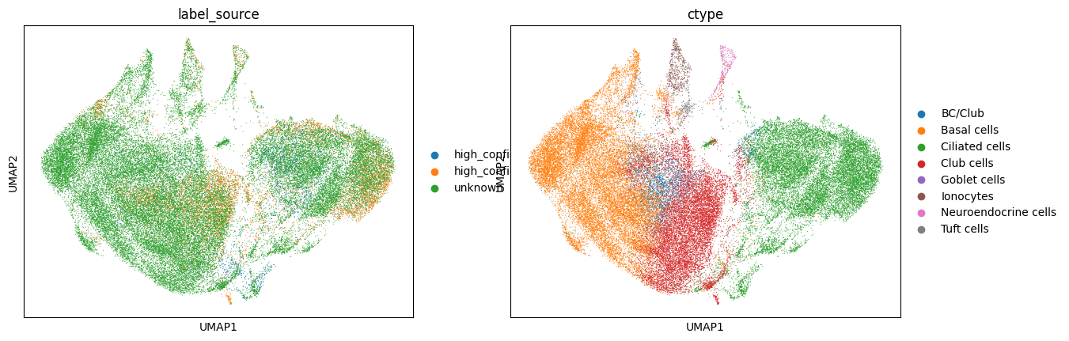
Topological relationships of cells
Select the top 3,000 highly variable genes
Performing clustering using PCA(n_comps = 50)
Cell type | Uninfected | Infected | Infection rate
BC/Club | 314 | 124 | 28.3%
Basal cells | 1357 | 167 | 11.0%
Ciliated cells | 3212 | 1219 | 27.5%
Club cells | 2443 | 193 | 7.3%
Goblet cells | 10 | 0 | 0%
Ionocytes | 76 | 2 | 2.6%
Neuroendocrine cells | 72 | 2 | 2.7%
Tuft cells | 21 | 0 | 0%
Construct a KNN graph(n_neighbors=15)
* P-value < 0.001
Notes:
確認3000個基因是不是都有包含virus gene(可能有confounding)(不太確定 原始檔案沒有基因的annotation)

Slide 6
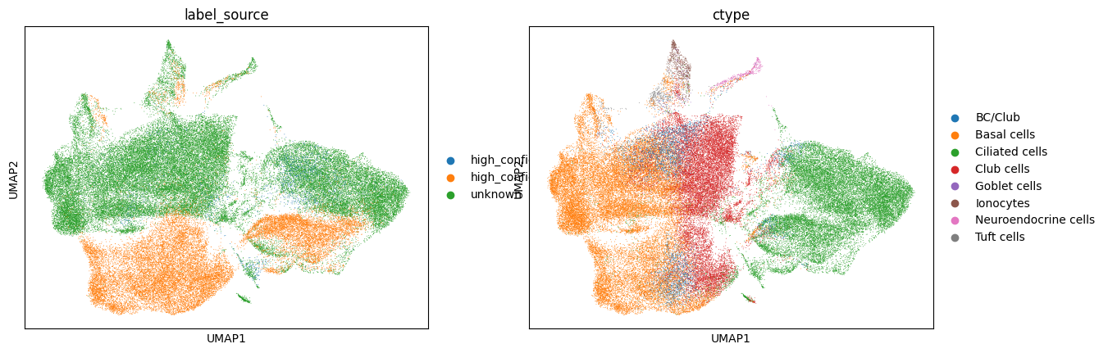
Topological relationships of cells
Done before the discussion on August 6th
Select the top 3,000 highly variable genes
Performing clustering using PCA(n_comps = 50)
Cell type | Uninfected | Infected | Infection rate
BC/Club | 1521 | 124 | 7.5%
Basal cells | 9549 | 169 | 1.7%
Ciliated cells | 6208 | 1222 | 16.4%
Club cells | 4493 | 194 | 4.1%
Goblet cells | 43 | 0 | 0%
Ionocytes | 123 | 2 | 1.6%
Neuroendocrine cells | 74 | 2 | 2.6%
Tuft cells | 69 | 0 | 0%
Construct a KNN graph(n_neighbors=15)
* P-value < 0.001
Notes:
確認3000個基因是不是都有包含virus gene(可能有confounding)(不太確定 原始檔案沒有基因的annotation)

Slide 7
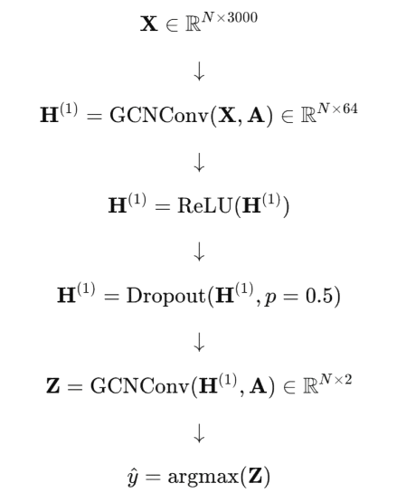
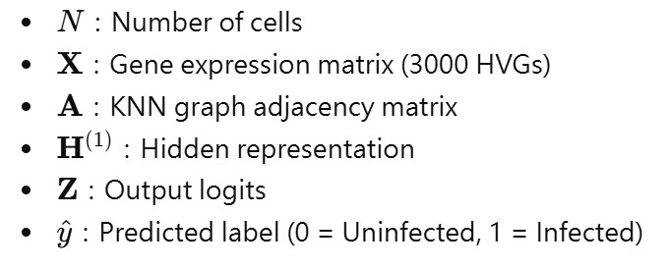

GCN model
All cells
Labeled cells
Stratified Split 80% / 20%
Unknown cells
Train / validation
GCN model
Predict unknown cells
GCN (Kipf & Welling ICLR 2017)
Notes:
other ml

Slide 8
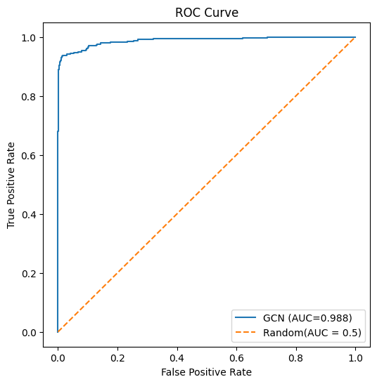
GCN results
Confusion matrix | Predicted Uninfected | Predicted Infected
True Uninfected | 1492 | 9
True Infected | 32 | 310
* PR-AUC = 0.9882
Class | Description | Precision | Recall | F1-score | Support
0 | Uninfected | 0.98 | 0.99 | 0.99 | 1501
1 | Infected | 0.97 | 0.91 | 0.94 | 342
Overall | Accuracy |  |  | 0.98 | 1843
Overall | Macro average | 0.98 | 0.95 | 0.96 | 1843
Overall | Weighted average | 0.98 | 0.98 | 0.98 | 1843

Slide 9

GCN results
Done before the discussion on August 6th
Confusion matrix | Predicted Uninfected | Predicted Infected
True Uninfected | 4411 | 5
True Infected | 9 | 334
* PR-AUC = 0.998
Class | Description | Precision | Recall | F1-score | Support
0 | Uninfected | 1.00 | 1.00 | 1.00 | 4,416
1 | Infected | 0.99 | 0.97 | 0.98 | 343
Overall | Accuracy |  |  | 1.00 | 4,759
Overall | Macro average | 0.99 | 0.99 | 0.99 | 4,759
Overall | Weighted average | 1.00 | 1.00 | 1.00 | 4,759

Slide 10
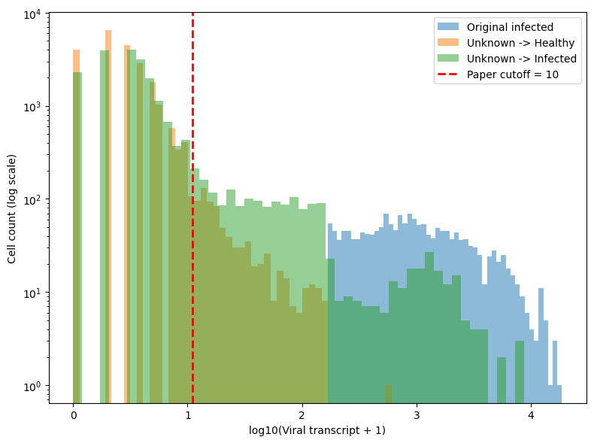
GCN results(2)
Unknown → Infected: 19823
cells Viral transcript < 10: 18001
cells Percentage: 90.81%
0: 2289
1~9: 15712

Slide 11
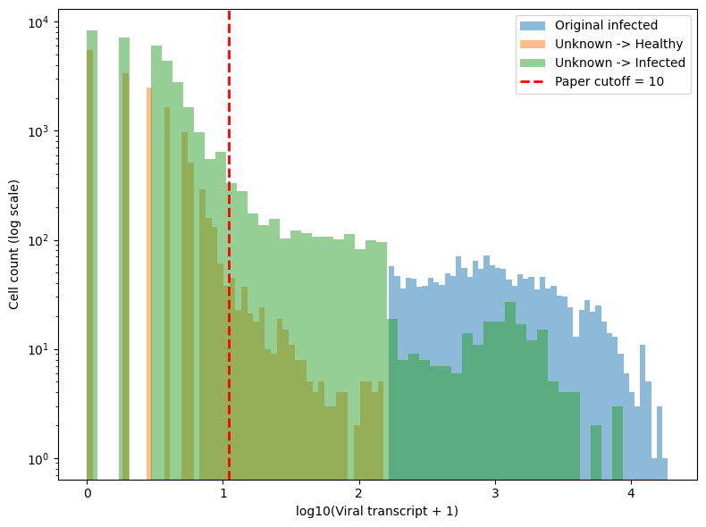
GCN results(2)
Done before the discussion on August 6th
Unknown → Infected: 34822
cells Viral transcript < 10: 32485
cells Percentage: 93.29%
0: 8349
1~9: 24136

Slide 12
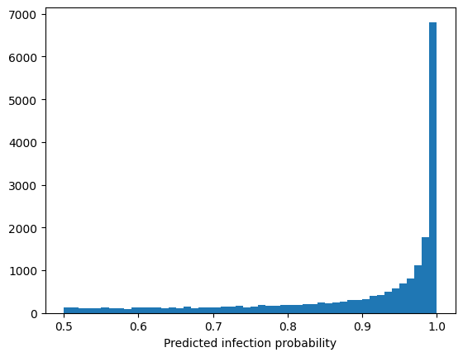
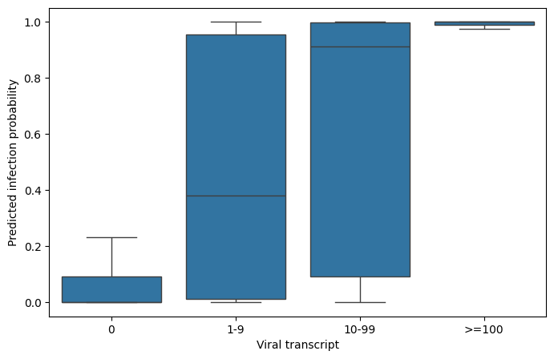
GCN results(3)
* The cutoff selected in the paper actually makes a lot of sense.
* The model is highly confident in its classification results.
Notes:
1 ~ 9要去看生物意義

Slide 13
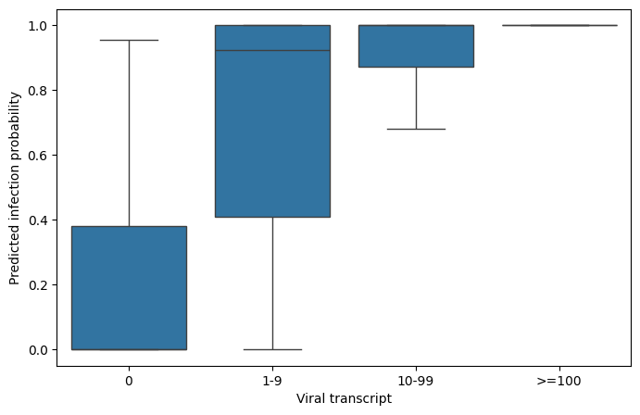
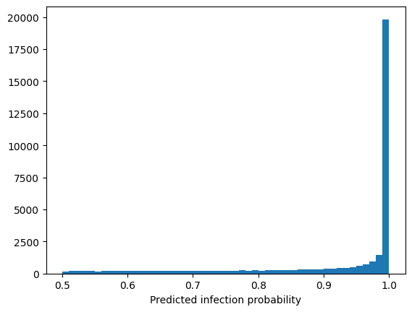
GCN results(3)
Done before the discussion on August 6th
* The original literature would overlook a significant proportion of infected cells.
* The model is highly confident in its classification results.
Notes:
1 ~ 9要去看生物意義

Slide 14
Infection and Cell Type
Cells with high-confidence labels
Cells with unknown labels
Cell type | Uninfected | Infected | Infection rate
BC/Club | 314 | 124 | 28.3%
Basal cells | 1357 | 167 | 11.0%
Ciliated cells | 3212 | 1219 | 27.5%
Club cells | 2443 | 193 | 7.3%
Goblet cells | 10 | 0 | 0%
Ionocytes | 76 | 2 | 2.6%
Neuroendocrine cells | 72 | 2 | 2.7%
Tuft cells | 21 | 0 | 0%
Cell type | Uninfected | Infected | Infection rate
BC/Club | 876 | 1160 | 56.9%
Basal cells | 7823 | 10137 | 56.4%
Ciliated cells | 6190 | 5764 | 48.2%
Club cells | 7151 | 2707 | 27.4%
Goblet cells | 47 | 17 | 26.5%
Ionocytes | 427 | 27 | 5.9%
Neuroendocrine cells | 225 | 2 | 4.1%
Tuft cells | 207 | 9 | 0.8%
* P-value < 0.001

Slide 15
Infection and Cell Type
Done before the discussion on August 6th
Cells with high-confidence labels
Cells with unknown labels
Cell type | Uninfected | Infected | Infection rate
BC/Club | 1521 | 124 | 7.5%
Basal cells | 9549 | 169 | 1.7%
Ciliated cells | 6208 | 1222 | 16.4%
Club cells | 4493 | 194 | 4.1%
Goblet cells | 43 | 0 | 0%
Ionocytes | 123 | 2 | 1.6%
Neuroendocrine cells | 74 | 2 | 2.6%
Tuft cells | 69 | 0 | 0%
Cell type | Uninfected | Infected | Infection rate
BC/Club | 145 | 2,206 | 93.8%
Basal cells | 6,439 | 12,891 | 66.7%
Ciliated cells | 2,794 | 12,378 | 81.6%
Club cells | 5,261 | 7,041 | 57.2%
Goblet cells | 58 | 16 | 21.6%
Ionocytes | 472 | 58 | 10.9%
Neuroendocrine cells | 106 | 193 | 64.5%
Tuft cells | 198 | 39 | 16.5%
* P-value < 0.001
Notes:
為什麼判斷完的infection比例會那麼高，訓練前後每個cell type在感染上都大幅提升

Slide 16
Logistics regression
Confusion matrix | Predicted Uninfected | Predicted Infected
True Uninfected | 1501 | 0
True Infected | 2 | 340
* PR-AUC = 0.9992
Class | Description | Precision | Recall | F1-score | Support
0 | Uninfected | 1.00 | 1.00 | 1.00 | 1501
1 | Infected | 1.00 | 0.99 | 1.00 | 342
Overall | Accuracy |  |  | 1.00 | 1843
Overall | Macro average | 1.00 | 1.00 | 1.00 | 1843
Overall | Weighted average | 1.00 | 1.00 | 1.00 | 1843

Slide 17
GCN vs Logistics regression
Cells with unknown labels of GCN
Cells with unknown labels of GCN
Cell type | Uninfected | Infected | Infection rate
BC/Club | 876 | 1160 | 56.9%
Basal cells | 7823 | 10137 | 56.4%
Ciliated cells | 6190 | 5764 | 48.2%
Club cells | 7151 | 2707 | 27.4%
Goblet cells | 47 | 17 | 26.5%
Ionocytes | 427 | 27 | 5.9%
Neuroendocrine cells | 225 | 2 | 4.1%
Tuft cells | 207 | 9 | 0.8%
Cell type | Uninfected | Infected | Infection rate
BC/Club | 875 | 1161 | 57.0%
Basal cells | 4097 | 13863 | 77.1%
Ciliated cells | 6403 | 5551 | 46.4%
Club cells | 6429 | 3429 | 34.7%
Goblet cells | 43 | 21 | 32.8%
Ionocytes | 321 | 133 | 29.2%
Neuroendocrine cells | 173 | 54 | 23.7%
Tuft cells | 145 | 71 | 32.8%
* P-value < 0.001

Slide 18
GCN vs Logistics regression
GCN \ Logistic | Logistic = 0 | Logistic = 1 | Total
GCN = 0 | 16,523 | 6,423 | 22,946
GCN = 1 | 1,963 | 17,860 | 19,823
Total | 18,486 | 24,283 | 42,769
* Disagreement rate = 19.6

Slide 19
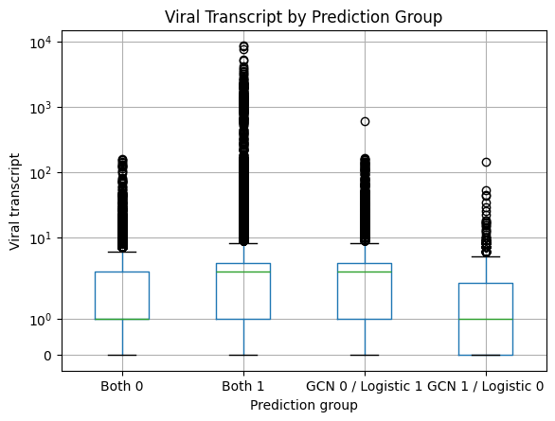
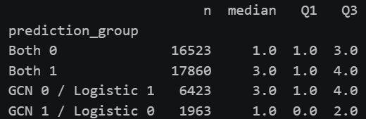
GCN vs Logistics regression
* The criterion used by GCN to determine whether a cell is infected—based on the abundance of viral transcripts—is quite peculiar.

Slide 20
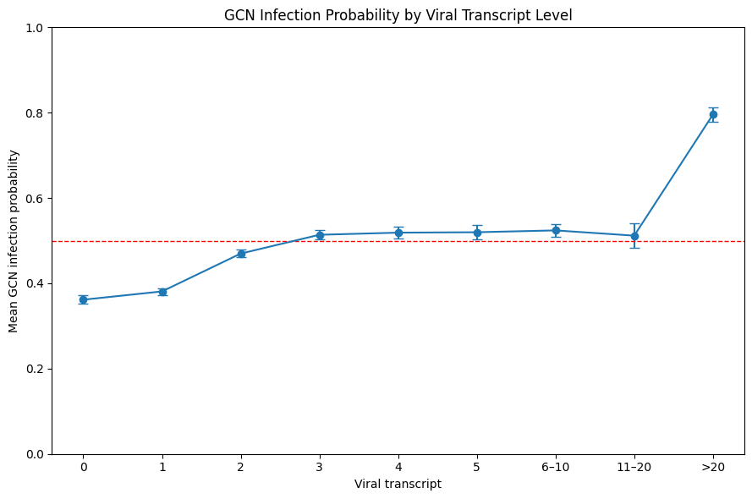
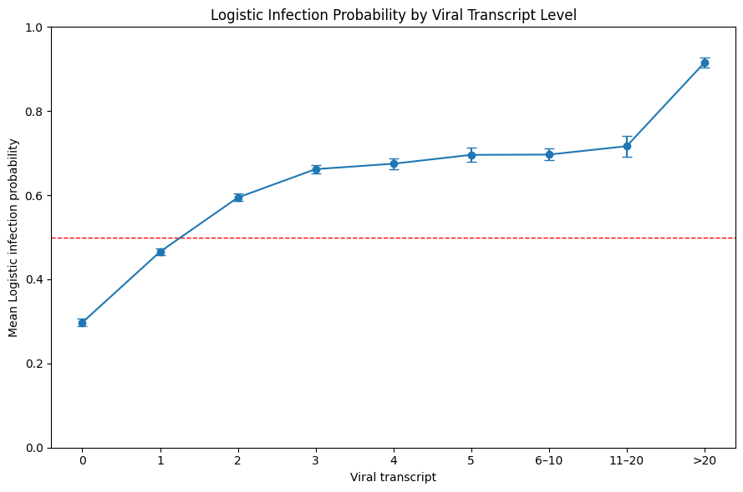
GCN vs Logistics regression

Slide 21
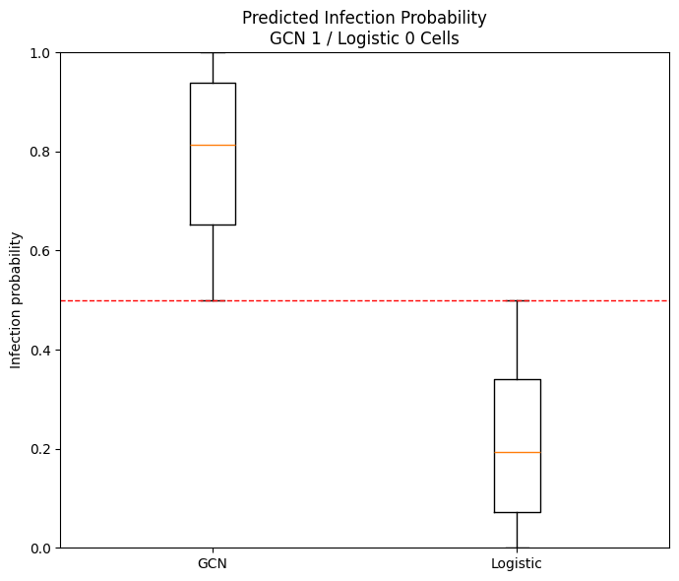

GCN vs Logistics regression
* For this set of cells (GCN1/Logistic0), the probabilities output of the two models are also different.

Slide 22
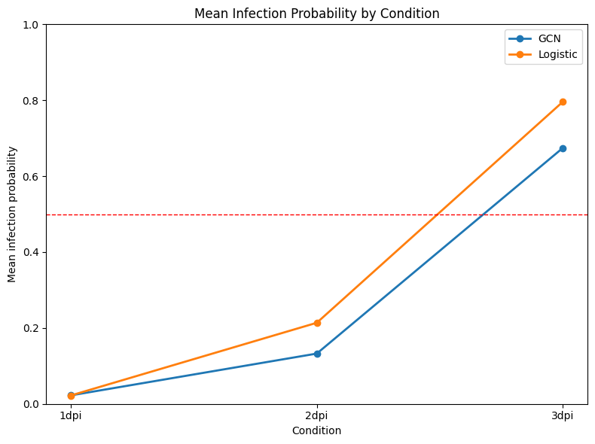
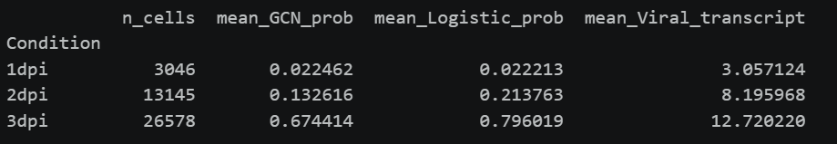
GCN vs Logistics regression
As the duration of infection increases, the number of viral transcripts in the cells rises, making them more likely to be classified as infected; both models exhibit the same trend.

Slide 23
Future works
Synthesize the results of Aim 1 and assign easily interpretable biological significance to each biological pathway.
Consolidate current progress and the results of various trial-and-error efforts into a summer program completion presentation, and propose ideas for future expansion.

