Slide 1
Summer Program Completion Report
2026.08.26

Slide 2
Outline
Aim 1:
Conducting downstream analysis—such as enrichment analysis—on gene sets identified by machine learning models.
Aim 2:
Predict unknown cells using existing gene expression data and some known cell labels.
What I learned

Slide 3
Aim 1

Slide 4
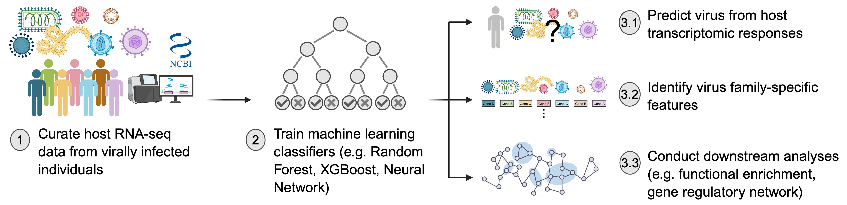
Previous work
Aim 1
Image source:Serina

Slide 5
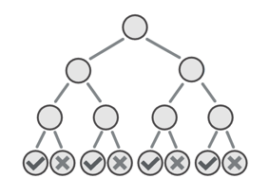



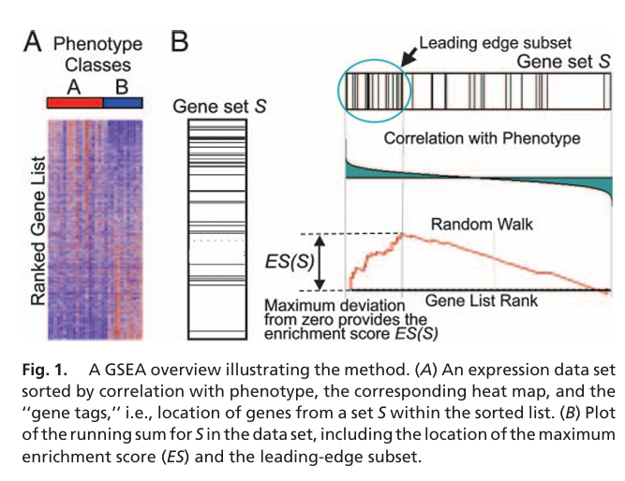
Enrichment Analysis
Aim 1
Conducting downstream analysis—such as enrichment analysis—on gene sets identified by machine learning models.
Remove genes with a value of 0
Rank the genes according to Shapley values
0.9 | 0.5 | 0
Gene Set Enrichment Analysis(GSEA)
Image source:pngtree
(Subramanian et al., 2005)
Notes:
圖片來源:pngtree
講immune gene是input

Slide 6
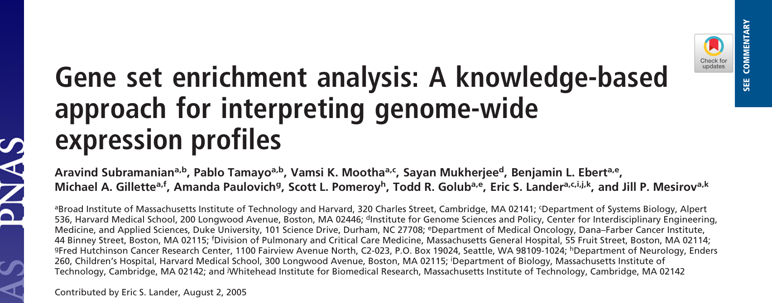
Gene Set Enrichment Analysis
Aim 1
(Subramanian et al., 2005)
Notes:
做gsea的原因

Slide 7
Why GSEA ?
Aim 1
No significant genes — Multiple testing + small biological effects
Too many significant genes — Difficult to identify a biological theme
Miss pathway-level effects — Genes often act together as a functional unit
Low reproducibility — Significant gene lists may show little overlap across studies
(Subramanian et al., 2005)
Notes:
做gsea的原因

Slide 8
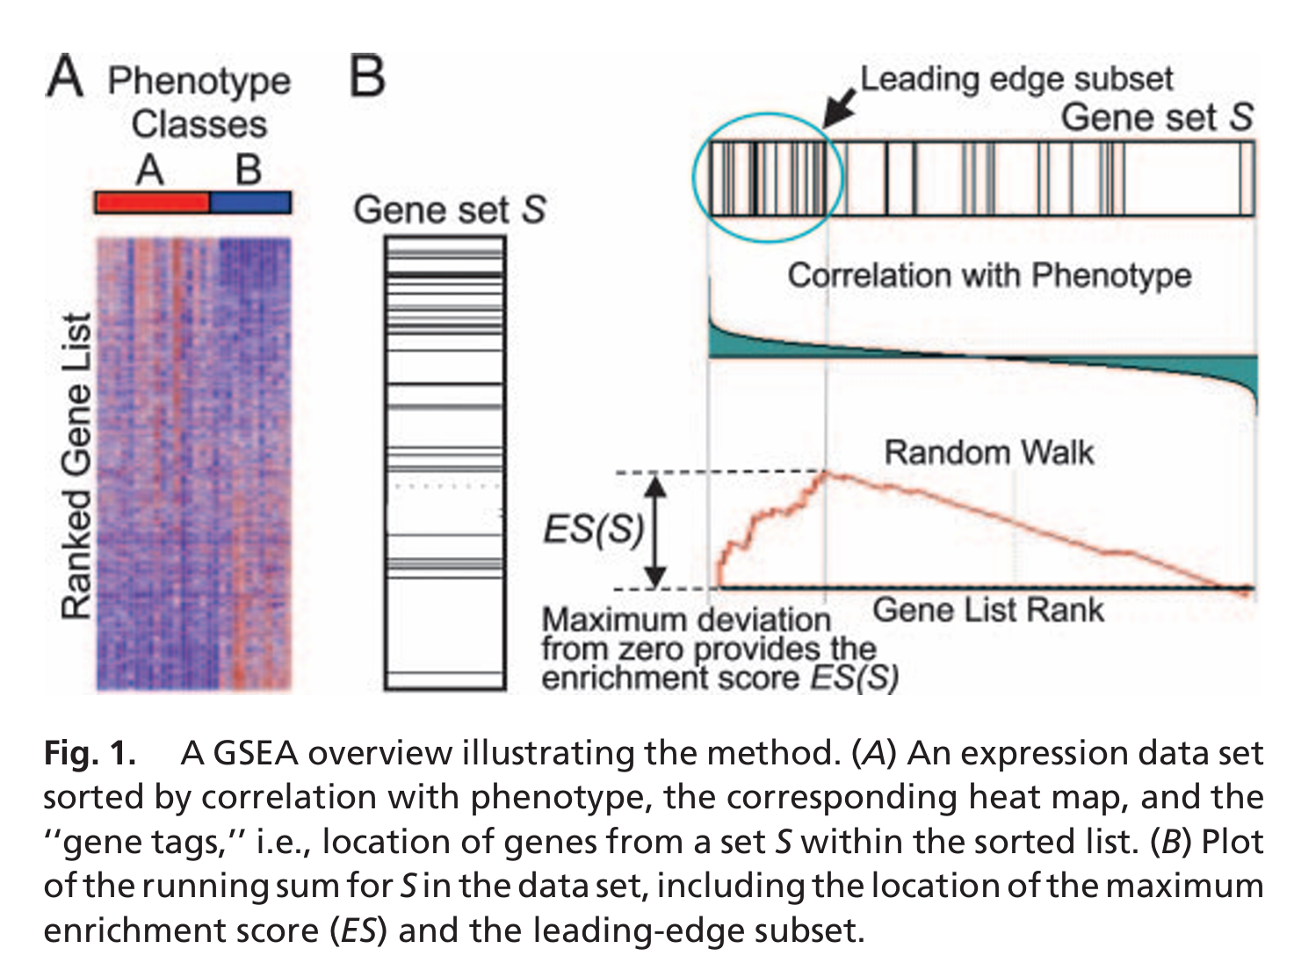
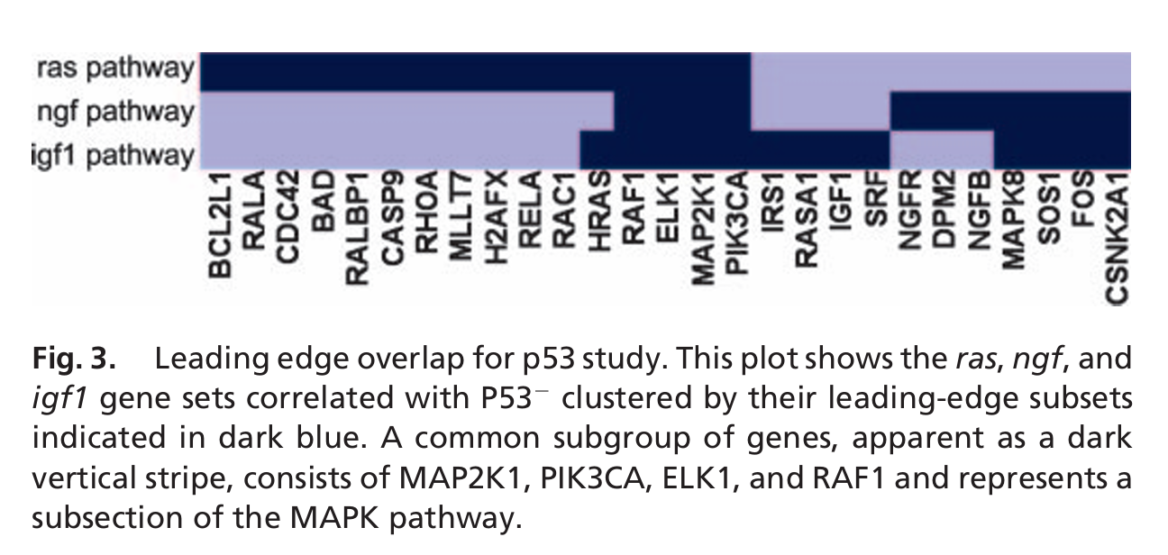
Gene Set Enrichment Analysis
Aim 1
(Subramanian et al., 2005)

Slide 9
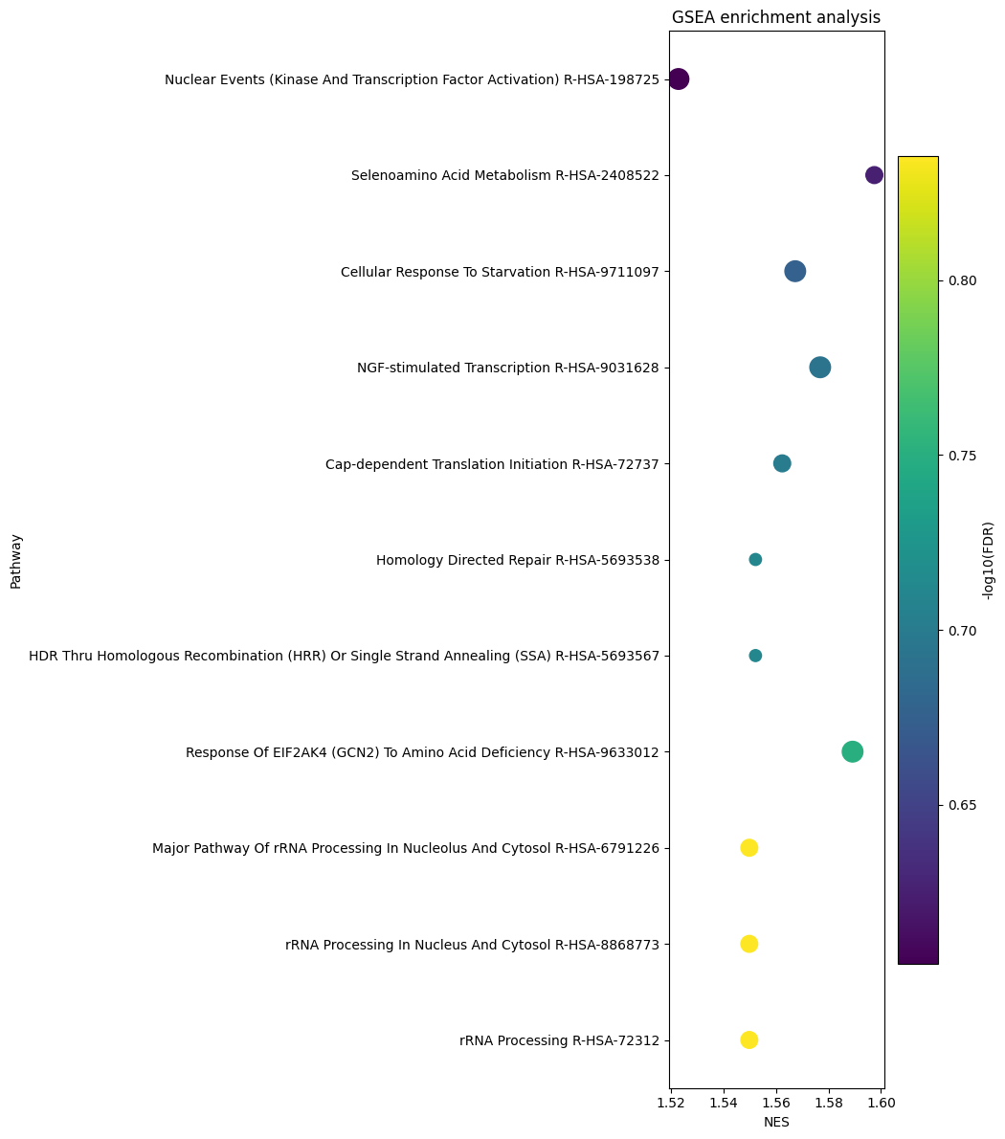
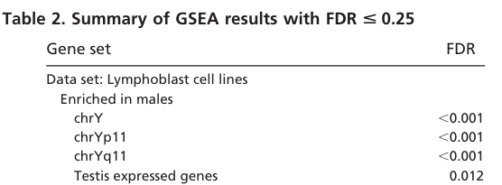
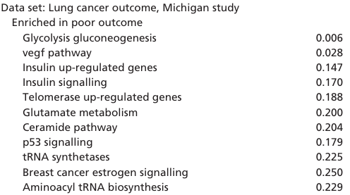
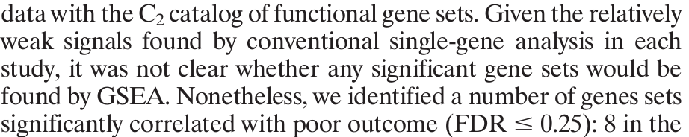
Enrichment results
Aim 1
Orthoherpesviridae
(Subramanian et al., 2005)
Notes:
Orthoherpesviridae : 水痘、帶狀皰疹
Reactome : 是一個開放原始碼（open-source）、開放存取（open access）、人工策展（manually curated）並經過同儕審查（peer-reviewed）的生物學 pathway 資料庫。

Slide 10
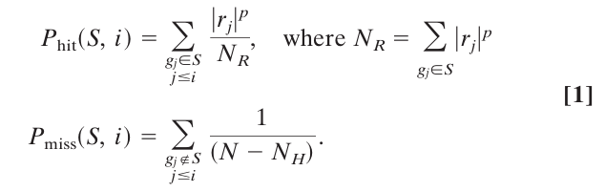
FDR warning
Aim 1
The permutation test in traditional GSEA
Is the gene set associated with the phenotype?
Permutation test for Aim 1
Is the gene-set associated with gene ranking?
(Subramanian et al., 2005)
Notes:
https://github.com/zqfang/GSEApy/blob/master/gseapy/algorithm.py

Slide 11
Current results(RF)
Aim 1
 | Alphaviridae | Coronaviridae | Flaviviridae | Orthoherpesviridae | Orthomyxoviridae | Picornaviridae | Reoviridae | Retroviridae
KEGG |  |  |  |  |  |  |  | 
Reactome |  |  |  |  |  |  |  | 
GO |  |  |  |  |  |  |  | 
MSigDB |  |  |  |  |  |  |  | 
WikiPathways |  |  |  |  |  |  |  | 
Notes:
Alphaviridae : 傳染性關節炎、腦炎、皮疹和發燒，透過病媒傳播
Coronaviridae : Sars、Covid
Orthomyxoviridae : 流感
KEGG : 日本於1995年制定的人類基因組計劃，此為關於基因、基因組、蛋白質、酶促反應以及生物化學物質的網絡資料庫。
GO : 是目前全球最大的基因功能資訊來源。這些資訊同時具有**人類可讀（human-readable）與機器可讀（machine-readable）的形式，因此能作為生物醫學研究中，大規模分子生物學與遺傳學實驗進行計算分析（computational analysis）**的重要基礎。

Slide 12
Alphaviridae(GO)
Aim 1
Pathway:
Regulation of viral entry into host cell
Definition:
Any process that modulates the frequency, rate or extent of the viral entry into the host cell
Image source:QuickGO
Notes:
圖片來源:https://www.ebi.ac.uk/QuickGO/GTerm?id=GO:0046596

Slide 13
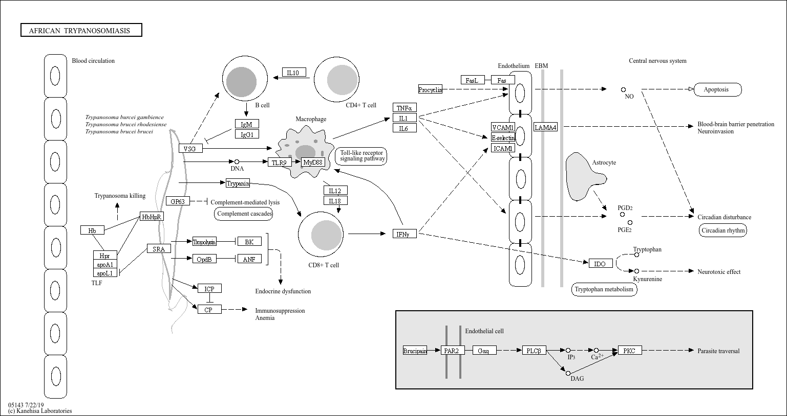
Coronaviridae(KEGG)
Aim 1
Pathway:
African trypanosomiasis
Description:
Trypanosoma brucei causes African trypanosomiasis (sleeping sickness) and is transmitted by tsetse flies. It can cross the blood-brain barrier and induce inflammatory cytokines such as TNF-α, IFN-γ, and IL-1, leading to neurological damage and disrupted sleep and circadian rhythms.
Image source:https://www.kegg.jp/pathway/map05143
Notes:
圖片來源:https://www.kegg.jp/pathway/map05143

Slide 14
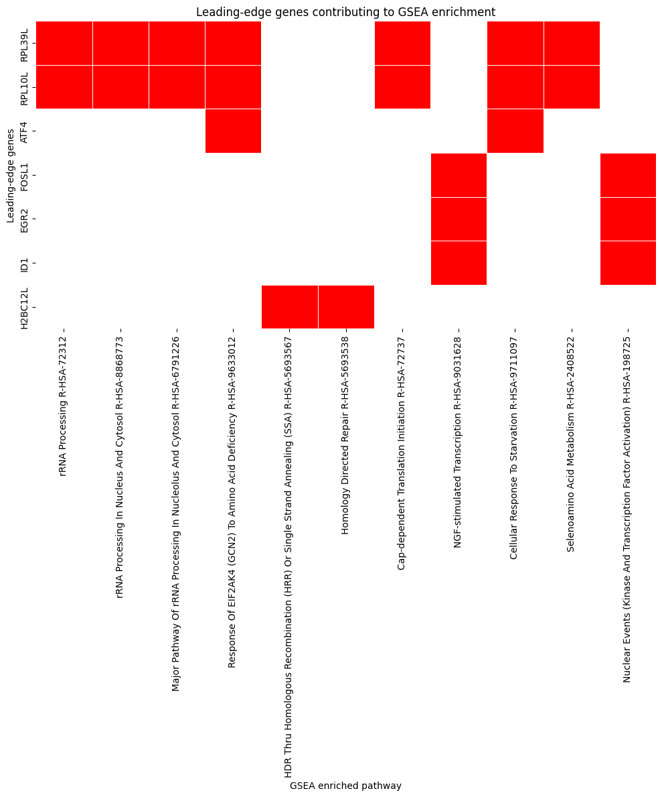
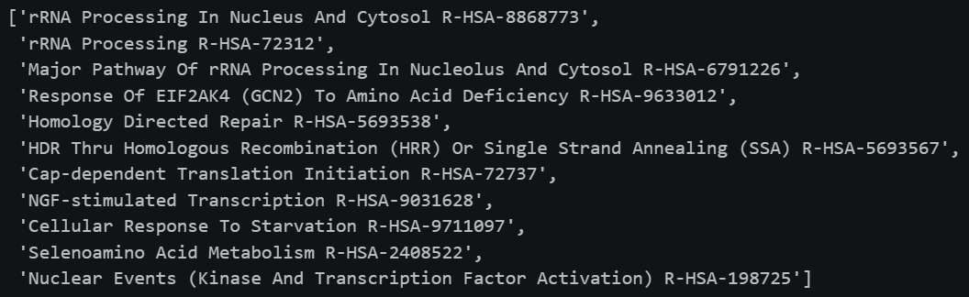
Orthoherpesviridae(Reactome)
Aim 1
Pathway:
Common leading_edge genes:
RPL10L and RPL39L are ribosomal protein paralogs whose specific biological functions remain unclear.
Notes:
資料來源:NCBI

Slide 15
Future work
Aim 1
The gene list needs to be reorganized to ensure the validity of the GSEA.
Evaluate the plausibility of the identified biological characteristics.
Notes:
資料來源:NCBI

Slide 16
Aim 2

Slide 17
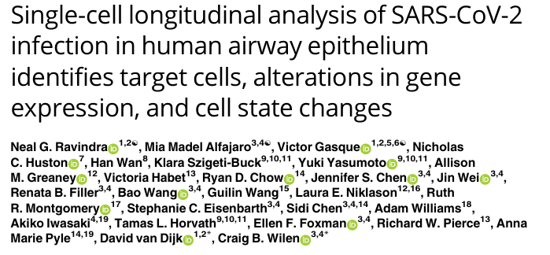
Previous work
Aim 2
Cell to cell communication
SARS-CoV-2 airway scRNA-seq analysis (Ravindra et al. PLoS Biology 2021)
Notes:
最終目標是要看感染細胞與未細胞之間的溝通

Slide 18
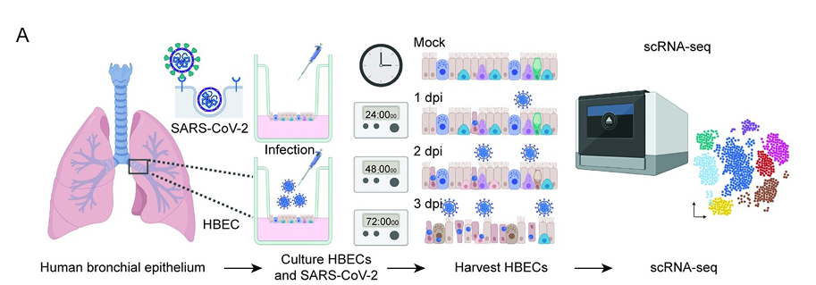
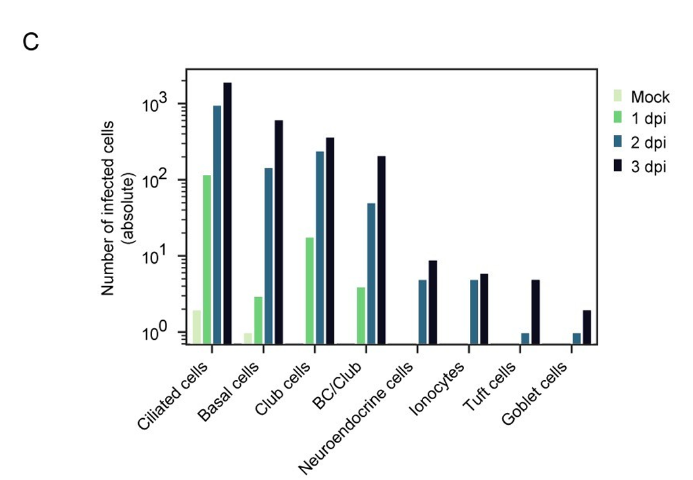
Previous work
Aim 2
SARS-CoV-2 airway scRNA-seq analysis (Ravindra et al. PLoS Biology 2021)

Slide 19
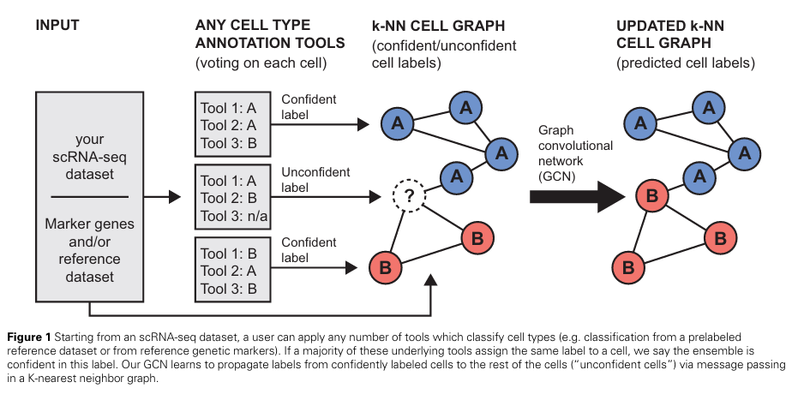

Literature Review
Aim 2
Predict unknown cells using existing gene expression data and some known cell labels.
Graph
Feature
GCN (Kipf & Welling ICLR 2017)
scSHARP (Lewinsohn et al. Bioinformatics 2023)

Slide 20




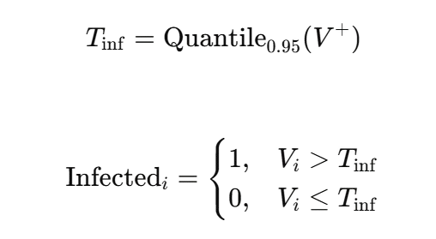


Data preprocessing
Aim 2
Quality Control
Cells with high-confidence labels
Pmito < 0.2
n_genes > 1000
Condition != Mock
1707
Viral_transcript > Tinf
7505
Viral_transcript = 0
Condition = 1dpi
Min_cells= 10
(Ravindra et al. PLoS Biology 2021)
* 42769 Unknown cell
Image source:pngtree
Notes:
Image source : pngtree

Slide 21
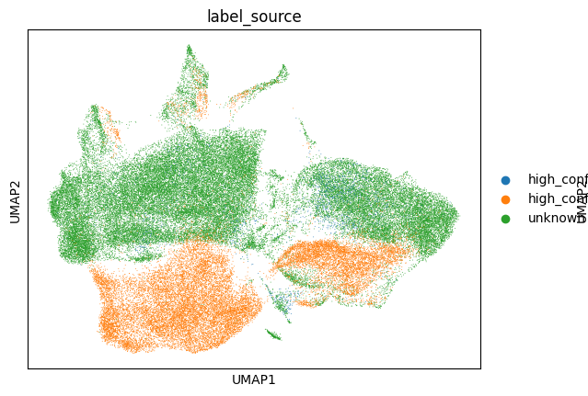
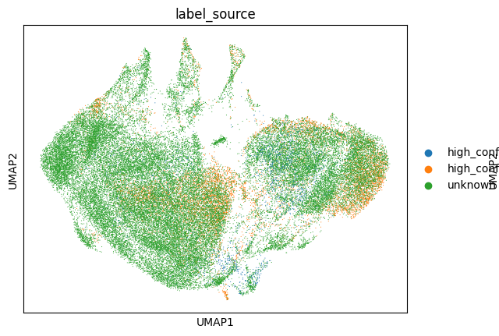
Topological relationships of cells
Aim 2
Select the top 3,000 highly variable genes
Performing clustering using PCA(n_comps = 50)
Construct a KNN graph(n_neighbors=15)

Slide 22
GCN model
Aim 2
All cells
Labeled cells
Stratified Split 80% / 20%
Unknown cells
Graph
Train / test
Feature
GCN model
GCN (Kipf & Welling ICLR 2017)
Predict unknown cells

Slide 23
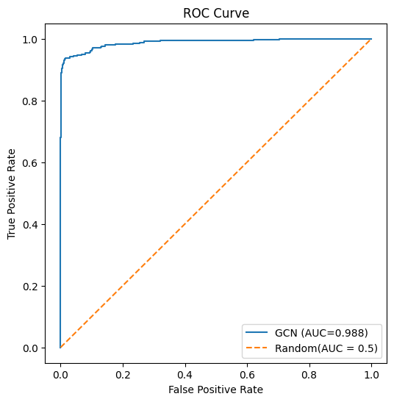
GCN results
Aim 2
Confusion matrix | Predicted Uninfected | Predicted Infected
True Uninfected | 1492 | 9
True Infected | 32 | 310
* PR-AUC = 0.9882
Class | Description | Precision | Recall | F1-score | Support
0 | Uninfected | 0.98 | 0.99 | 0.99 | 1501
1 | Infected | 0.97 | 0.91 | 0.94 | 342
Overall | Accuracy |  |  | 0.98 | 1843
Overall | Macro average | 0.98 | 0.95 | 0.96 | 1843
Overall | Weighted average | 0.98 | 0.98 | 0.98 | 1843

Slide 24
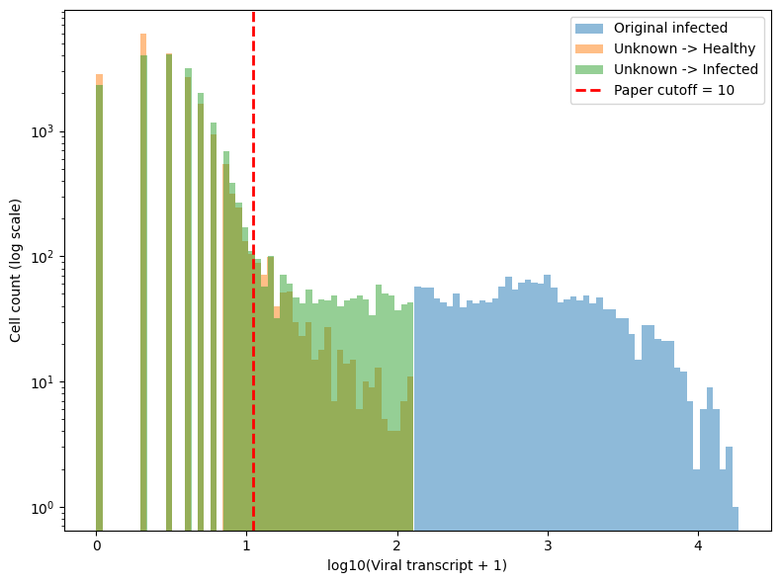
GCN results(2)
Aim 2
Unknown → Infected: 19823
cells Viral transcript < 10: 18001
cells Percentage: 90.81%
0: 2289
1~9: 15712

Slide 25
Infection and Cell Type
Aim 2
Cells with high-confidence labels
Cells with unknown labels
Cell type | Uninfected | Infected | Infection rate
BC/Club | 314 | 124 | 28.3%
Basal cells | 1357 | 167 | 11.0%
Ciliated cells | 3212 | 1219 | 27.5%
Club cells | 2443 | 193 | 7.3%
Goblet cells | 10 | 0 | 0%
Ionocytes | 76 | 2 | 2.6%
Neuroendocrine cells | 72 | 2 | 2.7%
Tuft cells | 21 | 0 | 0%
Cell type | Uninfected | Infected | Infection rate
BC/Club | 876 | 1160 | 56.9%
Basal cells | 7823 | 10137 | 56.4%
Ciliated cells | 6190 | 5764 | 48.2%
Club cells | 7151 | 2707 | 27.4%
Goblet cells | 47 | 17 | 26.5%
Ionocytes | 427 | 27 | 5.9%
Neuroendocrine cells | 225 | 2 | 0.9%
Tuft cells | 207 | 9 | 0.8%
* P-value < 0.001

Slide 26

Logistics regression
Aim 2
Confusion matrix | Predicted Uninfected | Predicted Infected
True Uninfected | 1501 | 0
True Infected | 2 | 340
* PR-AUC = 0.9992
Class | Description | Precision | Recall | F1-score | Support
0 | Uninfected | 1.00 | 1.00 | 1.00 | 1501
1 | Infected | 1.00 | 0.99 | 1.00 | 342
Overall | Accuracy |  |  | 1.00 | 1843
Overall | Macro average | 1.00 | 1.00 | 1.00 | 1843
Overall | Weighted average | 1.00 | 1.00 | 1.00 | 1843

Slide 27
GCN vs Logistics regression(1)
Aim 2
GCN \ Logistic | Logistic = 0 | Logistic = 1 | Total
GCN = 0 | 16,523 | 6,423 | 22,946
GCN = 1 | 1,963 | 17,860 | 19,823
Total | 18,486 | 24,283 | 42,769
* Disagreement rate = 19.6

Slide 28
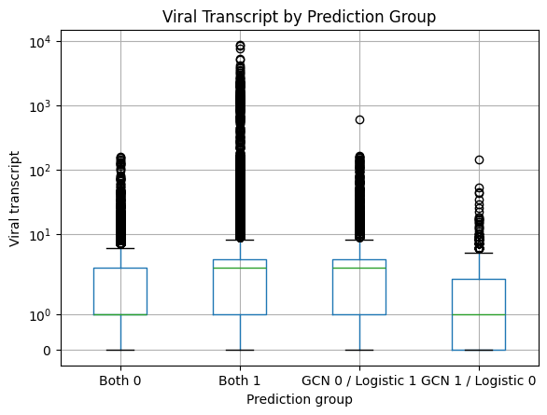
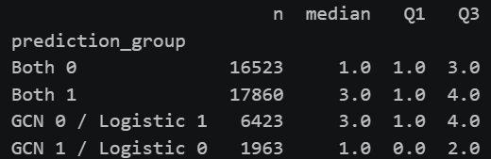
GCN vs Logistics regression(2)
Aim 2
* The criterion used by GCN to determine whether a cell is infected—based on the abundance of viral transcripts—is quite peculiar.

Slide 29
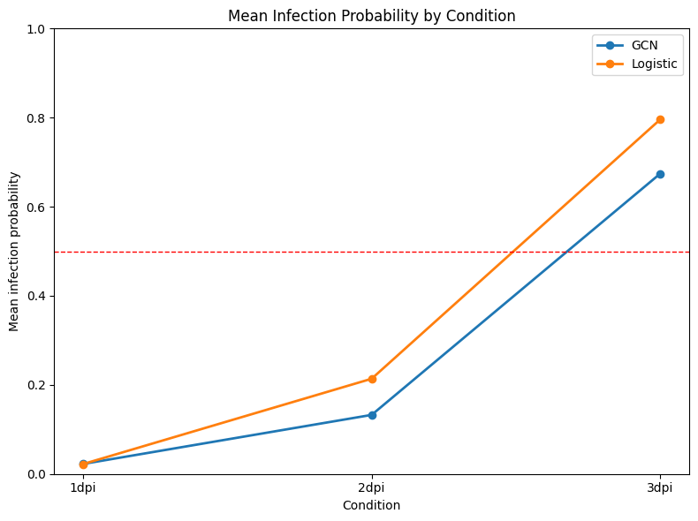
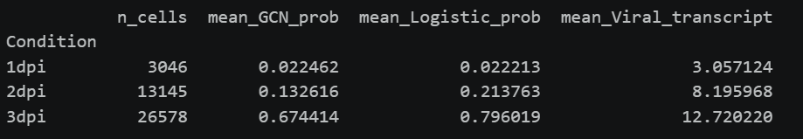
GCN vs Logistics regression(3)
Aim 2
As the duration of infection increases, the number of viral transcripts in the cells rises, making them more likely to be classified as infected; both models exhibit the same trend.

Slide 30
Future work
Aim 2
Determine whether GCN performance is truly inferior to logistic regression.
By incorporating data containing other clinical indicators, the network of relationships between cells can provide additional information, highlighting the advantages of GCN.
Notes:
資料來源:NCBI

Slide 31
What I Learned

Slide 32
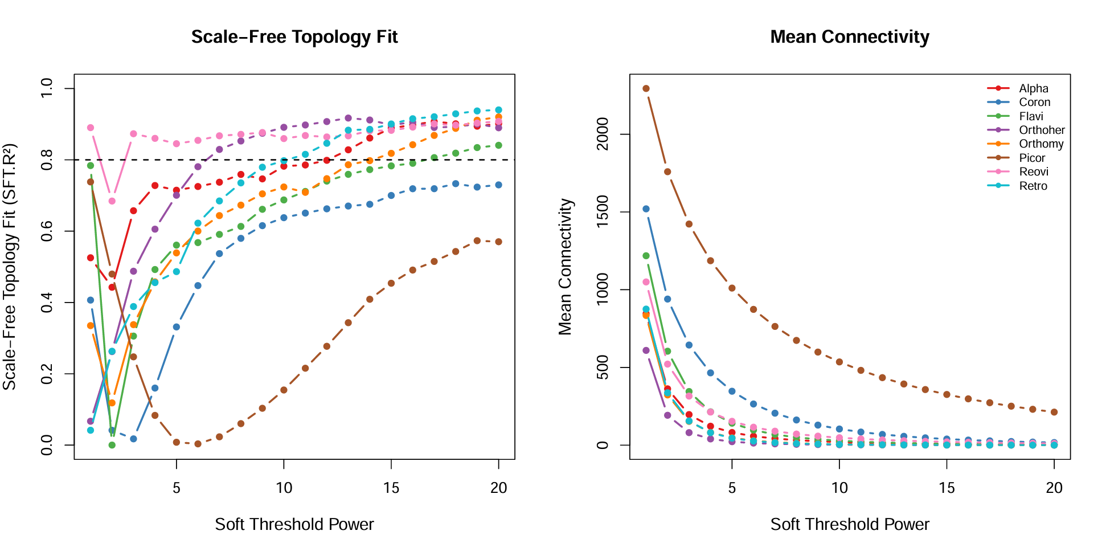
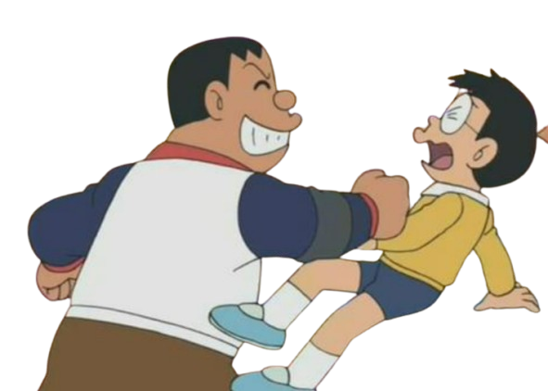
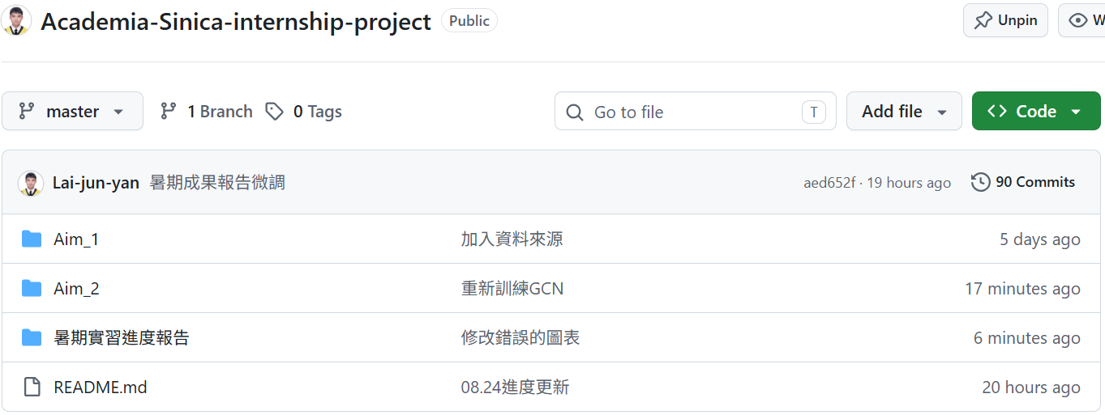
Conclusion
What I learned
Before conducting research, you need to clearly define your motivation
Making plans for the subsequent results of the experiment
Learn to use Git for version control
Logistic
GCN
Image source :搜狐
Notes:
圖片來源:搜狐

