Slide 1
Research Progress and Future Work
08.12

Slide 2
Aims
Aim 1:
After excluding non-coding genes, re-run the enrichment analysis.
Aim 2:
Predict unknown cells using existing gene expression data and some known cell labels.

Slide 3
Aim 1

Slide 4
Immune gene list enrichment analysis
GSEA:
ORA has issues related to gene list background, so GSEA is used for the analysis instead.
Results:
Enrichment analysis was performed only for the RF model; for XGBoost, the majority of SHAP values ​​were zero, resulting in a gene list too small to yield reliable enrichment analysis results.

Slide 5
Results of enrichment analysis(RF only)
 | Alphaviridae | Coronaviridae | Flaviviridae | Orthoherpesviridae | Orthomyxoviridae | Picornaviridae | Reoviridae | Retroviridae
KEGG |  |  |  |  |  |  |  | 
Reactome |  |  |  |  |  |  |  | 
GO |  |  |  |  |  |  |  | 
MSigDB |  |  |  |  |  |  |  | 
WikiPathways |  |  |  |  |  |  |  | 
* The significance level is set at 0.25, which is very lenient.
(Subramanian et al., 2005)
Notes:
Enrichment要做的多詳細?

Slide 6
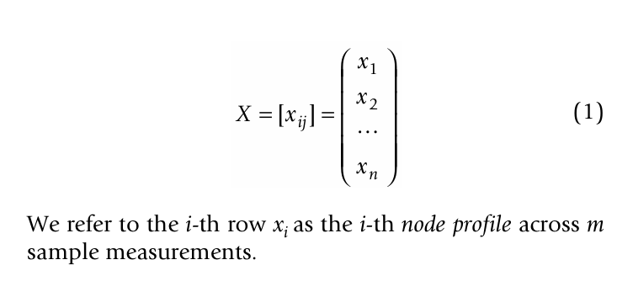

WGCNA
Done after the discussion on August 6th
Purpose:
Observe whether gene network relationships differ depending on the viral infection.
Methods for selecting genes:
Using the Shapley genes common to the eight viral families, any gene showing no variation in at least one viral family is excluded.
WGCNA (Langfelder & Horvath BMC Bioinf 2008)
Notes:
Gene 沒有變異挑出來
做不同的定義( 看是不是真的不一樣)

Slide 7
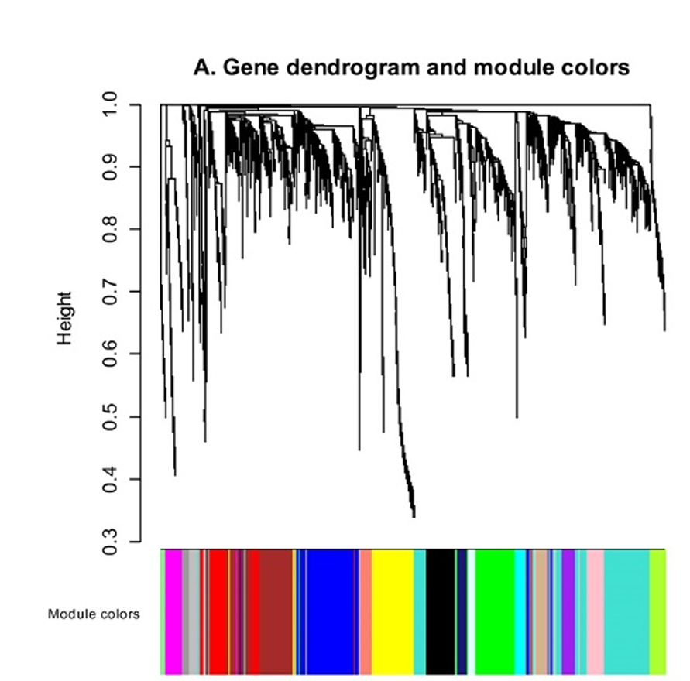
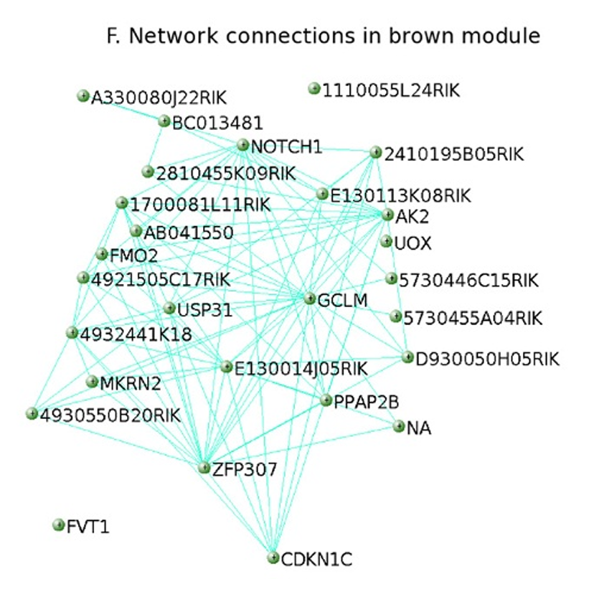
The Concept of WGCNA
Done after the discussion on August 6th
WGCNA (Langfelder & Horvath BMC Bioinf 2008)
Notes:
Shapley 的分布 找斷點

Slide 8
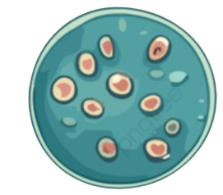

Data used for WGCNA
Done after the discussion on August 6th
Virus family | Cell 數量
Coronaviridae | 2,416
Picornaviridae | 428
Flaviviridae | 359
Orthomyxoviridae | 330
Alphaviridae | 172
Orthoherpesviridae | 93
Retroviridae | 71
Reoviridae | 60
3929
3341

Slide 9
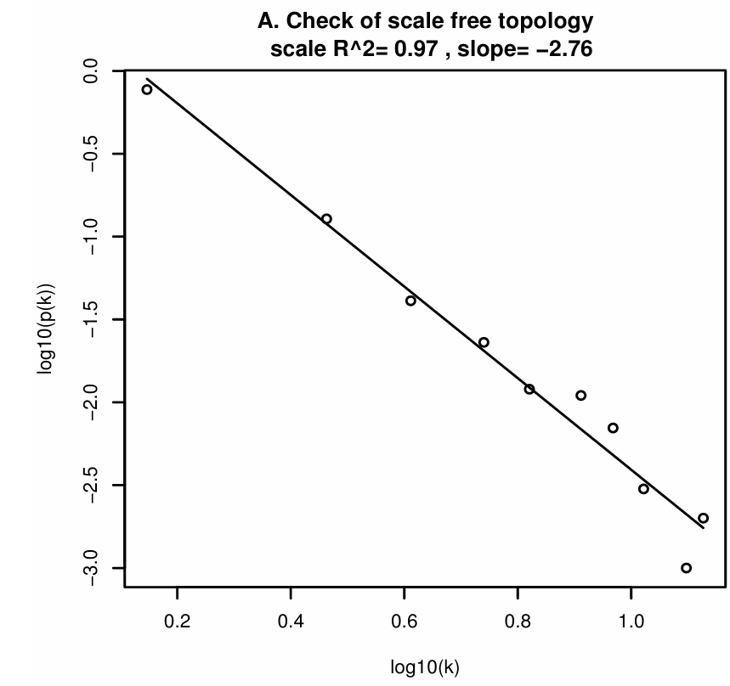
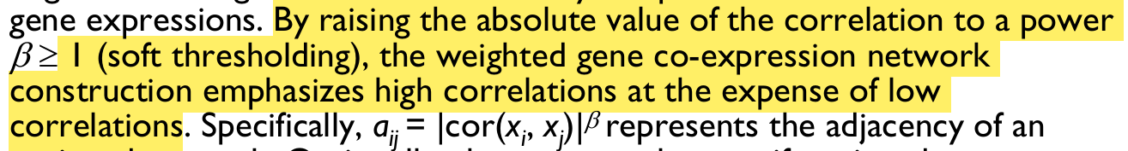


Scale−Free assumption
Done after the discussion on August 6th
WGCNA (Langfelder & Horvath BMC Bioinf 2008)

Slide 10
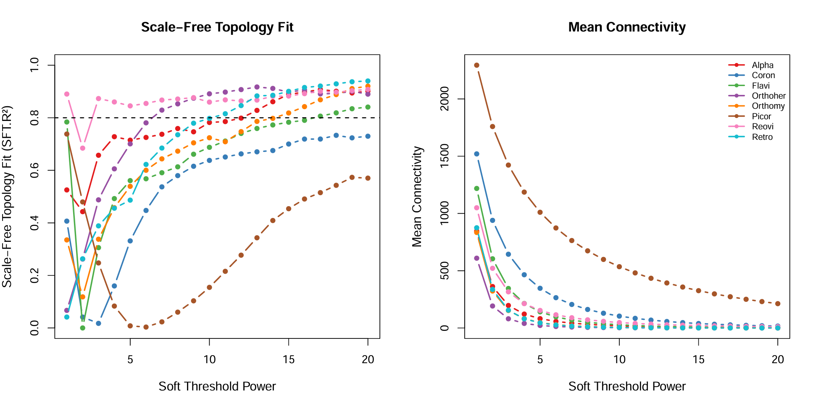
Issues regarding the choice of power
Done after the discussion on August 6th
* It is not possible to compare gene networks at the same level of statistical power.
Notes:
不一定要參考scale free，可以參考商
用文氏圖去找交集

Slide 11
Future works
Based on the database annotations, identify the biological pathways that achieved statistical significance and examine the potential biological significance of the features learned by the model.
Analyze gene topological relationships using raw RNA data and WGCNA.
It is not yet clear how to resolve the issue with XGBoost.

Slide 12
Aim 2

Slide 13
Data information
Ravindra2021:
RNA raw count data comprising 77,668 cells and 33,539 genes.
Key fields:
‘pmito’, ‘n_genes’, ‘Viral_transcript’, ‘Condition’,

Slide 14



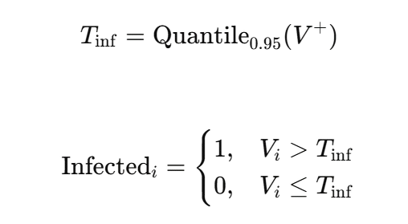

Data preprocessing
Quality Control
Cells with high-confidence labels
1713
Viral_transcript > Tinf
Condition != Mock
n_genes > 1000
Pmito < 0.2
n_genes > 500
22080
Viral_transcript = 0
Condition = Mock
Min_cells= 10
* 50295 Unknown cell
Notes:
Image source : pngtree
Cell type 不完整 
看一下mock的vt distribution 
1dpi vt = 0 當作healthy 

Slide 15
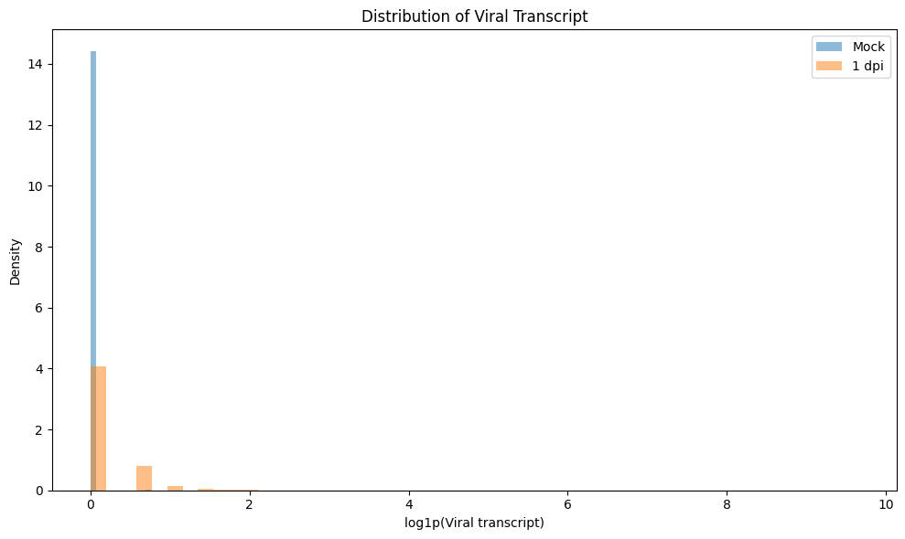
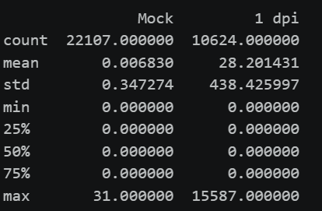
Mock vs 1 dpi
Done after the discussion on August 6th
Notes:
Image source : pngtree
Cell type 不完整 
看一下mock的vt distribution 
1dpi vt = 0 當作healthy 

Slide 16
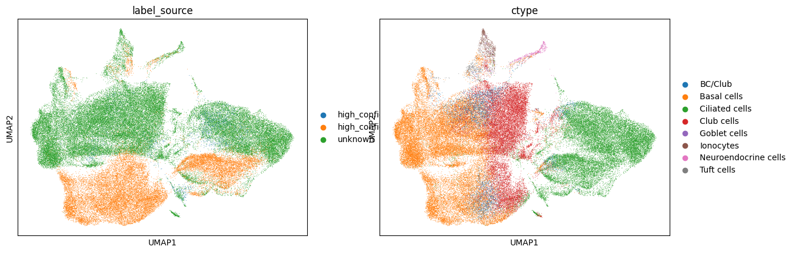
Topological relationships of cells
Select the top 3,000 highly variable genes
Performing clustering using PCA(n_comps = 50)
Cell type | Uninfected | Infected | Infection rate
BC/Club | 1521 | 124 | 7.5%
Basal cells | 9549 | 169 | 1.7%
Ciliated cells | 6208 | 1222 | 16.4%
Club cells | 4493 | 194 | 4.1%
Goblet cells | 43 | 0 | 0%
Ionocytes | 123 | 2 | 1.6%
Neuroendocrine cells | 74 | 2 | 2.6%
Tuft cells | 69 | 0 | 0%
Construct a KNN graph(n_neighbors=15)
* P-value < 0.001
Notes:
確認3000個基因是不是都有包含virus gene(可能有confounding)(不太確定 原始檔案沒有基因的annotation)

Slide 17
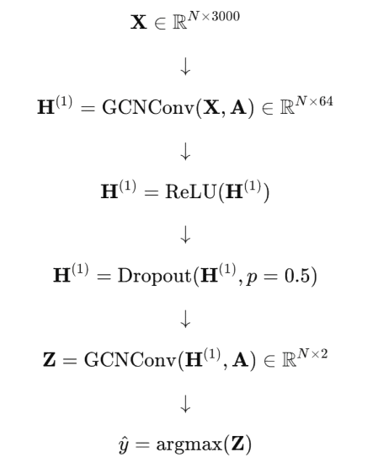
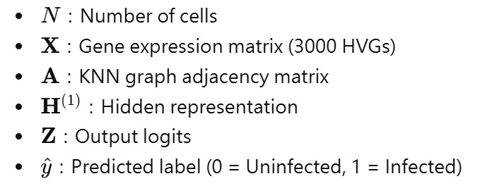

GCN model
All cells
Labeled cells
Stratified Split 80% / 20%
Unknown cells
Train / validation
GCN model
Predict unknown cells
GCN (Kipf & Welling ICLR 2017)
Notes:
other ml

Slide 18
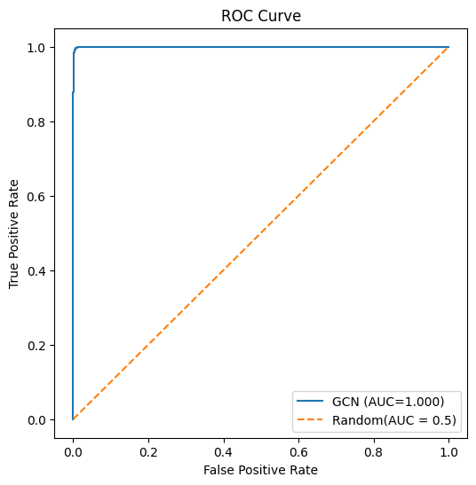
GCN results
Confusion matrix | Predicted Uninfected | Predicted Infected
True Uninfected | 4411 | 5
True Infected | 9 | 334
* PR-AUC = 0.998
Class | Description | Precision | Recall | F1-score | Support
0 | Uninfected | 1.00 | 1.00 | 1.00 | 4,416
1 | Infected | 0.99 | 0.97 | 0.98 | 343
Overall | Accuracy |  |  | 1.00 | 4,759
Overall | Macro average | 0.99 | 0.99 | 0.99 | 4,759
Overall | Weighted average | 1.00 | 1.00 | 1.00 | 4,759

Slide 19
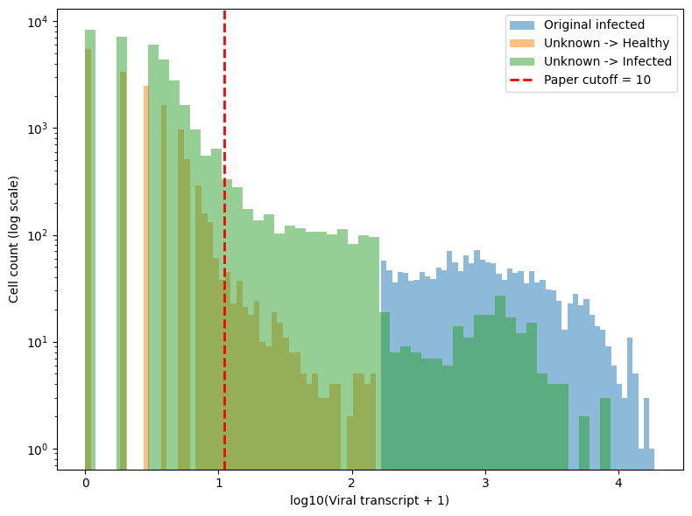
GCN results(2)
Unknown → Infected: 34822
cells Viral transcript < 10: 32485
cells Percentage: 93.29%
0: 8349
1~9: 24136

Slide 20
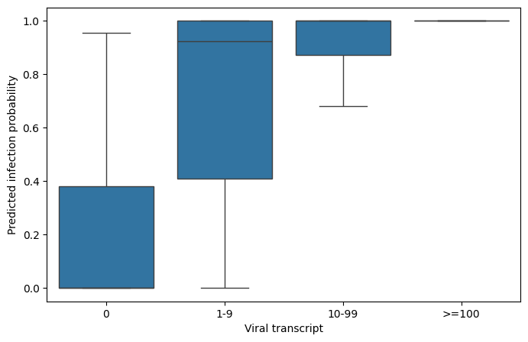
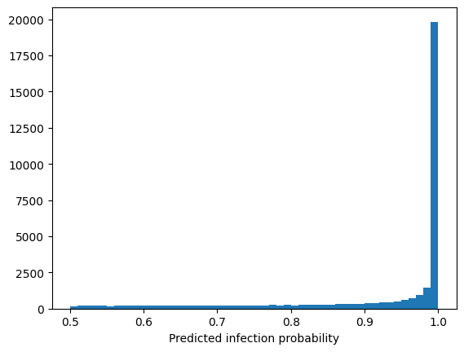
GCN results(3)
* The original literature would overlook a significant proportion of infected cells.
* The model is highly confident in its classification results.
Notes:
1 ~ 9要去看生物意義

Slide 21
Infection and Cell Type
Done after the discussion on August 6th
Cells with high-confidence labels
Cells with unknown labels
Cell type | Uninfected | Infected | Infection rate
BC/Club | 1521 | 124 | 7.5%
Basal cells | 9549 | 169 | 1.7%
Ciliated cells | 6208 | 1222 | 16.4%
Club cells | 4493 | 194 | 4.1%
Goblet cells | 43 | 0 | 0%
Ionocytes | 123 | 2 | 1.6%
Neuroendocrine cells | 74 | 2 | 2.6%
Tuft cells | 69 | 0 | 0%
Cell type | Uninfected | Infected | Infection rate
BC/Club | 145 | 2,206 | 93.8%
Basal cells | 6,439 | 12,891 | 66.7%
Ciliated cells | 2,794 | 12,378 | 81.6%
Club cells | 5,261 | 7,041 | 57.2%
Goblet cells | 58 | 16 | 21.6%
Ionocytes | 472 | 58 | 10.9%
Neuroendocrine cells | 106 | 193 | 64.5%
Tuft cells | 198 | 39 | 16.5%
* P-value < 0.001
Notes:
為什麼判斷完的infection比例會那麼高，訓練前後每個cell type在感染上都大幅提升

Slide 22
Future works
The topological relationships of cells are constructed based on other characteristics (such as clinical indicators, etc.).
Confirm whether the gene expression profiles of the cells identified as infected align with known biological significance.

