Slide 1
Research Progress and Future Work
08.06

Slide 2
Aims
Aim 1:
After excluding non-coding genes, re-run the enrichment analysis.
Aim 2:
Predict unknown cells using existing gene expression data and some known cell labels.

Slide 3
Aim 1

Slide 4
Immune gene list enrichment analysis
GSEA:
ORA has issues related to gene list background, so GSEA is used for the analysis instead.
Results:
Enrichment analysis was performed only for the RF model; for XGBoost, the majority of SHAP values ​​were zero, resulting in a gene list too small to yield reliable enrichment analysis results.

Slide 5
Results of enrichment analysis(RF only)
 | Alphaviridae | Coronaviridae | Flaviviridae | Orthoherpesviridae | Orthomyxoviridae | Picornaviridae | Reoviridae | Retroviridae
KEGG |  |  |  |  |  |  |  | 
Reactome |  |  |  |  |  |  |  | 
GO |  |  |  |  |  |  |  | 
MSigDB |  |  |  |  |  |  |  | 
WikiPathways |  |  |  |  |  |  |  | 
* The significance level is set at 0.25, which is very lenient.
(Subramanian et al., 2005)
Notes:
Enrichment要做的多詳細?

Slide 6
Future works
Based on the database annotations, identify the biological pathways that achieved statistical significance and examine the potential biological significance of the features learned by the model.
Analyze gene topological relationships using raw RNA data and WGCNA.
It is not yet clear how to resolve the issue with XGBoost.

Slide 7
Aim 2

Slide 8
Data information
Ravindra2021:
RNA raw count data comprising 77,668 cells and 33,539 genes.
Key fields:
‘pmito’, ‘n_genes’, ‘Viral_transcript’, ‘Condition’,

Slide 9


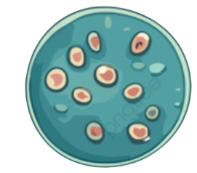

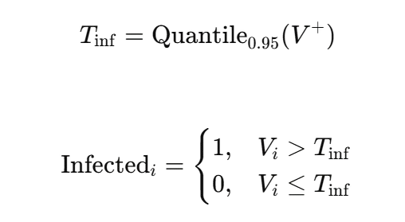


Data preprocessing
Quality Control
Cells with high-confidence labels
1713
Viral_transcript > Tinf
Condition != Mock
n_genes > 1000
Pmito < 0.2
n_genes > 500
22080
Viral_transcript = 0
Condition = Mock
Min_cells= 10
* 50295 Unknown cell
Notes:
Image source : pngtree
Cell type 不完整 
看一下mock的vt distribution 
1dpi vt = 0 當作healthy 

Slide 10
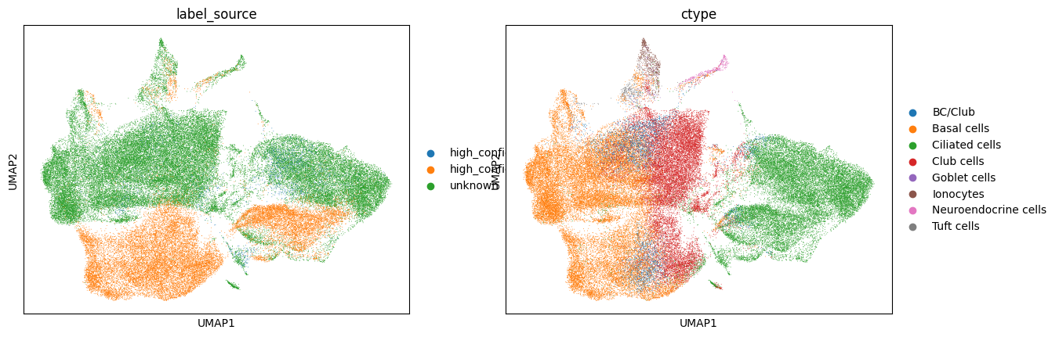
Topological relationships of cells
Select the top 3,000 highly variable genes
Performing clustering using PCA(n_comps = 50)
Cell type | Uninfected | Infected | Infection rate
BC/Club | 1521 | 124 | 7.5%
Basal cells | 9549 | 169 | 1.7%
Ciliated cells | 6208 | 1222 | 16.4%
Club cells | 4493 | 194 | 4.1%
Goblet cells | 43 | 0 | 0%
Ionocytes | 123 | 2 | 1.6%
Neuroendocrine cells | 74 | 2 | 2.6%
Tuft cells | 69 | 0 | 0%
Construct a KNN graph(n_neighbors=15)
* P-value < 0.001
Notes:
Image source : pngtree
確認3000個基因是不是都有包含virus gene(可能有confounding)(不太確定 原始檔案沒有基因的annotation)

Slide 11
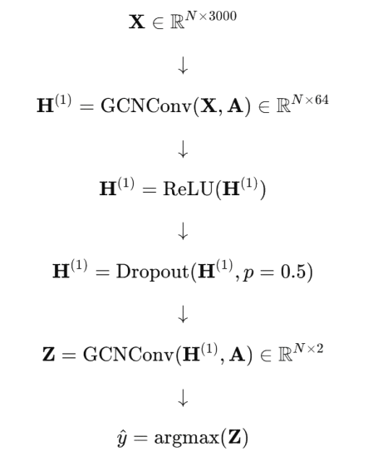
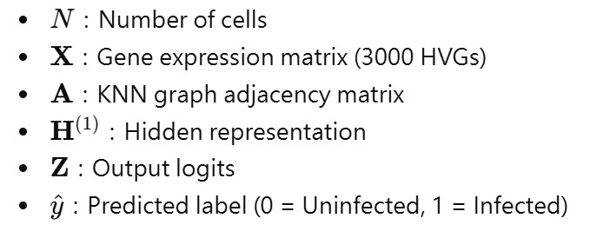

GCN model
All cells
Labeled cells
Stratified Split 80% / 20%
Unknown cells
Train / validation
GCN model
Predict unknown cells
GCN (Kipf & Welling ICLR 2017)
Notes:
Image source : pngtree

Slide 12
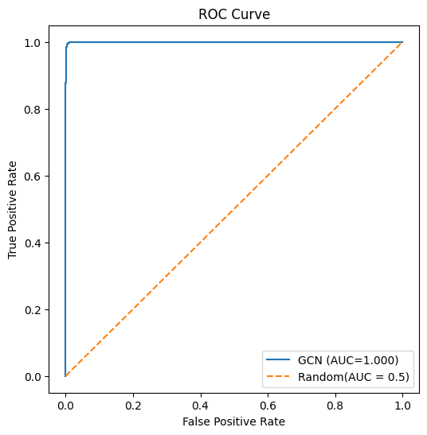
GCN results
Confusion matrix | Predicted Uninfected | Predicted Infected
True Uninfected | 4411 | 5
True Infected | 9 | 334
* PR-AUC = 0.998
Class | Description | Precision | Recall | F1-score | Support
0 | Uninfected | 1.00 | 1.00 | 1.00 | 4,416
1 | Infected | 0.99 | 0.97 | 0.98 | 343
Overall | Accuracy |  |  | 1.00 | 4,759
Overall | Macro average | 0.99 | 0.99 | 0.99 | 4,759
Overall | Weighted average | 1.00 | 1.00 | 1.00 | 4,759
Notes:
Image source : pngtree

Slide 13
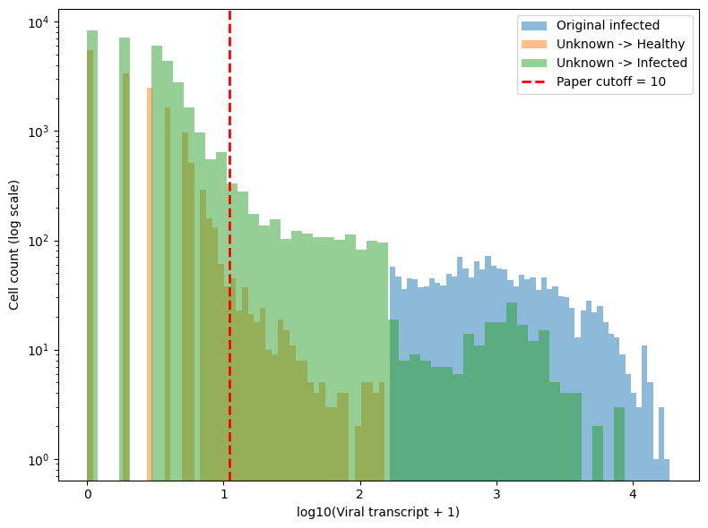
GCN results(2)
Unknown → Infected: 34822
cells Viral transcript < 10: 32485
cells Percentage: 93.29%
0: 8349
1~9: 24136
Notes:
Image source : pngtree

Slide 14
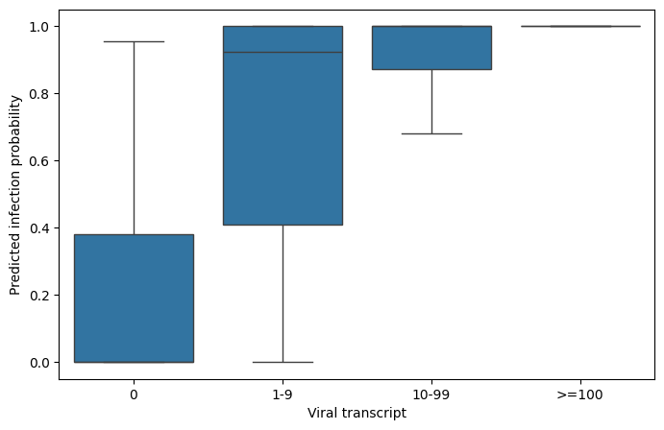
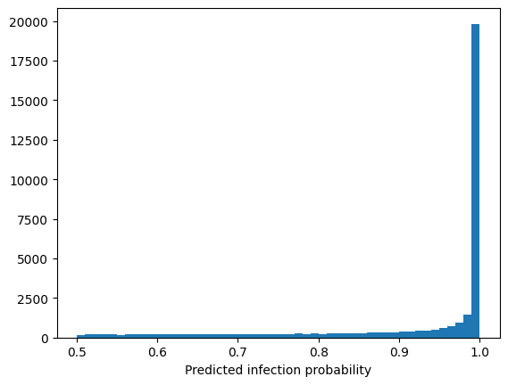
GCN results(3)
* The original literature would overlook a significant proportion of infected cells.
* The model is highly confident in its classification results.
Notes:
Image source : pngtree
1 ~ 9要去看生物意義

Slide 15
Future works
Since cell infection status is known to be associated with cell type, it is necessary to observe whether the unknown cells exhibit the same pattern.
The topological relationships of cells are constructed based on other characteristics (such as clinical indicators, etc.).
Confirm whether the gene expression profiles of the cells identified as infected align with known biological significance.

