Slide 1

SGU BLOCKCHAIN BOOTCAMP

Slide 2

DANG QUANG VU
6 Years experience about Blockchain Development
Blockchain Tech Lead at GFI Ventures
Head of Faculty at VBI Academy
Ethereum Virtual Machine
Near Protocol
Solana Protocol
Cosmos
SUI Protocol
WHO AM I?

Slide 3

OUTLINE BOOTCAMP
BLOCKCHAIN BASIC
WEB3 ARCHITECTURE – NEAR PROTOCOl
DEVELOPMENT
Typescript
Rust
BUILDING A PRODUCT

Slide 4
Agenda
What is Blockchain?
What is Consensus?
How it Work?
Transaction flow
Types of Blockchain
Components of Blockchain
Props & Cons

Slide 5

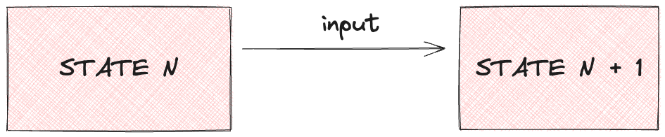
STATE MACHINE

Slide 6
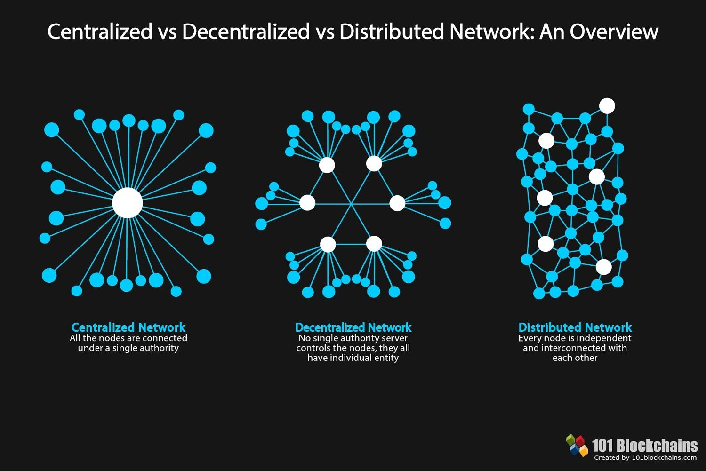

Slide 7
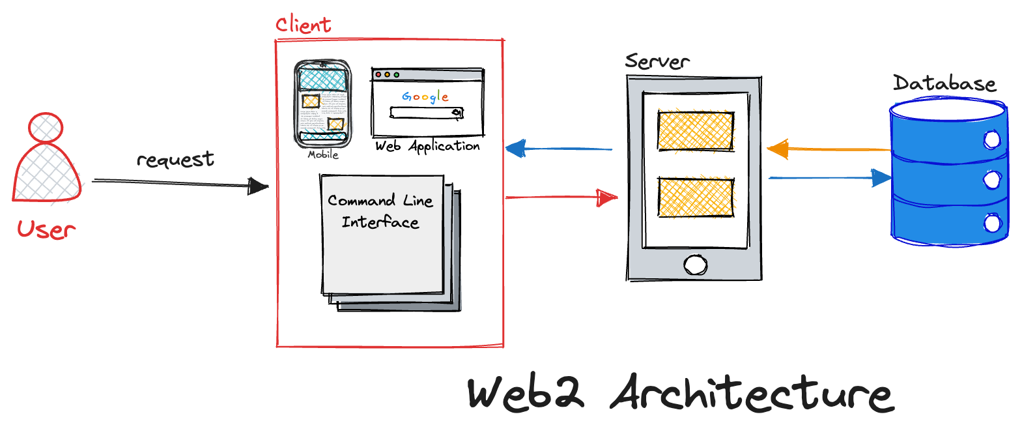

Slide 8
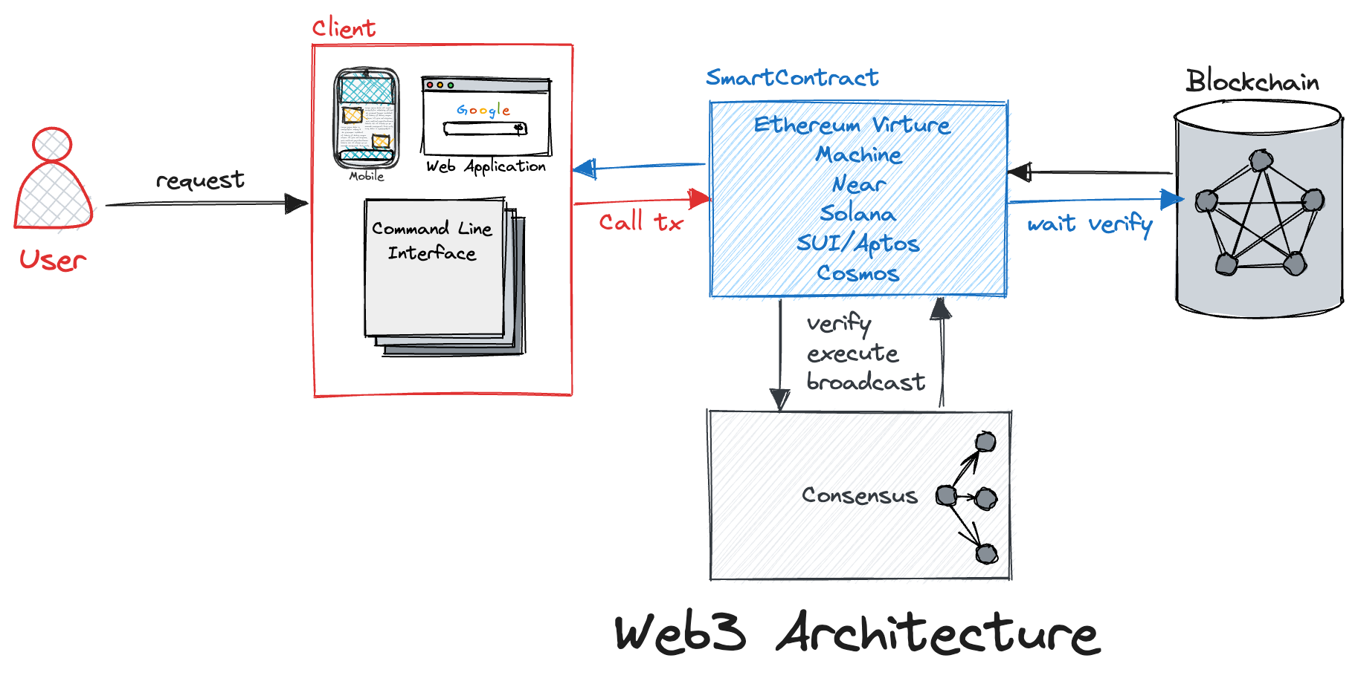

Slide 9
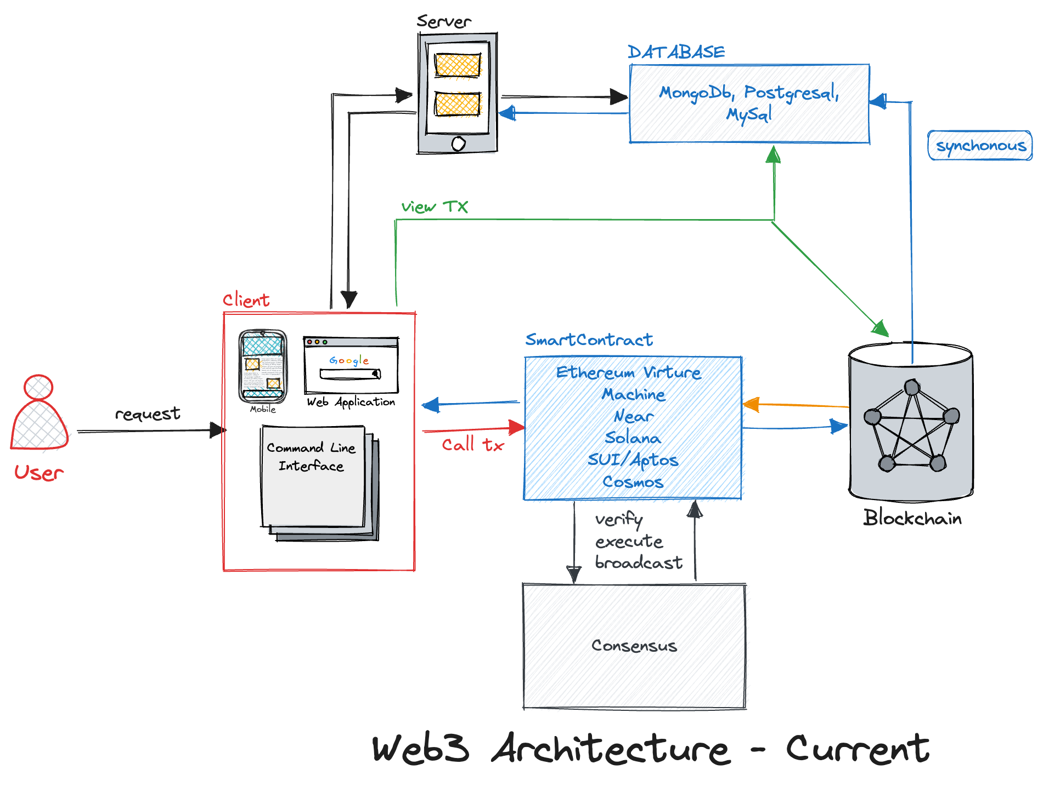

Slide 10
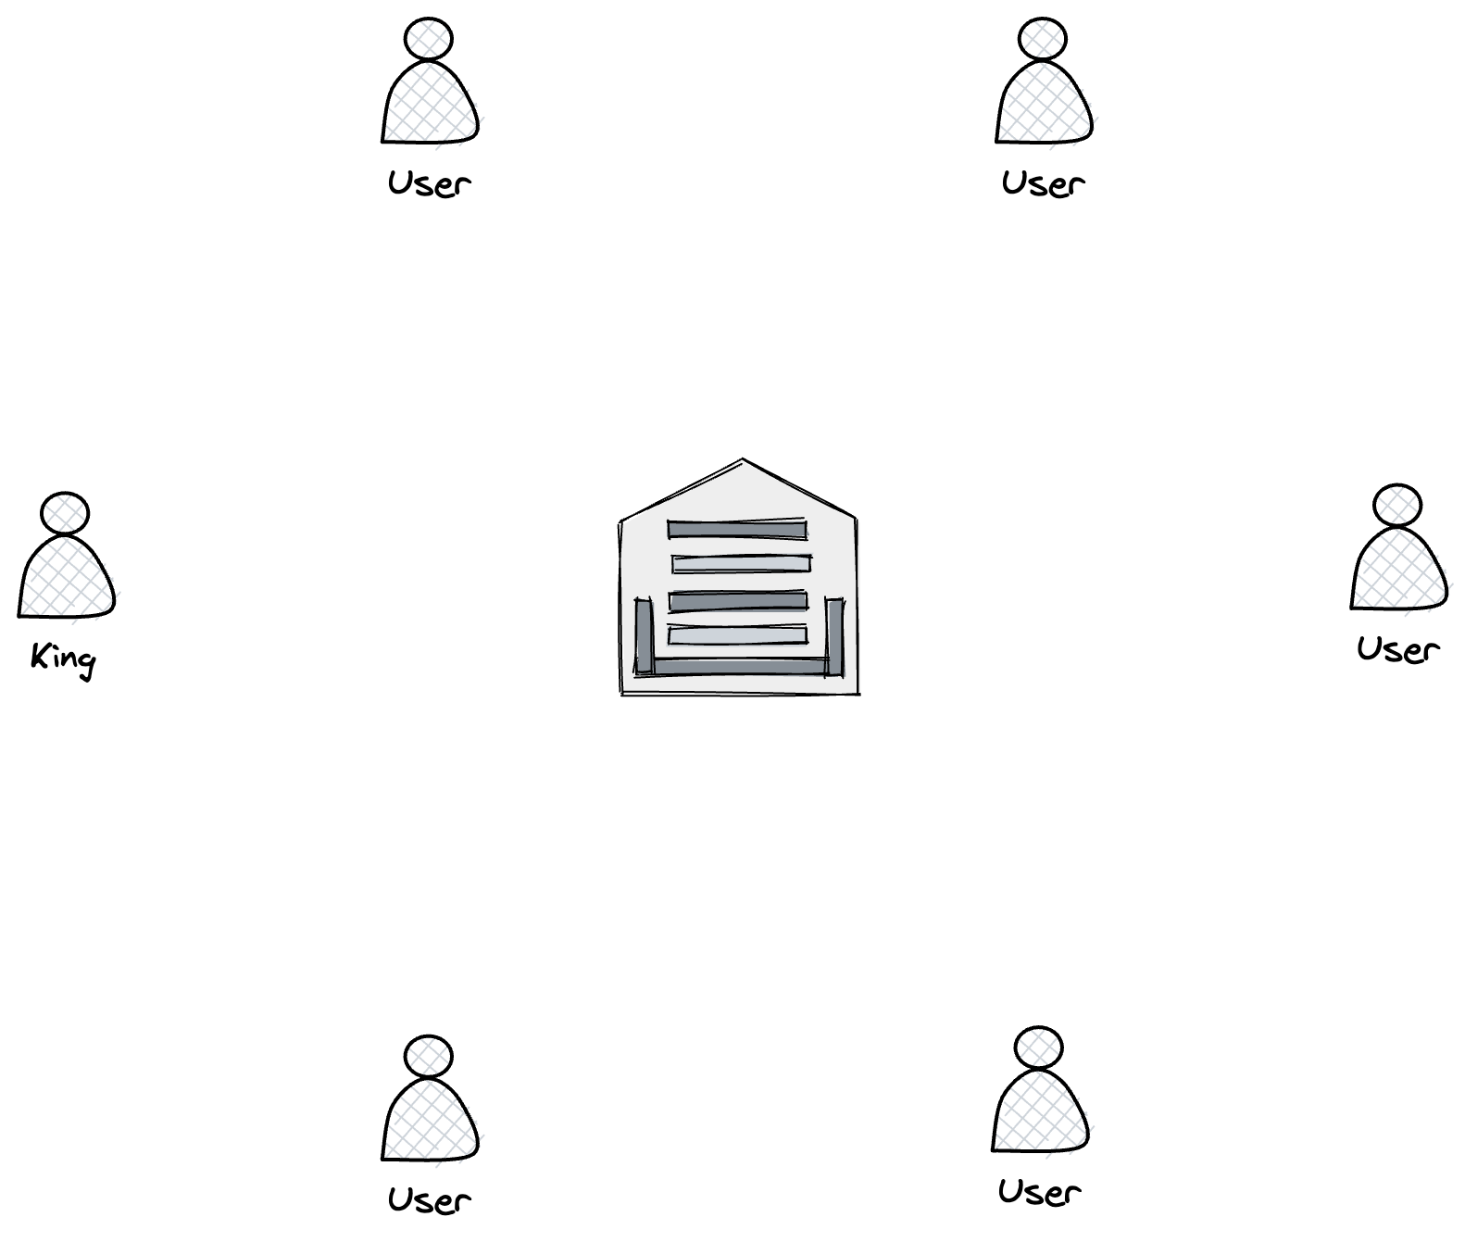
BYZANTINE FAULT TOLERANCE

Slide 11
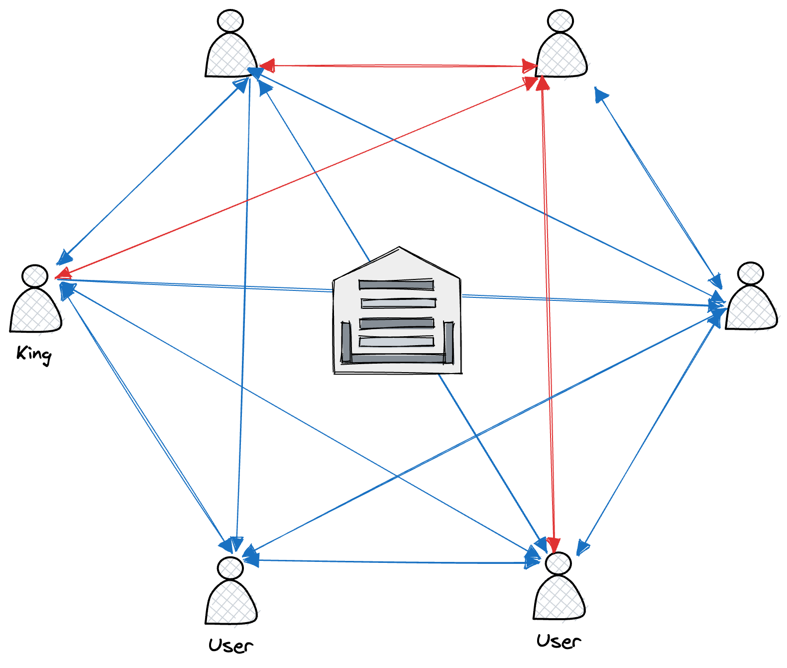
BYZANTINE FAULT TOLERANCE

Slide 12
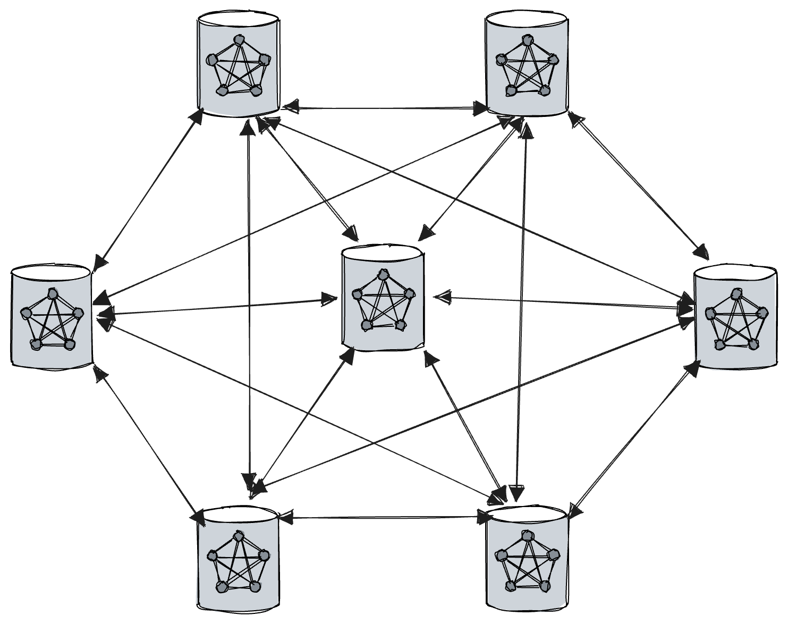
PRACTICAL BYZANTINE
FAULT TOLERANCE

Slide 13
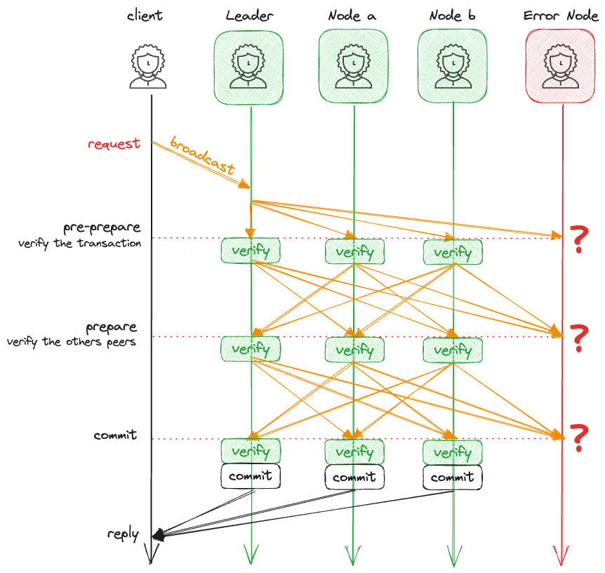
PRACTICAL BYZANTINE
FAULT TOLERANCE

Slide 14
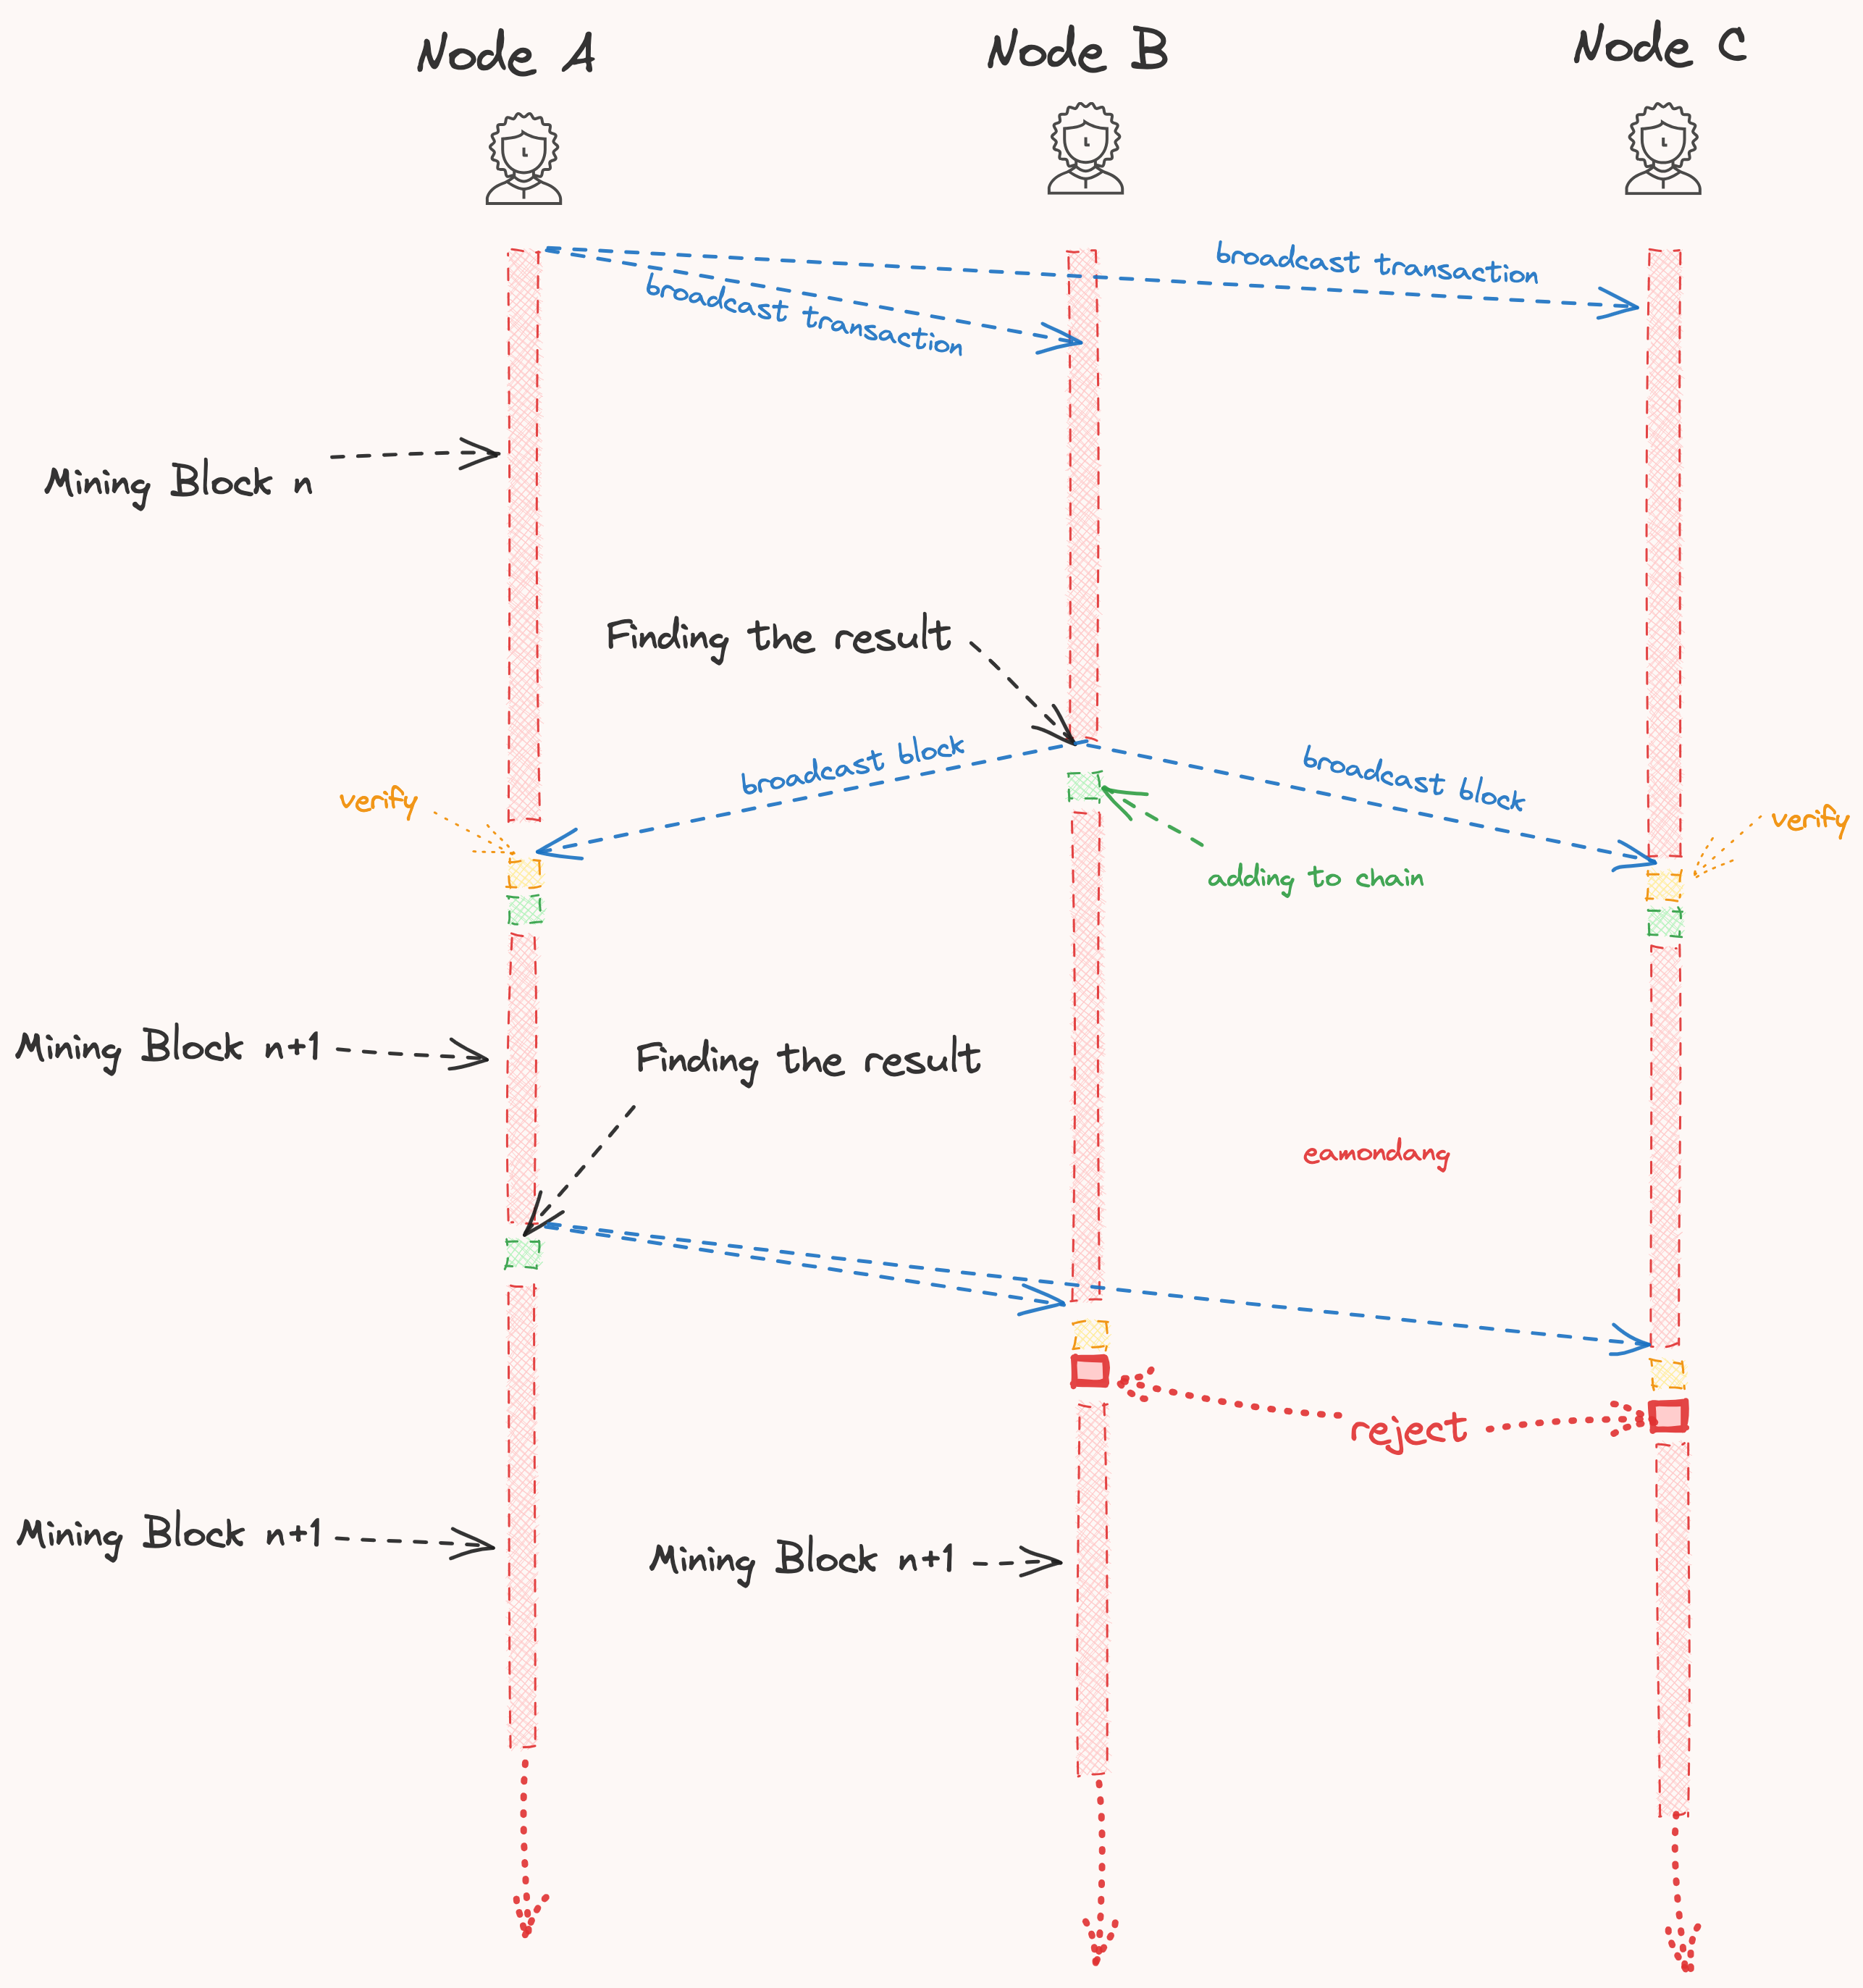
PROOF OF WORK

Slide 15
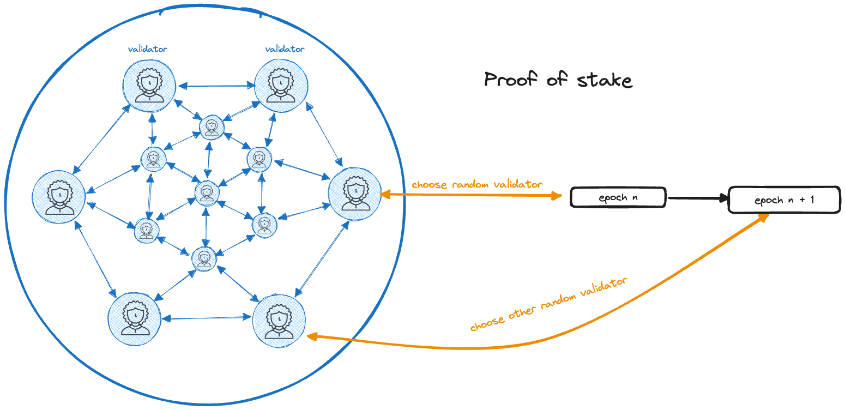
PROOF OF STAKE

Slide 16
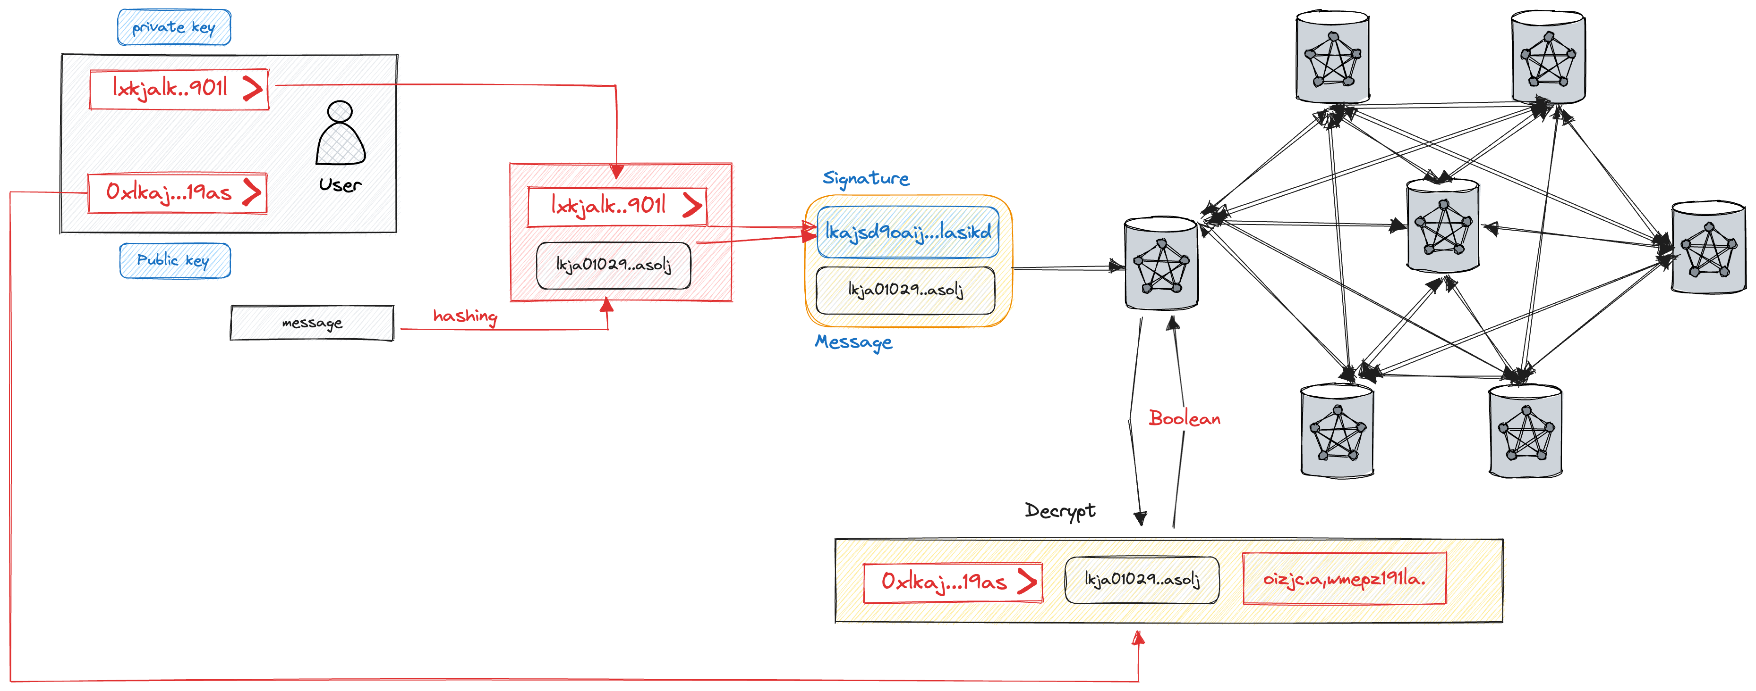

Slide 17

Requirements of
Blockchain System?
High Availability
Sustainability
Irreversibility
Transparency
Append-only
Consensus
Security
Global

Slide 18

Types of Blockchain
Permissionless Blockchain - Public Blockchain
Anyone can access to write the data
Anyone can read
Ex: 99%
Permissioned Blockchain - Private Blockchain
Participants need permission to accessing the data
Readers need permission to read
Ex: Hyperledger Fabric, Corda
Consortium Blockchain
Participants need permission to accessing the data
Anyone can read
Ex: Ripple

Slide 19

WHAT IS BLOCKCHAIN
It can be thought of as ONE BIG COMPUTER made up of small computers around the world.
All these computers (nodes) are connected to one another and have a full copy of the code and data.
One of the best ways to understand blockchain is by comparing it with a traditional client/server architecture

Slide 20
Components of Blockchain
Consensus
PoW/PoS/DPoS
Tendermint BFT
Doomslug
HotStuff
Nominated BFT (GRANDPA & BABE)
…etc
Cryptographic schemes
Hashing
Signature
Merkle Tree
Pub/Priv Key
Zero-Knowledge Proofs
Data Models
State Models
Account Models
Object Models
Decentralized Models
Permissionless Blockchain
Permissioned Blockchain
Consortium Blockchain
Network Models
Asynchronous
Synchronous
Partial Synchronous

Slide 21

CONS
SLOW
LATENCY
EXPENSIVE

