Slide 1
Classification
Logistic
Regression

Slide 2

Classification
Email: Spam / Not Spam?
Online Transactions: Fraudulent (Yes / No)?
Tumor: Malignant / Benign ?
0: “Negative Class” (e.g., benign tumor)
1: “Positive Class” (e.g., malignant tumor)

Slide 3

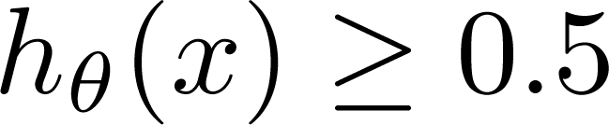
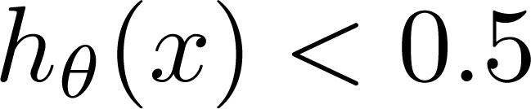





(Yes) 1
Malignant ?
(No) 0
Tumor Size
Tumor Size
Threshold classifier output at 0.5:
If , predict “y = 1”
If , predict “y = 0”

Slide 4

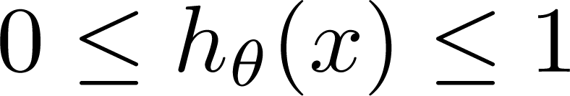









Classification: y = 0 or 1
can be > 1 or < 0
Logistic Regression:

Slide 5
Hypothesis Representation
Logistic
Regression

Slide 6
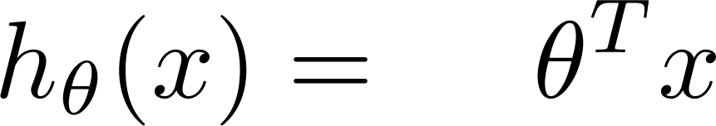






Logistic Regression Model
Want
1
0.5
Sigmoid function
Logistic function
0

Slide 7
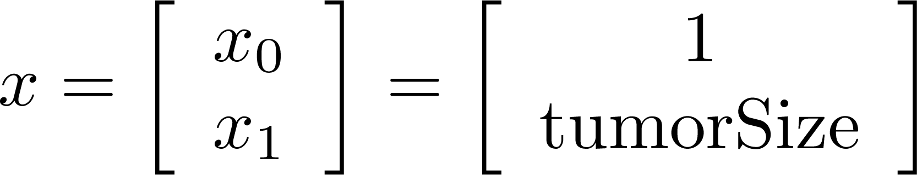
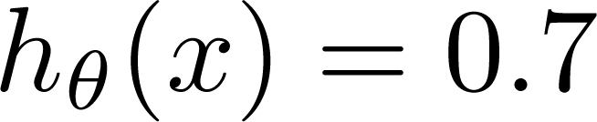
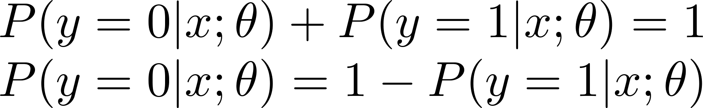








Interpretation of Hypothesis Output
= estimated probability that y = 1 on input x
Example: If
Tell patient that 70% chance of tumor being malignant
“probability that y = 1, given x,
parameterized by ”

Slide 8
Decision boundary
Logistic
Regression

Slide 9


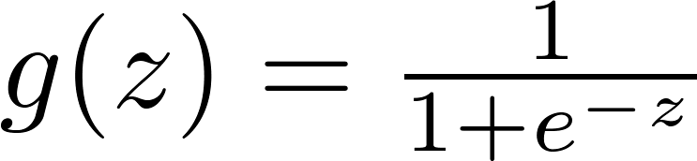

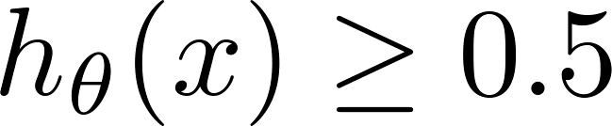

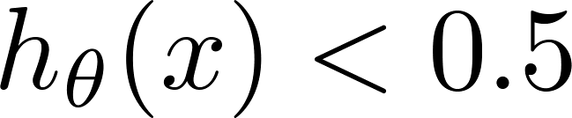



Logistic regression
1
z
Suppose predict “ “ if
predict “ “ if

Slide 10
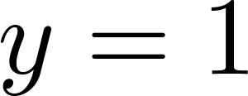
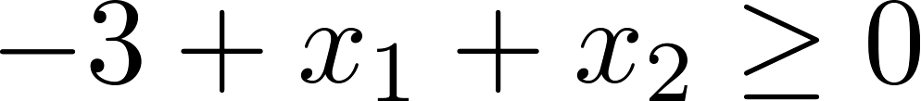






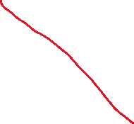


How to fit (find) Parameter θ Parameter θ (θ0, θ1, θ2) defines the decision boundary not the training set. Training set may be used to find the Parameter θ
Decision Boundary
x₂
3
2
1
1
2
3
x₁
Predict “ “ if

Slide 11
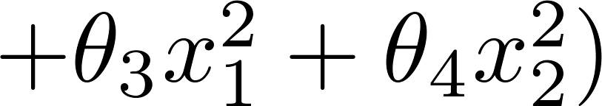
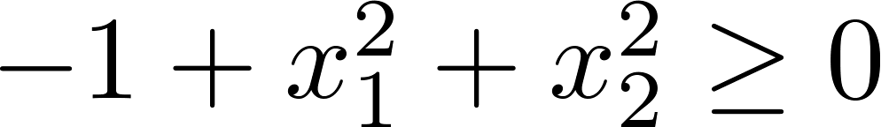


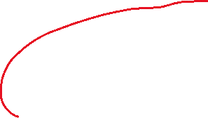






Non-linear decision boundaries
x₂
1
x₁
-1
1
-1
Predict “ “ if
x₂
x₁

Slide 12


Cost function
Logistic
Regression

Slide 13
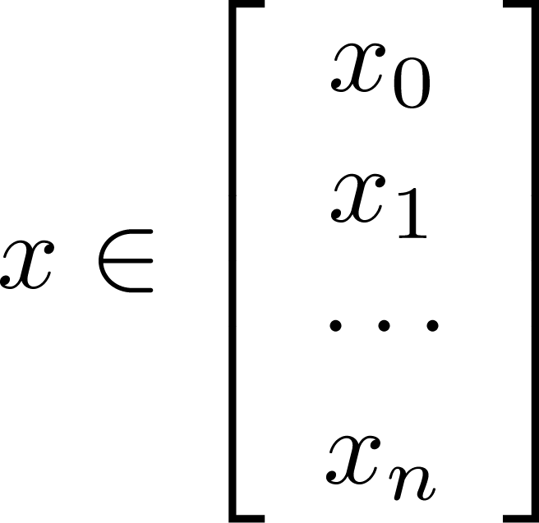
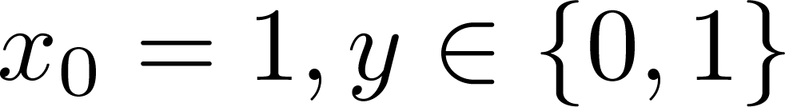
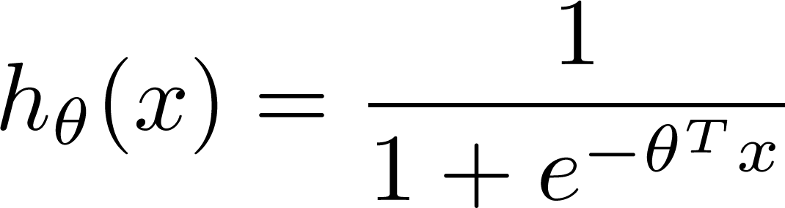

Training set:
m examples
How to choose parameters ?

Slide 14
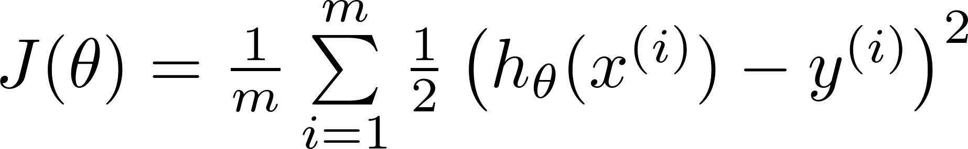









J(θ) is non-linear beacause of the
presence of non-linear sigmoid function
Cost function
Linear regression:
Non-Linear
Function
“non-convex”
“convex”
We want J(θ) to
behave like this

Slide 15
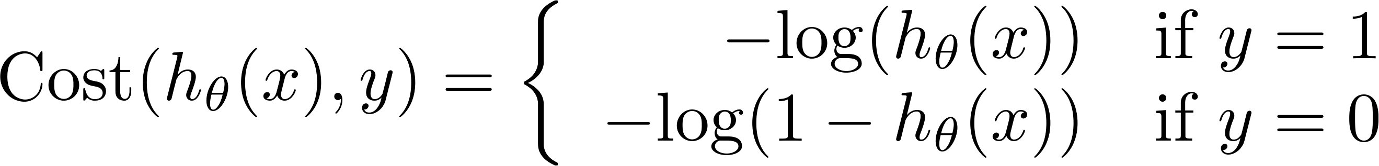
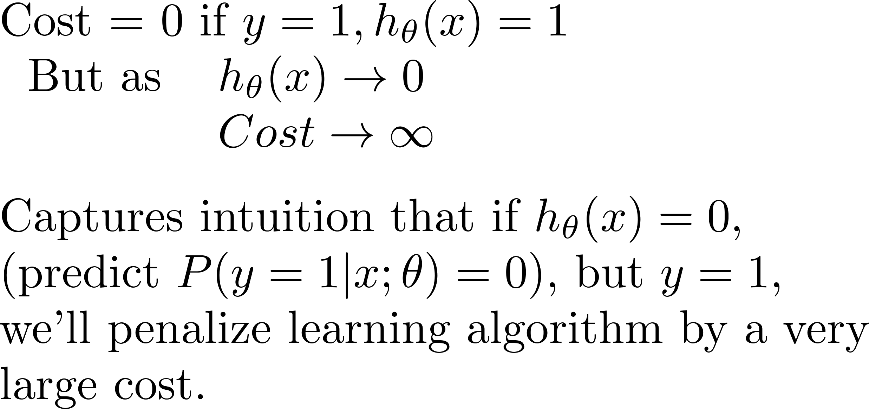

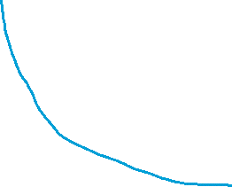














Logistic regression cost function
Different
Cost Function
If y = 1
0
1

Slide 16










Logistic regression cost function
If y = 0
0
1

Slide 17
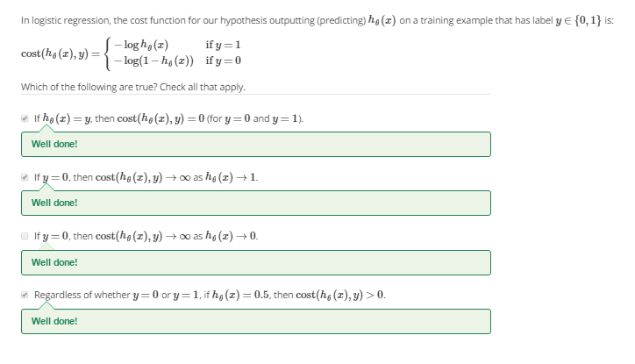






Slide 18
Simplified cost function and gradient descent
Logistic
Regression

Slide 19
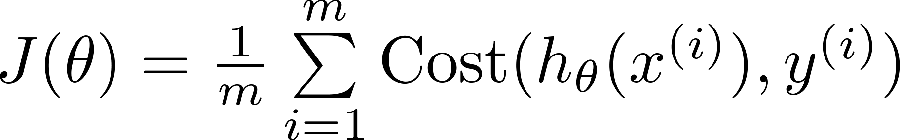


Logistic regression cost function

Slide 20



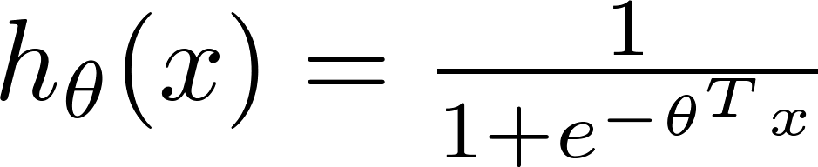





Logistic regression cost function
To fit parameters :
To make a prediction given new :
Output

Slide 21


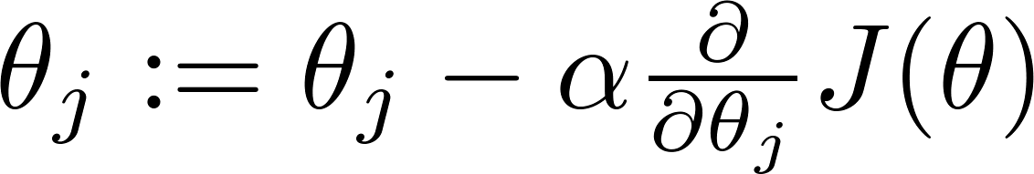








Gradient Descent
Want :
Repeat
(simultaneously update all )

Slide 22
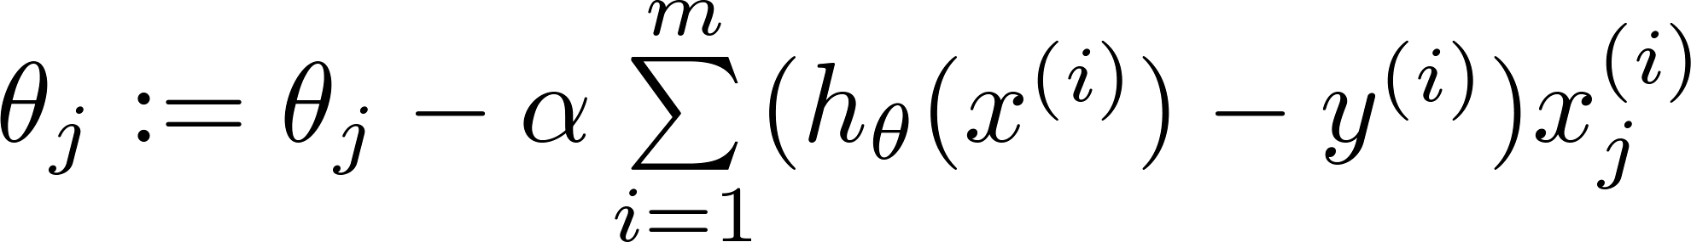



Gradient Descent
Want :
Repeat
(simultaneously update all )
Algorithm looks identical to linear regression!

Slide 23
Advanced optimization
Logistic
Regression

Slide 24

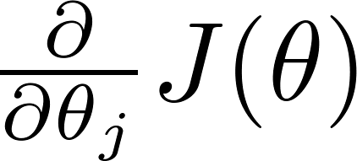
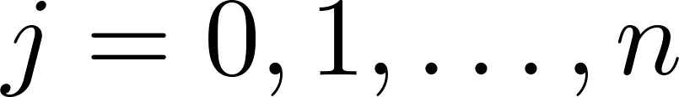


Optimization algorithm
Cost function . Want .
Given , we have code that can compute
(for )
Gradient descent:
Repeat

Slide 25







Optimization algorithm
Given , we have code that can compute
(for )
Optimization algorithms:
Gradient descent
Advantages:
No need to manually pick
Often faster than gradient descent.
Disadvantages:
More complex
Conjugate gradient
BFGS
L-BFGS

Slide 26
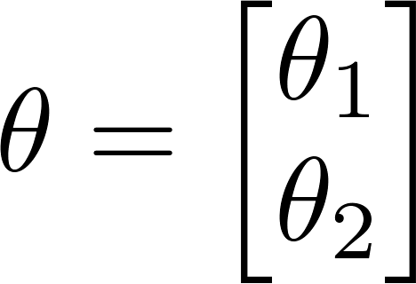
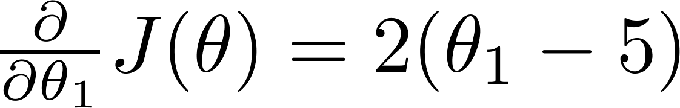

Example:
function [jVal, gradient] = costFunction(theta)
jVal = (theta(1)-5)^2 + ... (theta(2)-5)^2;
gradient = zeros(2,1);
gradient(1) = 2*(theta(1)-5); gradient(2) = 2*(theta(2)-5);
options = optimset(‘GradObj’, ‘on’, ‘MaxIter’, ‘100’);
initialTheta = zeros(2,1); [optTheta, functionVal, exitFlag] ...
= fminunc(@costFunction, initialTheta, options);

Slide 27

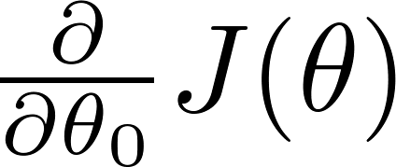
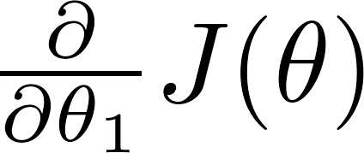
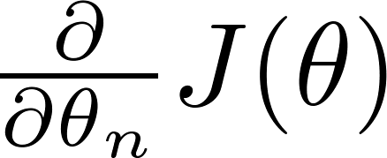
theta =
function [jVal, gradient] = costFunction(theta)
code to compute
jVal = [ ];
code to compute
gradient(1) = [ ];
code to compute
gradient(2) = [ ];
code to compute
gradient(n+1) = [ ];

Slide 28


Multi-class classification: One-vs-all
Logistic
Regression

Slide 29
Multiclass classification
Email foldering/tagging: Work, Friends, Family, Hobby
Medical diagrams: Not ill, Cold, Flu
Weather: Sunny, Cloudy, Rain, Snow

Slide 30



Binary classification:
Multi-class classification:
x₂
x₂
x₁
x₁

Slide 31
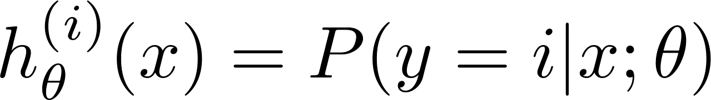





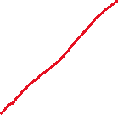










x₂
One-vs-all (one-vs-rest):
x₁
x₂
x₂
x₁
x₁
Class 1:
Class 2:
Class 3:
x₂
x₁

Slide 32
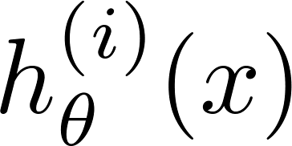

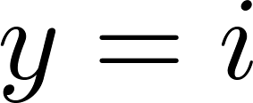
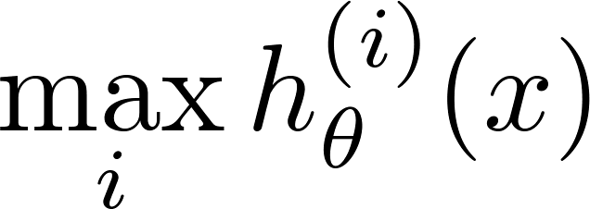


One-vs-all
Train a logistic regression classifier for each class to predict the probability that .
On a new input , to make a prediction, pick the class that maximizes

