Slide 1
The problem of overfitting
Regularization

Slide 2
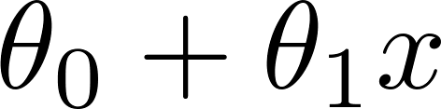
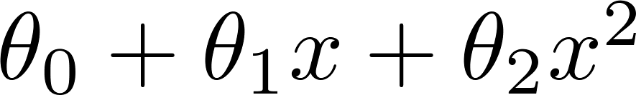
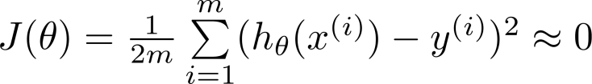
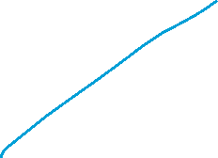
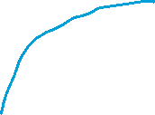

Example: Linear regression (housing prices)
Price
Price
Price
Size
Size
Size
Overfitting: If we have too many features, the learned hypothesis may fit the training set very well ( ), but fail to generalize to new examples (predict prices on new examples).

Slide 3
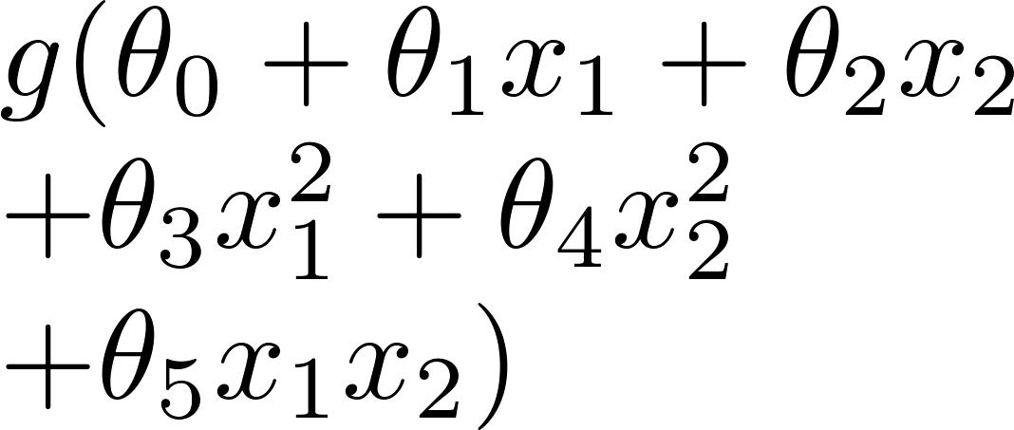
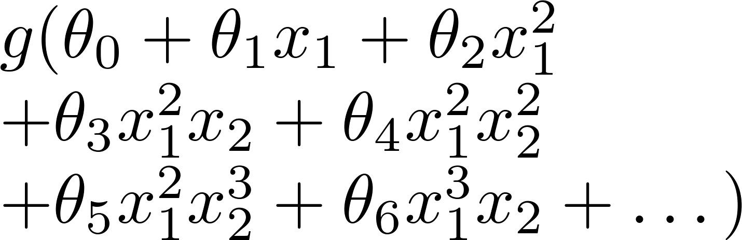
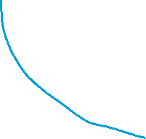




Example: Logistic regression
x₂
x₂
x₂
x₁
x₁
x₁
( = sigmoid function)

Slide 4






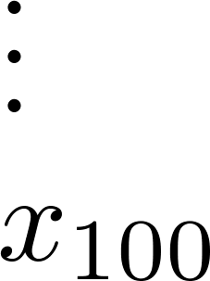
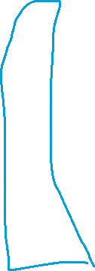

Addressing overfitting:
size of house
no. of bedrooms
Price
no. of floors
age of house
average income in neighborhood
Size
kitchen size

Slide 5




Addressing overfitting:
Options:
Reduce number of features.
Manually select which features to keep.
Model selection algorithm (later in course).
Regularization.
Keep all the features, but reduce magnitude/values of parameters .
Works well when we have a lot of features, each of which contributes a bit to predicting .

Slide 6
Cost function
Regularization

Slide 7


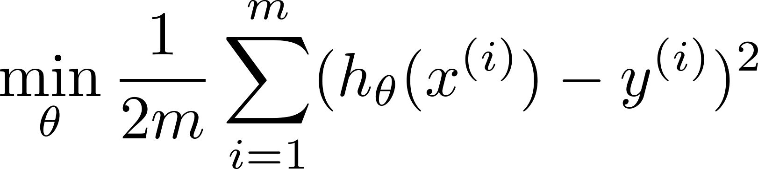







Intuition
Price
Price
Size of house
Size of house
Suppose we penalize and make , really small.

Slide 8
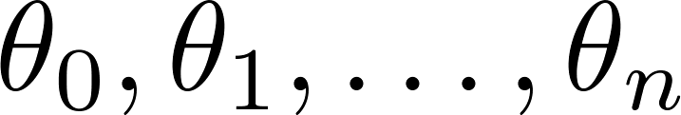
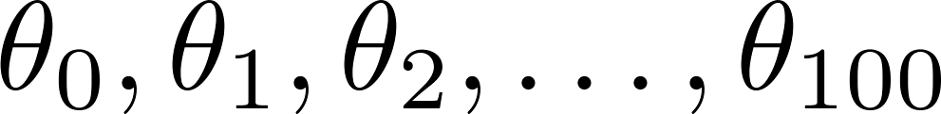
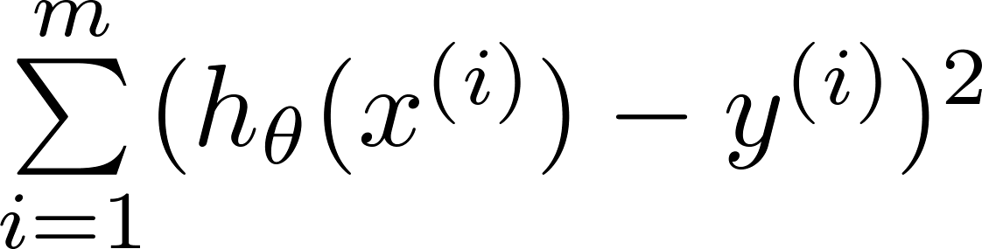
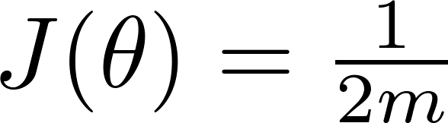








Regularization.
Small values for parameters
“Simpler” hypothesis
Less prone to overfitting
Housing:
Features:
Parameters:

Slide 9
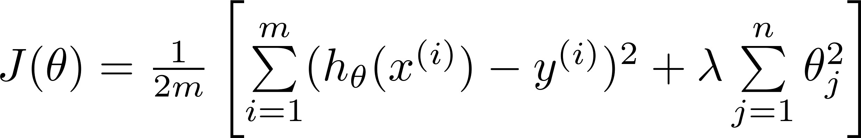
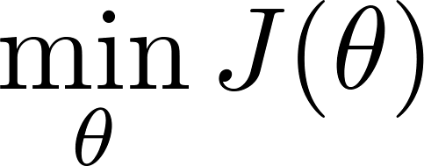




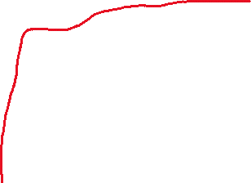
Regularization.
Price
Size of house

Slide 10


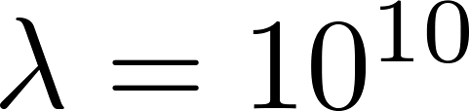







In regularized linear regression, we choose to minimize
What if is set to an extremely large value (perhaps for too large for our problem, say )?
Algorithm works fine; setting to be very large can’t hurt it
Algortihm fails to eliminate overfitting.
Algorithm results in underfitting. (Fails to fit even training data well).
Gradient descent will fail to converge.

Slide 11
In regularized linear regression, we choose to minimize
What if is set to an extremely large value (perhaps for too large for our problem, say )?
Price
Size of house

Slide 12
Regularized linear regression
Regularization

Slide 13

Regularized linear regression

Slide 14

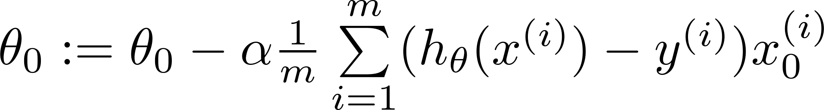
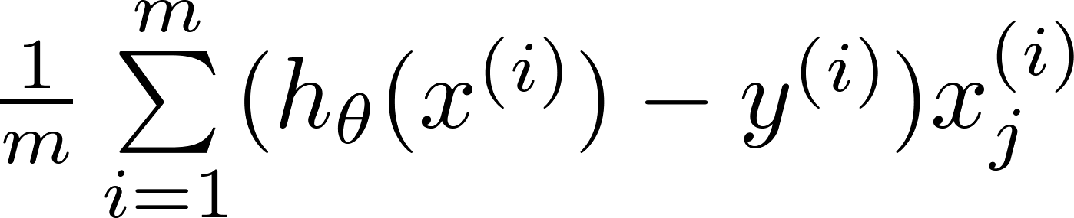
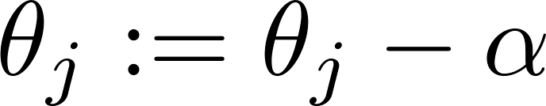


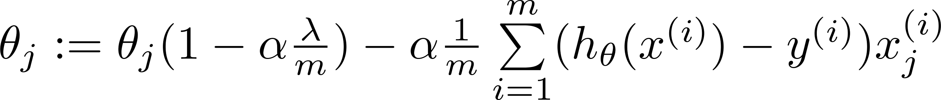







Gradient descent
Repeat

Slide 15
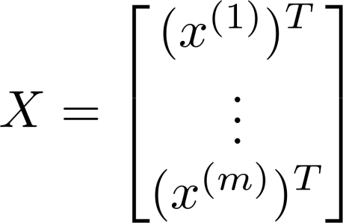
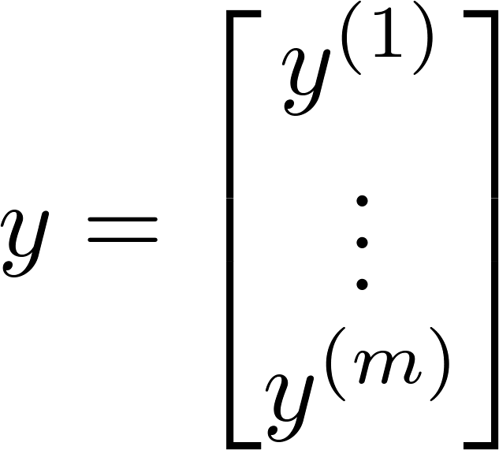
Normal equation

Slide 16
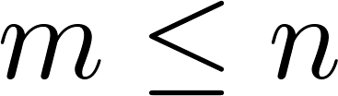
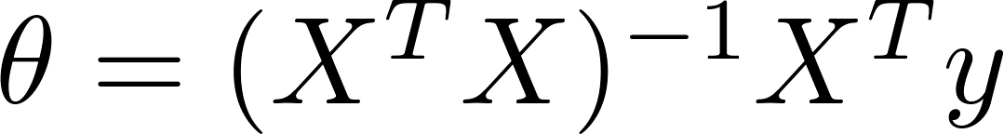

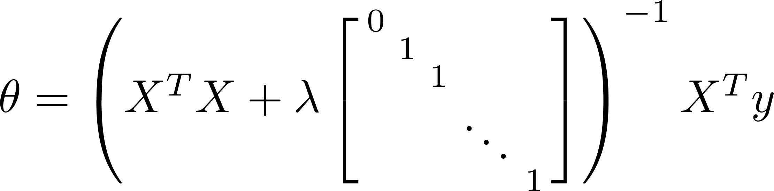
Non-invertibility (optional/advanced).
Suppose ,
(#examples) (#features)
If ,

Slide 17
Regularized logistic regression
Regularization

Slide 18
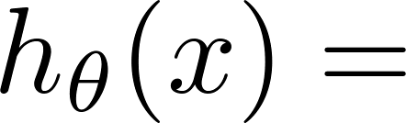
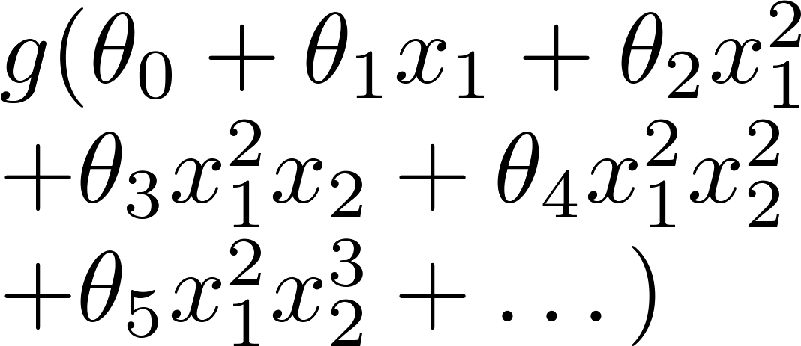
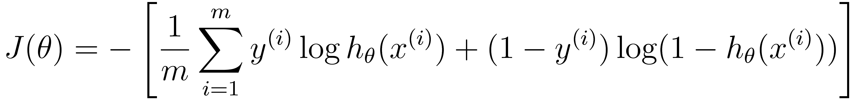
Regularized logistic regression.
x₂
x₁
Cost function:

Slide 19
Gradient descent
Repeat

Slide 20


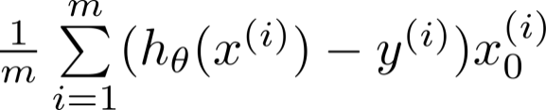

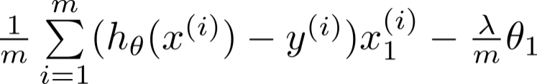

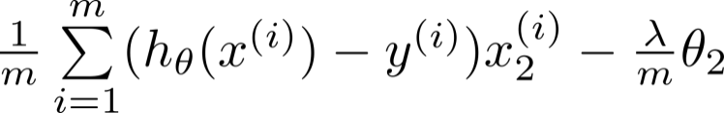

Advanced optimization
function [jVal, gradient] = costFunction(theta)
code to compute
jVal = [ ];
code to compute
gradient(1) = [ ];
code to compute
gradient(2) = [ ];
code to compute
gradient(3) = [ ];
code to compute
gradient(n+1) = [ ];

