Slide 1
INPUT
PROCESSOR
OUTPUT
GUI
image
label
Text detection
image
label
processing
connecting
Panorama
Text recognition
data.csv
image
label
image
label
…
…
Key information extraction

Slide 2
20x160x160
150x512
image
embed
image
150x160x160
embed
encode
saving
<id>.npy
image
Augmentation
Face recognition
embed
image
embed
…
…

Slide 3
nx160x160
1x512
20x1
face
Face recognition
embed
FAISS
Get max score
ID
face
Distance threshold
frame
Face detection
Load dataset
face
face
…

Slide 4
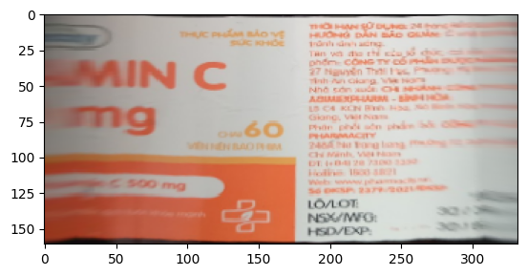
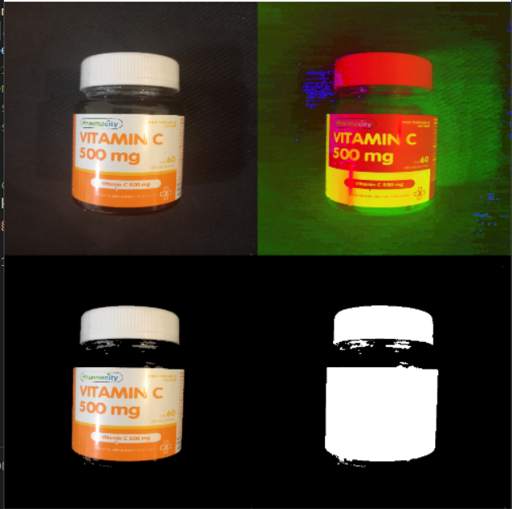
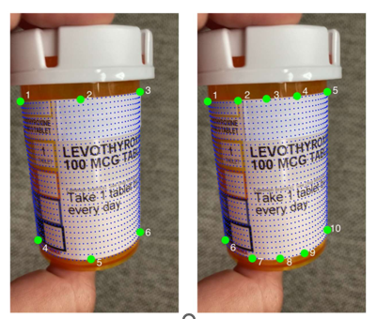
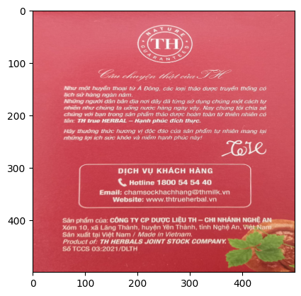
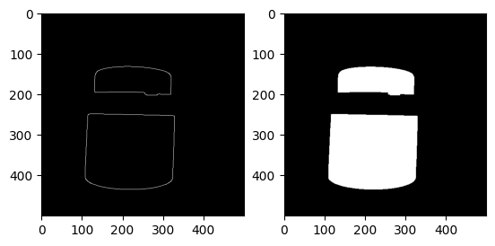
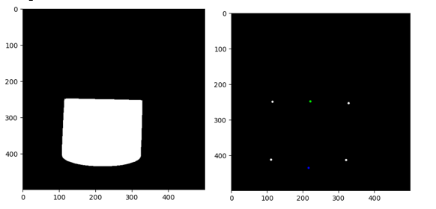
PREPROCESSING IMAGES

Slide 5
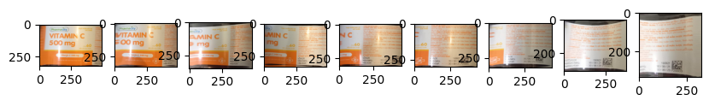
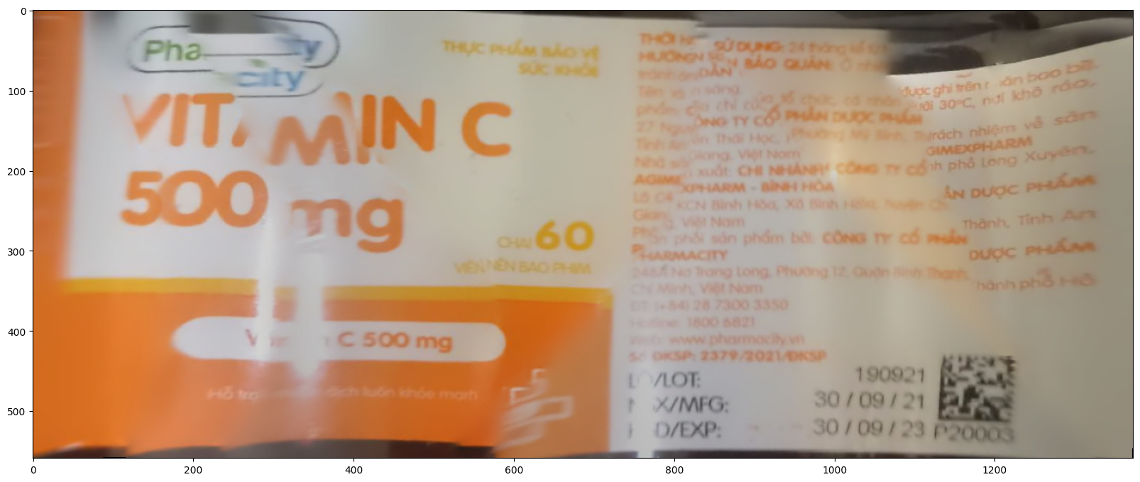
CONNECTING

Slide 6
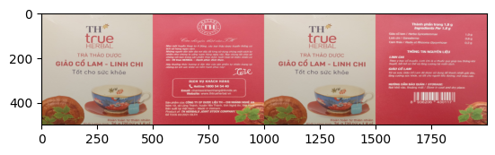
CONNECTING

Slide 7
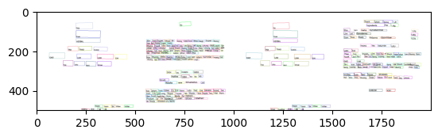
Text extracter
OCR library of open-mmlab

