Slide 1
Optimization of backpropagation
Group 22
SHAO-YU WENG, YU-HONG LAI

Slide 2
Outline
Introduction
Methodology
Experimental Setup
Results and Discussion
Limitation and Conclusion

Slide 3
Introduction
Backpropagation is a fundamental strategy in contemporary AI model training
Each neuron's computation is independent of others.
GPUs can parallelize the computation of neurons
Our current focus is on exploration of backpropagation through CUDA code
The objective is to implement and find out a better strategy/optimize backpropagation performance using CUDA

Slide 4
Methodology (Experimental Procedure)
Initial Execution and Profiling:
Executed the existing program.
Analyzed timeline data using tools like nvprof and NVIDIA Visual Profiler.
Identified potential bottlenecks in the backpropagation algorithm.
Runtime Comparison Across Data Types:
Conducted a comparative analysis of program running times.
Focused on variations in data types to understand their impact on overall execution efficiency.
Memory Allocation Optimization:
Adopted pageable memory, unified memory and pinned memory strategies
Aimed at improving overall program performance by seeking for best memory allocations

Slide 5
Methodology (Data Types)
fp8 (8-bit Floating Point):
Significantly reduces memory requirements and enhances parallel computation throughput.
Suitable for applications where fine-grained precision is not critical, making it ideal for certain deep learning tasks.
half (16-bit Floating Point):
A 16-bit floating-point format balancing reduced memory usage and sufficient precision for deep learning tasks.
Accelerates neural network training and inference while maintaining a reasonable level of numerical accuracy.
bfloat16 (Brain Floating Point 16):
Optimized 16-bit floating-point format for machine learning workloads.
Retains advantages of reduced memory footprint and faster computation, suitable for tasks prioritizing lower precision.

Slide 6
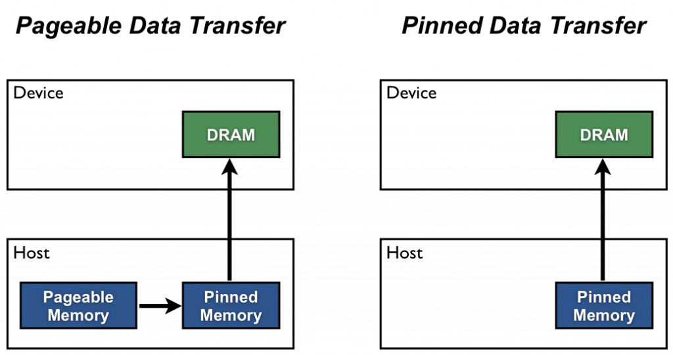
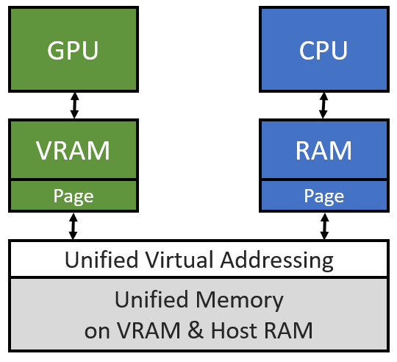
Methodology (CUDA Memory Access)
Pageable Memory:
Fundamental memory allocation in CUDA.
Involves host-side memory allocation and cudaMemcpy for data transfer to the device.
May introduce overhead due to data copying between host and device.
Pinned Memory:
Avoids data copying on the host side, aiming to enhance performance.
Eliminates the need for host-device data transfers during kernel execution.
Occupies a significant portion of host memory, potentially limiting scalability.
Unified Memory:
Employs a page table on both host and device sides.
On-demand data transfers, eliminating explicit copying between host and device.
Straightforward to use but requires careful optimization

Slide 7
Experimental Setup
Platform:
Utilized Tesla T4 GPU in Google Colaboratory.
Cuda Toolkit Version 12.2.
Profiling and Analysis Tools:
Employed Nvidia tools: nvprof, nsight, NVIDIA Visual Profiler.
Facilitated comprehensive examination of outcomes and timelines.
Data Type Comparison:
Executed backpropagation training with a single epoch.
Focused approach for evaluating diverse data types and their impact.
Memory Allocation Comparison:
Iterated backpropagation 1000 times for realistic analysis.
Assessed memory allocation efficiency, considering initialization costs and potential data reuse scenarios.

Slide 8
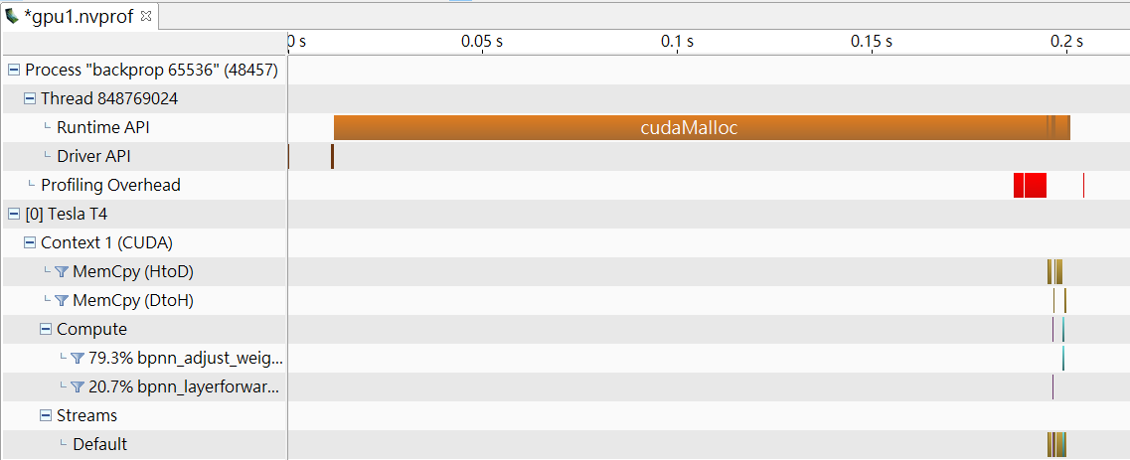
Results and Discussion (Initial Execution and Profiling)

Slide 9
Results and Discussion (Initial Execution and Profiling)
Initiation of Analysis:
Examined the original Rodinia benchmark's backpropagation program.
Leveraged profiling tools like nvprof and Nvidia Nsight for performance insights.
Key Observation:
Identified memory allocation method as a critical factor influencing efficiency.
Prompted prioritization of memory allocation strategy optimization.
Inspiration from Mixed Precision Learning:
Explored recent advancements (Micikevicius, Paulius, et al., 2017).
Focused on potential benefits of reduced precision data types for efficiency and memory consumption.
Dual Focus Strategy:
Prioritized memory allocation optimization.
Explored integration of reduced precision data types in storage and calculation processes.

Slide 10
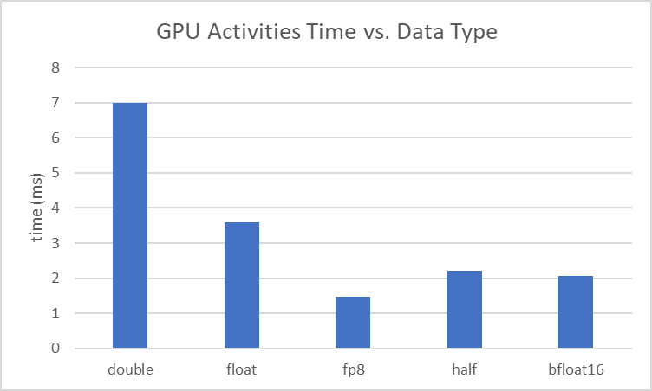
Results and Discussion (Reduced Data Precision)
Experimentation Summary:
Transitioned from double to float data types, supported by both C and CUDA.
Extended implementation to include fp8, half, and bfloat16 data types.
Converted float inputs to desired types, leveraging CUDA library functions for computation.
For fp8, due to the absence of specific math functions, converted back to float for calculations and later back to fp8.

Slide 11
Results and Discussion (Reduced Data Precision)
Outcome Profiling: Tools Used
Employed nvprof and Nsight for outcome profiling.
Observed reductions in GPU activity times (calculation and memory copying).
Reductions, while relatively small in overall execution time, were discernible.
Substantial decrease in memory occupation, often halving or more compared to the original version.
Impact on Execution Time and Memory:
Reduced data precision's impact on total execution time was minor.
Significant contribution to saving GPU execution time and memory.
Enables backpropagation on larger datasets or extended training epochs.
Demonstrates the practical implications of precision/resource efficiency trade-offs in deep learning tasks.

Slide 12
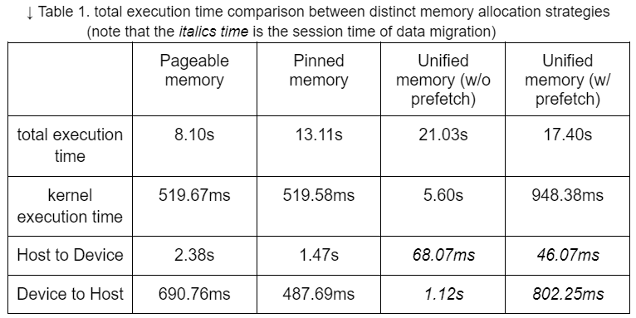
Results and Discussion (Cuda Memory Allocation)
Why pinned memory is slower?

Slide 13
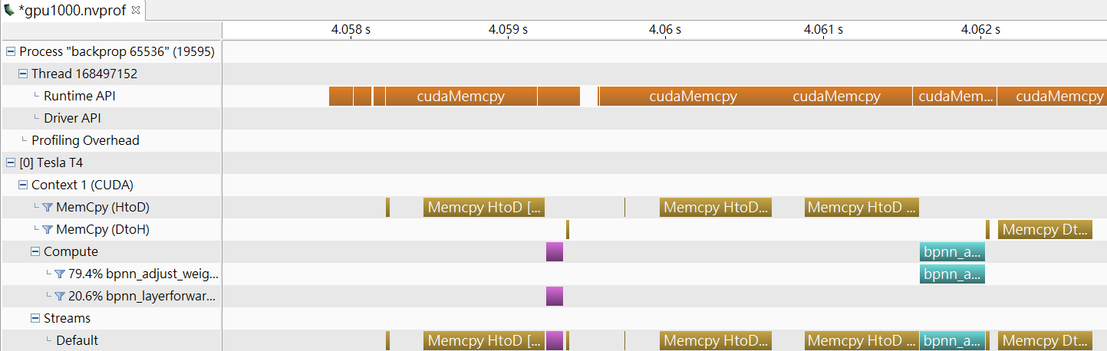
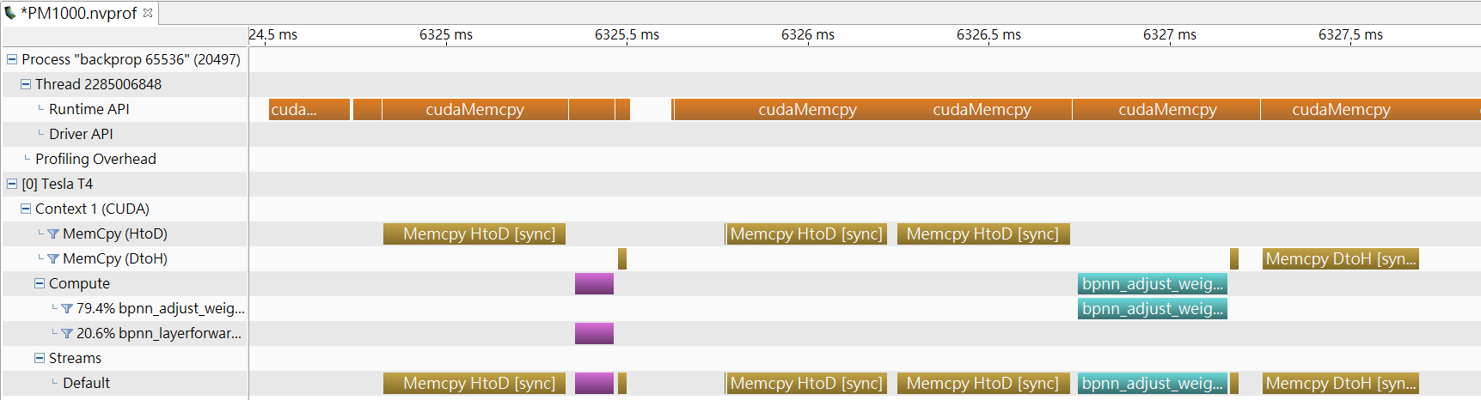
Results and Discussion (Why pinned memory is slower?)
pageable memory
frequent memory copies between the host and device are observed
the possibility of uncached memory access (read) in the main memory may lead to a slowdown in performance
pinned memory

Slide 14
Results and Discussion (Cuda Memory Allocation)
Why unified memory is slower?

Slide 15
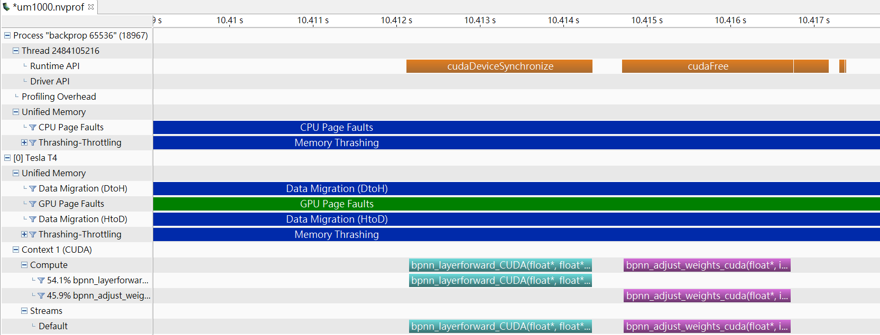
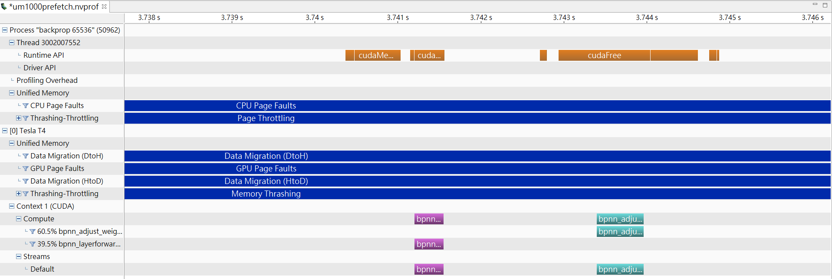
Results and Discussion (Why pinned memory is slower?)
Unified memory (w/o prefetch)
page faults are intrigued, which significantly degrades the performance of unified memory
cudaMemPrefetchAsync
prefetching operation, which still incurs an additional cost in terms of execution time and resource utilization
Unified memory (w/ prefetch)

Slide 16
Limitation and Conclusion
Limitation
Can not evaluate the accuracy of training:
Doesn’t equip with the ability to train with the real world data
Conclusion
For backpropagation implemented in the rodian benchmark,
reduced data type precision is useful in shortening runtime
the optimal setting is of memory allocation is pageable memory
The performance of each memory allocation strategy and datatype depends on the specific requirements and characteristics of the application

Slide 17
Thank you for your listening!
Q&A

Slide 18
Reference
S. Che et al., "Rodinia: A benchmark suite for heterogeneous computing," 2009 IEEE International Symposium on Workload Characterization (IISWC), Austin, TX, USA, 2009, pp. 44-54, doi: 10.1109/IISWC.2009.5306797.
Micikevicius, Paulius, et al. "Mixed precision training." arXiv preprint arXiv:1710.03740 (2017).
CUDA Memory Access: Global, Zero-Copy, Unified
Pinned Memory slower than pageable memory

