Slide 1
Calmly
An AI companion that grows with you, and keeps your therapist in the loop
Weekly adaptive quizzes | AI judged journal growth | Therapist-facing AI reports

Slide 2
The problem
Patients live their mental health everyday.
Therapy sees only an hour
Patients
Therapists
Anxiety happens between sessions
Self-help apps can feel repetitive
Triggers, moods and habits get lost
Stigma makes seeking therapy harder
Motivation fades without visible
Progress
See patients for a limited window each week
Daily patient behavior remains largely unseen
Progress tracking is often manual
Lack of continuous context limits intervention
The data patients generate between sessions never reach the people treating them
Calmly

Slide 3
The problem
Patients live their mental health everyday.
Therapy sees only an hour
Patients
Therapists
Anxiety happens between sessions
Self-help apps can feel repetitive
Triggers, moods and habits get lost
Stigma makes seeking therapy harder
Motivation fades without visible
Progress
See patients for a limited window each week
Daily patient behavior remains largely unseen
Progress tracking is often manual
Lack of continuous context limits intervention
The data patients generate between sessions never reach the people treating them
Calmly

Slide 4
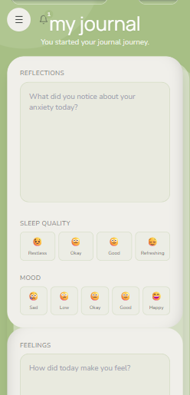
The solution
Calmly - One continuous care loop, connecting patients and therapists
Journal . Exercises . Mood and sleep .
Daily Practice
Calmly
Patient acts -> AI understands -> Therapist intervenes -> Care improves

Slide 5
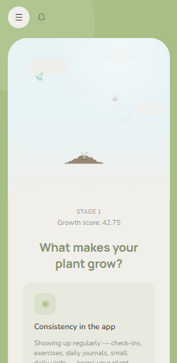
The solution
Calmly - One continuous care loop, connecting patients and therapists
Journal . Exercises . Mood and sleep .
A plant that grows with real progress
Daily Practice
Living Feedback
Calmly
Patient acts -> AI understands -> Therapist intervenes -> Care improves

Slide 6
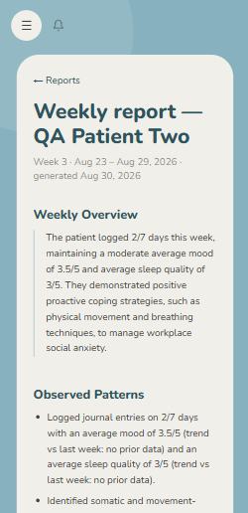
The solution
Calmly - One continuous care loop, connecting patients and therapists
Journal . Exercises . Mood and sleep .
A plant that grows with real progress
Weekly AI report to the therapist
Daily Practice
Living Feedback
Professional
Loop
Calmly
Patient acts -> AI understands -> Therapist intervenes -> Care improves

Slide 7
The solution
Calmly - One continuous care loop, connecting patients and therapists
Journal . Exercises . Mood and sleep .
A plant that grows with real progress
Weekly AI report to the therapist
Calmly
Patient acts -> AI understands -> Therapist intervenes -> Care improves

Slide 8
The need & impact
The Need
Calmly's impact
Calmly
AI turns everyday patient experiences into personalized insights and better human guidance

Slide 9
The need & impact
The Need
Calmly's impact
The gap between therapy sessions -
Therapists may not see what happens in a patients daily life.
Continuous visibility through daily journals, mood, sleep, exercises and weekly patterns.
Calmly
AI turns everyday patient experiences into personalized insights and better human guidance

Slide 10
The need & impact
The Need
Calmly's impact
The gap between therapy sessions -
Therapists may not see what happens in a patients daily life.
Continuous visibility through daily journals, mood, sleep, exercises and weekly patterns.
Access to therapy can be difficult – distance, time and limited availability can become barriers.
Remote therapy connection allows patients to stay connected with verified therapists beyond physical boundaries.
Calmly
AI turns everyday patient experiences into personalized insights and better human guidance

Slide 11
The need & impact
The Need
Calmly's impact
The gap between therapy sessions -
Therapists may not see what happens in a patients daily life.
Continuous visibility through daily journals, mood, sleep, exercises and weekly patterns.
Access to therapy can be difficult – distance, time and limited availability can become barriers.
Remote therapy connection allows patients to stay connected with verified therapists beyond physical boundaries.
Mental-health stigma can prevent people from seeking help.
A private low-barrier digital space lets users begin tracking and seeking support more comfortably.
Calmly
AI turns everyday patient experiences into personalized insights and better human guidance

Slide 12
The need & impact
The Need
Calmly's impact
The gap between therapy sessions -
Therapists may not see what happens in a patients daily life.
Continuous visibility through daily journals, mood, sleep, exercises and weekly patterns.
Access to therapy can be difficult – distance, time and limited availability can become barriers.
Remote therapy connection allows patients to stay connected with verified therapists beyond physical boundaries.
Mental-health stigma can prevent people from seeking help.
A private low-barrier digital space lets users begin tracking and seeking support more comfortably.
Patients often struggle to maintain consistent self-care and reflection.
Gentle engagement through guide exercises, journaling, personalized questions and the plant-growth system.
Calmly
AI turns everyday patient experiences into personalized insights and better human guidance

Slide 13
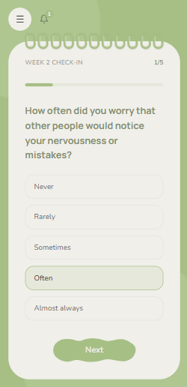
The need & impact
The Need
Calmly's impact
The gap between therapy sessions -
Therapists may not see what happens in a patients daily life.
Continuous visibility through daily journals, mood, sleep, exercises and weekly patterns.
Access to therapy can be difficult – distance, time and limited availability can become barriers.
Remote therapy connection allows patients to stay connected with verified therapists beyond physical boundaries.
Mental-health stigma can prevent people from seeking help.
A private low-barrier digital space lets users begin tracking and seeking support more comfortably.
Patients often struggle to maintain consistent self-care and reflection.
Gentle engagement through guide exercises, journaling, personalized questions and the plant-growth system.
Therapists need meaning., not just isolated session conversations.
AI-assisted weekly insights organize patterns so therapists can provide more informed, personalized guidance.
Calmly
AI turns everyday patient experiences into personalized insights and better human guidance

Slide 14
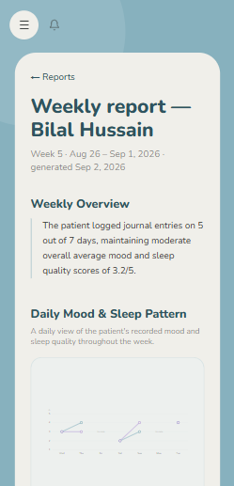
AI Feature
AI assisted personalization
Calmly

Slide 15
AI Feature
AI assisted personalization
Weekly quizzes that adapt to the person
Past 6 quiz weeks scored per dimension, recency-weighted
LLM also re-reads recent journals to score the same dimensions
Combined rank = 60% quiz + 40% journal
Top 3 weakest dimensions triggers fresh AI-written questions
No repeats inside a two week window
Calmly

Slide 16
AI Feature
AI assisted personalization
Weekly quizzes that adapt to the person
Journal entries
Past quiz score
Past 6 quiz weeks scored per dimension, recency-weighted
LLM also re-reads recent journals to score the same dimensions
Combined rank = 60% quiz + 40% journal
Top 3 weakest dimensions triggers fresh AI-written questions
No repeats inside a two week window
0.4 weight
0.6 weight
Dimension struggle ranking
Weakest dims
LLM writes new questions
2-week exclusion
5-question weekly quiz prepared
Calmly

Slide 17
AI Feature
AI assisted personalization
A journal that judges growth - honestly
The LLM as a strict gate-keeper
With 7+ entries of history , the LLM compares today's writing against recent pattern –more positive attitude? Better trigger awareness? When in doubt, no bonus
Why this matters
- Anti-gaming
- Rewards genuine refection
- Plant become an honest
visual mental-health
timeline
Calmly

Slide 18
AI Feature
AI assisted personalization
A journal that judges growth - honestly
Feelings
Reflection
The LLM as a strict gate-keeper
With 7+ entries of history , the LLM compares today's writing against recent pattern –more positive attitude? Better trigger awareness? When in doubt, no bonus
Why this matters
- Anti-gaming
- Rewards genuine refection
- Plant become an honest
visual mental-health
timeline
LLM compares past 7 day entries
improvement
No positive feedback
Plant grows
Returns no score
Calmly

Slide 19
AI Feature
AI assisted personalization
A plant that symbolizes mental growth
Throughout the week , calmly notices the positive changes and efforts. Which are visually represented as your calmly companion- a plant that grows with you.
Keeps the patient motivated and consistent.
Calmly

Slide 20
AI Feature
AI assisted personalization
A plant that symbolizes mental growth
Journal
Quiz
Exercises
Throughout the week , calmly notices the positive changes and efforts. Which are visually represented as your calmly companion- a plant that grows with you.
Keeps the patient motivated and consistent.
Plant grows
Calmly

Slide 21
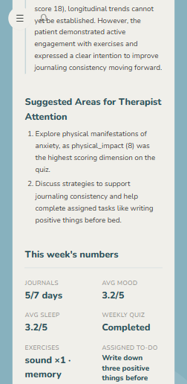
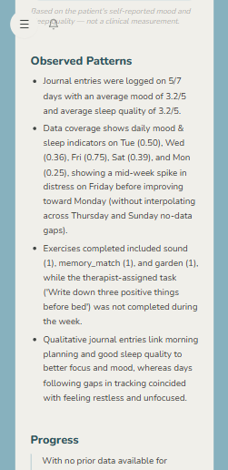
AI Feature
AI assisted personalization
Grounded weekly AI reports for therapist
Numbers are computed, never generated
Stats are generated directly from the db.
Always human-over-AI
Therapist review & edit future quizzes, add advices
Calmly

Slide 22
AI Feature
AI assisted personalization
Grounded weekly AI reports for therapist
Numbers are computed, never generated
Stats are generated directly from the db.
Always human-over-AI
Therapist review & edit future quizzes, add advices
Calmly

Slide 23
AI Feature
AI assisted personalization
Dual-LLM with graceful fallback
Gemini flash first, Groq fallback. If both fails, features degrades. The app never breaks
Calmly

Slide 24
AI Feature
Full-stack, production grade, self-healing
patient
Dual-LLM with graceful fallback
Gemini flash first, Groq fallback. If both fails, features degrades. The app never breaks
Journal & quiz
Exercises + mediapipe
therapist
Weekly Ai reports
Task: advice + feedback
Server next js &API
Security-first by design
Ai layer:
Gemini , Groq
bcrypt passwords and OTPs, JWT isolation and journal lock tokens, server-side data scoping
Mongodb Atlas
Calmly

Slide 25
AI Feature
Full-stack, production grade, self-healing
patient
Dual-LLM with graceful fallback
Gemini flash first, Groq fallback. If both fails, features degrades. The app never breaks
Journal & quiz
Exercises + mediapipe
therapist
Weekly Ai reports
Task: advice + feedback
Server next js &API
Security-first by design
Ai layer:
Gemini , Groq
bcrypt passwords and OTPs, JWT isolation and journal lock tokens, server-side data scoping
Mongodb Atlas
Calmly

Slide 26
AI Feature
Full-stack, production grade, self-healing
patient
Dual-LLM with graceful fallback
Gemini flash first, Groq fallback. If both fails, features degrades. The app never breaks
Journal & quiz
Exercises + mediapipe
therapist
Weekly Ai reports
Task: advice + feedback
Server next js &API
Security-first by design
Ai layer:
Gemini , Groq
bcrypt passwords and OTPs, JWT isolation and journal lock tokens, server-side data scoping
Mongodb Atlas
Beyond English
I18n with RTL serving
Full English / اُردُو
communities often ignores by mental-health tech
Calmly
Full English / اُردُو

Slide 27
The patient experience
a week in Calmly
Adaptive weekly quiz
5 questions – written fresh by AI for this patient's weakest dimensions, never repeating.
Daily journal with feelings and reflections
Mood + Sleep check-in. Entries are password protected, and AI reads them to personalize everything downstream
Calmly

Slide 28
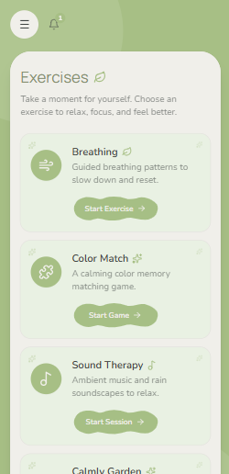
The patient experience
a week in Calmly
Adaptive weekly quiz
5 questions – written fresh by AI for this patient's weakest dimensions, never repeating.
Daily journal with feelings and reflections
Mood + Sleep check-in. Entries are password protected, and AI reads them to personalize everything downstream
Calmly

Slide 29
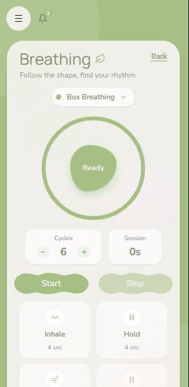
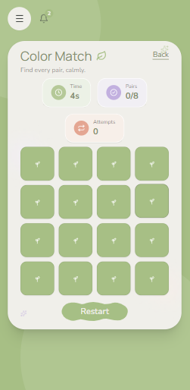
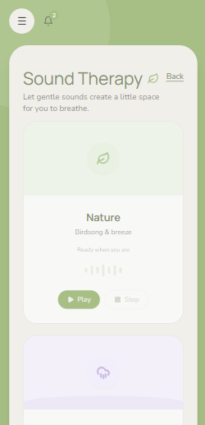
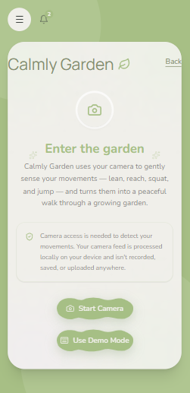
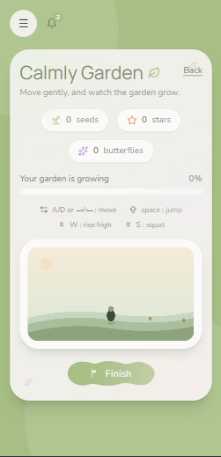
The patient experience
a week in Calmly
Adaptive weekly quiz
5 questions – written fresh by AI for this patient's weakest dimensions, never repeating.
Daily journal with feelings and reflections
Mood + Sleep check-in. Entries are password protected, and AI reads them to personalize everything downstream
Grounding Exercises
Guided breathing, sound therapy, color matcher for mind deviation – plus CALMLY GARDEN a vision tracked relaxation game
Calmly

Slide 30
The patient experience
a week in Calmly
Adaptive weekly quiz
5 questions – written fresh by AI for this patient's weakest dimensions, never repeating.
Daily journal with feelings and reflections
Mood + Sleep check-in. Entries are password protected, and AI reads them to personalize everything downstream
Grounding Exercises
Guided breathing, sound therapy, color matcher for mind deviation – plus CALMLY GARDEN a vision tracked relaxation game
Calmly

Slide 31
The patient experience
a week in Calmly
Adaptive weekly quiz
5 questions – written fresh by AI for this patient's weakest dimensions, never repeating.
Daily journal with feelings and reflections
Mood + Sleep check-in. Entries are password protected, and AI reads them to personalize everything downstream
Grounding Exercises
Guided breathing, sound therapy, color matcher for mind deviation – plus CALMLY GARDEN a vision tracked relaxation game
Calmly

Slide 32
The patient experience
a week in Calmly
Adaptive weekly quiz
5 questions – written fresh by AI for this patient's weakest dimensions, never repeating.
Daily journal with feelings and reflections
Mood + Sleep check-in. Entries are password protected, and AI reads them to personalize everything downstream
Grounding Exercises
Guided breathing, sound therapy, color matcher for mind deviation – plus CALMLY GARDEN a vision tracked relaxation game
Calmly

Slide 33
The patient experience
a week in Calmly
Adaptive weekly quiz
5 questions – written fresh by AI for this patient's weakest dimensions, never repeating.
Daily journal with feelings and reflections
Mood + Sleep check-in. Entries are password protected, and AI reads them to personalize everything downstream
Grounding Exercises
Guided breathing, sound therapy, color matcher for mind deviation – plus CALMLY GARDEN a vision tracked relaxation game
Calmly

Slide 34
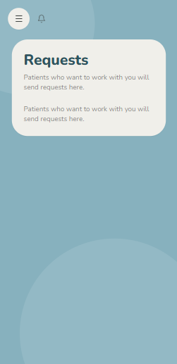
The patient experience
a week in Calmly
Adaptive weekly quiz
5 questions – written fresh by AI for this patient's weakest dimensions, never repeating.
Daily journal with feelings and reflections
Mood + Sleep check-in. Entries are password protected, and AI reads them to personalize everything downstream
Grounding Exercises
Guided breathing, sound therapy, color matcher for mind deviation – plus CALMLY GARDEN a vision tracked relaxation game
The Plant growth
A plant that grows with patients mental health. Score is counted carefully comparing past week with this one.
Calmly

Slide 35
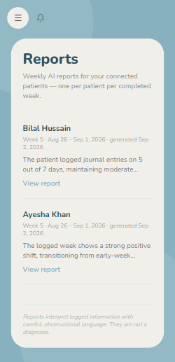
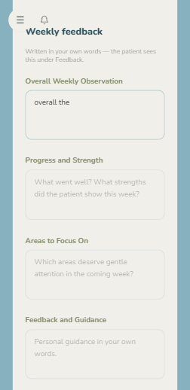
The Therapist experience
a week in Calmly
Accepts patient requests
5 questions – written fresh by AI for this patient's weakest dimensions, never repeating.
Receives weekly report
Mood + Sleep check-in. Entries are password protected, and AI reads them to personalize everything downstream
Sends weekly feedback
Guided breathing, sound therapy, color matcher for mind deviation – plus CALMLY GARDEN a vision tracked relaxation game
Calmly

Slide 36
The Therapist experience
a week in Calmly
Accepts patient requests
5 questions – written fresh by AI for this patient's weakest dimensions, never repeating.
Receives weekly report
Mood + Sleep check-in. Entries are password protected, and AI reads them to personalize everything downstream
Sends weekly feedback
Guided breathing, sound therapy, color matcher for mind deviation – plus CALMLY GARDEN a vision tracked relaxation game
Calmly

Slide 37
The Therapist experience
a week in Calmly
Accepts patient requests
5 questions – written fresh by AI for this patient's weakest dimensions, never repeating.
Receives weekly report
Mood + Sleep check-in. Entries are password protected, and AI reads them to personalize everything downstream
Sends weekly feedback
Guided breathing, sound therapy, color matcher for mind deviation – plus CALMLY GARDEN a vision tracked relaxation game
Calmly

Slide 38
Calmly
Lets make the space between sessions count
Built with Next.js . Mongodb Atlas . Gemini & Groq . MediaPipe
Thankyou

Slide 39
Calmly
Lets make the space between sessions count
4
2
0
2
AI systems in production
LLMs with auto-fallback
AI-invented statistics
Languages , full RTL support
Built with Next.js . Mongodb Atlas . Gemini & Groq . MediaPipe
Thankyou

