Slide 1




BSCS-F23
AI PROJECT
TITLE
AI TEACHER AGENT
WITH ADAPTIVE DIFFICULTY
SUBMITTED TO:
TO MAAM IRFANA

Slide 2

GROUP MEMBERS
BCSF23M002 - HAFIZ ABDUL QADIR
BCSF23M010 - AYESHA WAQAR
BCSF23M033 - LAIBA NAVEED
BCSF23M042 - HAFIZ SHOAIB AHMAD

Slide 3
PROJECT SUMMARY
AI Teacher Assistant: an intelligent tutoring system that offers personalized, AI-powered explanations (intro, definitions, examples, applications, problem-solving, advanced concepts, research papers), auto-generates quiz questions from topics or PDFs with adjustable difficulty, evaluates responses with semantic analysis and detailed feedback, tracks performance with analytics, maintains memory for context-aware interactions, and supports multiple data sources (JSON/CSV) with advanced search, filtering, and categorization.

Slide 4
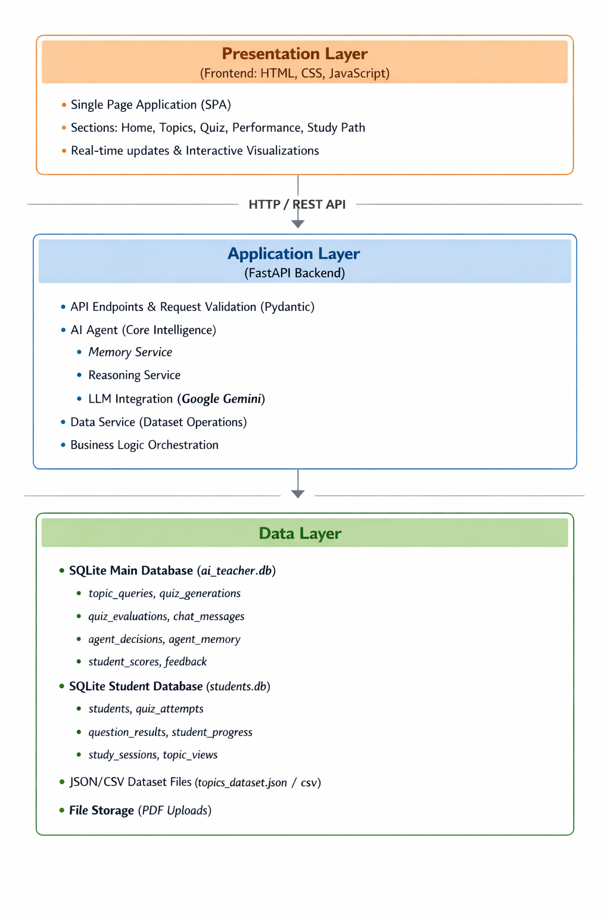
ARCHITECTURAL DIAGRAM

Slide 5
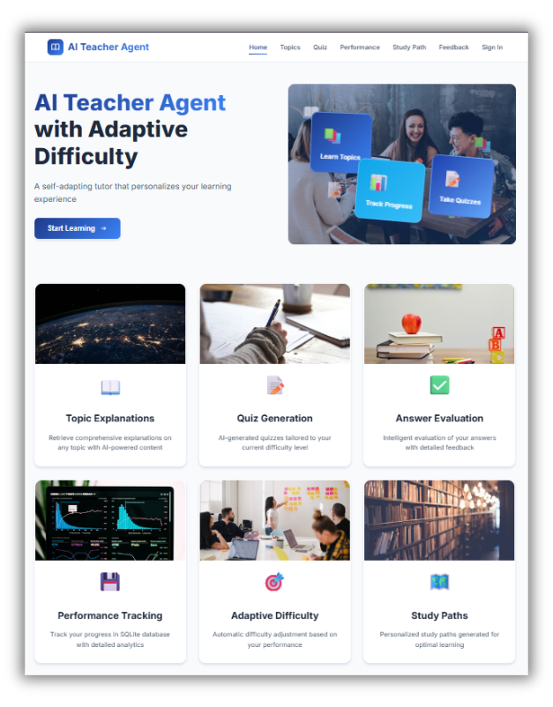
DEMONSTRATION SCREENSHOTS
Home Page

Slide 6

DEMONSTRATION SCREENSHOTS

Slide 7
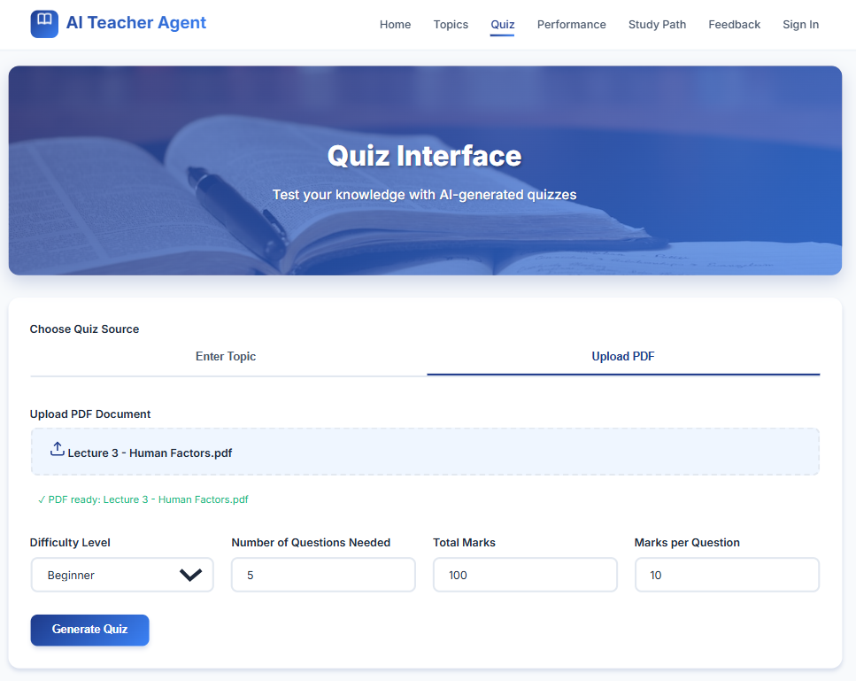
Quiz Generation
Demonstration Screenshots

Slide 8
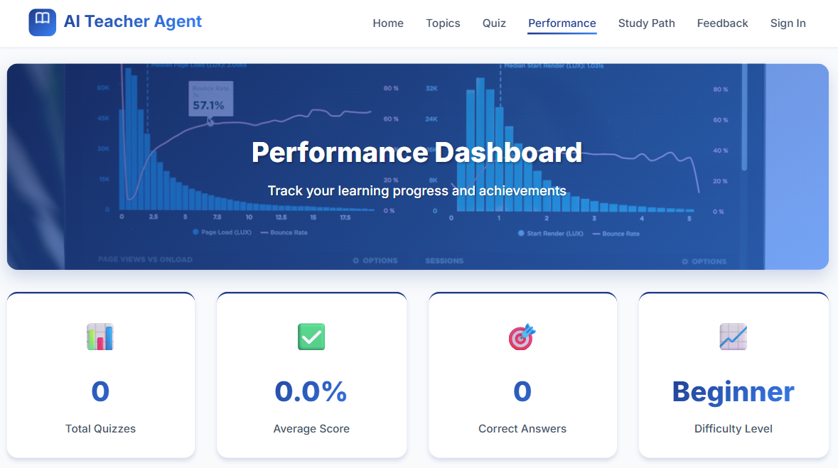
Performance Tracking
Demonstration Screenshots

Slide 9
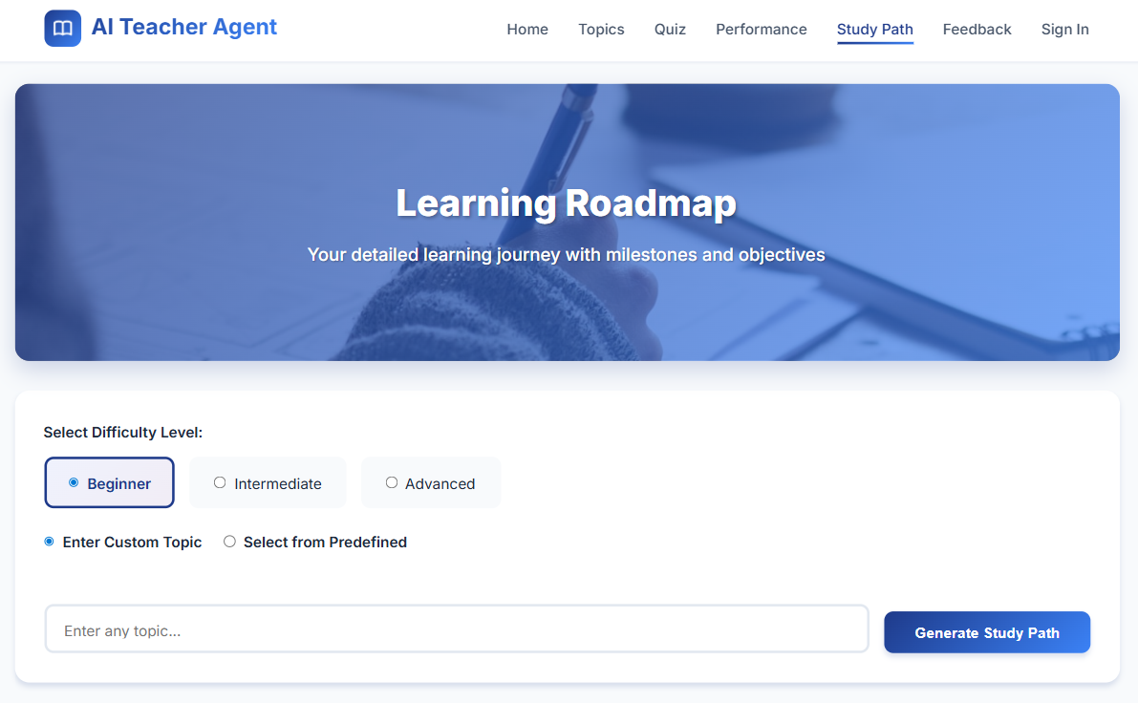
Study Paths
Demonstration Screenshots

Slide 10
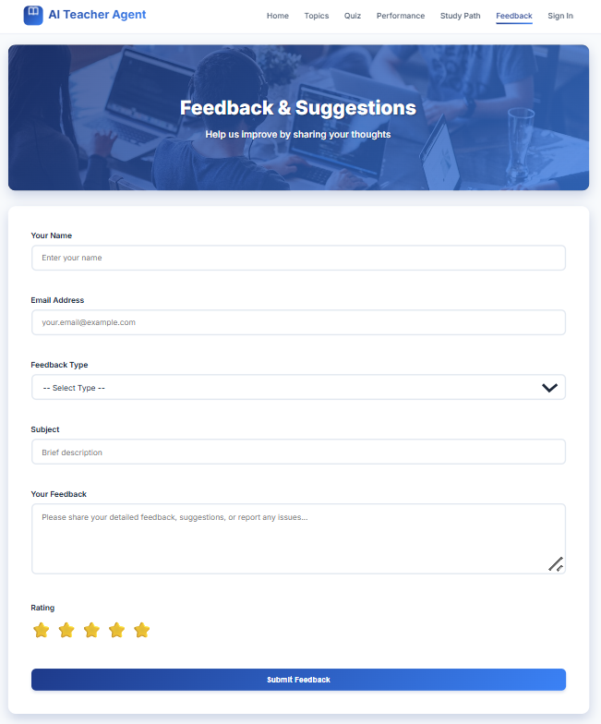
Demonstration Screenshots

Slide 11
KEY FINDINGS
Technical Achievements
Robust Fallback Mechanisms
Operates reliably without LLMs using template-based generation.
Intelligent Content Type Detection
Automatically detects intent and extracts topics from queries.
Comprehensive Validation Layer
Ensures data integrity with strict validation and bounded scoring.
Sign in/ Sign up
Don’t allow user to use website without sign in/up.
AI-Powered Answer Evaluation
Semantically evaluates answers with feedback and partial scoring.

Slide 12
KEY FINDINGS
2. User Experience Insights
Personalization
Adapts learning using conversation memory and performance tracking.
Flexibility
Generates customizable quizzes from topics or PDF documents.
Resource Integration
Enhances learning with videos, references, and document-based content.

Slide 13
KEY FINDINGS
3. System Performance
Response Times
Ensures fast APIs, efficient database queries, and timely LLM and PDF processing.
Quality Metrics
Maintains high completeness, confidence, diversity, and semantic answer accuracy.

Slide 14
FUTURE
ENHANCEMENTS
Context-based enhancements
Generation of MCQs, LQs in Quiz Generation
PDF Words Enhancements

Slide 15
CONCLUSION
Successfully integrates AI technologies with traditional educational systems
Delivers intelligent reasoning features including memory, summarization, and explanations
Ensures reliability through strong validation, logging, and fallback mechanisms
Enhances learning with personalized study paths and performance tracking
Designed with a flexible, scalable, and user-centric architecture.

Slide 16
THANK YOU

