Slide 1
Information Processing Techniques
Week 02
Abeeha Sattar

Slide 2
A Quick Overview of Azure DevOps
Notes:
Version control
Reporting
Requirements Management
Project Management
Automated Builds
Testing
Release Management

Slide 3
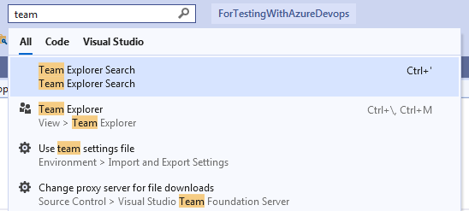
Connection from VS

Slide 4
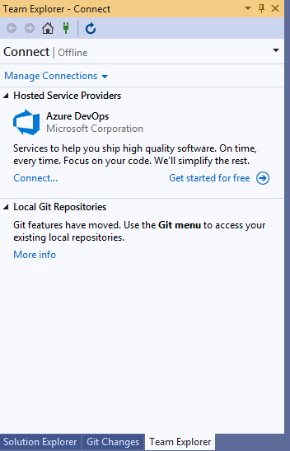
Team Explorer

Slide 5
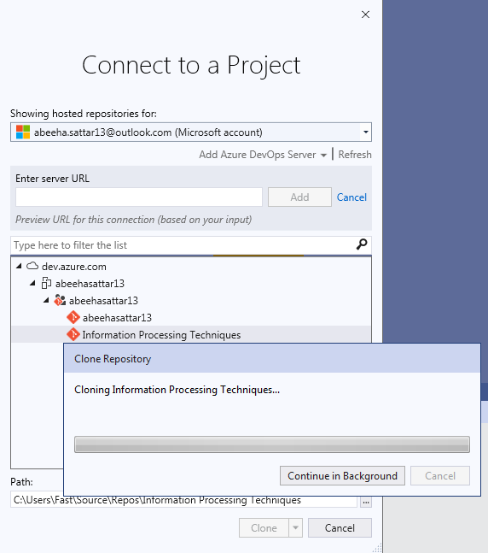
Connecting to a Project

Slide 6
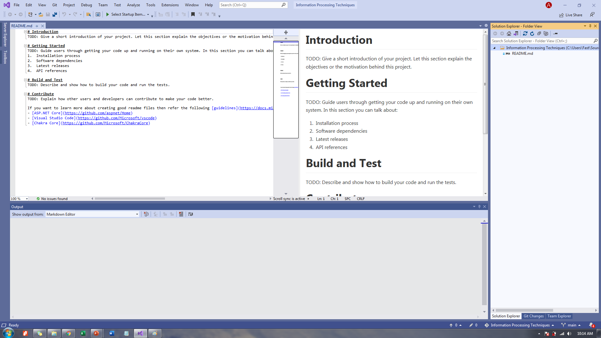
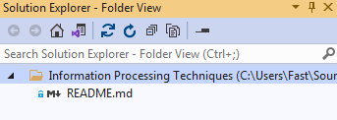
Solution Explorer

Slide 7
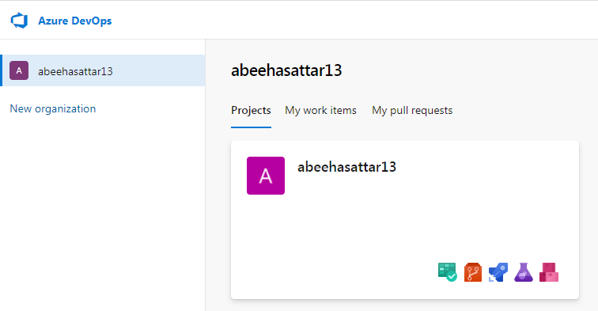
Azure DevOps

Slide 8
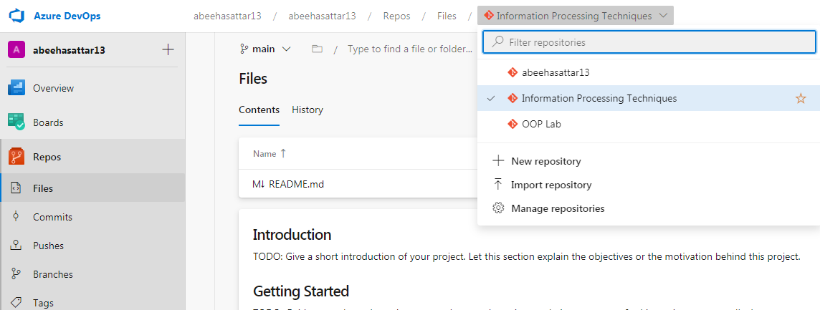
Repositories

Slide 9
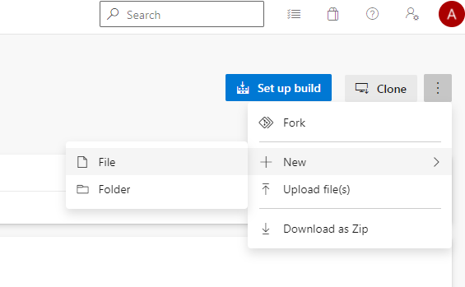
Adding a File to a Repository

Slide 10
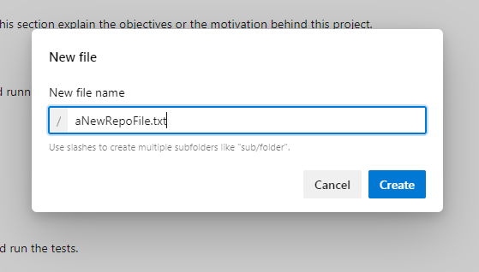
Adding a File to a Repository

Slide 11
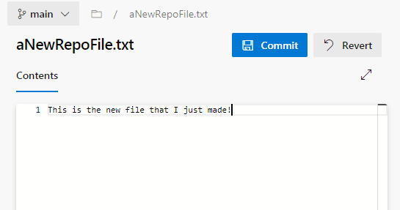
Adding a File to a Repository

Slide 12
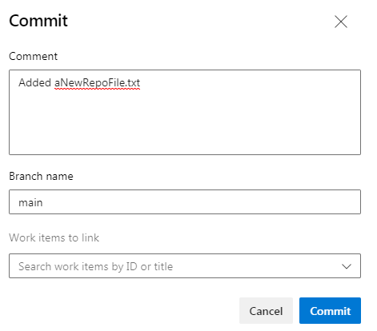
Adding a File to a Repository

Slide 13
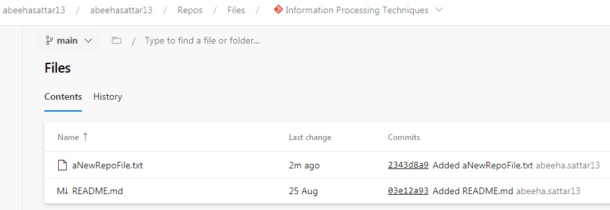
Adding a File to a Repository

Slide 14

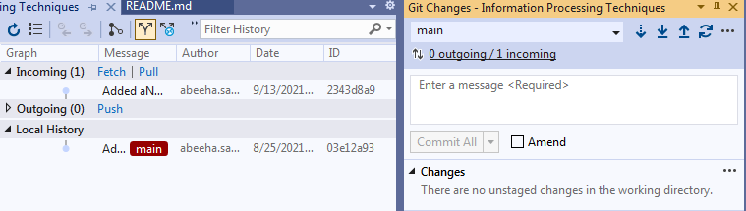
Fetching Incoming Changes

Slide 15
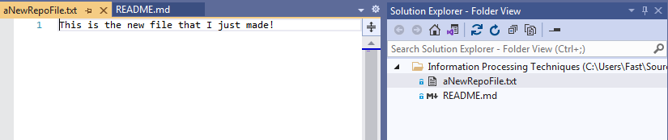
Fetching Incoming Changes

Slide 16
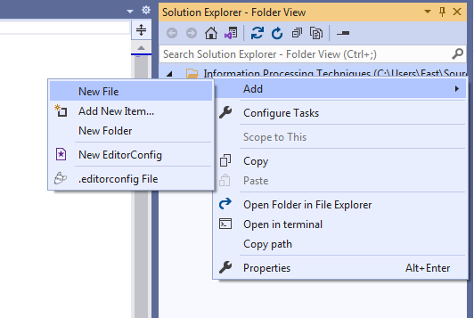
Creating a VS File

Slide 17
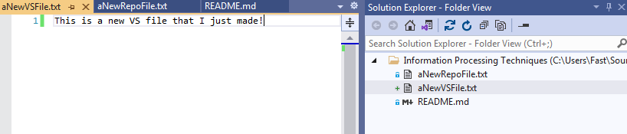
Creating a VS File

Slide 18
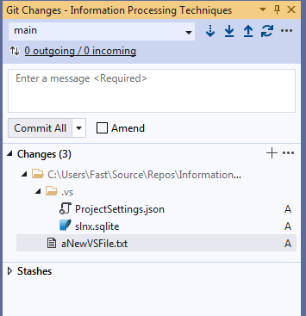
Committing Changes

Slide 19
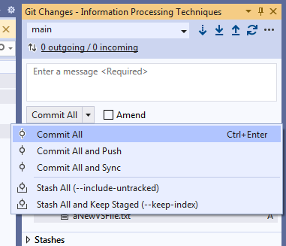
Committing Changes

Slide 20
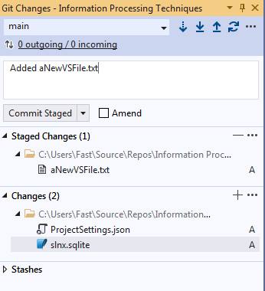
Committing Staged Changes

Slide 21
Committing Staged Changes

Slide 22
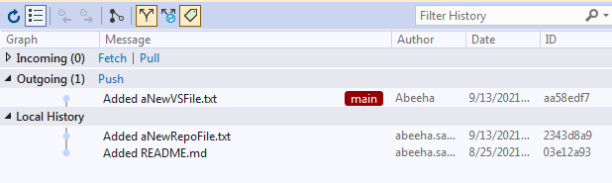
Pushing Changes

Slide 23
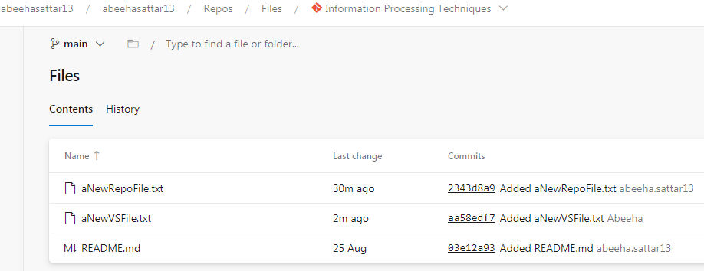
Pushing Changes

Slide 24
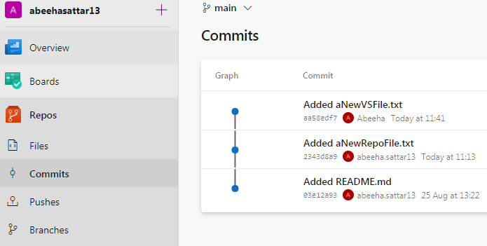
Looking at Committed Changes

Slide 25
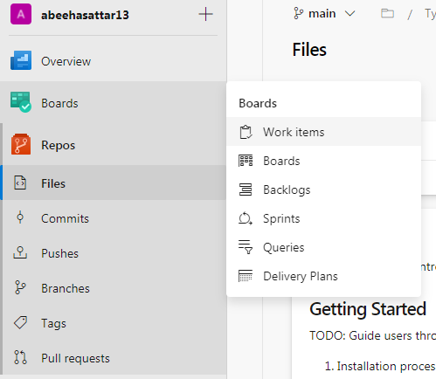
Work Items

Slide 26
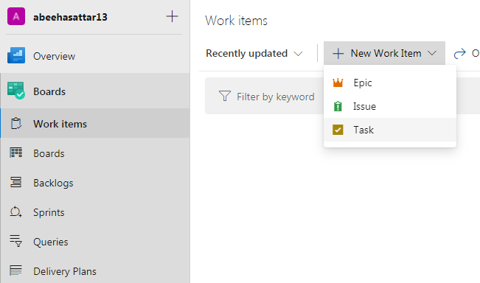
Work Items > Tasks

Slide 27
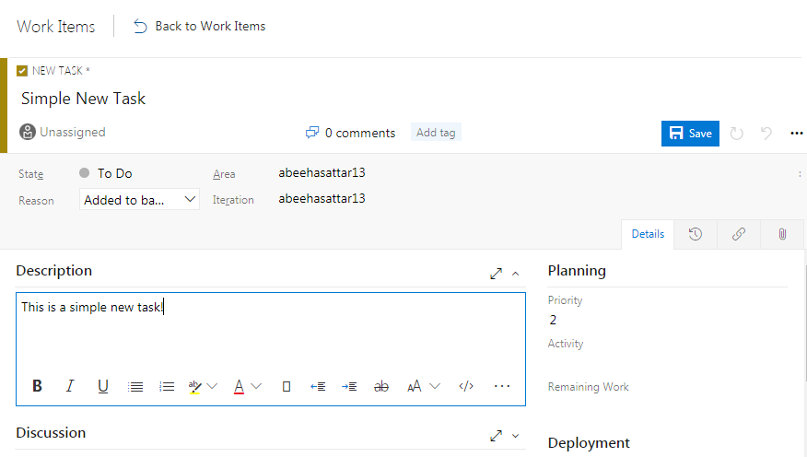
Adding a Work Item

Slide 28
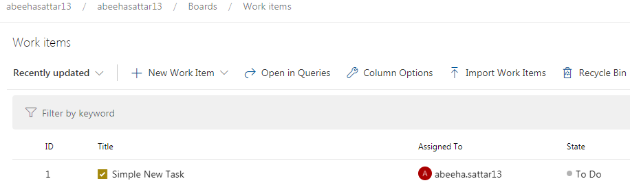
Looking at Work Items

Slide 29
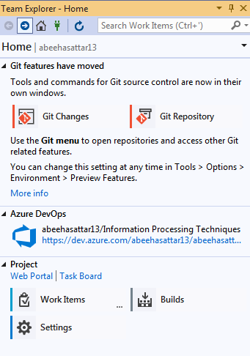
Finding Work Items in VS

Slide 30
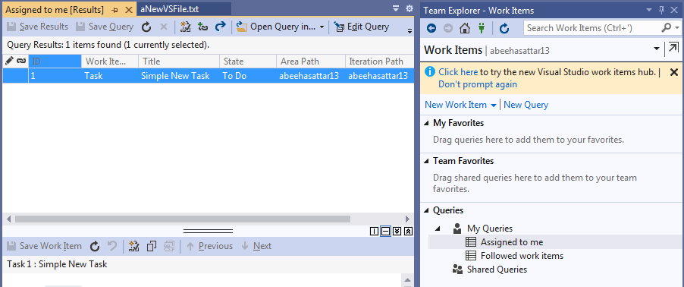
Viewing Your Work Items

Slide 31
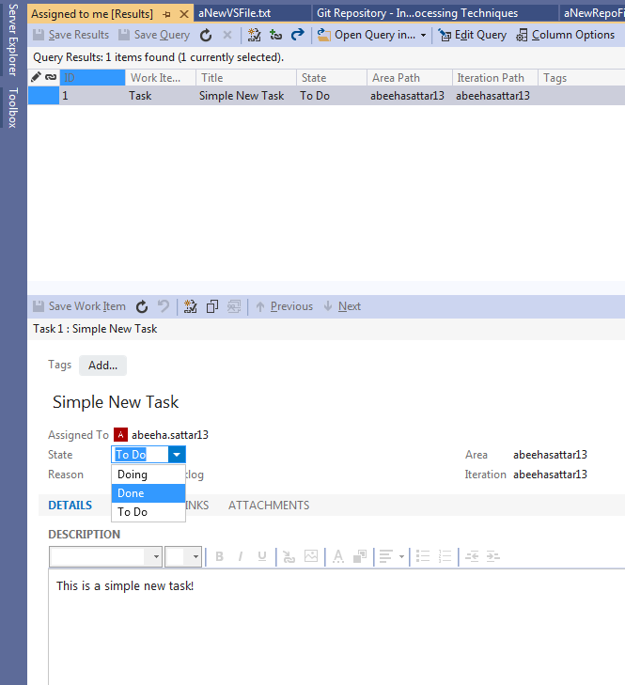
Work Items

Slide 32
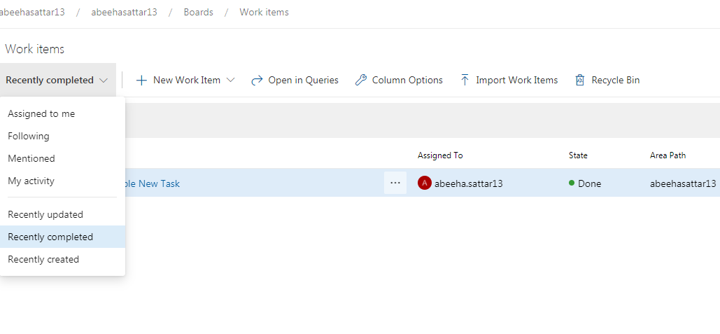
Completed Work Items

Slide 33
Fin.

