Slide 1



CIFAR-10 IMAGE CLASSIFICATION USING CNN
Optimization and Regularization Analysis
GROUP MEMBERS ROLL NO
TURAB HASHMI BSSE23002
AYESHA USMAN BSSE23031
ASMA HAIDER BSSE23051
LAIBA AHMAD BSSE23085

Slide 2
Goal
Design and train a custom CNN for CIFAR-10 image classification
Analyze training behavior and design choices
Focus on justification, not just highest accuracy
Motivation
CIFAR-10 is a standard benchmark for image classification
Understand impact of:
Optimizers (Adam vs SGD)
Regularization (Dropout)
Build a transparent CNN from scratch instead of using pre-trained models

Slide 3
Setup
We used the CIFAR-10 dataset, which gave us 50,000 images to train the model and 10,000 images to test it.
Batch Size of 128
2 workers: Parallel processing
Single, reusable function: train_model()
Number of epochs = 10 (each epoch made 1 full trip through the entire training dataset)

Slide 4
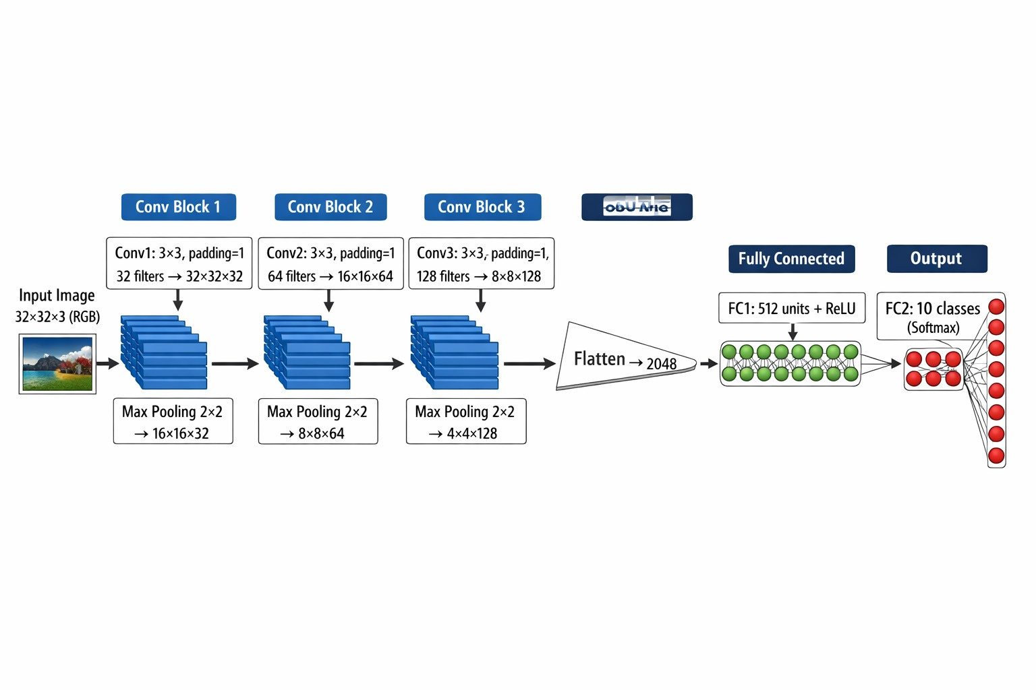
Model Architecture

Slide 5
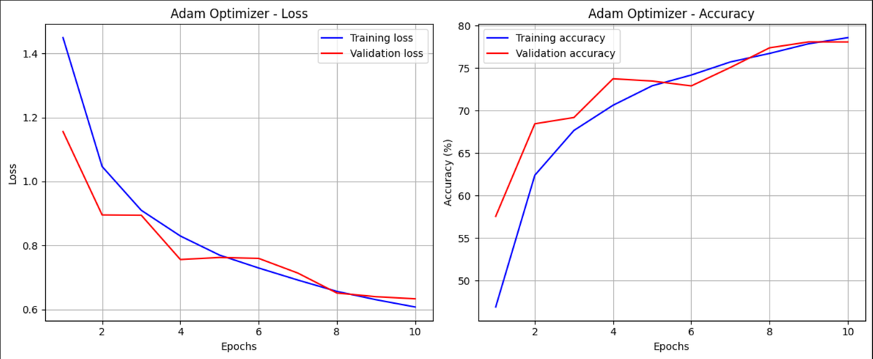
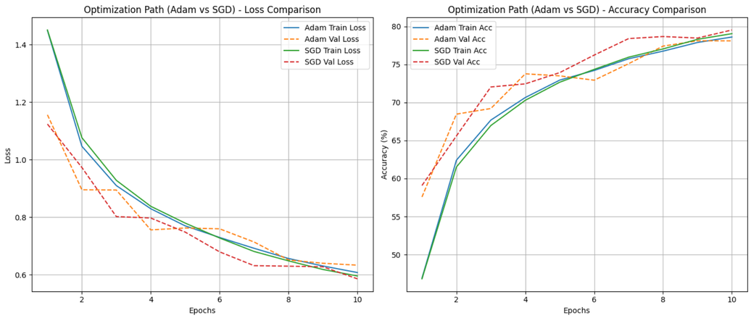
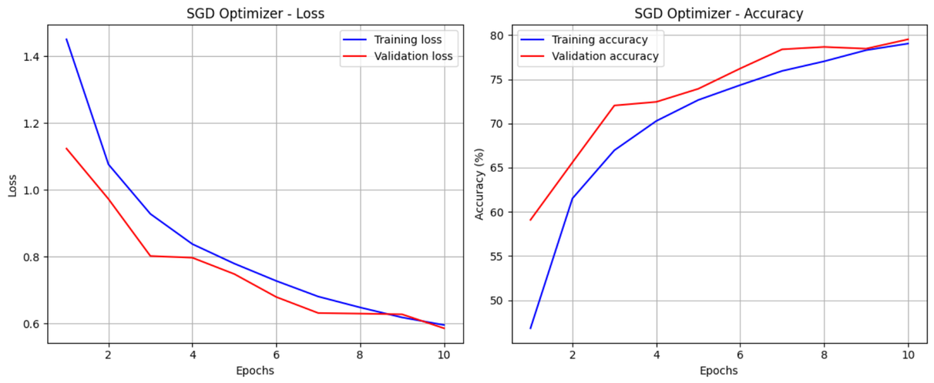
Experiment 1 — Optimization Path
Setup
Same CNN & data
Adam (lr=0.001)
SGD(lr=0.01, momentum=0.9)
Result
Adam: faster start
SGD: more stable validation

Slide 6
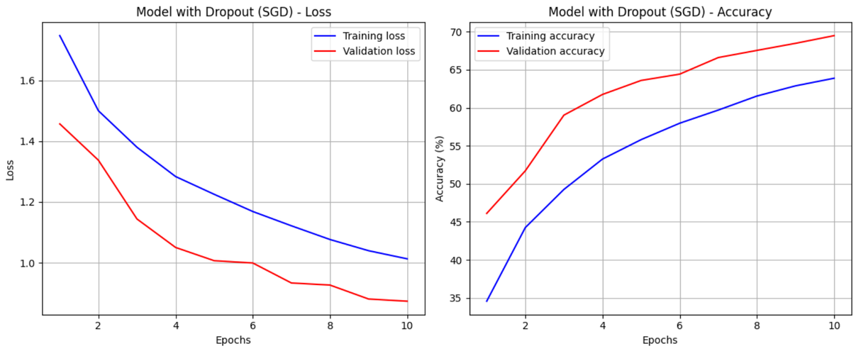
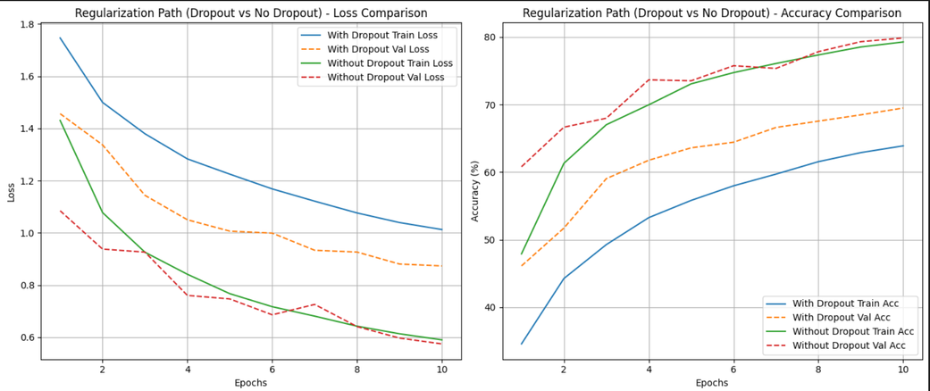
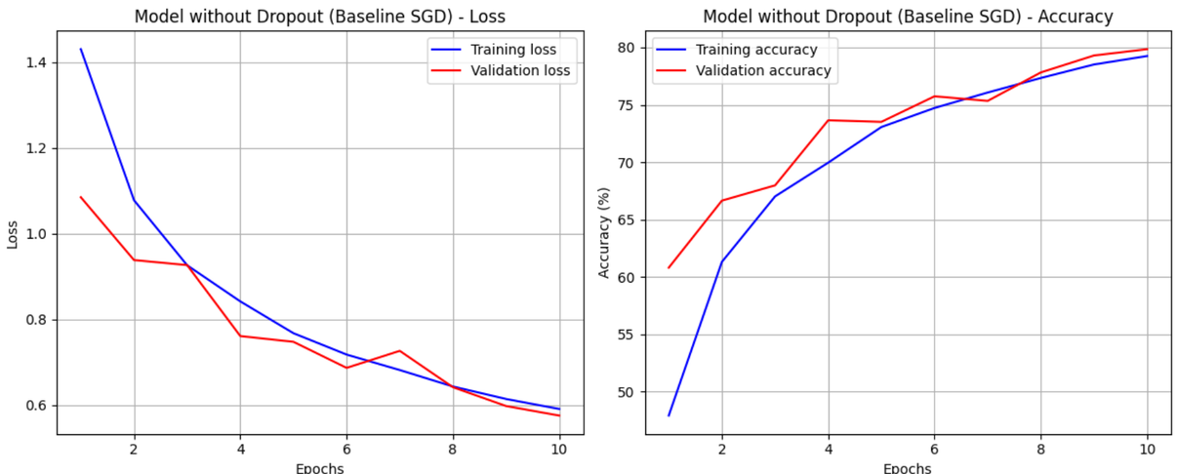
Experiment 2 — Regularization
Setup
Dropout after Conv (0.25)
Dropout in FC (0.5)
Result
Dropout reduces overfitting
Validation performance improves

Slide 7
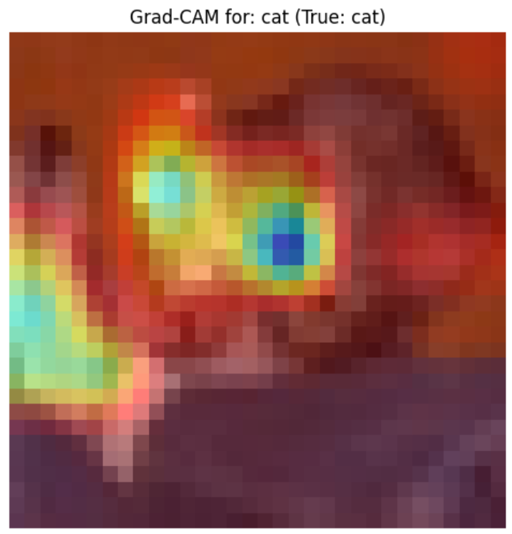
Conclusion + Best Model
Best Performing Model
SGD + No Dropout
Test Accuracy: ~80%
Key Insights
Optimizer choice strongly affects convergence
Dropout improves generalization
CIFAR-10 needs careful regularization

Slide 8
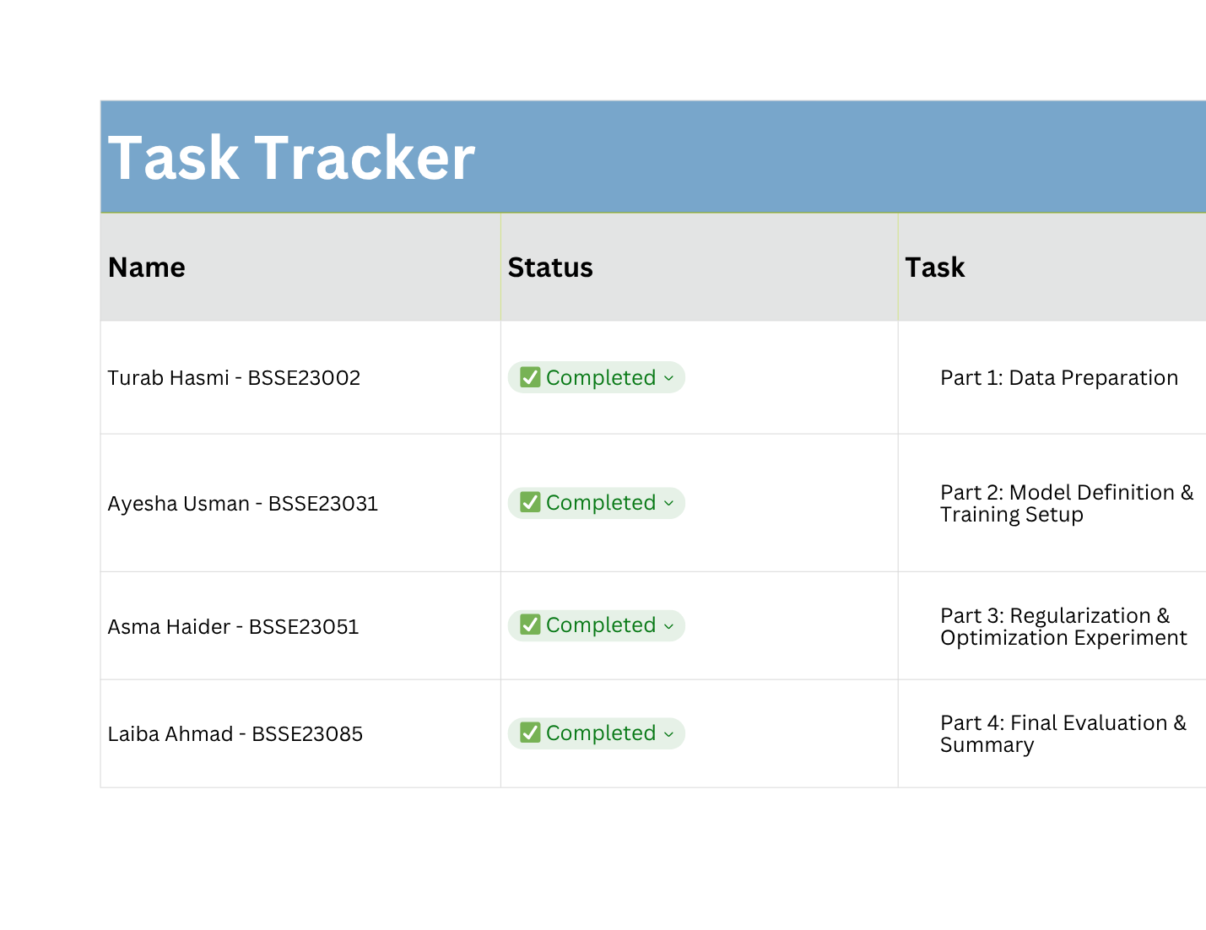
Contributions

Slide 9
THANK YOU

