Slide 1
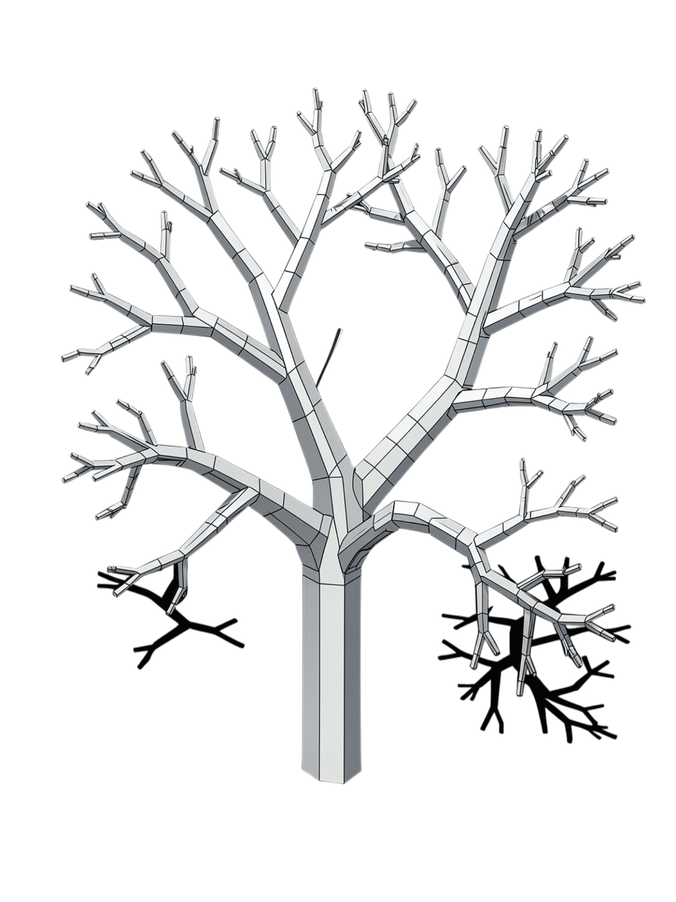
Session 01 — Git & GitHub: Professional Workflow
Week 1 · Session 1 of 18
HANDS-ON, NOT LECTURE

Slide 2






Session Goal
By the end of this session, every intern will personally:
Open a PR
Submit a real Pull Request
Review
Review a teammate's PR & leave a comment
Resolve Conflict
Fix a real merge conflict
Merge
Successfully merge the PR
Branch → Commit → Push → PR → Review → Conflict → Resolve → Merge

Slide 3

Why This Matters
Git/GitHub is a universal day-one engineering skill.
Solo Git
Collaborative GitHub
commits
history
branches
local changes
Pull Requests
code review
merge conflicts
team workflow
Today = adding the collaborative layer to the Git skills you already have.

Slide 4





Core Vocabulary
Repository
Project folder + complete Git history
Commit
A saved snapshot of your changes
Branch
An isolated line of development
Pull Request
A request to review and merge your changes
Merge Conflict
When Git cannot automatically combine two sets of changes

Slide 5
2-Hour Session
0:00–0:10
1
Framing
Why collaborative Git matters
2
0:10–0:30
Live Demo
Branch → PR → Review → Conflict → Merge
0:30–1:20
3
Hands-On Replication
Everyone performs the workflow
4
1:20–1:45
Everyone Merges
Resolve conflicts + merge real PRs
1:45–2:00
5
Wrap-Up
Review + next task

Slide 6
Git Command Cheat Sheet
Core Workflow
Purpose
Clone the repository
Create and switch to a new branch
Stage changes
Commit with a message
Push branch to GitHub
Bring main into your branch
git clone <repo-url>
git checkout -b feature/my-change
git add .
git commit -m "Add feature"
git push -u origin feature/my-change
git merge main
Useful Commands
git status
git diff
git log --oneline --graph
git pull
git stash

Slide 7
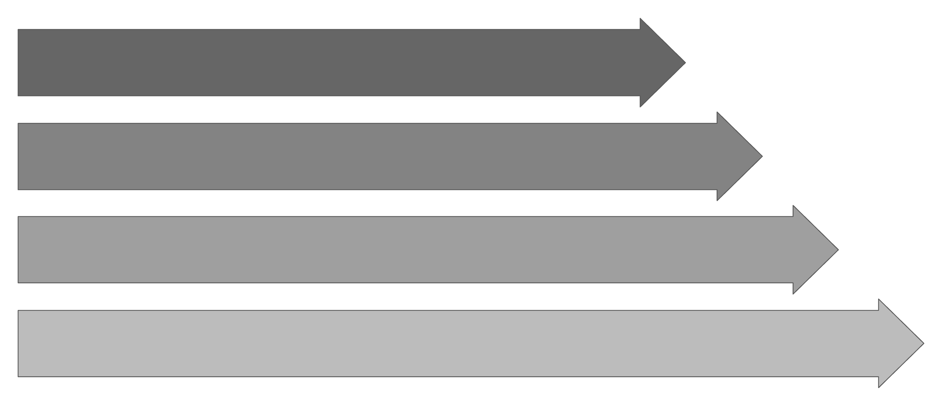
From Branch to Merge
Create Branch
Make Changes
Commit & Push
PR, Review & Merge
Never treat

Slide 8
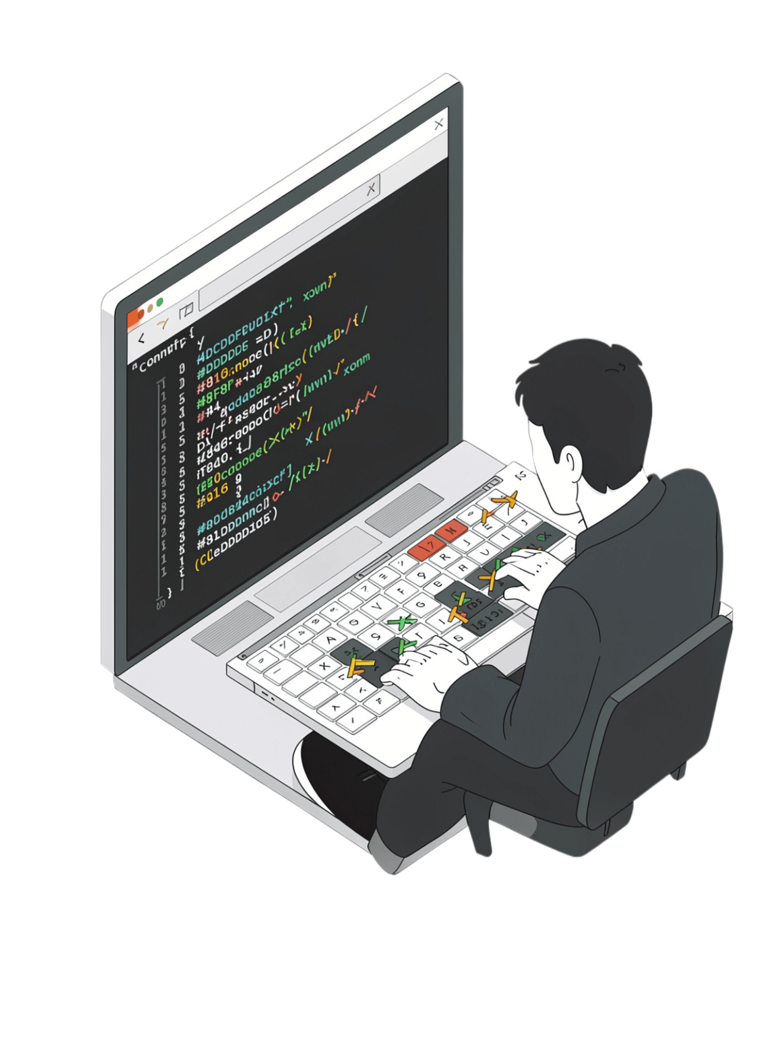

Don't Panic at the Conflict
Common Pitfalls
When Git Says "CONFLICT"
❌ Committing directly to main
❌ Vague commit messages
❌ Working without pulling recent changes
❌ Ignoring review comments
❌ Panicking when conflict markers appear
<<<<<<< HEAD
your changes
=======
their changes
>>>>>>> main
Read → Decide → Edit → Remove markers → Add → Commit → Push
A merge conflict is not an error to fear — it is a decision Git needs you to make.

Slide 9
Did You Complete the Workflow?
Today's Success Checklist
Post-Session Task
Opened a Pull Request
Solo Challenge
Create a second PR and intentionally encounter and resolve a second merge conflict.
Gave a review comment
Resolved a merge conflict
Successfully merged a PR
DUE BEFORE SESSION 2

Slide 10
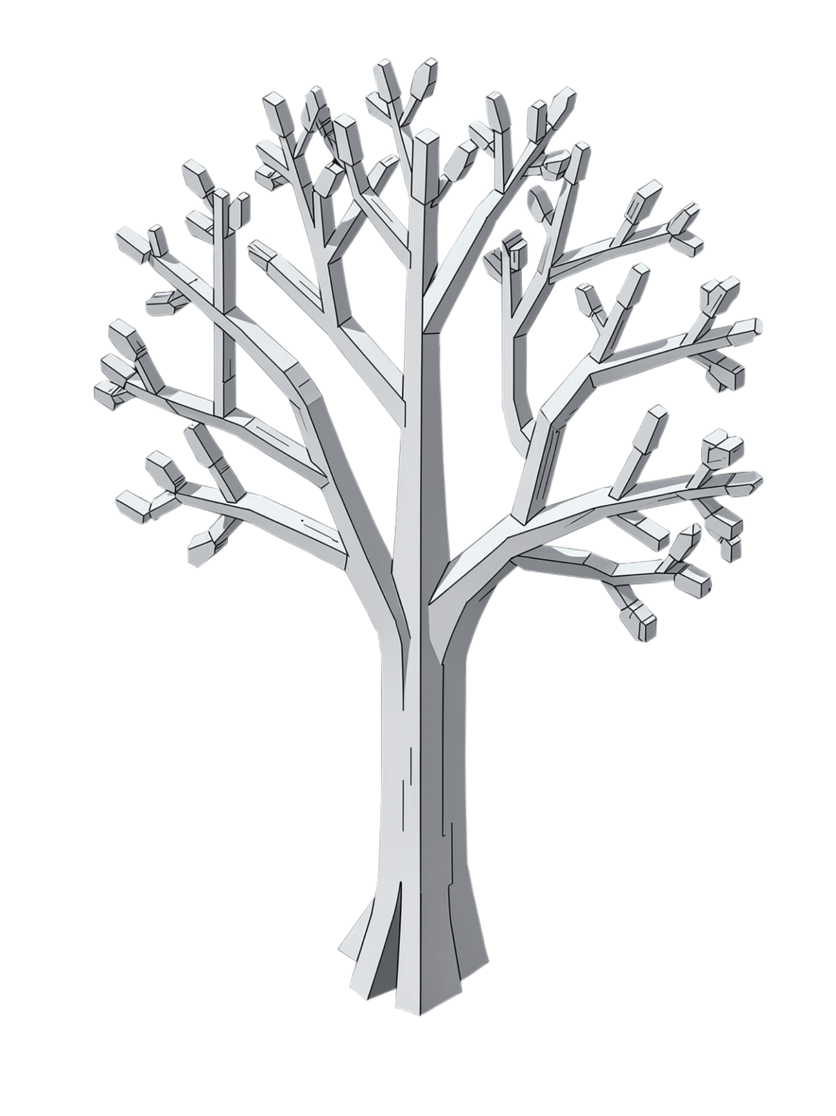
You now know the professional GitHub workflow.
Branch → Commit → PR → Review → Resolve → Merge
Next up: Session 16 — Advanced Rebase

