Slide 1
Category Theory
Monads in Agda
Yu-Yang Lin
1228863
MSci Computer Science
Individual Study 2 Presentation
School of Computer Science
University of Birmingham
21/12/2015

Slide 2
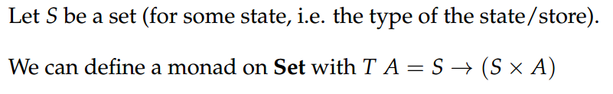
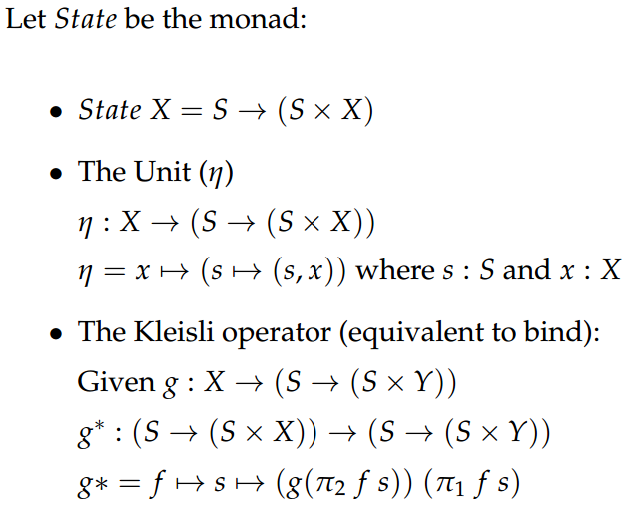
Exercise: The State Monad

Slide 3
Extension Task
Implement monads in Agda and verify the definition of the State monad is indeed a monad
Steps:
  Implement categories
  Implement the category Set
  Implement monads
  Implement the State monad on Set

Slide 4
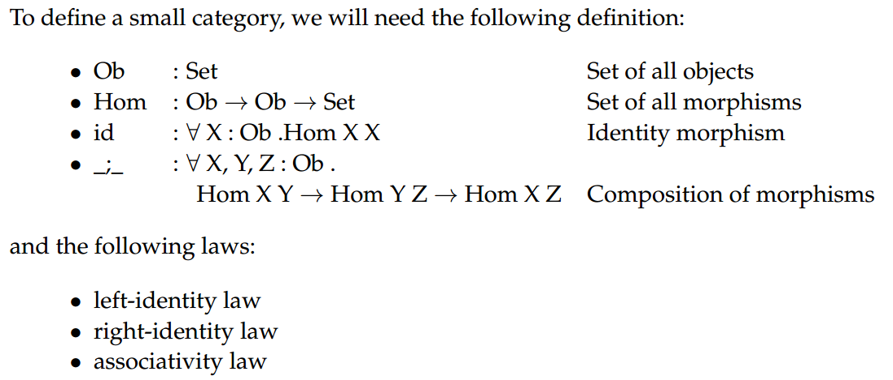
Categories in Agda: Small Categories

Slide 5
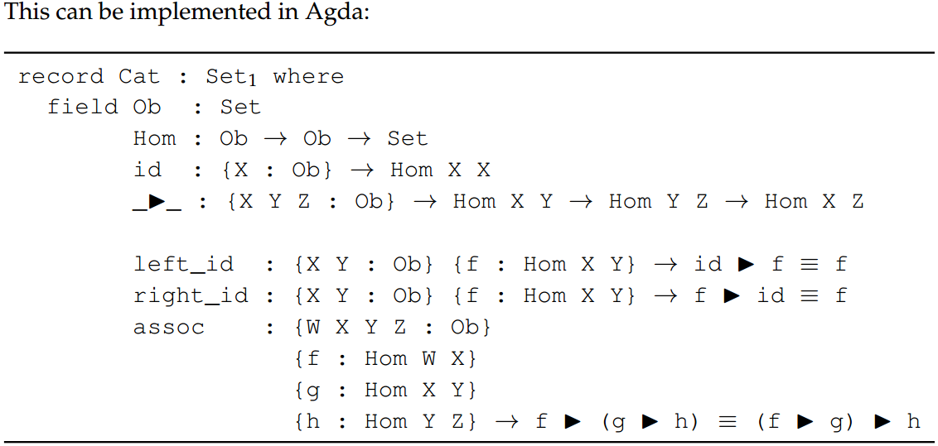
Categories in Agda: Small Categories

Slide 6
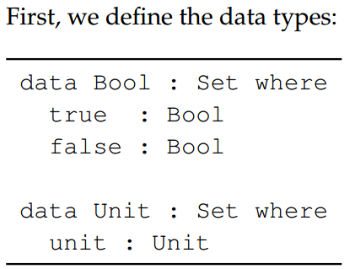
Example Small Category:
Category of endofunctions on Booleans

Slide 7
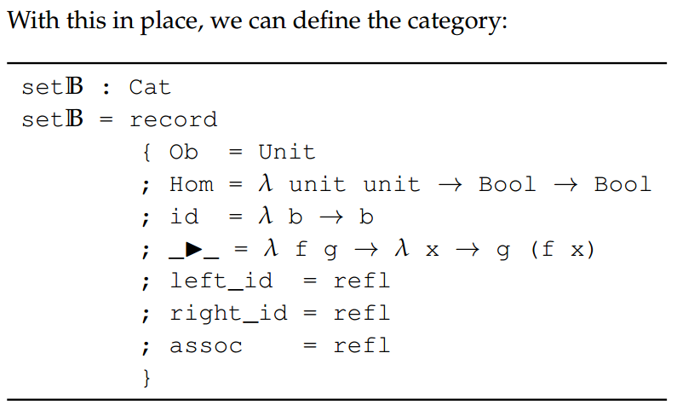
Example Small Category:
Category of endofunctions on Booleans

Slide 8
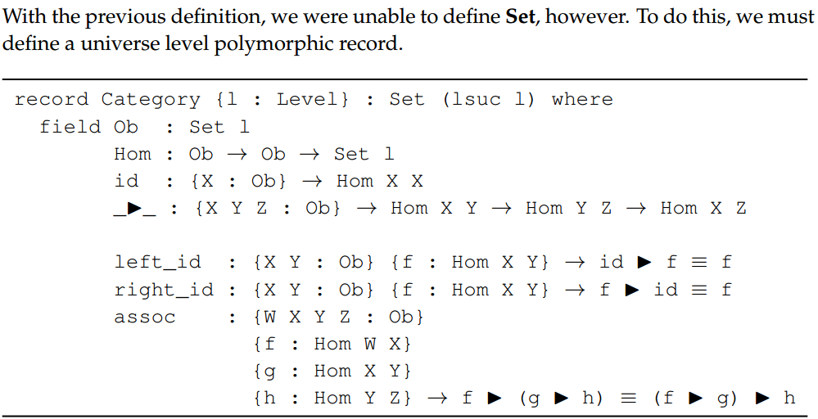
Categories in Agda: Set

Slide 9
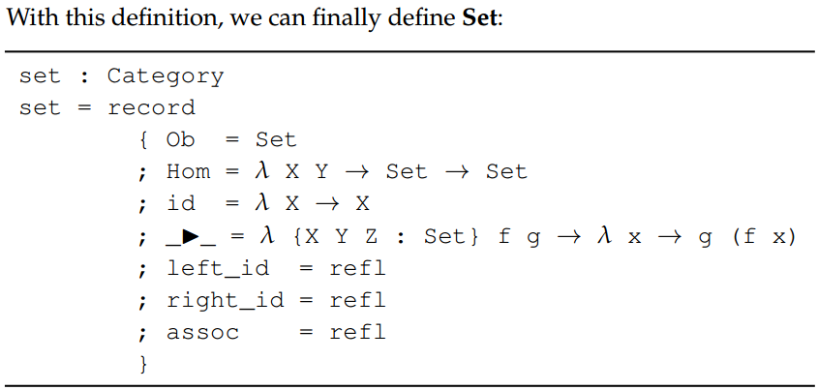
Categories in Agda: Set

Slide 10
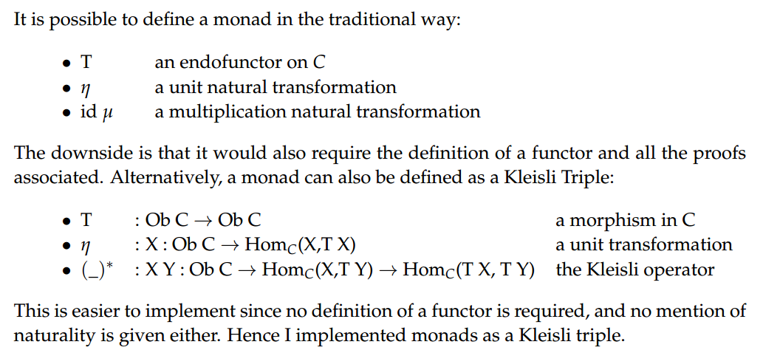
Monads in Agda

Slide 11
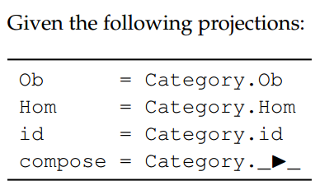
Monads in Agda

Slide 12
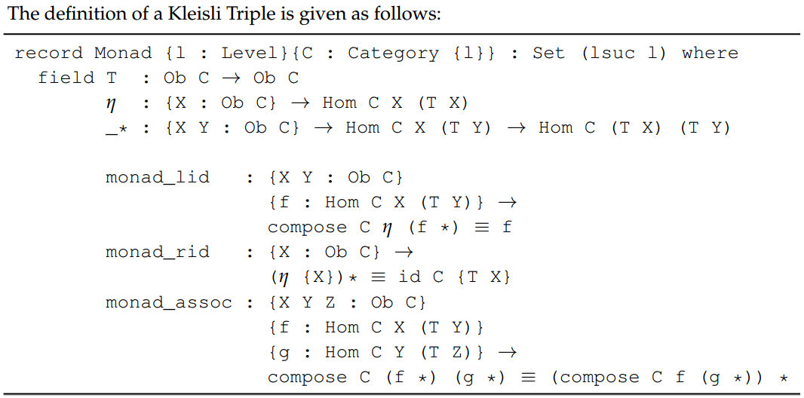
Monads in Agda

Slide 13
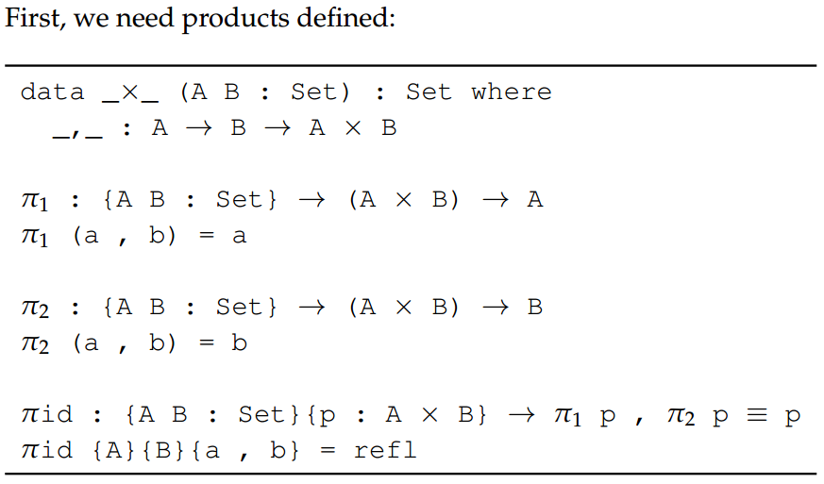
State Monad: Products

Slide 14
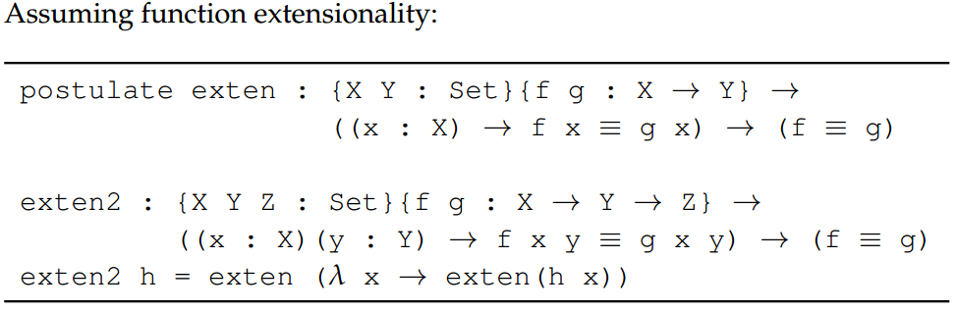
State Monad: Extensionality

Slide 15
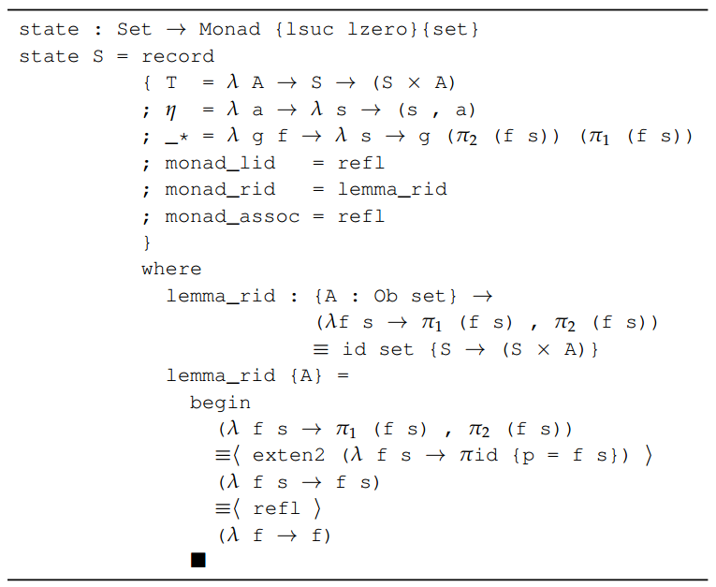
State Monad: Definition

