Slide 1
Exploratory Data Analysis (EDA) on Hotel Booking Dataset
🔍 Objective: To analyze hotel booking data and discover key patterns that impact cancellations and customer behavior.

Slide 2
🏨 Project Background
This project analyzes real-world hotel booking data to better understand the factors influencing reservation cancellations.
The dataset includes essential details such as lead time (how early a booking was made), number of nights, room types, average price per night, market segment, and whether the reservation was canceled or not.
📊 The goal is to conduct Exploratory Data Analysis (EDA) to uncover patterns that reveal:
When and why guests are more likely to cancel,
Which room types or customer segments carry higher risks,
And how timing, price, or stay duration impacts cancellation behavior.
These insights help hotel managers improve decision-making in pricing, policies, and marketing strategies, ultimately aiming to reduce cancellations, increase revenue, and enhance guest satisfaction.

Slide 3
🔍Business Questions Investigated in the Dataset:
How does lead time affect the cancellation rate? → Are bookings made far in advance more likely to be canceled?
Which room types experience the highest cancellation rates? → Do guests cancel more frequently with specific room types?
During which reservation months do cancellations peak? → Are certain months more prone to booking cancellations?
Does the total number of nights book affect cancellations? → Are people more likely to cancel longer stays or shorter stays?
Is there a relationship between the average price per night and cancellations? → Do higher or lower prices impact guest commitment?

Slide 4
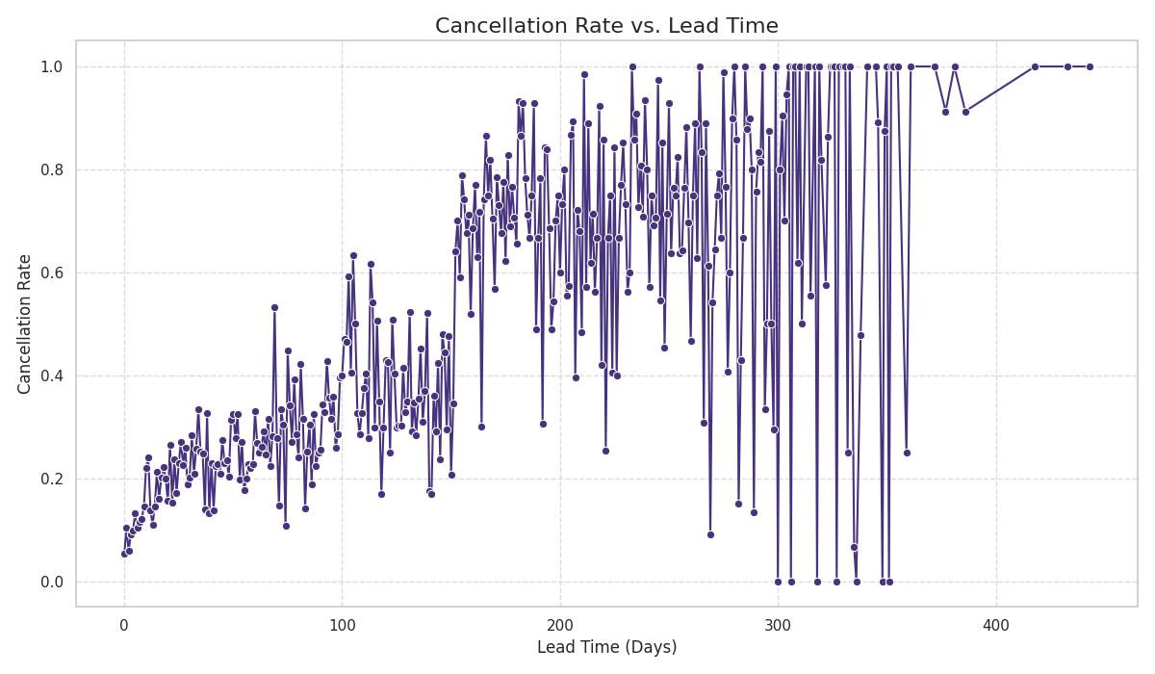
Cancellation Rate vs. Lead Time: The Early Bird's Dilemma
This chart illustrates a clear trend: as the lead time (days between booking and arrival) increases, the cancellation rate generally rises. Bookings made far in advance, especially those over 200 days out, show significantly higher cancellation probabilities, often approaching 100%. This suggests that guests booking with long lead times have fewer firm plans, leading to greater uncertainty and a higher likelihood of cancellation. For hotels, this highlights the need to manage expectations and potentially adjust policies for long-term advance bookings to mitigate revenue loss.
To reduce hotel booking cancellations, hotels should adopt a data-driven strategy. This includes implementing flexible policies based on booking lead time, offering personalized deals to high-risk customers, and requiring deposits for longer stays. Lastly, predictive models can forecast potential cancellations, allowing staff to manage bookings dynamically and improve revenue and guest retention.

Slide 5
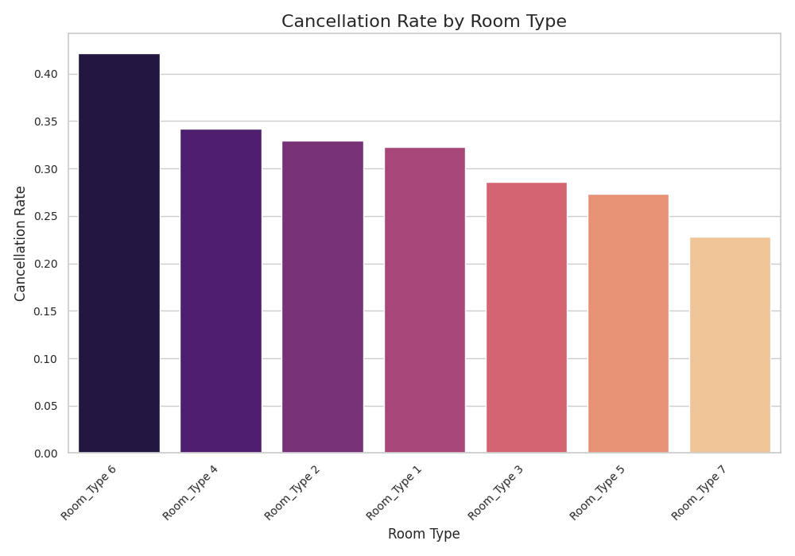
Cancellation Rate vs. Room Type: Room-Specific Cancellation Trends
The analysis highlights notable differences in cancellation behavior across room types. "Room Type 6" experiences the highest rate of cancellations, signaling potential issues in guest satisfaction or booking confidence. In contrast, "Room Type 7" stands out with minimal cancellations, indicating strong guest preference or trust. These trends offer valuable insight into how specific room features or conditions may influence booking decisions.
To reduce cancellations for "Room Type 6", hotels should review its pricing, features, and guest expectations. Offering clearer descriptions, better value, or small incentives can improve guest confidence. Applying flexible policies or booking conditions tailored to this room type may also help. Learning from the success of "Room Type 7" can guide improvements across all room types.

Slide 6
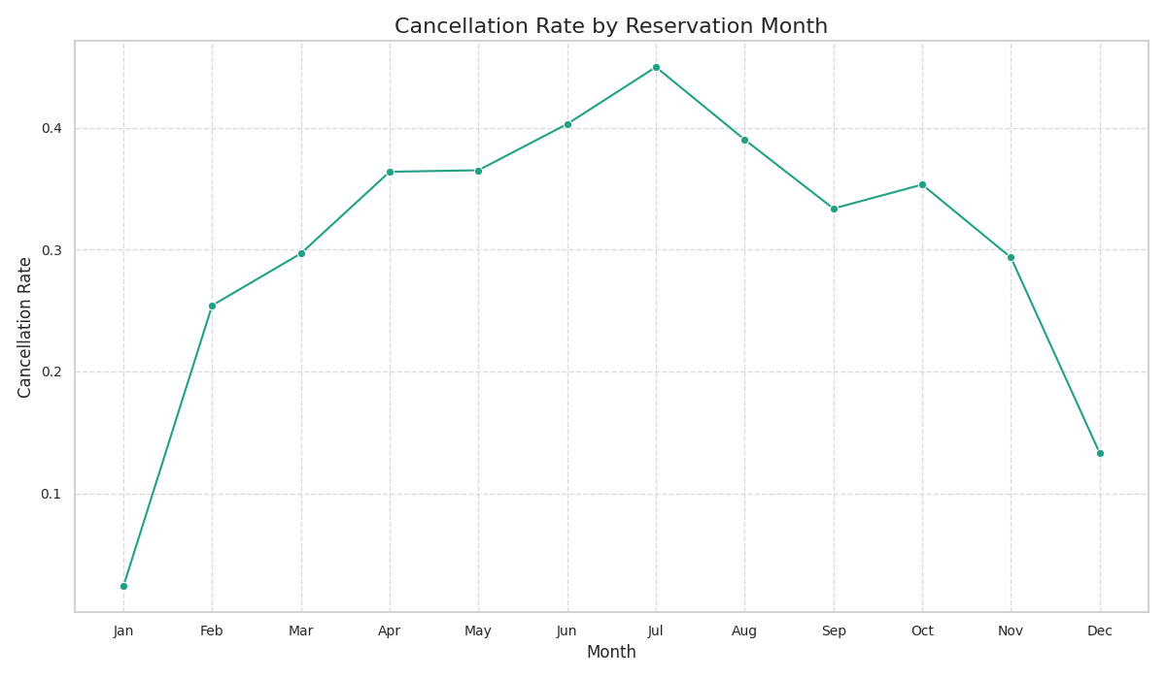
Cancellation Rate vs. Reservation Month: Seasonal Cancellation Patterns
The line graph uncovers a seasonal trend in booking cancellations. Summer months, especially July, show a noticeable increase in cancellations, reflecting less stable booking behavior during popular vacation times. In contrast, winter months like December and January experience lower cancellation rates, indicating stronger booking reliability. Recognizing these patterns helps hotels better prepare for fluctuations in guest behavior across the year.
To address high cancellation rates during peak months like July, hotels can design seasonal loyalty perks and targeted early-bird offers exclusive to those booking during volatile periods. Introducing limited-time room upgrades, summer experience bundles, or non-refundable discount tiers only for peak months can increase booking commitment.

Slide 7
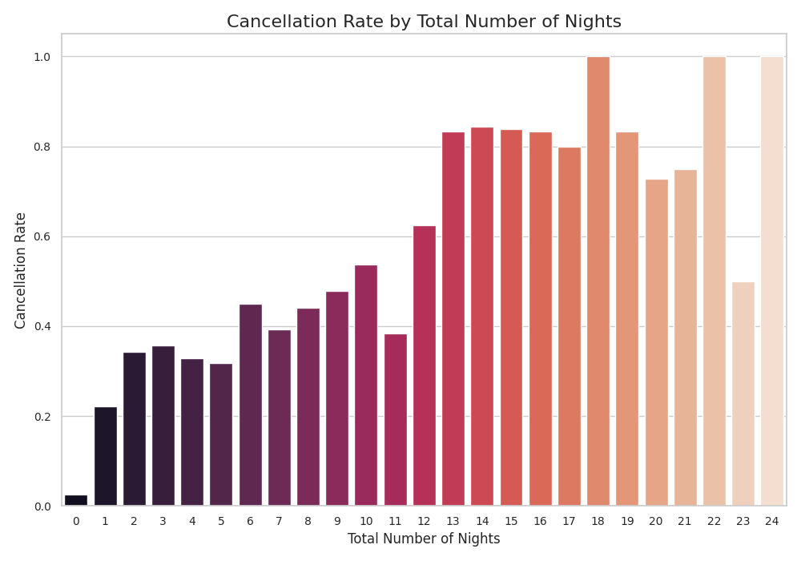
Cancellation Rate vs. Total Number of Nights: Duration and Cancellation Risk
This chart illustrates a clear pattern: bookings with longer durations are significantly more likely to be canceled. While short stays (1–2 nights) remain stable, cancellations climb sharply for stays exceeding a week, reaching critical levels. This trend indicates that extended bookings introduce higher volatility, likely due to the increased complexity and uncertainty of long-term travel. Recognizing this behavioral shift allows hotels to rethink how they manage and support extended stay guests.
To reduce cancellations for longer stays, hotels can introduce progressive stay incentives—such as increasing discounts or exclusive perks (e.g., spa access or free airport transfers) based on the number of nights booked. This approach encourages guests to commit to longer stays while feeling rewarded, rather than pressured. It also helps reduce cancellation risk by making longer bookings more appealing and worthwhile.

Slide 8
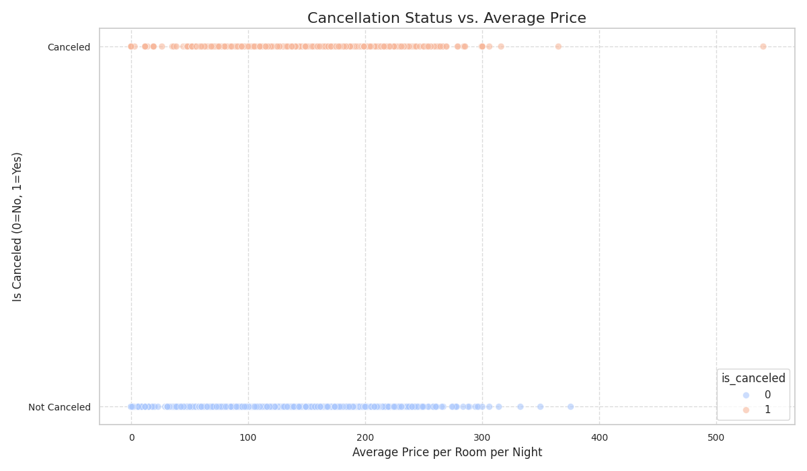
Cancellation Status vs. Average Price per Room per Night: Price and Booking Commitment
This scatter plot analyzes how average room price correlates with booking cancellations. While cancellations and non-cancellations are spread across all price ranges, a visible cluster of cancellations exists in the higher price segment. This reveals that more expensive bookings may face increased cancellation risk due to guests reconsidering larger financial commitments. Understanding these patterns helps hotels assess where guest commitment may fluctuate based on pricing.
To reduce cancellations at higher room prices, hotels can enhance perceived value by offering bundled experiences or added benefits (e.g., early check-in, welcome gifts, or personalized services) for premium bookings. This encourages guests to feel their higher spend is justified and discourages cancellations, not through stricter policies, but by increasing guest satisfaction and emotional investment in the stay.

Slide 9
Overall Conclusion: Strategic Insights for Hotel Revenue Optimization
Our analysis of hotel reservation cancellations reveals several key insights crucial for strategic revenue management. Cancellations are significantly influenced by lead time, with longer booking windows correlating to higher cancellation rates. Room type also plays a role, as certain room categories show higher cancellation tendencies. Seasonal patterns are evident, with reservation months like July experiencing peaks in cancellations, while December and January show lower rates. Furthermore, longer stays surprisingly exhibit increased cancellation risks. Finally, while average price isn't a direct cause, higher-priced bookings may be more susceptible to cancellation. By understanding these factors, hotels can implement targeted strategies, such as dynamic pricing, tailored cancellation policies, and focused marketing, to mitigate revenue loss and optimize booking commitments across all segments.

Slide 10
Thank you! Presented by: Laila Elhadidy Email: lailahassanelhadidy@gmail.com

