Slide 1
Streamlining Hospital Operations – Business Analyst Report
Prepared by: Ume Laila Batool
Date: [02/08/2025]

Slide 2
Introduction & Project Overview
Purpose: Improve efficiency, reduce delays, enhance patient experience
Duration: [2 hours]
Scope: Patient admissions, record management, inter-department communication
Notes:
Purpose: To identify and address inefficiencies in hospital operations by analyzing current workflows, gathering stakeholder requirements, and proposing technology-driven solutions to improve patient management, communication, and record-keeping.
Duration: Estimated 2 hours (training simulation)
Scope: Covers admissions, doctors, pharmacy, IT, and patient interaction processes. Focuses on patient flow, interdepartmental communication, and medical record management, excluding clinical treatment protocols or financial auditing.

Slide 3
Problem Statement & Scope
Problems Identified:
Delays in patient management
•Outdated manual record-keeping
•Inefficient communication between admissions, doctors, pharmacy
Scope: Admissions, Doctors, Pharmacy, IT, Patients

Slide 4
Stakeholder Analysis
Hospital Admin – Decision-making, funding – High influence, High interest
Doctors – Patient care – Medium influence, High interest
Nurses – Support in patient care – Medium influence, High interest
IT Dept. – System upgrades – High influence, Medium interest
Patients – Service recipients – Low influence, High interest

Slide 5
Business Requirements Document (BRD) Summary
Objectives: Reduce wait times, improve communication, streamline records
Functional Requirements: EMR integration, real-time updates, secure data sharing
Non-Functional Requirements: HIPAA compliance, user-friendly interface, scalability

Slide 6
Gap Analysis
Manual patient records → Integrated EMR
Delayed communication → Real-time updates
Long patient waits → 20% reduction

Slide 7

Prioritization Matrix
EMR Implementation – High Impact, Medium Feasibility – High Priority
Department Messaging System – High Impact, High Feasibility – High Priority
Patient Self-Check-In – Medium Impact, Medium Feasibility – Medium Priority

Slide 8
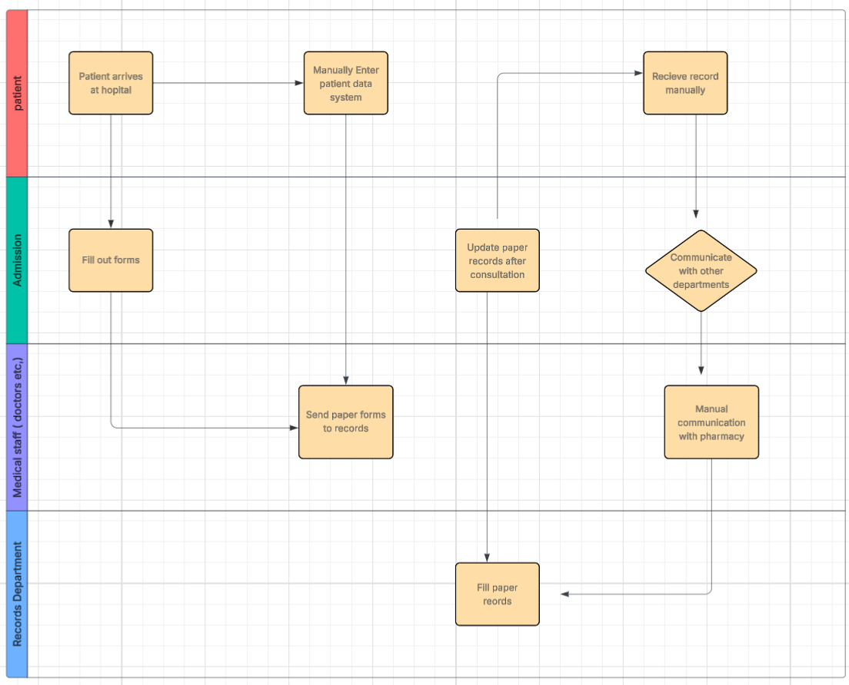
Current Process Flow

Slide 9
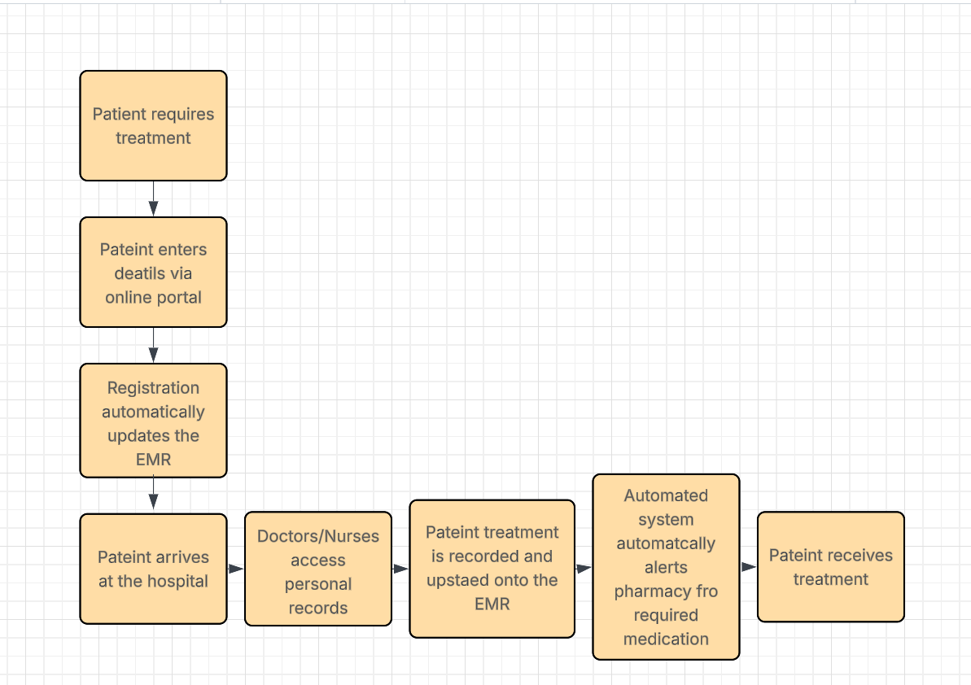
Future Process Flow

Slide 10
Technology Assessment
Existing infrastructure: Outdated, paper-based
Recommended tools: EMR software, secure messaging, digital check-in kiosks
Integration plan with current systems

Slide 11
Change Management Plan
Training: Hands-on sessions for all staff
Communication: Regular updates via meetings & email
Support: Onsite IT helpdesk for first 3 months

Slide 12
Risk Mitigation Strategy
Staff resistance – Medium likelihood, High impact – Training & early involvement
Data breaches – Low likelihood, High impact – HIPAA compliance, encryption
Cost overruns – Medium likelihood, Medium impact – Phased implementation

Slide 13
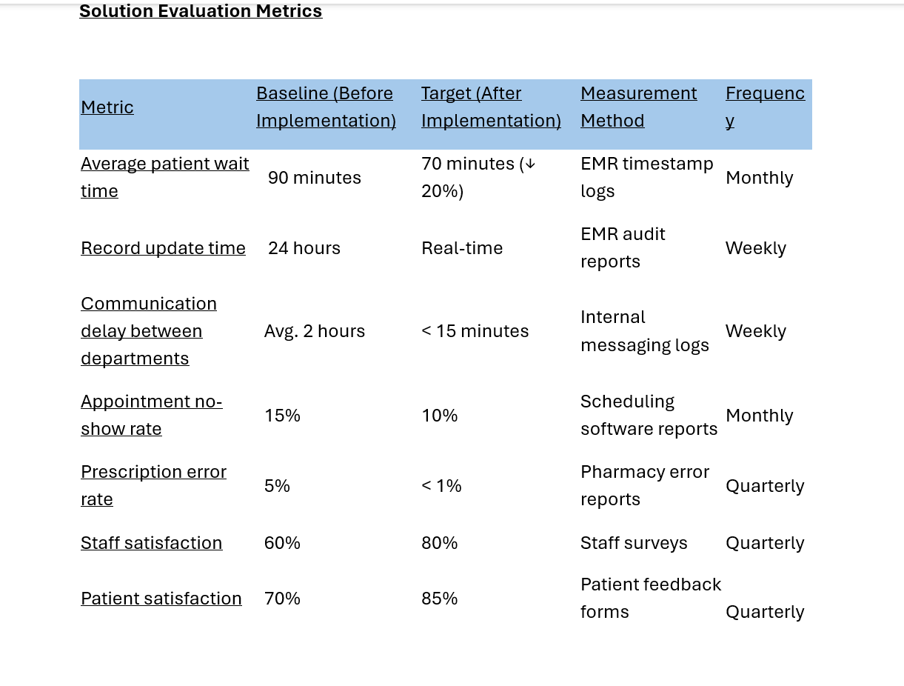
Solution Evaluation Metrics

Slide 14
Conclusion & Next Steps
Recap main improvements
Expected results:
20% reduction in wait times
Faster record updates
Improved inter-department coordination
Next steps: Pilot implementation, review after 6 months

