Slide 1
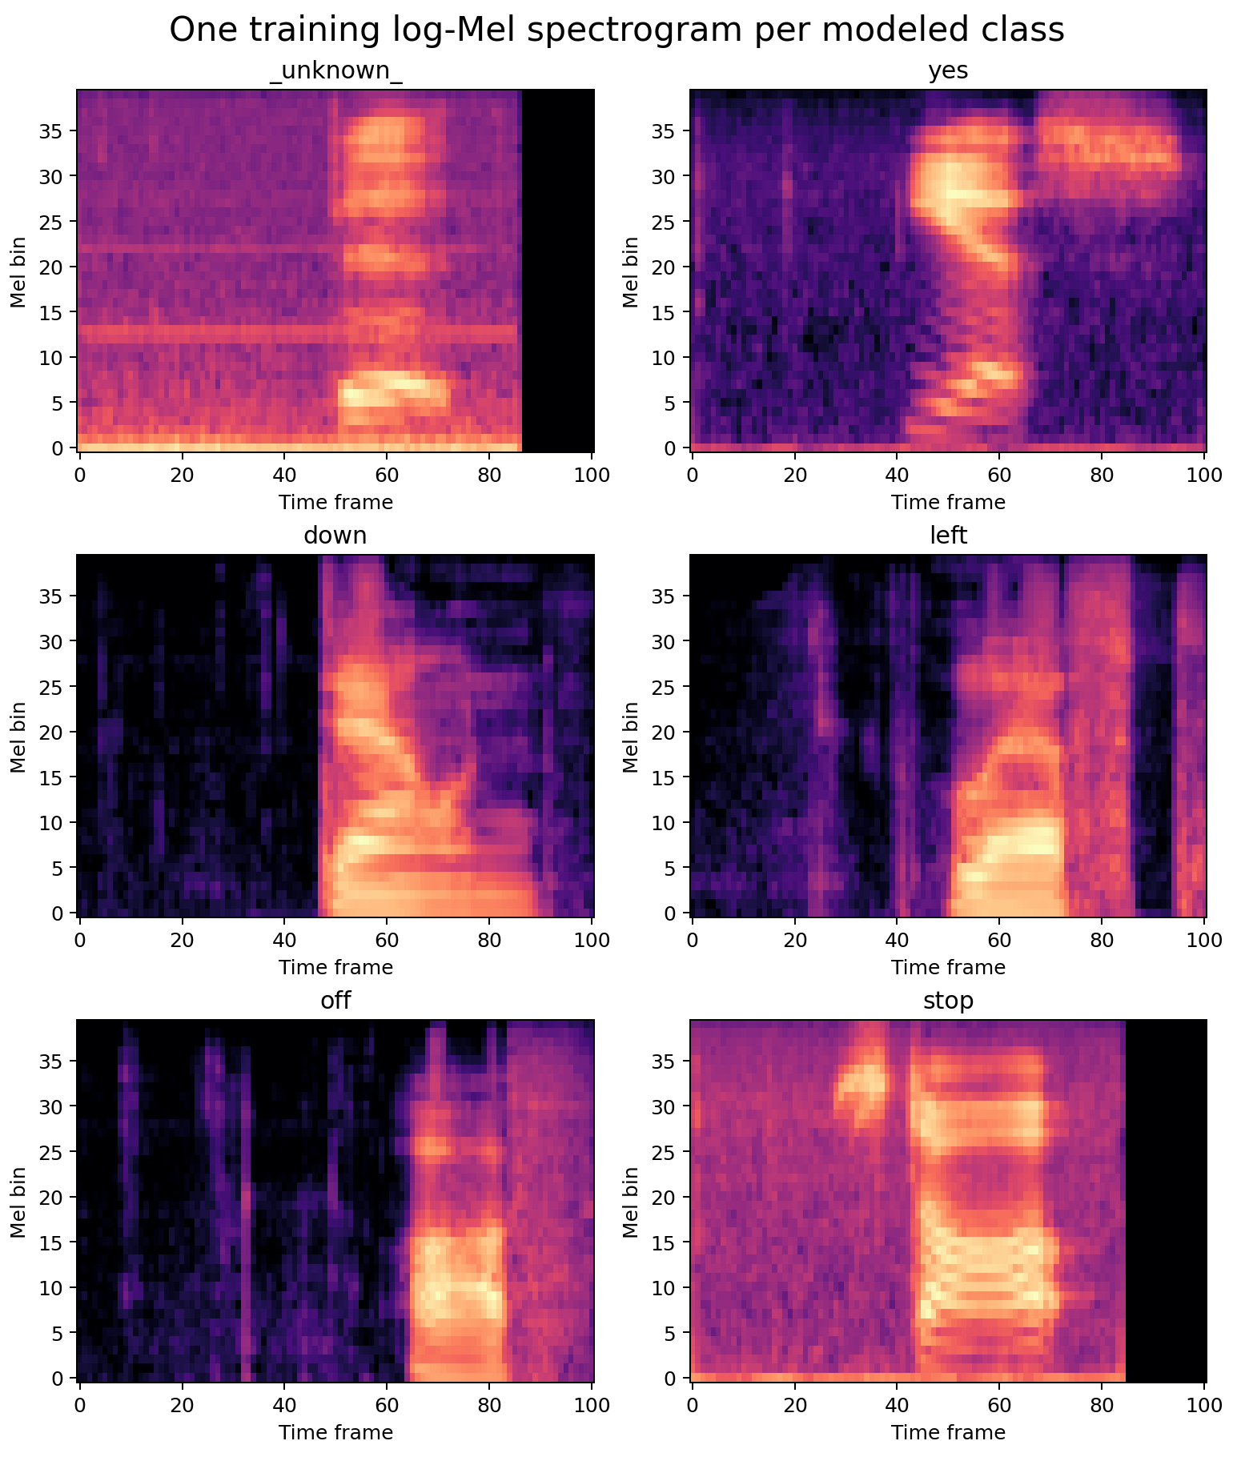
FOUNDATIONS OF DEEP LEARNING
Robust keyword
spotting from scratch
A leakage-safe study of audio representations, compact neural networks, and failure modes.
Simone (INSERT SURNAME) | Vlad (INSERT SURNAME) | INSERT FULL NAME
Academic Year 2025/2026 | 15 September 2026
01
Notes:
We built a complete keyword-spotting system from scratch. The central question is not only which model scores highest, but which design decisions survive a strict speaker-independent protocol and controlled audio corruption.
[Sources]
- Warden, Speech Commands: A Dataset for Limited-Vocabulary Speech Recognition, https://arxiv.org/abs/1804.03209
- Repository evidence: artifacts/figures/eda/class_spectrogram_examples.png
[/Sources]

Slide 2
SPEECH COMMANDS
One second of audio becomes one reliable intent
Input
Output
A mono waveform sampled at 16 kHz
10 commands + unknown + silence
1 s
12
0
maximum clip duration
modeled classes
pretrained components
Educational goal: isolate the impact of representation, architecture, and augmentation without transfer learning.
02
Notes:
The task is 12-way classification. Ten labels are actionable words; unknown catches non-target speech; silence rejects background audio. The modeled dataset is near-balanced rather than exactly balanced, and we intentionally avoid pretrained encoders.
[Sources]
- Repository protocol: docs/experiment_protocol.md
- Repository configuration: configs/e05_logmel_crnn_aug.yaml
[/Sources]

Slide 3
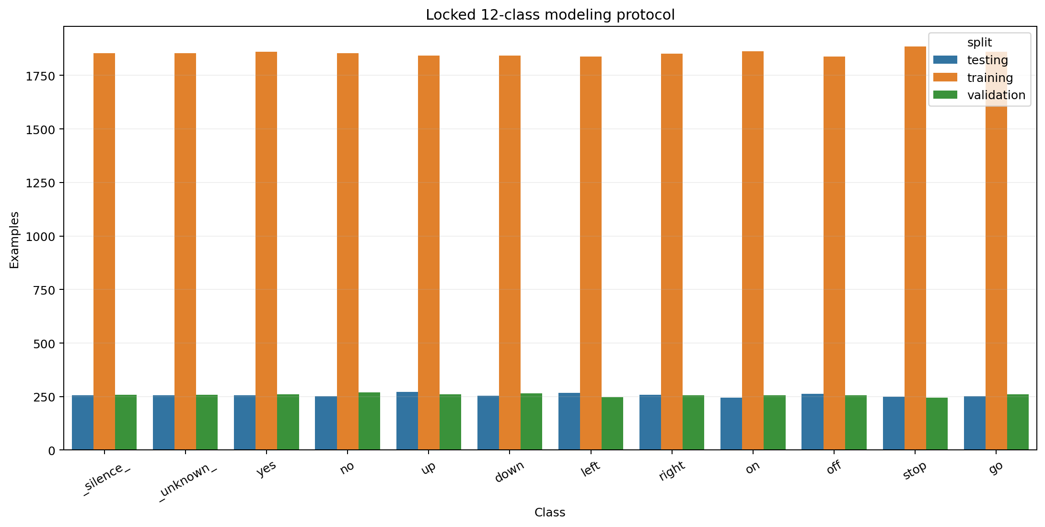
SPEECH COMMANDS
Near-balanced modeling preserves the raw audit
28,420 modeled examples
64,721
All target recordings are retained; unknown and silence are constructed at controlled ratios within each official split.
spoken clips in the raw audit
1,881
anonymized speakers
03
Notes:
The release contains 30 spoken words, but the professor-defined task uses 12 modeled classes. Every target recording is retained. Unknown is sampled deterministically from non-target words and silence is constructed from reserved background regions, producing an approximately balanced, reproducible manifest.
[Sources]
- Warden 2018, https://arxiv.org/abs/1804.03209
- Repository audit: artifacts/tables/eda_summary.json
- Repository figure: artifacts/figures/eda/modeling_distribution.png
[/Sources]

Slide 4
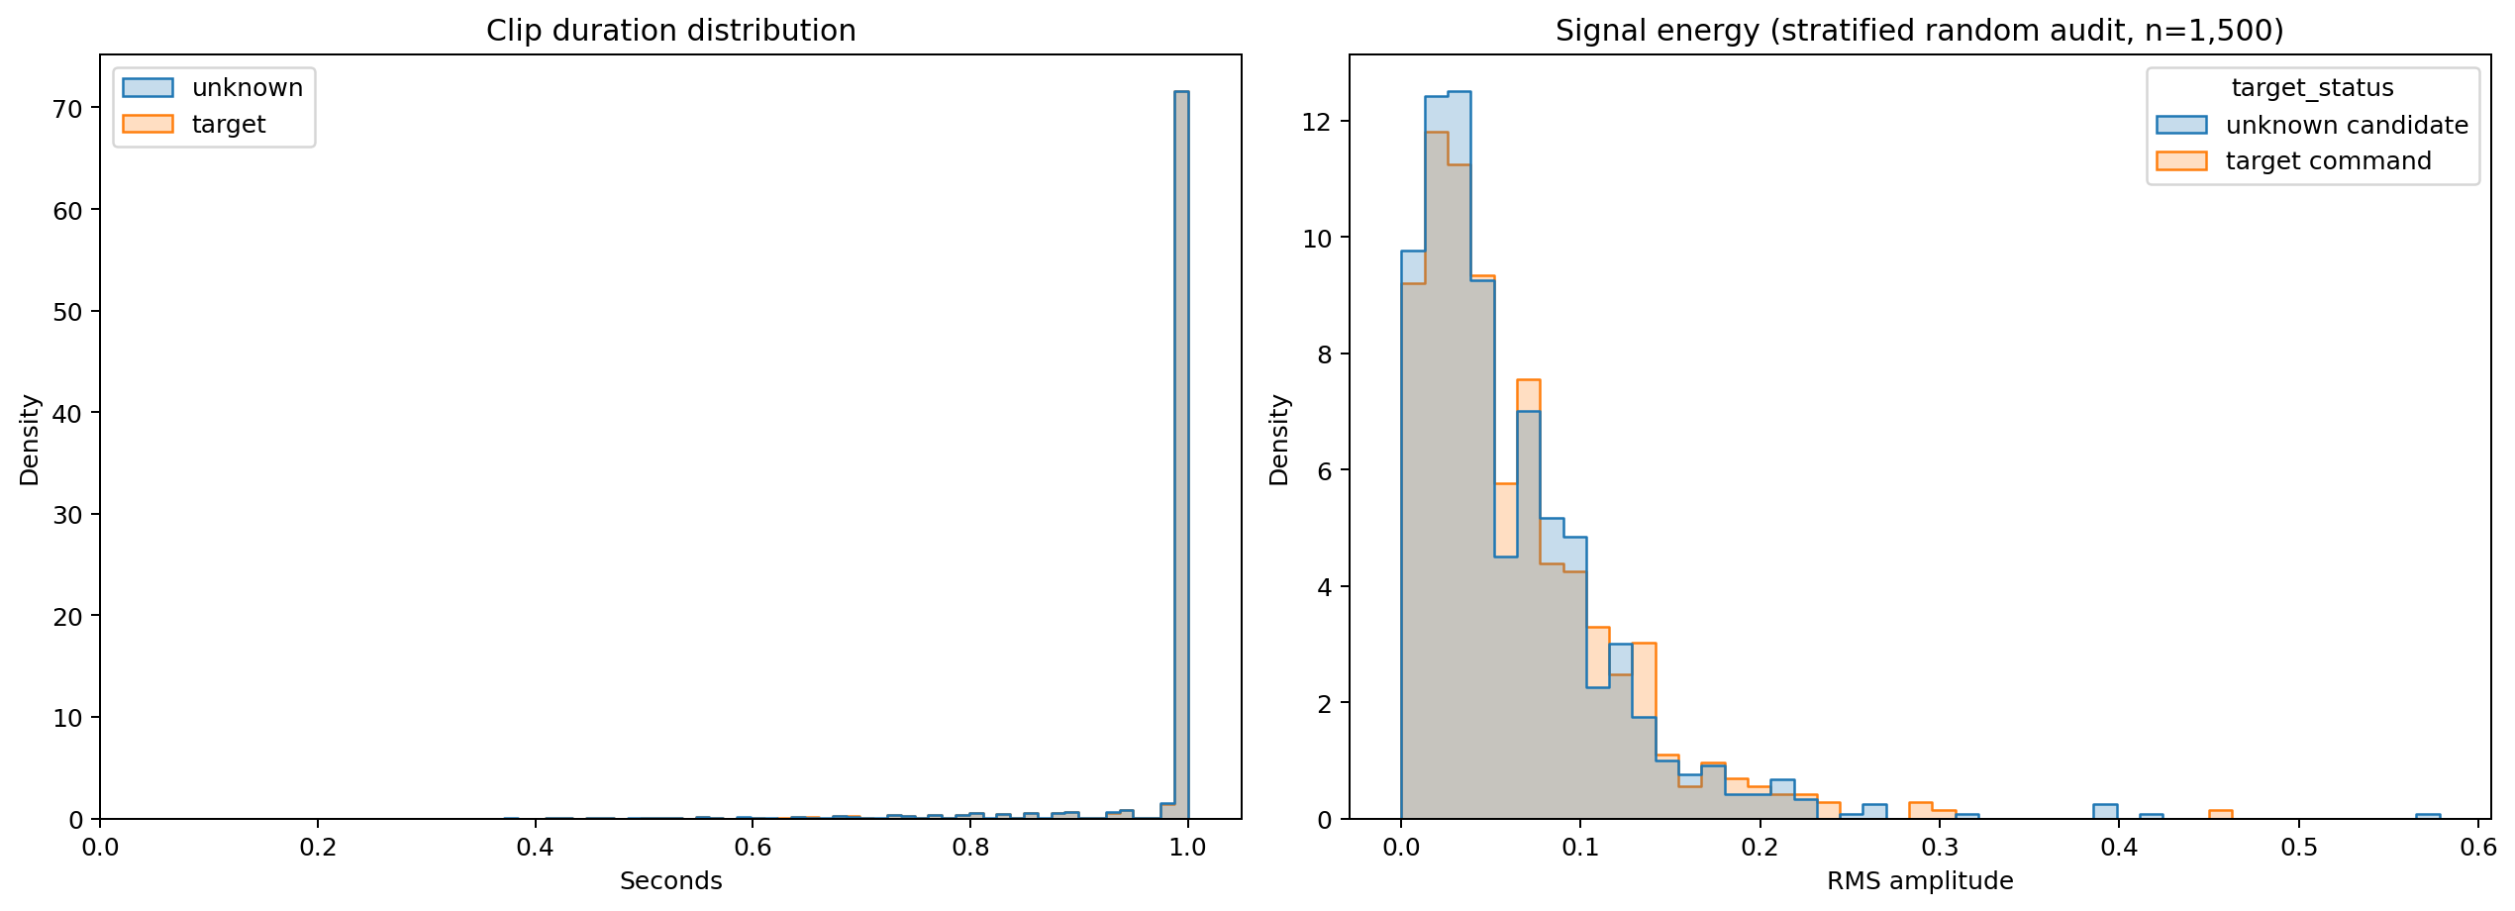
SPEECH COMMANDS
Clip length is stable; signal energy is not
EDA implication
Pad or trim to 16,000 samples; normalize on training data only; augment amplitude, time position, and background noise.
04
Notes:
Duration is nearly standardized, so fixed one-second tensors are natural. Energy is not standardized: quiet and loud speakers overlap across target and unknown classes. This motivates gain perturbation and real background mixing rather than assuming a clean recording level.
[Sources]
- Repository figure: artifacts/figures/eda/duration_and_energy.png
- Repository table: artifacts/tables/eda_energy_sample.csv
[/Sources]

Slide 5
SPEECH COMMANDS
Speaker identity never crosses a split
Official lists define validation and test; all remaining speakers train. Background audio is reserved 80% / 10% / 10% by split.
22,246
3,093
3,081
training examples
validation examples
testing examples
Hard guards
- speaker-disjoint splits + silence regions
- split-aware noise + train-only statistics
Fail fast
on any overlap
05
Notes:
Leakage is the biggest silent risk in audio. Official lists keep speakers disjoint. Synthetic silence uses non-overlapping temporal regions, and background recordings used for augmentation or robustness are reserved by time: the first 80 percent for training, the next 10 for validation, and the final 10 for testing. Automated guards fail on speaker overlap.
[Sources]
- Repository manifest checks: src/fdl_speech_commands/data.py
- Repository noise partition: src/fdl_speech_commands/audio.py
- Repository tests: tests/test_data_protocol.py
[/Sources]

Slide 6
SPEECH COMMANDS
Log-Mel preserves time-frequency structure
Waveform
STFT
Mel filterbank
Neural input
16,000 samples
mono, padded/trimmed
30 ms Hann window
10 ms stride
40 perceptual
frequency bins
40 x 98 map
train-normalized
MFCCs are the compact baseline; main experiments retain the full log-Mel map.
06
Notes:
We standardize each clip to 16,000 samples, then apply a 30 millisecond Hann-window STFT with a 10 millisecond stride. Forty Mel filters compress frequency and the logarithm stabilizes amplitude. With no end padding, the implemented neural input is a 40 by 98 map normalized using training statistics only.
[Sources]
- Repository feature implementation: src/fdl_speech_commands/features.py
- Repository configuration: configs/e05_logmel_crnn_aug.yaml
[/Sources]

Slide 7
SPEECH COMMANDS
Five experiments isolate each design choice
Selection metric: validation macro-F1; the test set remains sealed.
ID | Representation | Architecture | Augmentation | Question
E01 | 13 MFCC | MLP | None | Can a dense baseline suffice?
E02 | 40 log-Mel | Small CNN | None | Does local structure help?
E03 | 40 log-Mel | DS-CNN | None | Can efficiency retain accuracy?
E04 | 40 log-Mel | DS-CNN | Wave + SpecAugment | What does augmentation trade?
E05 | 40 log-Mel | Conv + BiGRU | Wave + SpecAugment | Does temporal memory help?
07
Notes:
The matrix is deliberately controlled. E01 changes the representation and capacity; E02 introduces convolution; E03 replaces standard convolution with depthwise-separable blocks; E04 changes only augmentation; E05 adds bidirectional temporal modeling. No experiment sees test labels during selection.
[Sources]
- Repository configurations: configs/e01_mfcc_mlp.yaml through configs/e05_logmel_crnn_aug.yaml
- Repository protocol: docs/experiment_protocol.md
[/Sources]

Slide 8
SPEECH COMMANDS
Task structure beats parameter count
MFCC MLP
DS-CNN
Conv + BiGRU
361,999 params
46,863 params
292,271 params
Flattened coefficients
3 dense blocks
No explicit locality
Depthwise + pointwise conv
Global pooling
Compact spatial model
Convolutional front end
Bidirectional recurrence
Temporal pooling
Inductive bias beats raw parameter count.
08
Notes:
Parameter count is not a reliable proxy for fit. The MLP has the largest count but discards local time-frequency structure. The DS-CNN is six times smaller than the final CRNN yet strong. The CRNN pays a moderate parameter cost to model sequential context explicitly.
[Sources]
- Repository model builders: src/fdl_speech_commands/models.py
- Repository summaries: artifacts/runs/*/model_summary.txt
[/Sources]

Slide 9
SPEECH COMMANDS
The test set stays sealed until selection is frozen
0.9394 +/- 0.0005
Best-model validation macro-F1 across seeds
The stability check did not reopen architecture selection.
1
2
3
4
Train
Select
Repeat
Freeze + test
Adam + early stopping
fixed seeds
validation macro-F1
then accuracy
best config
3 independent seeds
one clean evaluation
then diagnostics
09
Notes:
All five corrected runs use early stopping and the same data protocol. We rank on validation macro-F1 and then repeat the winner on two additional seeds. A protocol audit invalidated earlier artifacts because E04 was not a strict ablation and background noise was not split-aware; those artifacts were superseded, all affected models were retrained, and the corrected seed-42 model was frozen before the final evaluation.
[Sources]
- Repository protocol revision: docs/experiment_protocol.md
- Repository seed study: artifacts/tables/seed_stability_validation.csv
- Repository frozen selection: artifacts/models/selection.json
[/Sources]

Slide 10
SPEECH COMMANDS
CRNN leads validation; DS-CNN stays compact
0.9399
0.9399
0.9324
validation macro-F1
0.9095
+0.76 points over clean DS-CNN
6.24x more parameters
0.8759
0.8390
10
Notes:
The corrected CRNN reaches 0.9399 validation macro-F1, 0.76 percentage points above the clean DS-CNN. The margin is not free: the final model is 6.24 times larger. The strict E03-to-E04 comparison also shows that augmentation trades some clean validation score for robustness.
[Sources]
- Repository leaderboard: artifacts/tables/experiment_leaderboard.csv
- Repository validation metrics: artifacts/runs/*/validation_metrics.json
[/Sources]

Slide 11
SPEECH COMMANDS
Augmentation buys noise robustness
-2.29 pt
clean cost for DS-CNN augmentation
+50.20 pt
0 dB gain for the same model
11
Notes:
E03 and E04 now differ only in augmentation, making this a strict ablation. Augmentation lowers clean validation macro-F1 by 2.29 points but improves the extreme zero-decibel result by 50.20 points. The background corruption bank is split-aware, so these validation curves do not reuse the training region.
[Sources]
- Park et al., SpecAugment, https://arxiv.org/abs/1904.08779
- Repository ablation: artifacts/tables/robustness_ablation_validation.csv
- Repository corruption implementation: src/fdl_speech_commands/evaluation.py
[/Sources]

Slide 12
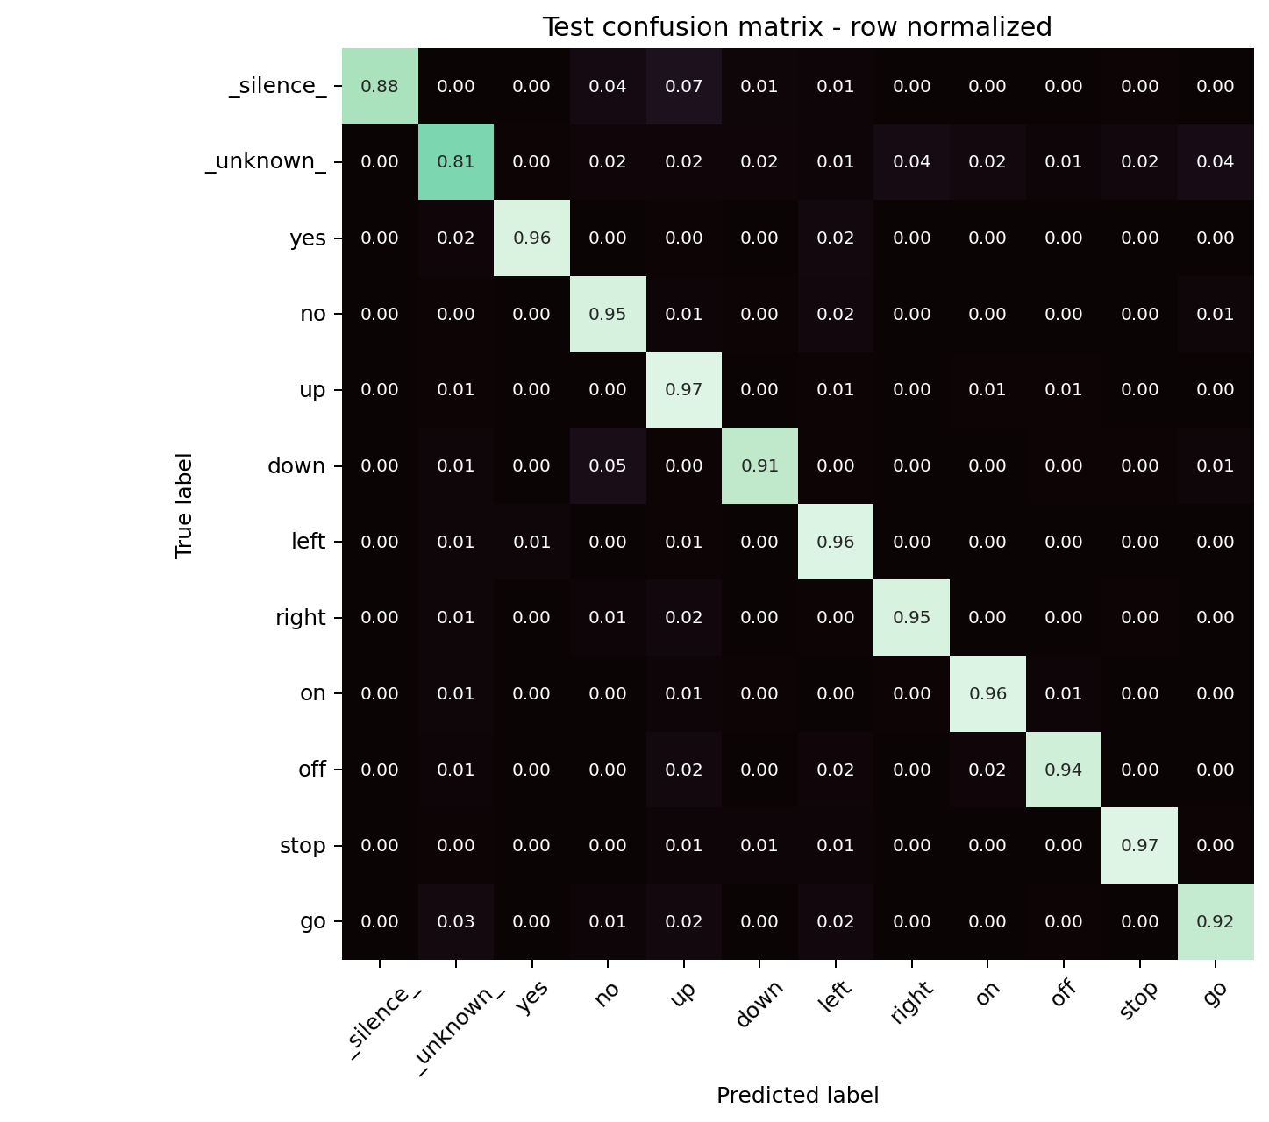
SPEECH COMMANDS
Frozen test confirms the validation result
93.12%
test accuracy
95% CI: 92.24-94.00
0.9315
test macro-F1
95% CI: 0.9228-0.9402
Validation -> test: -0.85 points
12
Notes:
After the corrected protocol and frozen selection, the official test split was evaluated. Accuracy is 93.12 percent and macro-F1 is 0.9315. Ten-thousand stratified bootstrap samples give a macro-F1 interval from 0.9228 to 0.9402. The validation-to-test change is minus 0.85 percentage points.
[Sources]
- Repository test metrics: artifacts/runs/e05_logmel_crnn_aug/evaluation_testing/metrics.json
- Repository confusion matrix: artifacts/runs/e05_logmel_crnn_aug/evaluation_testing/confusion_matrices.png
- Bootstrap implementation: src/fdl_speech_commands/evaluation.py
[/Sources]

Slide 13
SPEECH COMMANDS
Noise remains the main failure axis
0.93
0.0303
0.92
0.91
expected calibration error
0.82
3.33 ms
median CPU end-to-end latency
3.42 MiB serialized | +/-100 ms shift costs at most 0.38 points
13
Notes:
Temporal shifts of plus or minus 100 milliseconds cost at most 0.38 macro-F1 points. Background noise is the harder axis: zero decibels lowers macro-F1 by 11.16 points. Expected calibration error is 0.0303, and compiled feature extraction plus inference takes a 3.33 millisecond median on the recorded CPU machine.
[Sources]
- Repository robustness: artifacts/runs/e05_logmel_crnn_aug/evaluation_testing/robustness.csv
- Repository calibration bins: artifacts/runs/e05_logmel_crnn_aug/evaluation_testing/calibration_bins.csv
- Repository latency and model size: artifacts/runs/e05_logmel_crnn_aug/evaluation_testing/metrics.json
[/Sources]

Slide 14
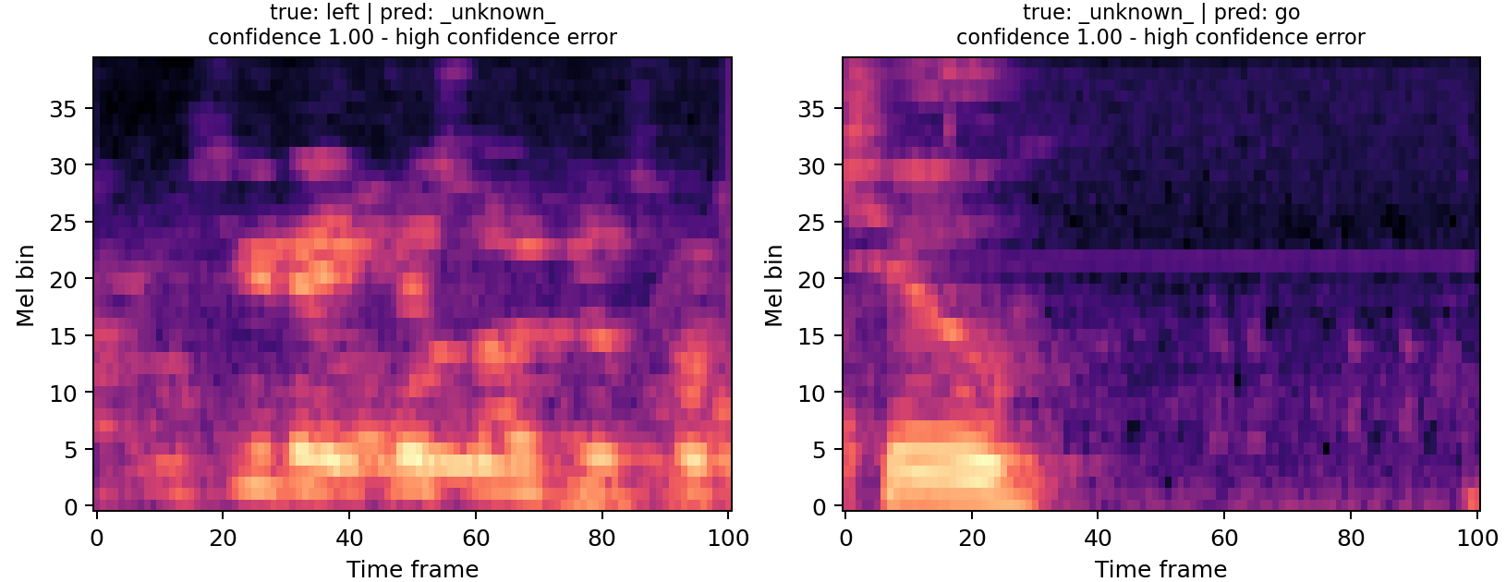
SPEECH COMMANDS
Rare confident failures survive good calibration
Weakest class
unknown F1 = 0.840
Most common error
silence -> up (17 clips)
6 confident errors
all confidence >= 0.998
Every gallery item links to a playable WAV for listening during the defense.
14
Notes:
Quantitative averages hide rare but important failures. Unknown is the weakest class at 0.840 F1, while silence-to-up is the most common directed confusion with 17 clips. All six most confident errors round to at least 0.998 confidence, so an aggregate ECE near three percent does not mean the model is never overconfident. Every exported example has a playable WAV.
[Sources]
- Repository qualitative gallery: artifacts/runs/e05_logmel_crnn_aug/evaluation_testing/qualitative_gallery.png
- Repository sample index: artifacts/runs/e05_logmel_crnn_aug/evaluation_testing/qualitative_samples.csv
- Repository playable files: artifacts/runs/e05_logmel_crnn_aug/evaluation_testing/qualitative_audio/
[/Sources]

Slide 15
CONCLUSION
Protocol matters as much as architecture
01
Structure
Log-Mel convolution plus temporal recurrence reached 0.9315 test macro-F1.
02
Trade-offs
A 46.9k-parameter DS-CNN remains compelling when footprint matters.
03
Honest limits
Noise, unknown speech, and rare overconfidence remain the deployment risks.
Reproducible: manifest, five runs, frozen weights, bootstrap, WAV gallery, CLI demo.
15
Notes:
Our conclusion has three parts. First, preserving time-frequency structure and modeling temporal context produces the best corrected score: 0.9315 test macro-F1. Second, the compact DS-CNN remains a valid alternative when footprint dominates. Third, a strong average does not erase noise sensitivity, unknown speech, or rare confident errors. The repository reproduces every claim and supports a live inference demo.
[Sources]
- Repository final report: docs/final_report.md
- Repository model card: docs/model_card.md
- Repository reproducibility guide: docs/reproducibility.md
[/Sources]

