Slide 1
DATA VISUALIZATION / DEFI
Evidence snapshot
Stablecoin Yield
A compact view of the analytical scale
The price of yield: persistence, mechanisms and TVL response in stablecoin DeFi
250
137k
POOLS
POOL-DAYS
CENTRAL CLAIM
Stablecoin APY becomes interpretable only when duration, TVL, mechanism and peg context are shown together.
4.3%
2
Yield as a regime, not a ranking.
POOL-DAY MEDIAN APY
MEDIAN EPISODE DURATION
Simone Ragusini · 945119
s.ragusini@campus.unimib.it
Educational analysis only. No financial advice, no pool ranking.
01 / 17
Notes:
Open with the precise scope: persistence, mechanisms and observed TVL response. State that this is not a protocol-risk model or a recommendation list.

Slide 2
RESEARCH FRAME
02
Yield is a regime, not a rank
APY = quoted annualized yield. TVL = total value locked, measured in USD.
ONE ANALYTICAL GRAIN
01
How long do episodes at or above 10% APY last?
POOL × DAY
02
Which mechanisms explain headline APY?
Each observation connects yield level, capacity, mechanism and market context at a defensible temporal resolution.
03
How stable are top-yield rankings?
04
What changes during peg stress?
Boundary: APY is quoted annualized APY. TVL change is an observed proxy, not direct wallet-level flow.
05
Which pools clear all three thresholds?
STABLECOIN YIELD
Notes:
State the five research questions and the decision to use pool-day as the analytical grain.

Slide 3
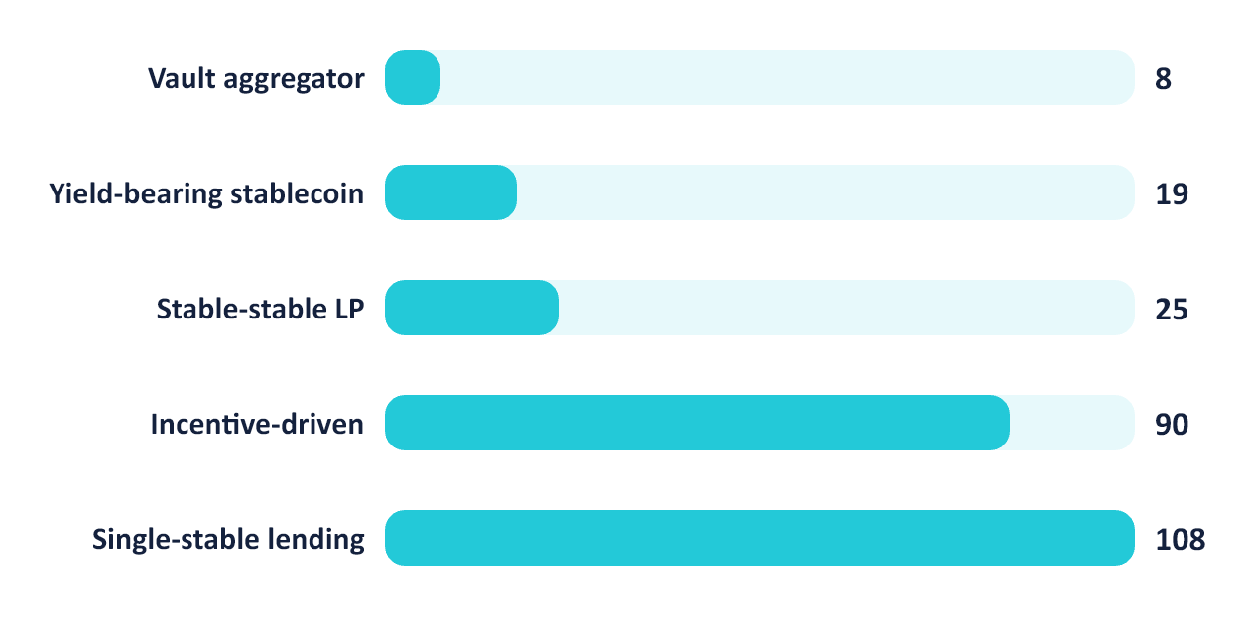
DATA SCOPE
03
The sample is broad, but deliberately selected
2022-02-11 to 2026-07-08 | 137,095 pool-days | unbalanced panel
Selected pools by analytical type
SELECTION LOGIC
Eligibility
Stablecoin pool, TVL >= USD 1M, at least 180 provider history observations.
Cap of 250
70% highest TVL; remaining capacity highest current APY. No random sampling claim.
Entry and exit
Observed pool-specific dates only. No synthetic backfill or balanced-panel imputation.
Data quality
26 missing TVL rows | 32 APY > 1,000% flagged, not hidden
STABLECOIN YIELD
Notes:
Explain the eligibility rules: stablecoin flag, at least USD 1 million TVL and 180 history observations. The 250-pool cap combines 70 percent highest TVL with the remaining capacity highest APY.

Slide 4
METHODS
04
Four definitions make the analysis auditable
Each result has an explicit threshold, comparison window and interpretation boundary.
01
High-yield episode
APY at or above 10%; contiguous observed run; one missing calendar day tolerated; active runs right-censored.
Kaplan-Meier retains censored episodes.
02
Ranking churn
1 - intersection share of top-k sets at t and t+h; k = 10 or 20; h = 1, 7 or 30 days.
Stability diagnostic, not a leaderboard.
03
APY-jump event
APY increase >= 5 pp on consecutive calendar days and APY >= 10%. First 3 events per pool. Window: -7 to +30 days.
450 events at day 0; TVL remains observational.
04
Joint threshold screen
At or above the sample medians for pool-level APY, persistence and TVL simultaneously.
Descriptive three-threshold screen; not a Pareto frontier.
STABLECOIN YIELD
Notes:
High-yield and ranking definitions are unchanged. APY jumps require consecutive calendar dates, APY change >= 5 percentage points and APY >= 10%. Select the first three qualifying dates per pool. 450 corrected events from 174 pools. Joint-screen comparisons are inclusive (>=) on unrounded pool metrics. Source: scripts/refine_submission.py, outputs/refinement/report_summary.json.

Slide 5
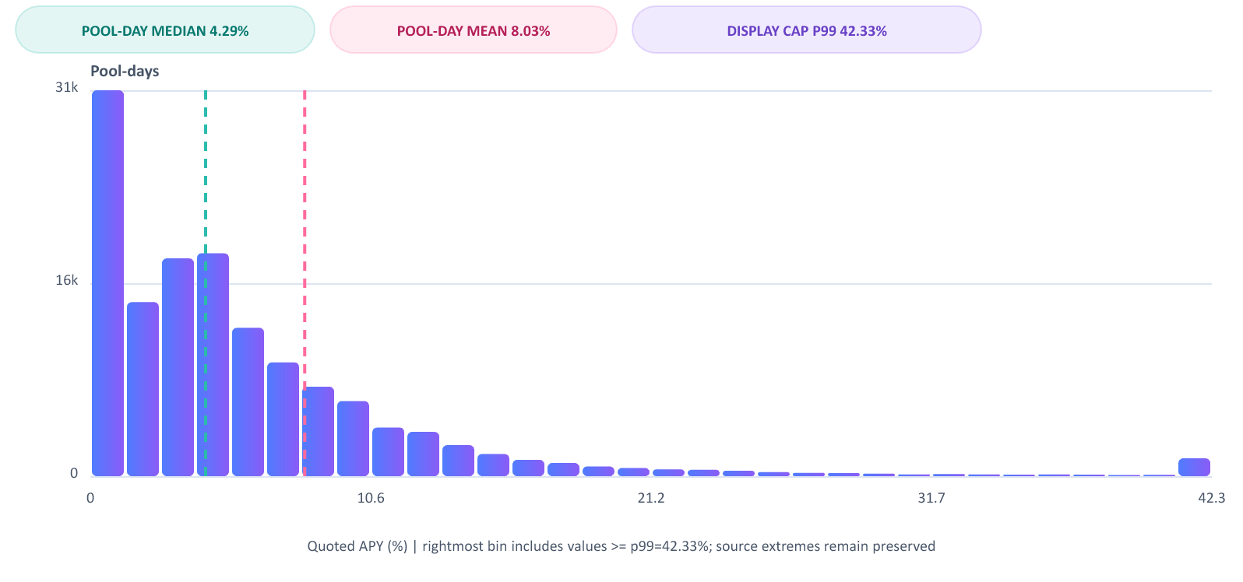
DISTRIBUTION
05
Headline APY needs robust summaries
Why are headline APY values hard to compare?
WHAT THE CHART SAYS
Pool-day median APY is 4.29% while the pool-day mean is 8.03%.
Pool-day median APY: 4.29%
Pool-day mean APY: 8.03%
Extreme observations are flagged and preserved
Sources: DeFiLlama, CoinGecko checks and protocol documentation. Quoted APY differs from realized return.
STABLECOIN YIELD
Notes:
Use the p99 display cap and preserved extreme-value flags to justify robust summaries without deleting source observations.

Slide 6
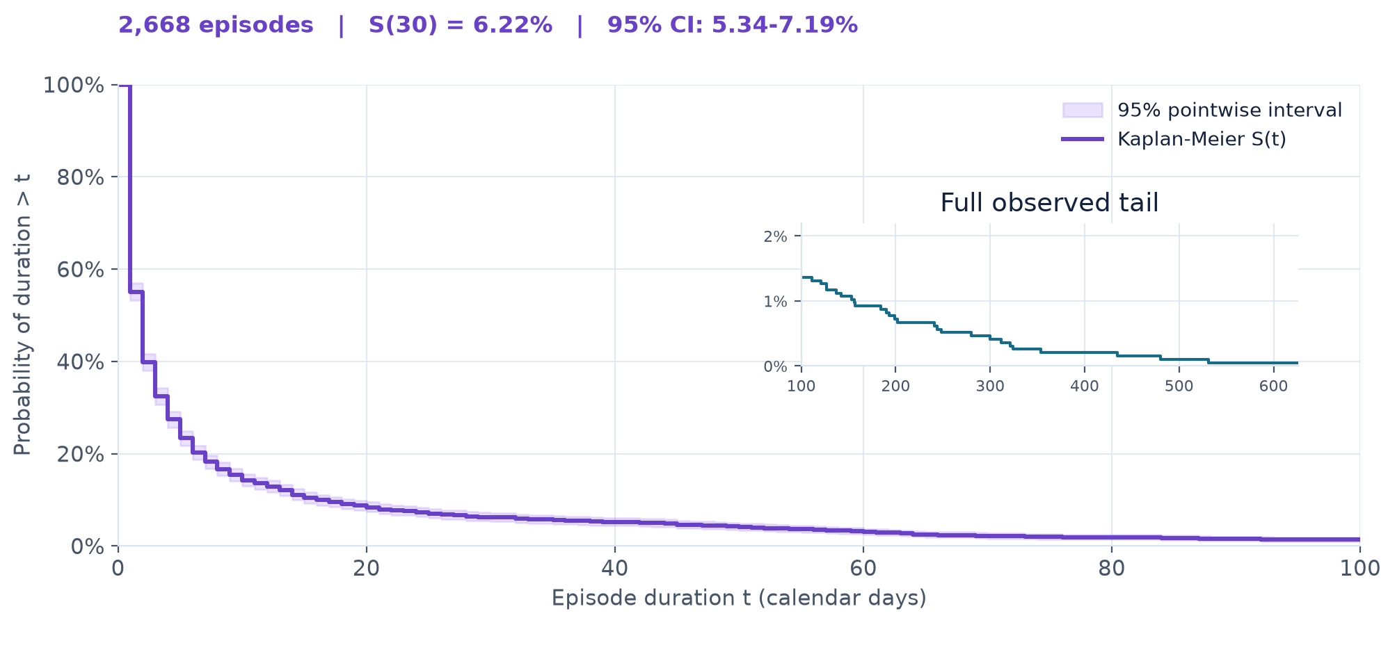
PERSISTENCE
06
High yield usually behaves like a short regime
How long do episodes at or above 10% APY last?
WHAT THE CHART SAYS
The median high-yield episode lasts 2 days; only 6.2% remain after 30 days.
2,668 episodes at or above 10% APY
Median duration: 2 days
6.2% survive beyond 30 days
Sources: DeFiLlama, CoinGecko checks and protocol documentation. Quoted APY differs from realized return.
STABLECOIN YIELD
Notes:
Explain Kaplan-Meier survival and right censoring. Report 2,668 episodes, median 2 days, p90 16 days and 1.2 percent censored.

Slide 7
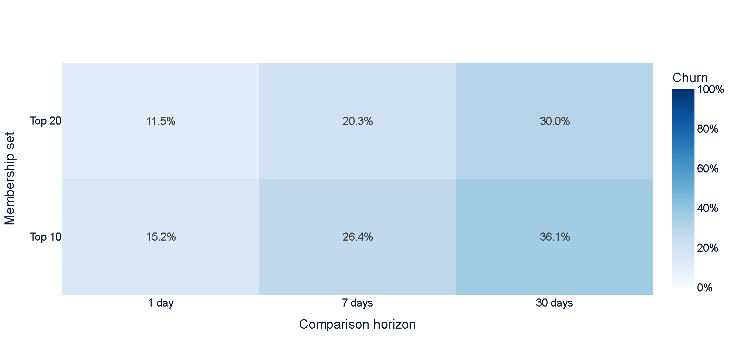
RANKING STABILITY
07
Top-yield membership changes with horizon
Do top-yield pools stay at the top?
WEIGHTED AVERAGE
Weighted by valid date × top-k comparisons, churn rises from 13.5% after 1 day to 33.3% after 30 days.
1 day: 13.5% (n=2,669)
7 days: 23.6% (n=2,657)
30 days: 33.3% (n=2,612)
Sources: DeFiLlama, CoinGecko checks and protocol documentation. Quoted APY differs from realized return.
STABLECOIN YIELD
Notes:
Define churn as one minus top-k retention. The heatmap cells are separate top-10 and top-20 date means. The text summary pools all valid observed-date/top-k comparisons, so it is weighted by their counts: 2,669 at 1 day, 2,657 at 7 days and 2,612 at 30 days.

Slide 8
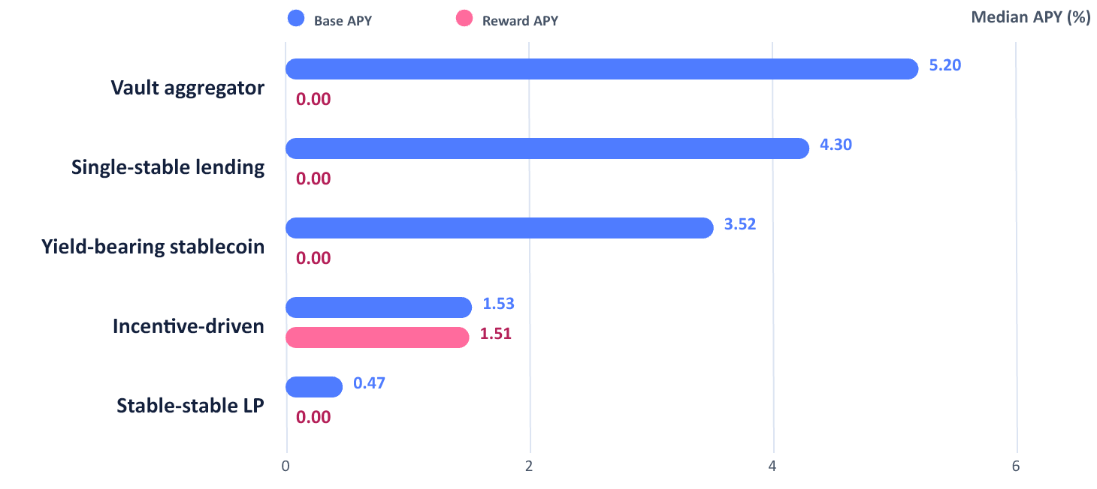
MECHANISMS
08
Mechanism changes what headline APY means
What sits behind headline APY?
Median APY components by pool type
INTERPRETATION
Components prevent false equivalence
90.3%
Base APY coverage
61.6%
Reward APY coverage
Reward coverage varies by type: 15.9% to 91.9%. Missing values are excluded.
Medians use available pool-days. Zero is observed, N/A means missing.
Component medians do not necessarily sum to median total APY.
Sources: DeFiLlama, CoinGecko and protocol documentation. Quoted APY differs from realized return.
STABLECOIN YIELD
Notes:
Component medians exclude nulls and use available pool-days within each analytical type. Zero reward medians are observed values, not imputation. Coverage and counts by category: outputs/refinement/mechanism_coverage.csv. Separate component medians do not sum to total-APY median. Category composition is descriptive.

Slide 9
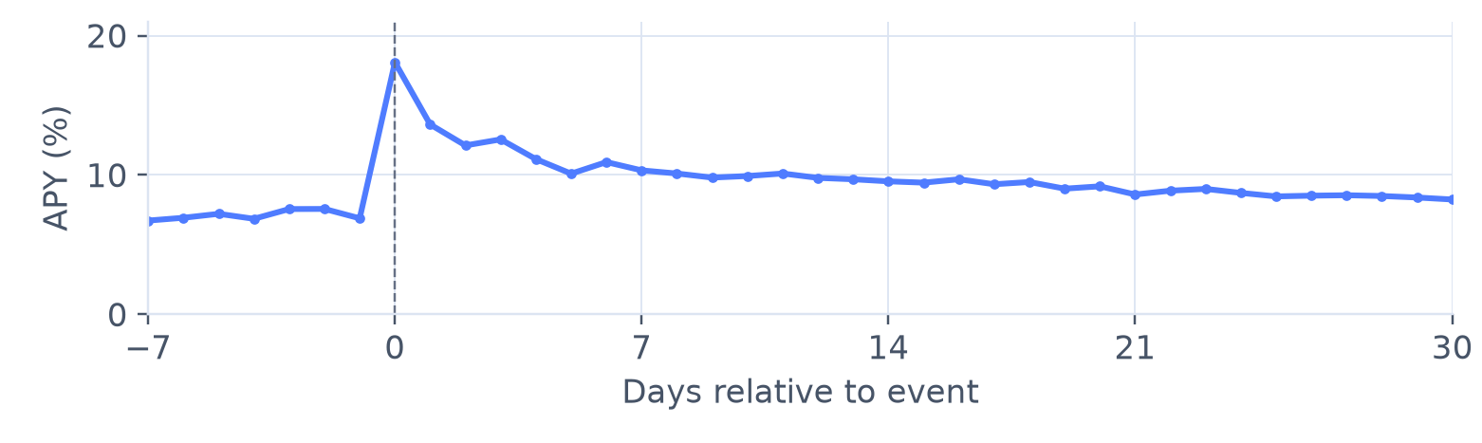
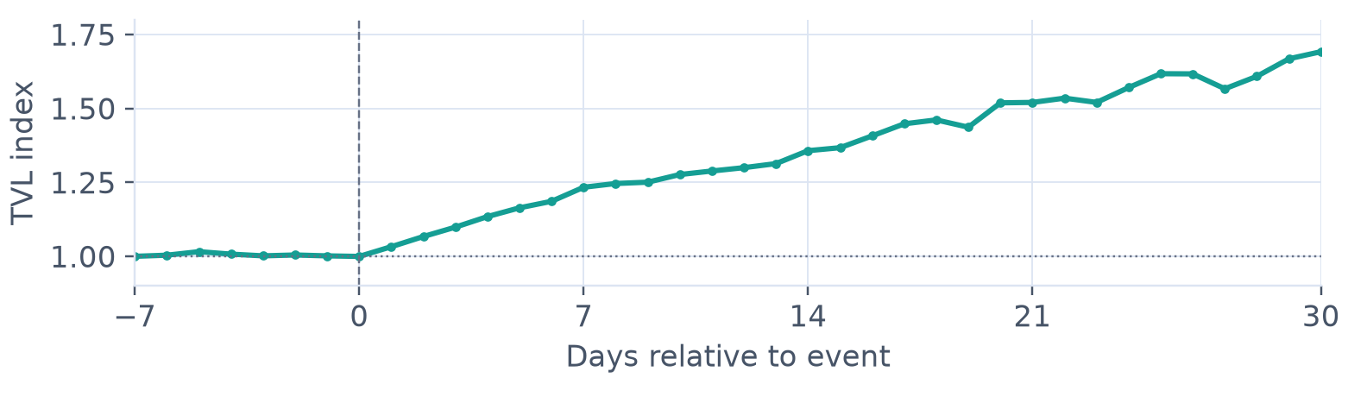
EVENT STUDY
09
APY declines while observed TVL rises
What happens after an observed APY jump?
Median quoted
APY
OBSERVED RESULT
18.09% to 8.24%
Median APY from event day to day 30
450
Events at day 0
Median normalized
TVL
1.69x
Median TVL / day-0 TVL at day 30
Same-event check (n=439): APY 17.96% to 8.24%, TVL 1.69x. Descriptive, non-causal.
Source: DeFiLlama. Consecutive-day jumps only. Events: 394 at -7d, 450 at 0d, 439 at +30d. Composition varies by day.
STABLECOIN YIELD
Notes:
Corrected consecutive-calendar-day trigger. 450 events at day 0, 439 at day 30. The first three valid events per pool can overlap. Endpoint sensitivity retains 439 identical events with valid APY and TVL at days 0 and 30: 17.96% to 8.24%, median TVL ratio 1.692. No causal interpretation or independent-event inference. Sources: outputs/refinement/apy_tvl_event_response.csv, refinement_audit.json and scripts/refine_submission.py. Original historical deck used successive-observation changes and 453 events; 10 nonconsecutive selections are excluded, and later valid events can enter under the cap.

Slide 10
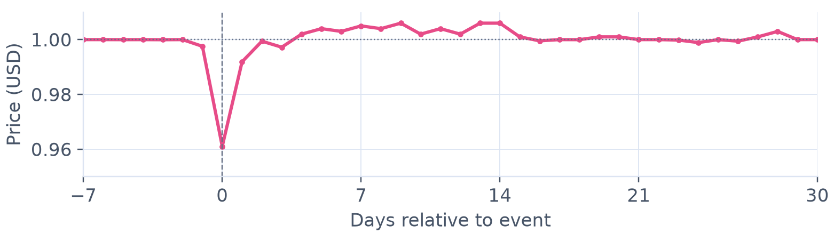
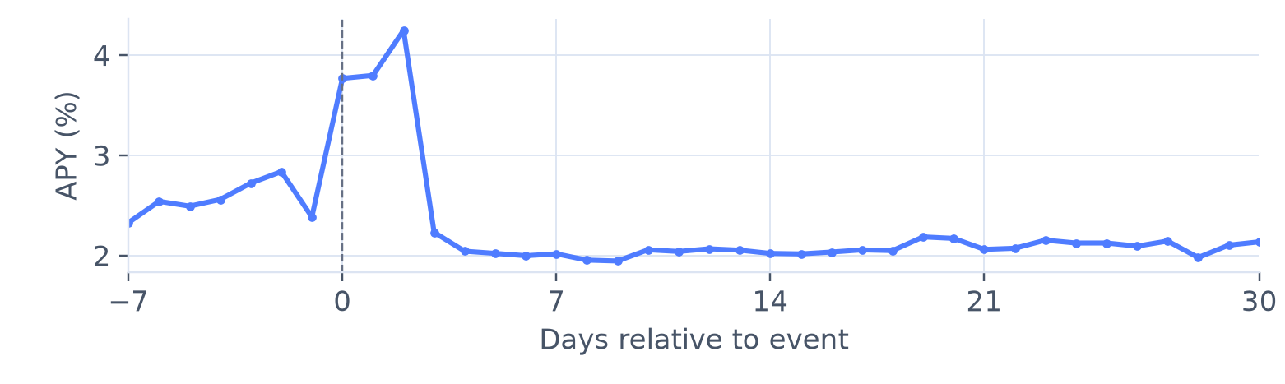
PEG STRESS
10
Peg stress changes the denominator behind yield
What changed during the March 2023 USDC depeg?
USDC price
USDC / 12 MAR 2023
$0.9611
Minimum daily observation in this window
+1.38 pp
Median APY, day -1 to day 0
Median exposed-pool
APY (%)
9-10
Pools per day (9 at day 0)
Changing pool composition. One descriptive case, without a control group.
Sources: DeFiLlama, CoinGecko and protocol documentation. Quoted APY differs from realized return.
STABLECOIN YIELD
Notes:
Report the selected reviewed event, the 10-pool exposure window and the descriptive APY change. Do not generalize one event into a causal risk estimate.

Slide 11
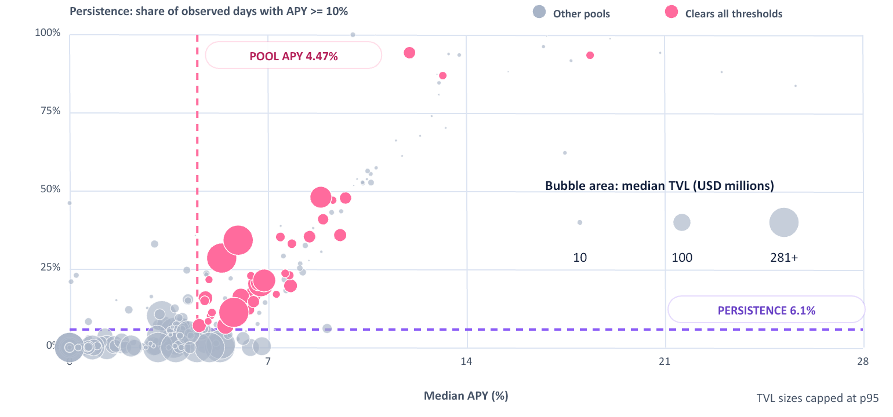
JOINT SCREEN
11
Only 15.2% clear all three descriptive thresholds
Which pools combine APY, persistence and capacity?
THREE-MEDIAN SCREEN
38 of 250 pools
clear APY, persistence and TVL thresholds simultaneously
4.47%
Median APY
6.1%
Persistence
$17.74M
Median TVL
Inclusive thresholds. Bubble area encodes TVL. Descriptive screen.
Sources: DeFiLlama, CoinGecko and protocol documentation. Quoted APY differs from realized return.
STABLECOIN YIELD
Notes:
All three thresholds are inclusive. TVL threshold is USD 17,736,233. Bubble areas are proportional to median TVL up to the sample 95th percentile, with identical size mapping in both color groups. Numerical bubble key uses USD millions. Sources: outputs/refinement/report_summary.json, joint_screen section.

Slide 12
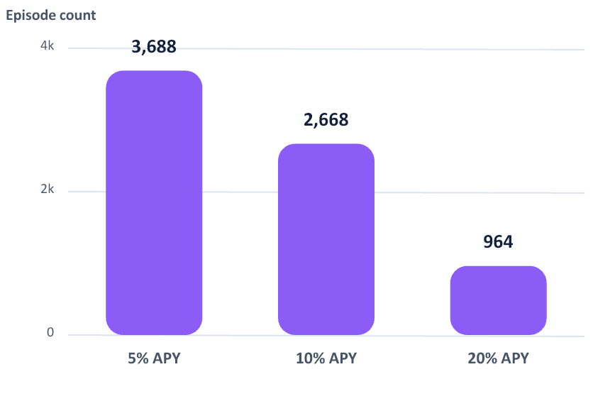
ROBUSTNESS
12
The main duration result survives alternative thresholds
Does the short-episode conclusion depend on one threshold?
Episode count changes; median duration does not
FIVE CHECK FAMILIES
APY threshold
5%, 10%, 20%
2 days
Minimum TVL
USD 0.5M, 1M, 5M
median duration at 5%, 10% and 20% APY thresholds
History length
90, 180, 365 days
Episode gap
0, 1, 3 days
Counts: 3,688 | 2,668 | 964
Winsorization
p1 to p99
Filters change counts. Quoted APY remains distinct from realized return.
STABLECOIN YIELD
Notes:
Show that episode counts change with the threshold but the median duration does not. Mention all five robustness families materialized by the pipeline.

Slide 13
LIMITS / ETHICS
13
Market context is not total protocol risk
What does the project deliberately not claim?
MEASURED HERE
NOT MEASURED HERE
What the evidence supports
What the project cannot rank
Quoted APY level and persistence
Smart-contract and oracle failure
Observed TVL and reward components
Counterparty and collateral quality
Top-k membership stability
Bridge, chain and governance risk
Stablecoin peg context
Executable liquidity and slippage
Data quality and sensitivity checks
Investor-specific realized return
Ethical consequence: no pool ranking, no hidden safety score and no financial recommendation.
STABLECOIN YIELD
Notes:
Name the unmeasured dimensions: smart-contract, counterparty, bridge, chain, oracle, liquidity and collateral quality. This boundary is why the project avoids recommendations.

Slide 14
UNCERTAINTY
14
Precision has a defined scope
Day-30 survival: 6.22%
95% pointwise CI: 5.34%-7.19%. Pool bootstrap: 4.76%-7.86%.
Repeated episodes
2,000 bootstrap resamples of whole pools preserve within-pool episode dependence. The interval is wider.
Observation limits
70 episodes start at panel entry; 56 end at long gaps. Observed runs can differ from economic episodes.
Sample selection
Selection excludes short histories. The 90-day check cannot recover them. Bootstrap does not correct selection bias.
Interpretation
The evidence describes selected observed regimes. It does not estimate every pool's future yield.
Sources: episode_survival.csv and refinement_audit.json. Bootstrap: 250 pools, seed 945119, percentile interval.
STABLECOIN YIELD
Notes:
Original lifelines 95% log-log pointwise CI assumes independent episodes. Additional 95% percentile bootstrap resamples all 250 pools with replacement, preserving each selected pool's entire episode set. 2,000 replicates, numpy default_rng seed 945119. S(30)=6.2247%, pool-bootstrap CI 4.7611%-7.8564%. This conditions on the observed sample and episode definition. 70 episodes start at the pool's panel entry, and 56 end before gaps exceeding two calendar days. These bounds are descriptive, not an estimator of latent economic duration. Code and aggregate audit: scripts/refine_submission.py and outputs/refinement/refinement_audit.json.

Slide 15
TOOLS / VISUAL DESIGN
15
Two visualization tools, complementary uses
MATPLOTLIB
PLOTLY
Static analytical figures
Ranking heatmap in this PDF
This PDF uses Matplotlib for the survival curve (page 6) and daily event charts (pages 9–10).
The survival band shows uncertainty. Numerical time axes preserve the actual spacing of days.
Page 7 contains a static export of the Plotly ranking heatmap, using the same published aggregate data.
Every cell includes its value. Reading the result requires no hover, live demo or additional file.
Analysis: Python, pandas, NumPy, lifelines, SciPy and scikit-learn
Seaborn supports static figures. ReportLab builds the report. Artifact Tool assembles the PowerPoint.
All findings are readable in this PDF. Interactive HTML and editable sources are optional supporting materials.
STABLECOIN YIELD
Notes:
The PDF includes the actual Plotly heatmap on page 7 and Matplotlib plots on pages 6, 9 and 10. No live demonstration is needed. The two distinct visualization libraries are Matplotlib and Plotly; Seaborn is documented as supporting Matplotlib, not counted as an independent rendering system. Matplotlib code: src/stablecoin_yield/visualization/figures.py. Plotly code: scripts/reproduce_published.py. Presentation charts are assembled separately by @oai/artifact-tool. Versions are locked in uv.lock and recorded in outputs/revision/published_evidence_audit.json. Repository: https://github.com/Laimon99/stablecoin-yield-visualization

Slide 16
REPRODUCIBILITY / RIGHTS
16
Code, evidence and reuse terms
github.com/Laimon99/stablecoin-yield-visualization
1. Rebuild the published evidence
uv sync --frozen --extra dev
uv run python scripts/refine_submission.py
From the cloned repository: rebuild static charts and verify event headlines from published aggregates, without API calls.
2. Recollect and rerun the method
uv run python scripts/reproduce_all.py --mode full
Live data can change. The historical raw snapshot is private. Bootstrap recalculation requires that snapshot. Deck: Artifact Tool.
© 2026 Simone Ragusini. Code: MIT. Original presentation and text: CC BY 4.0.
DeFiLlama and CoinGecko data retain their own terms. Sources, exclusions and attribution: NOTICE.md.
STABLECOIN YIELD
Notes:
Public repository: https://github.com/Laimon99/stablecoin-yield-visualization . The refined static charts and event headline checks use scripts/refine_submission.py and outputs/refinement aggregates. --refresh-local recomputes the corrected event selection, paired endpoint sensitivity and whole-pool bootstrap from the private historical panel. Plain offline reconstruction does not independently reproduce raw-to-aggregate computations or the bootstrap. uv.lock pins dependencies. Optional layout requires Artifact Tool and PowerPoint export. Code: MIT. Original presentation: CC BY 4.0. Provider data excluded; see NOTICE.md.

Slide 17
FINAL SYNTHESIS
Stablecoin yield is best shown as trade-offs
The project closes on three lenses that keep a volatile number interpretable.
ONE SENTENCE DEFENSE
PERSISTENCE
Under the main 10% definition, the median episode lasts 2 days, so duration matters as much as level.
High stablecoin yield is common in snapshots. Persistent high yield with capacity and interpretable risk context is rarer.
CONTEXT
Mechanism, reward dependence and peg stress change what a nominal APY number means.
RESPONSIBLE DESIGN
The joint screen keeps APY, persistence and capacity visible without encoding a recommendation.
Code: github.com/Laimon99/stablecoin-yield-visualization
Matplotlib + Plotly. Code: MIT. Original presentation: CC BY 4.0.
Educational analysis only. No financial advice.
17 / 17
Notes:
Close with the one-sentence defense, reproducibility and the no-financial-advice boundary.

