Slide 1
Title: Housing Price Predictions with Multiple Linear Regression
Author: Laine Beatty

Slide 2
Introduction
The goal of this analysis was to select the most accurate multiple linear regression model for housing price predictions.
Correlation thresholds: 0.50, 0.65, 0.35
Number of predictor variables: 12, 19, 8
All linear regression models used the correlation with sale price as the basis for the selection of predictor variables.

Slide 3
The Data
Data description:
* Training File: houseSmallData.csv
* Testing File: jtest.csv
* Source: Emeritus
The training and testing data sets each include 100 observations with 81 fields. The fields include one identification column, 79 features and the target variable, sale price.

Slide 4
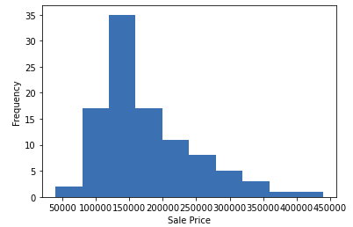
Data Exploration
The target variable, sale price, approximately follows a log-normal distribution.

Slide 5
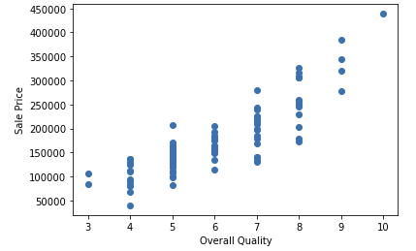
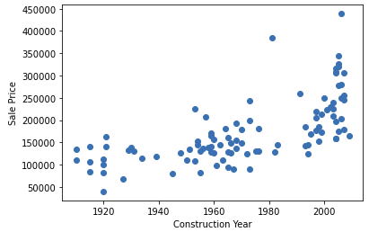
Data Exploration
The sale price has a strong correlation with variables such as overall quality and a weaker correlation with variables such as the construction year.

Slide 6
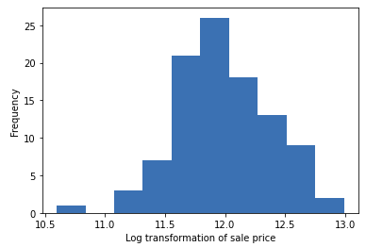
Data Preparation
Because a linear regression model requires continuous predictor and target variables, all categorical features were removed from consideration.
Pool quality, pool area due to missing values. ‘Id’ was removed from consideration due to the lack of relationship with sale price.
The training data was divided into training and validation sets with 75 and 25 observations, respectively. The log transformation of sale price was used to achieve an approximately normal distribution for the target variable.

Slide 7
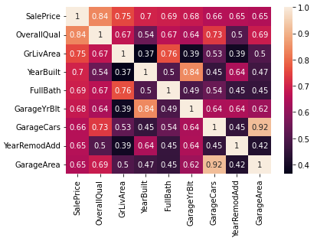
Correlation
The three sets of predictor variables were selected based on correlation thresholds of 0.5, 0.65 and 0.35. The 8 variables with the highest correlation to sale price showed some multicollinearity that would likely be removed in models based on statistical significance.

Slide 8
Project Description
All models used multiple linear regression to predict sale price based on the selected predictor variables.
Based on the provided variable selection method of correlation with the target variable, this analysis identifies the approximate optimal correlation threshold for variable selection. The three models used sets of predictor variables based on sale price correlation thresholds of 0.5, 0.65 and 0.35. These thresholds resulted in sets of 12, 19 and 8 predictor variables, respectively.

Slide 9
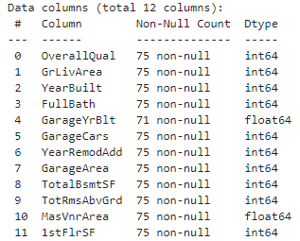
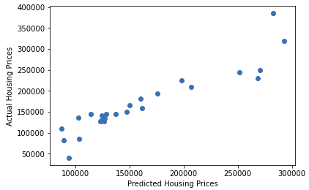
Analysis and Results
Model 1
Correlation threshold: 0.50
Number of predictor variables: 12
Training score: 0.890
Validation score: 0.770

Slide 10
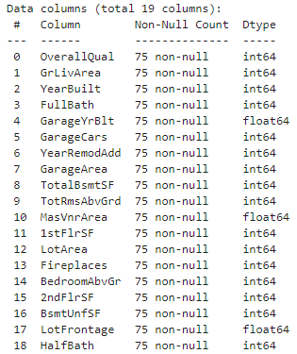
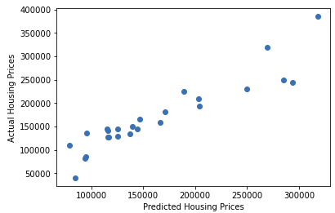
Analysis and Results
Model 2
Correlation threshold: 0.35
Number of predictor variables: 19
Training score: 0.921
Validation score: 0.782

Slide 11
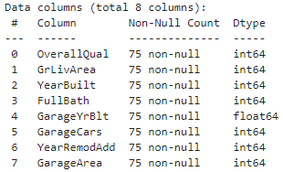
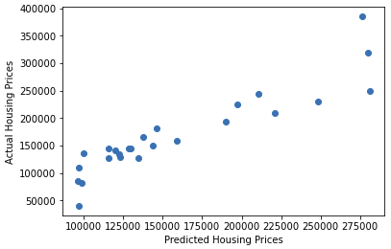
Analysis and Results
Model 3
Correlation threshold: 0.65
Number of predictor variables: 8
Training score: 0.871
Validation score: 0.741

Slide 12
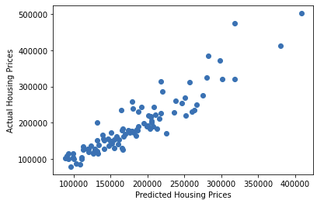
Verification
The models achieved similar results between the training and validation steps. Model 3, with the lowest number of predictor variables, achieved the lowest training and validation scores. Model 2, with the highest number of predictor variables, achieved the highest training and validation scores.
The testing score for Model 2, 0.846, was higher than the validation score, but lower than the initial training score. This is the expected result of machine learning algorithms achieving higher training metrics as they fit the given data, with validation and testing scores dependent on the level of over- or underfitting.

Slide 13
Conclusion
The model with the lowest correlation threshold and highest number of predictor variables was able to achieve the highest R². These results may not apply to other machine learning algorithms or scoring metrics due to issues such as multicollinearity among the independent variables.

Slide 14
References
Pedregosa, F., et al. “Linear Models - Scikit-Learn 1.2.1 Documentation.” Scikit-learn: Machine Learning in Python. February 7, 2023. https://scikit-learn.org/stable/modules/linear_model.html.
Pedregosa, F., et al. “Scikit-learn: Machine Learning in Python.” Journal of Machine Learning Research Volume 12 (2011): 2825-2830.

