Slide 1
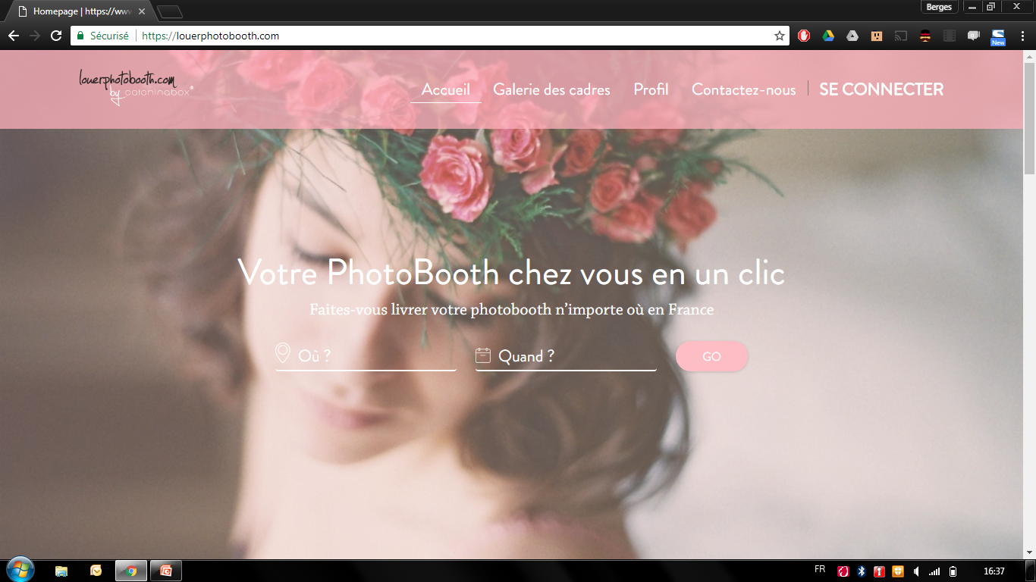
Make the menu (header) fixed and resizing when scrolling from 1 to 2/3.
Add a background-color with transparency (black for example) to make the image darker

Slide 2
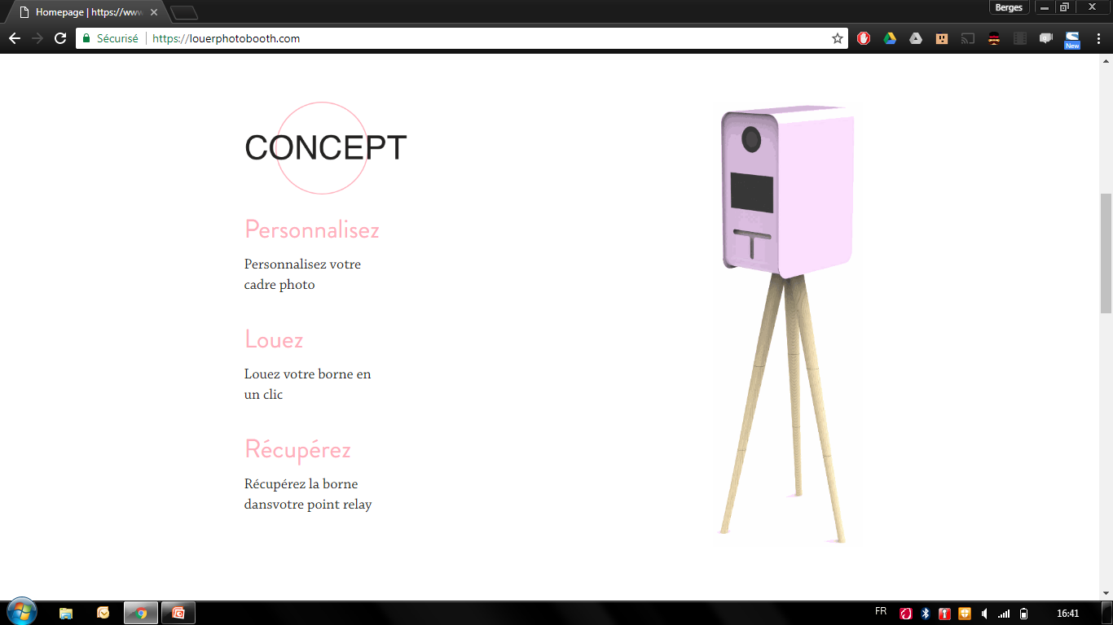
Text in one line not two
Once done resize the image if needed to keep the height proportions

Slide 3
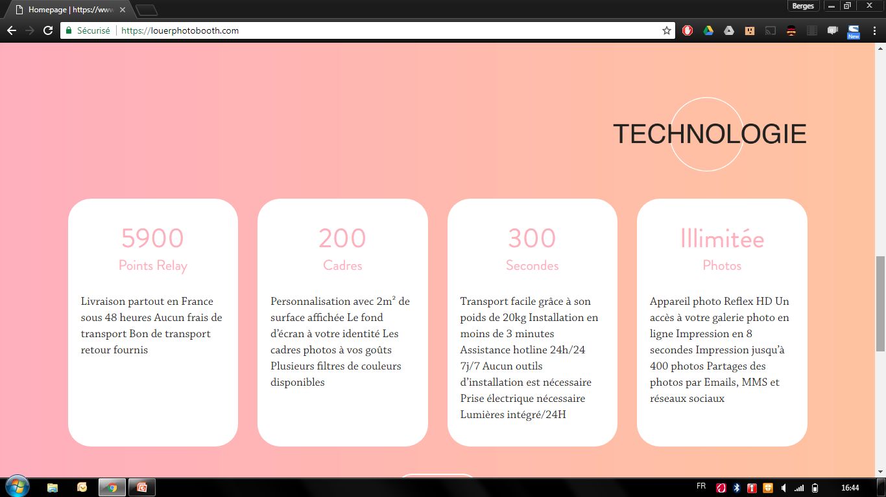
Every word with Uppercase is a new line
Add padding between each sentence (not line)
Livraison partout en France sous 48h
Aucun frais de transport
Bon de transport retour fournis

Slide 4
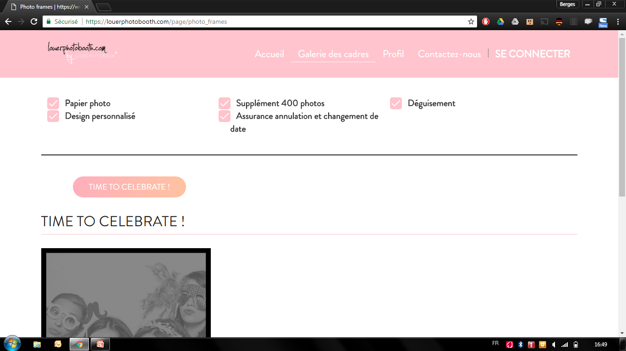
Assurance annulation et changement de date in one line please
Add column width if needed
Make this submenu centered not left aligned

Slide 5
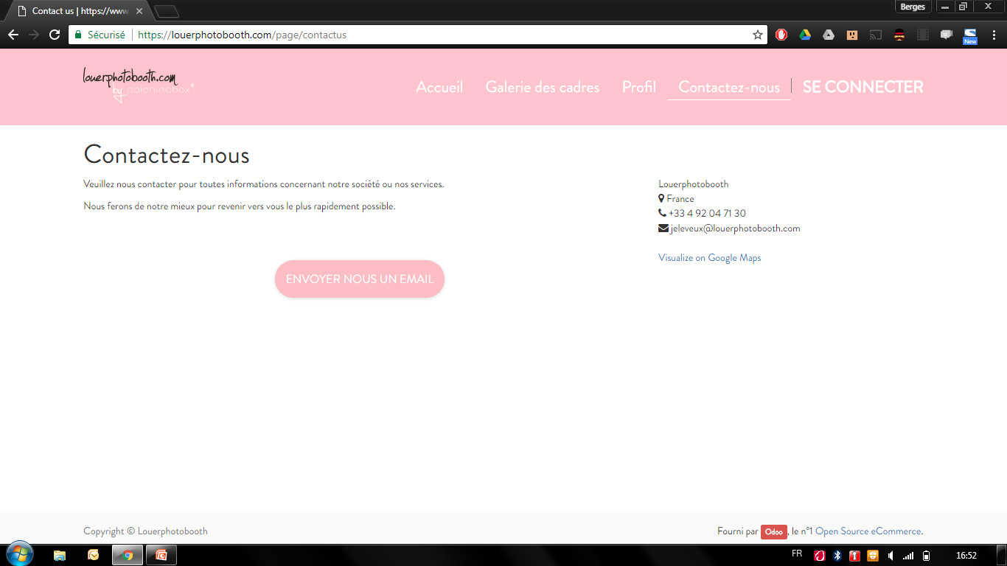
Keep the design but add a contact form in this page
Remove in every pages the Odoo watermark

