Slide 2
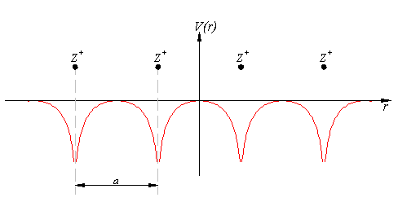
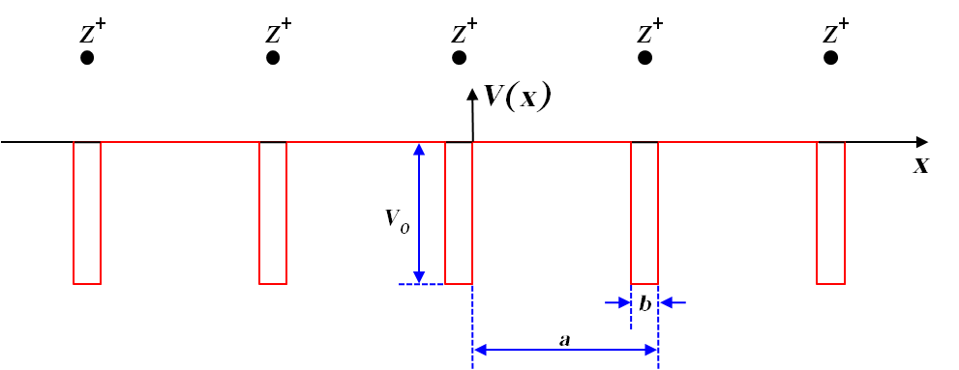


Slide 3
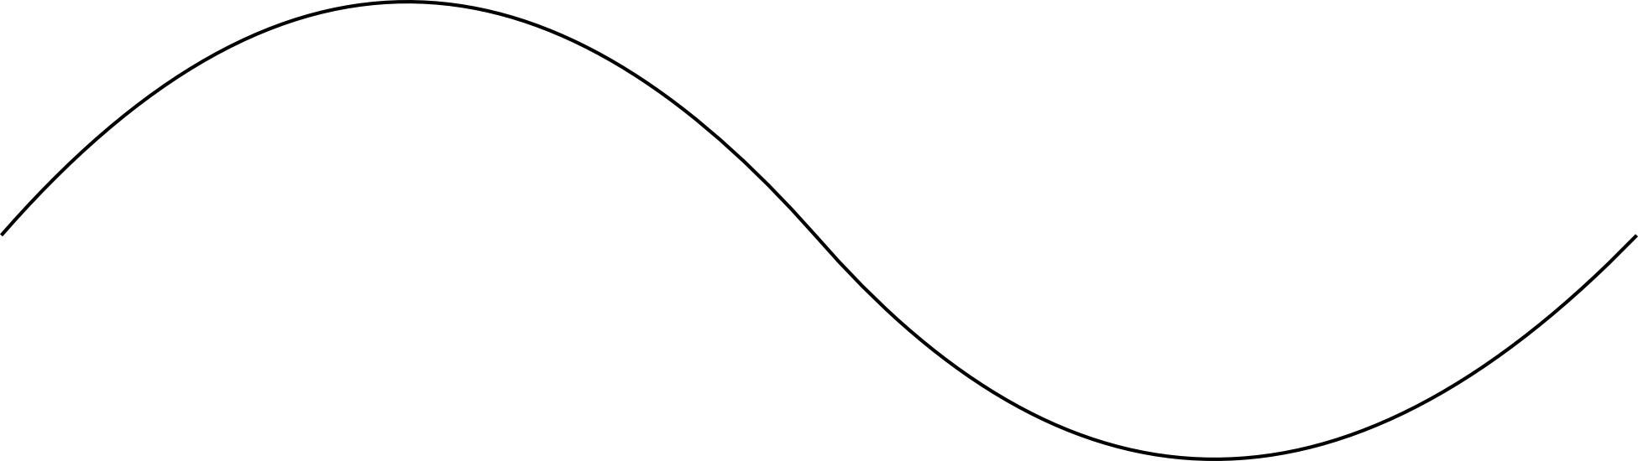
E
E_{g}
k
π/a

Slide 4
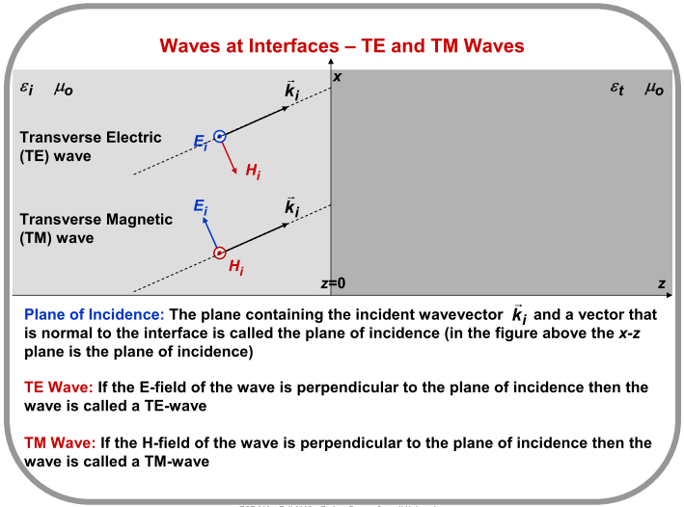

Slide 5
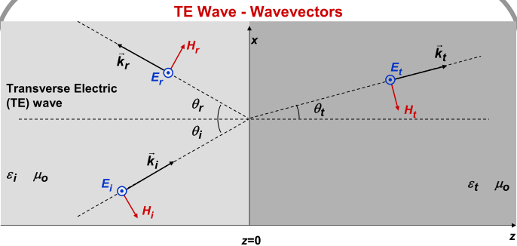

Slide 6
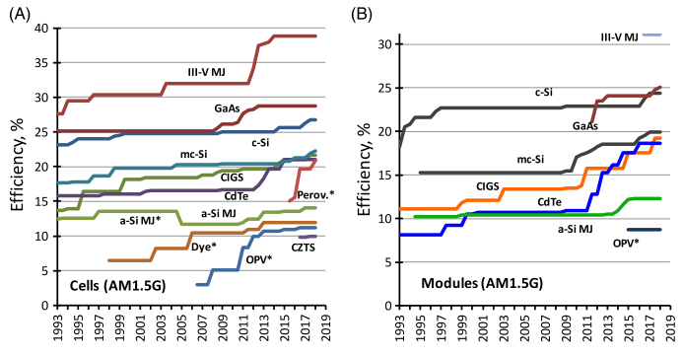
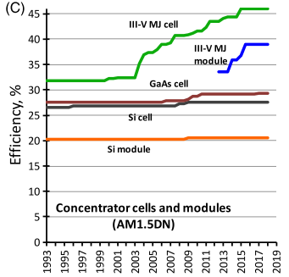
Twenty ‐ five years of progress: A, highest confirmed efficiencies for ≥ 1 ‐ cm2 area cells fabricated using the different technologies shown (*the results for the OPV, dye ‐ sensitised and perovskite cells are unstabilised results as are those for a ‐ Si multijunction cells prior to 2005). B, highest confirmed module results for modules sizes ≥ 800 ‐ cm2. C, highest confirmed concentrator cell and module results

