Slide 2
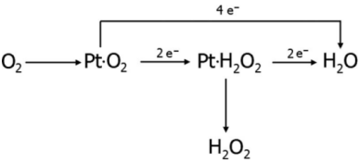
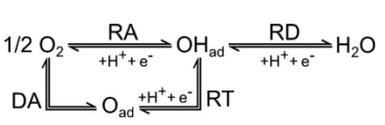
Fig. Proposed ORR mechanisms. (left) The series and direct mechanism, (right) another assumed paths.

Slide 3
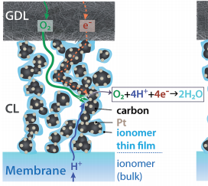
O₂, N₂, H₂O
Gas channel
gas
e-
H₂O
GDL
O₂ + 4H⁺ +4 e⁻ → H₂O
CL
Load
H⁺
PEM
H₂ → H⁺ + e⁻
CL
gas
e-
GDL
H₂, H₂O
Gas channel

Slide 4
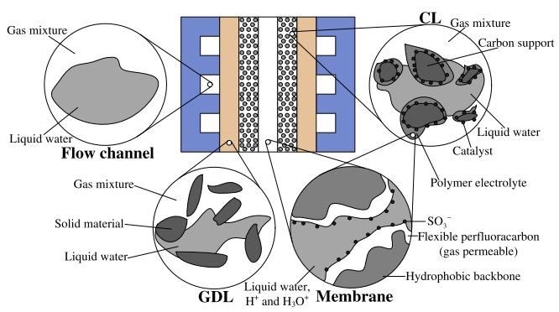
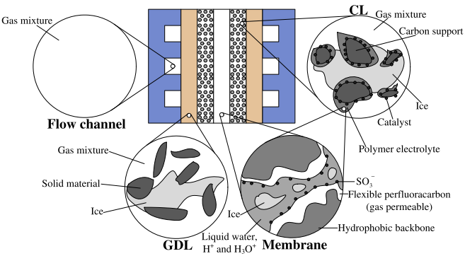
Non-frozen Membrane Water
Non-frozen/Frozen Membrane Water
Non-frozen Membrane Water, Liquid, Vapor
Non-frozen Membrane Water, Liquid, Vapor, Ice
Liquid, Vapor
Liquid, Vapor, Ice
Schematics of a single PEMFC with the structure of each cell component illustrated. (left). Normal operating condition; (right). cold start.

Slide 5
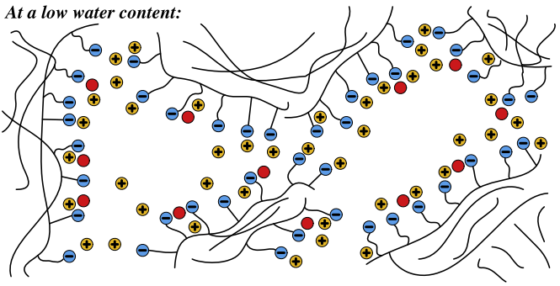
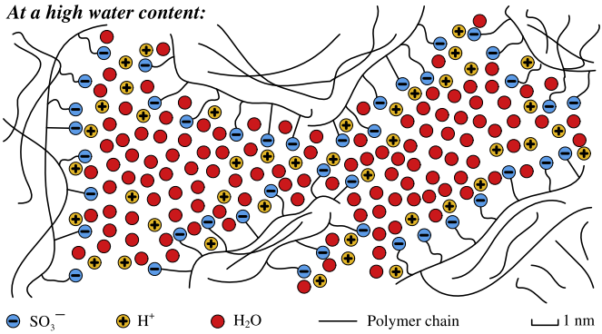
Fig. Schematics of micro-structural features of Naﬁon for low and high water contents (note that the free volume containing water at a low water content is smaller than at a high water content, and such difference is neglected in this ﬁgure).

Slide 6
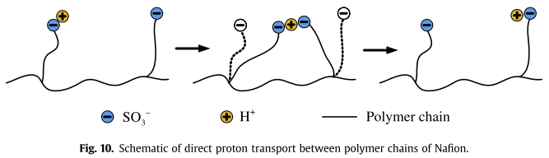
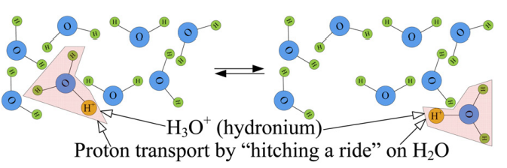

Slide 7
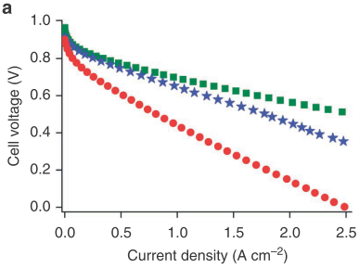
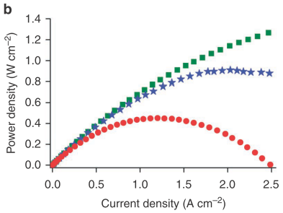
Figure 1 | Polarization and power density curves of MEAs with Fe-based and Pt-based cathodes. (a) Polarization curves for MEAs comprising a cathode made with 1/20/80-Z8-1050 °C-15 min, the most active Fe/Phen/Z8-derived catalyst in this work (blue stars) and 1/50/50-BP-1050 °C-60 min, our previous most active iron-based catalyst (red circles). For comparison, the polarization curve of an MEA made with a state-of-the-art Pt-based cathode with a loading of 0.3 mg Pt cm − 2 (green squares) supplied by an industry leader is also shown. (b) Power density curves corresponding to polarization curves shown in (a).

