Slide 2
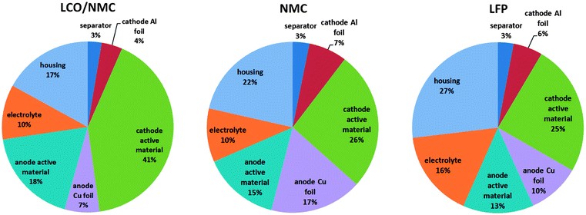

Slide 3
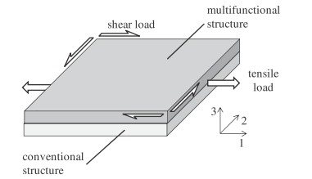
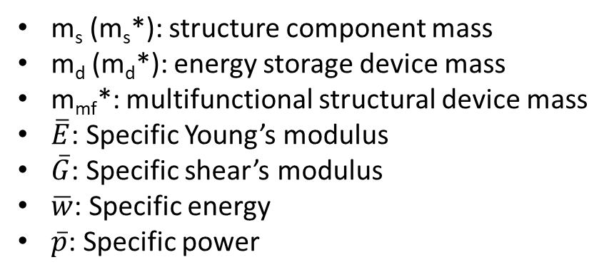
m_{s} (m_{s}*): structure component mass
m_{d} (m_{d}*): energy storage device mass
m_{mf}*: multifunctional structural device mass
$\overline{E}$: Specific Young’s modulus
$\overline{G}$: Specific shear’s modulus
$\overline{w}$: Specific energy
$\overline{p}$: Specific power

