Slide 2
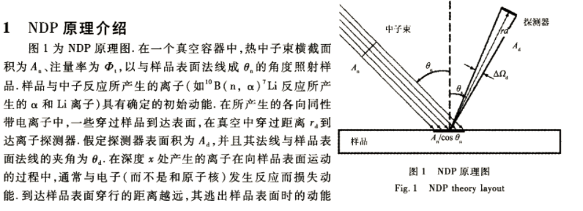

Slide 3
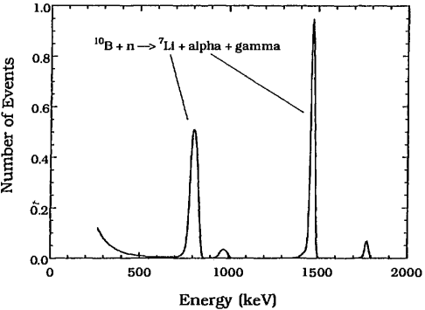
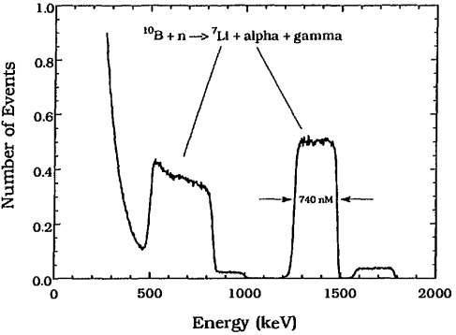
(a)
(b)
Energy profiles of particles emitted by the ¹⁰B reaction for (a) a 2 nm thick surface deposition, (b) a 740 nm thicic borosilicate glass film on Si

Slide 4
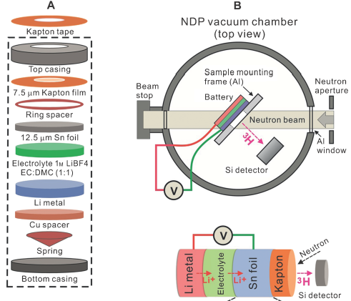
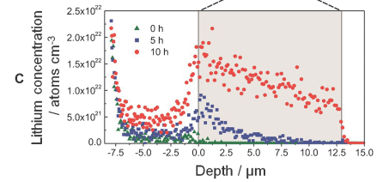
Figure 1. A) A schematic representation of the battery components. B) Illustration of the NDP chamber at NCNR. C) Three snapshots of the in situ NDP spectra showing Li transport during charging/discharging a battery. EC=ethylene carbonate, DMC=dimethyl carbonate.

