Slide 2
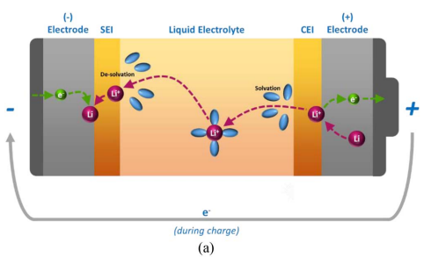
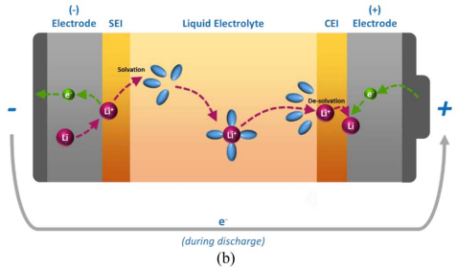
Figure 1. (a) A schematic view of the Li⁺ charge transfer process during charge. (b) A schematic view of the Li⁺ charge transfer process during discharge.

Slide 3
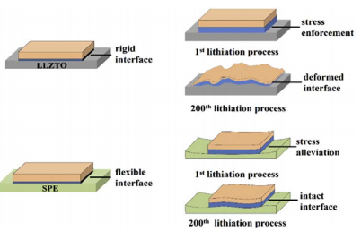
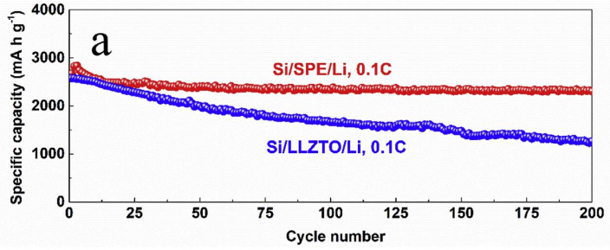

Slide 4
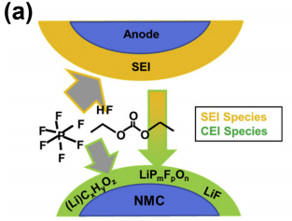
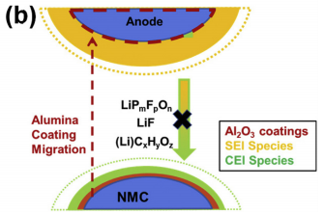
Scheme 1. Illustration of (a) CEI formation via migration of SEI (b) Electrochemical processes in Al2O3 coated NMC cells.

Slide 5
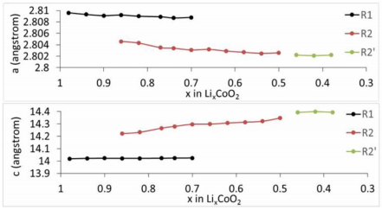
Fig. variation of the lattice parameter of the rhombohedral R1, R2 and R2’ phases as a function of cathode oxidation (Li content x).

Slide 6
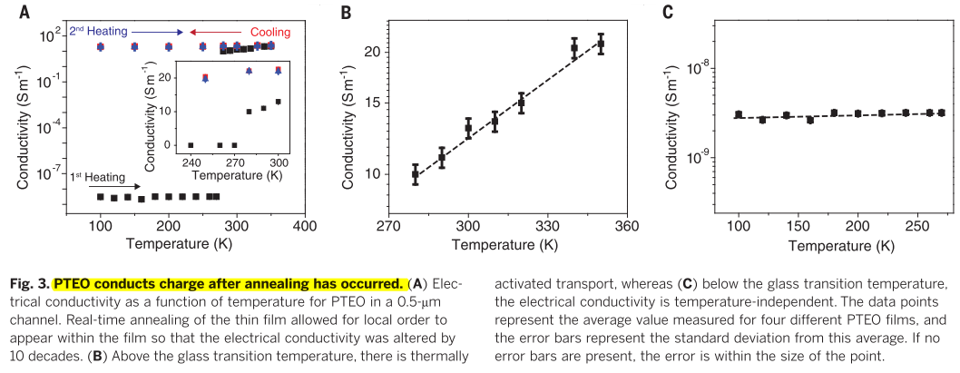
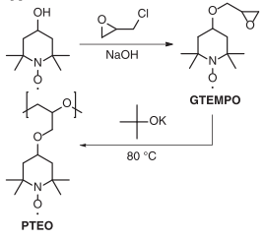

Slide 7
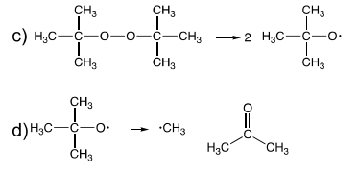
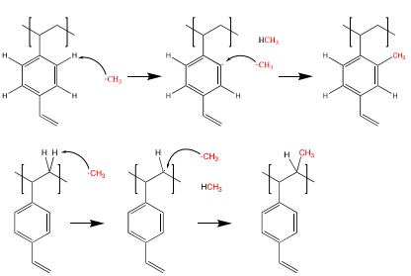
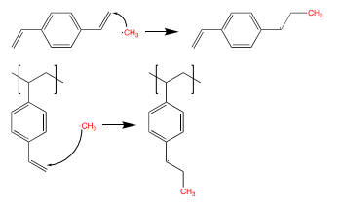
α scission
β scission
Potential reactions with methyl radical

Slide 8
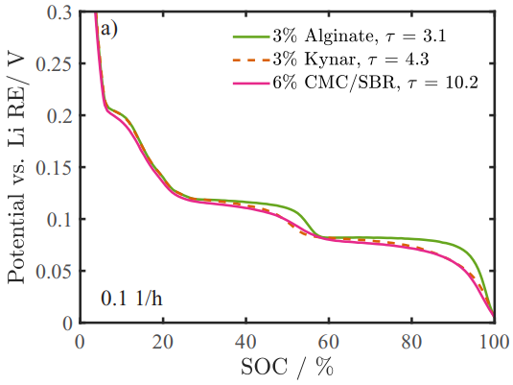
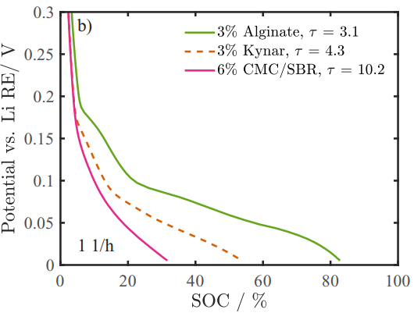
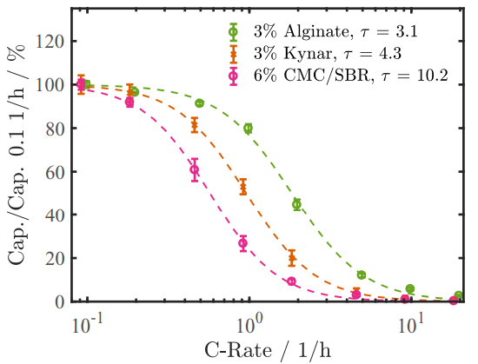
Figure 4. Third-cycle galvanostatic charging (lithiation) curves at C-rates of a) 0.1 1/h and b)1 1/h of porous graphite electrodes (see Table II for details) with three different tortuosities, recorded in three-electrode cells with lithium counter and lithium reference electrodes.
Figure 5. Mean charging capacities vs. galvanostatic charging rates ranging from 0.1 1/h to 20 1/h

Slide 9
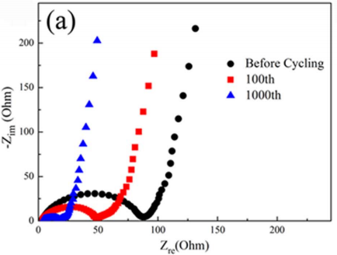
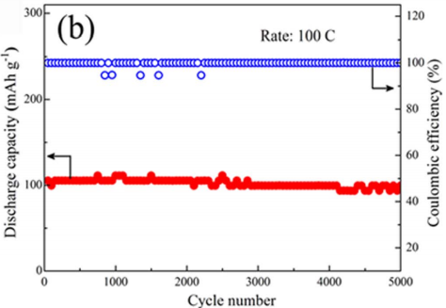
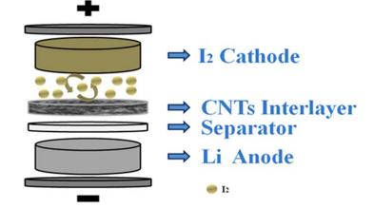

Slide 10
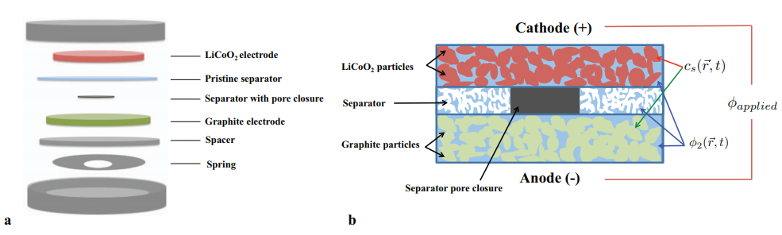
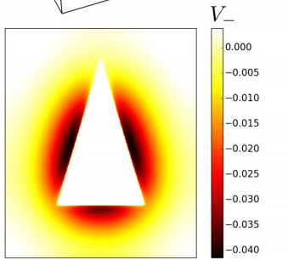
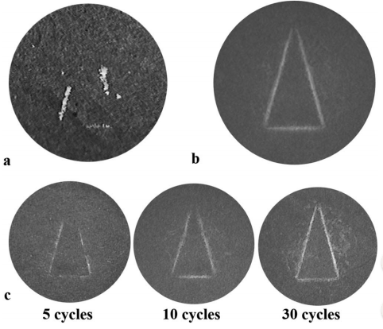

Slide 11
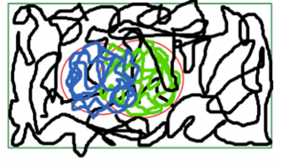
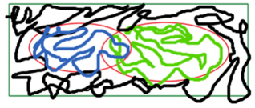

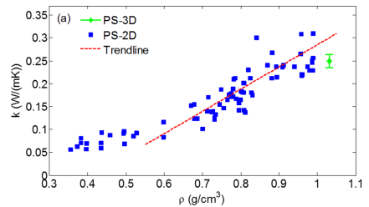
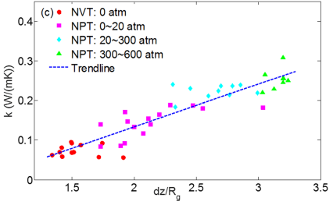
Schematics of the chain structure as gyration (dz/Rg) decreases. (Left) large dz/Rg, polymer chains entangle with each other; (Middle) middle dz/Rg, polymer chains have less overlap; and (Right) small dz/Rg, polymer chains are isolated.
Equilibrium molecular dynamics (EMD) results of thermal conductivity of 2D PS at 300 K versus (a) density and (c) dz=Rg.

Slide 12
