Slide 2
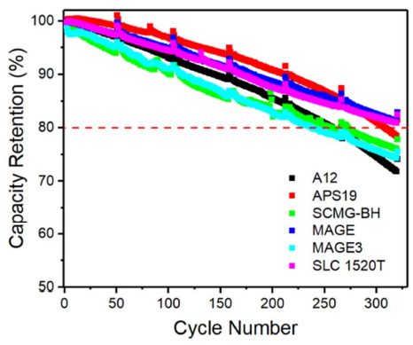
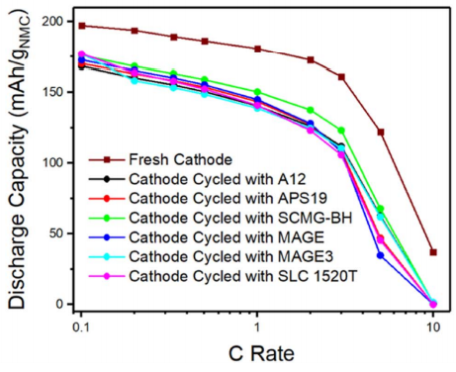
Cycling performance of NMC811 full cells with different graphite anodes during C/3-C/3 aging cycles from 3.0 to 4.2 V at 30◦C
Rate capability of NMC811 half cells with a fresh cathode and cathodes extracted from full cells with different graphite anodes after aging cycles.

Slide 3
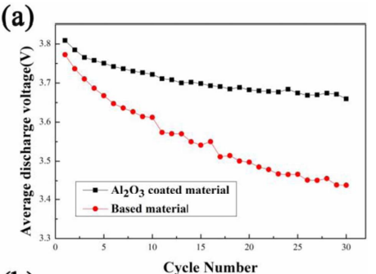
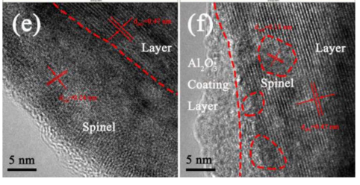

Slide 4
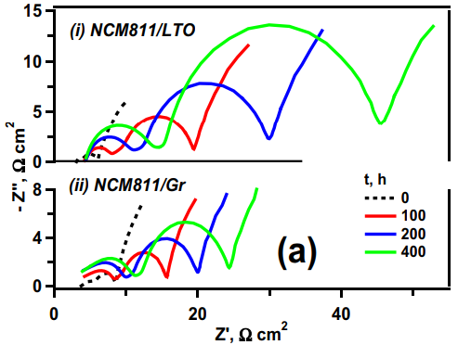
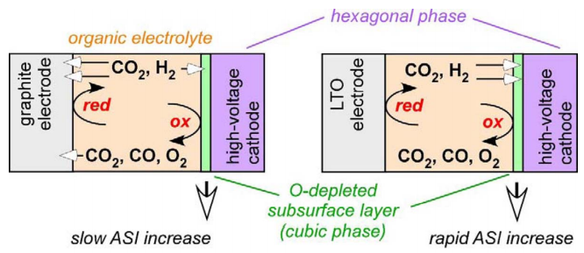
A sketch of cells with NCM cathodes paired with (left) lithiated graphite and (right) LTO anodes. In Gr cells, the gases generated on the electrodes by reduction and oxidation of the electrolyte and impurities (including moisture) are partially consumed by the anode itself, whereas LTO electrode remains unreactive. Diffusion of these gases, primarily H2, into the thin O-depleted subsurface layer (shown in green) and the crystalline interior (shown in magenta) of the oxide particles can cause the modification of their properties; e.g., by changing the rate of oxygen atom and Li+ ion transport through the O-depleted layer and by “HELPing” crack propagation in the interior.
Time progressions of Nyquist plots (100 kHz – 0.01 Hz, 30◦C) for the cathode in (i) NCM811/LTO and (ii) NCM811/Gr cells during their calendar-aging (see legend for color coding of the traces).

Slide 5
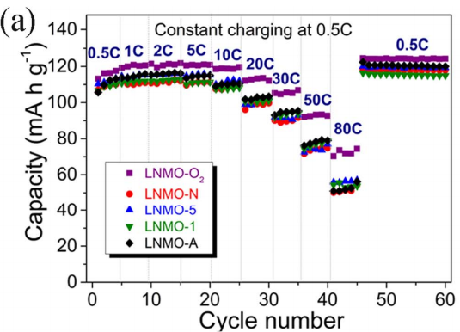
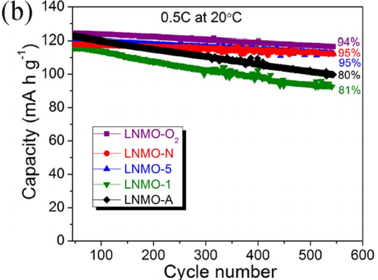
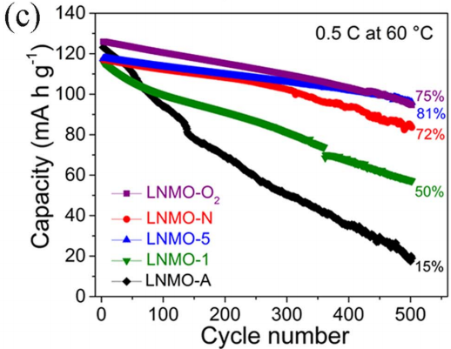
Figure 12. (a) Rate capabilities with constant charging C-rate at 0.5 C followed by discharging at various C-rates from 0.5 to 80 C, and cycling performances at 0.5 C between 3.5 and 5 V at (b) 20◦C and (c) 60◦C for the LNMO-O2, LNMO-N, LNMO-5, LNMO-1 and LNMO-A samples

