Slide 2
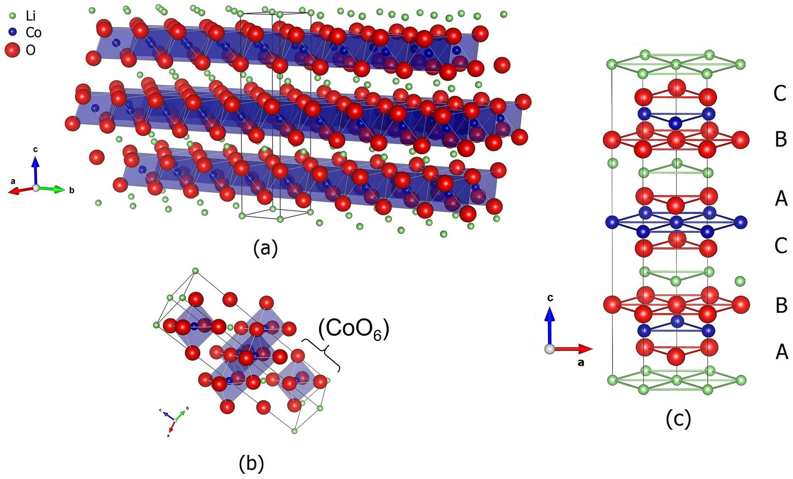
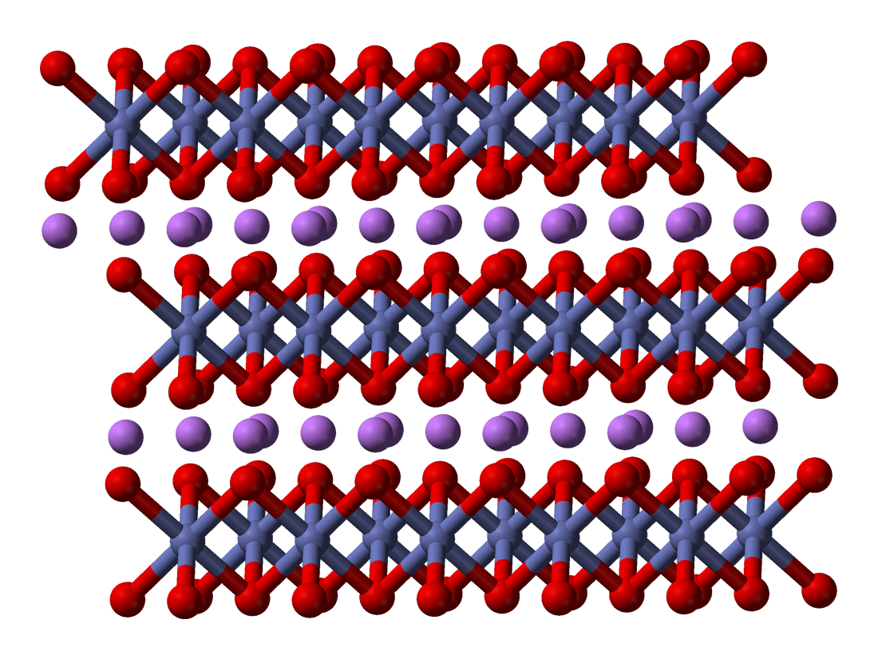
each O is shared by 3 CoO₆ → CoO₂
(a) Layered crystalline structure of the rhombohedral LiCoO₂; (b) representation of the octahedral CoO₆structure; (c) stacking arrangement of the layers (ABCABC)
(Ref: Synthesis and Characterization of LiCoO₂from Different Precursors by Sol-Gel Method)

Slide 3
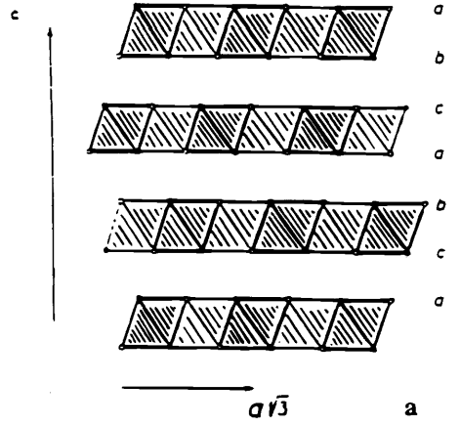
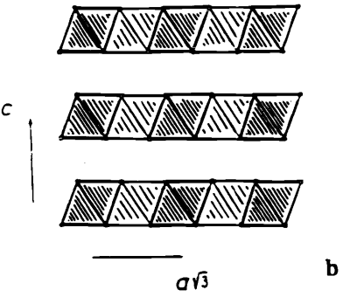
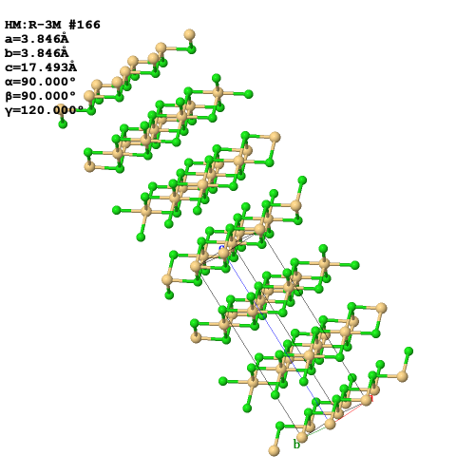
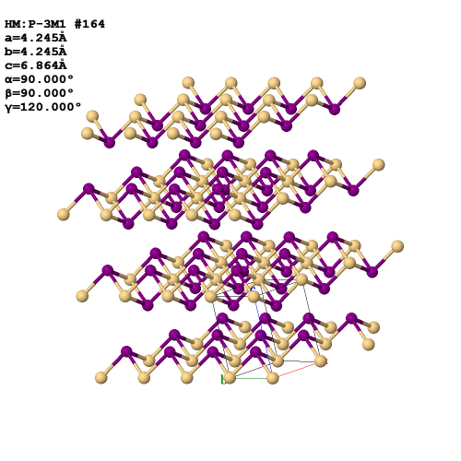

CdCl2
CdI2
Ref: Coo2, the end member of the LixCoo2 solid solution
http://www.chemtube3d.com/solidstate

Slide 4
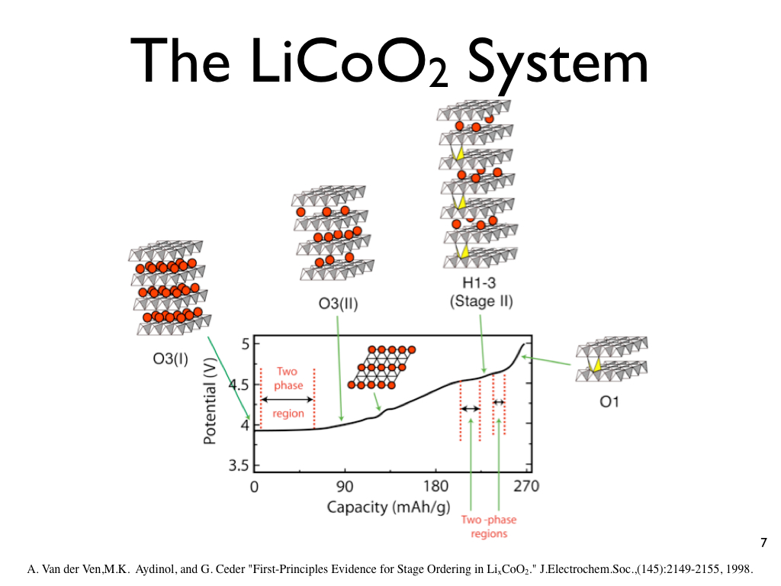
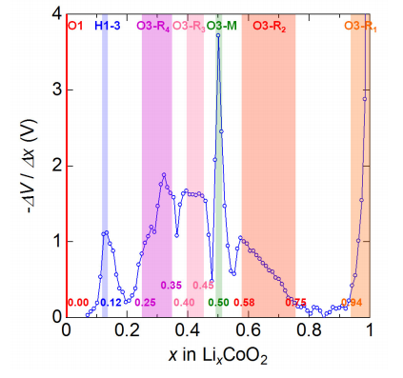

Slide 5
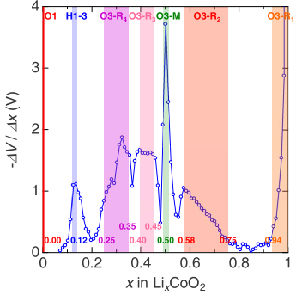
With this result, it is not possible to determine the position of phase boundaries without ambiguity. In fact, the electrochemical behavior below x=1 / 3 is controversial among previous literatures

Slide 6
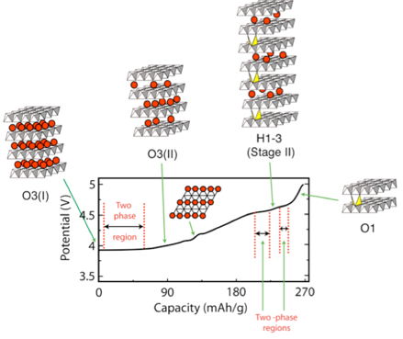
Ref: First-principles investigation of phase stability in LixCoO2
Electronic phase diagram of the layered cobalt oxide systemLixCoO2(0.0≤x≤1.0)

Slide 7
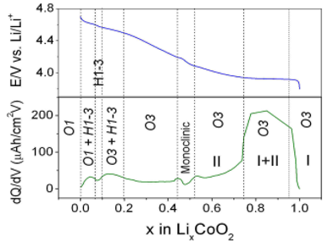
Ref: First-principles investigation of phase stability in LixCoO2
Ref: Electrochemical behavior and Li Diffusion study of LiCoO2 thin film electrodes prepared by PLD

Slide 8
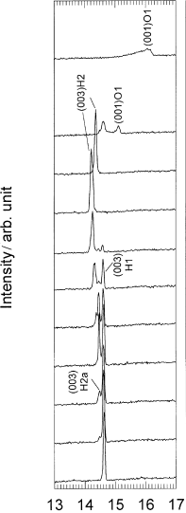
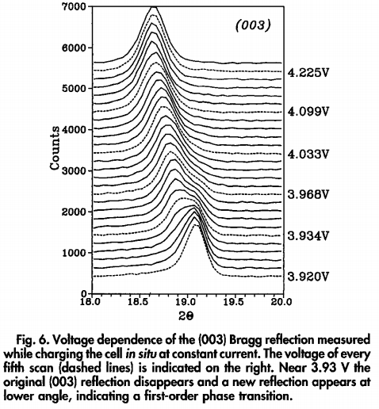
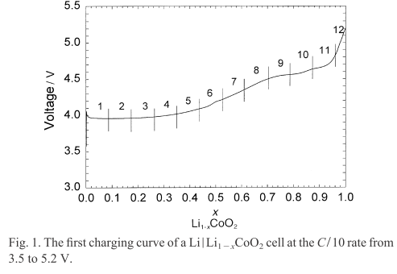

Slide 9
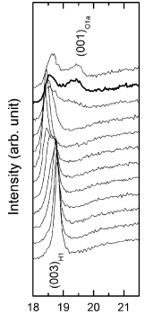
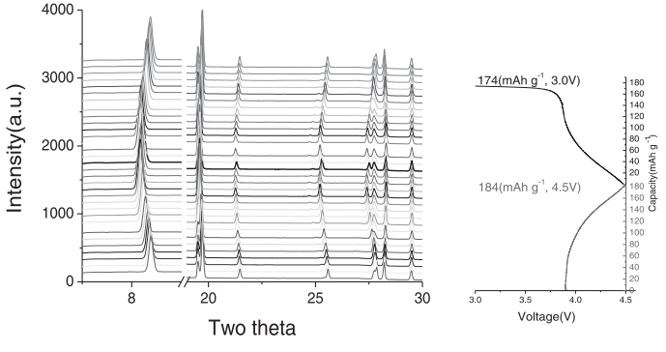

Slide 10
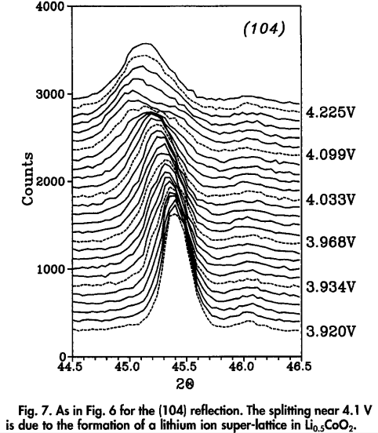
J. Electrochem. Soc., Vol. 139, No. 8, August 1992

Slide 11
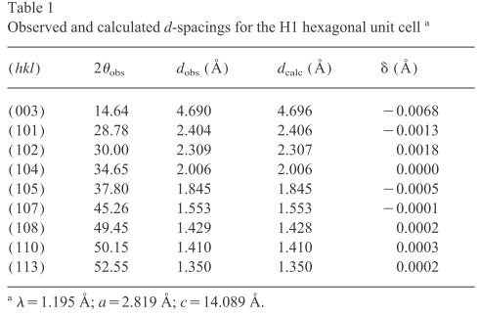
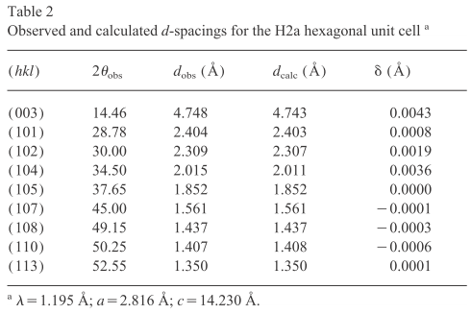

Slide 12
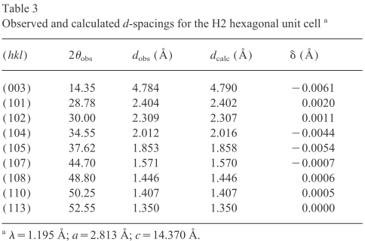
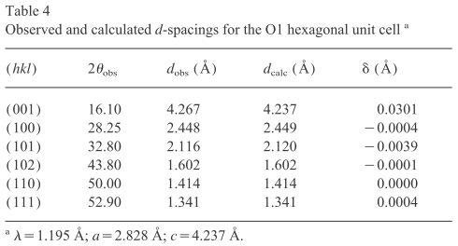

Slide 13
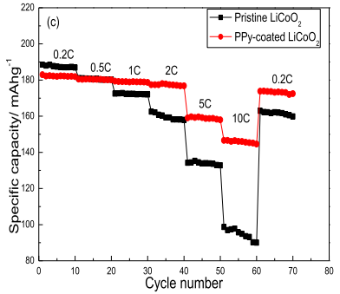
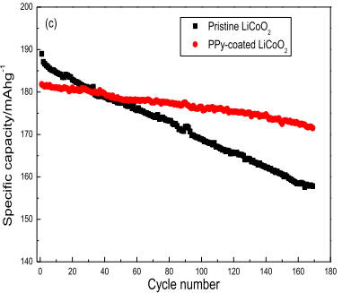

Slide 14
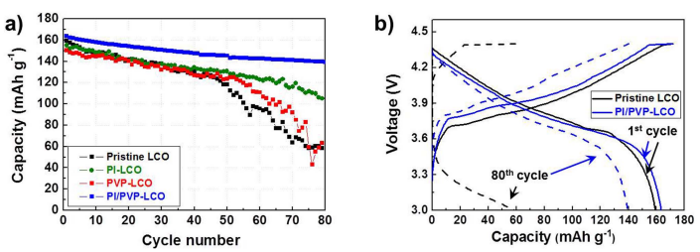
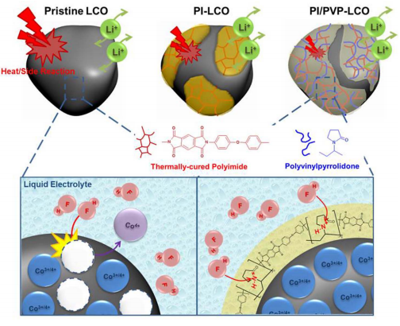

Slide 15
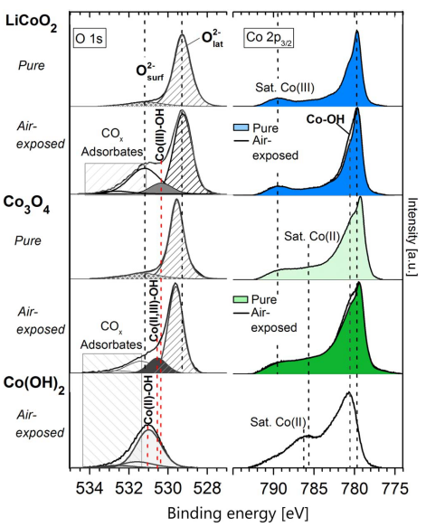
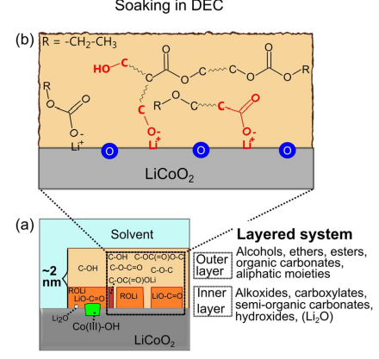
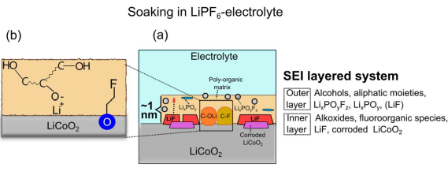

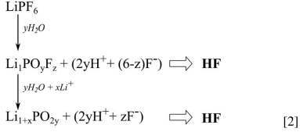
2nm SEI formed on the surface of LiCoO2 after soaking in DEC for 1 hr at 25°C
1nm SEI formed on the surface of LiCoO2 after soaking in LiPF6-electrolyte (EC:DMC=1::1) for 1 hr at 25°C
XPS data of Co composites

Slide 16
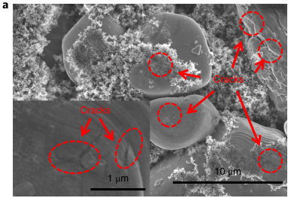
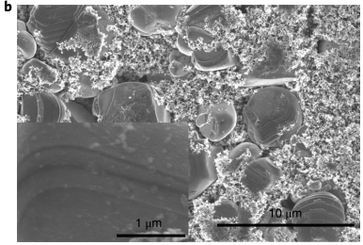
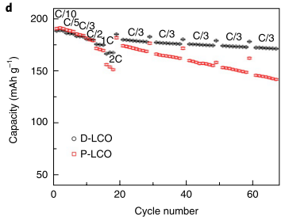
SEM characterization of P-LCO and D-LCO particles after the cycling test. a, The SEM images of P-LCO. The inset shows an image with high resolution. b, The SEM images of D-LCO.

Slide 17
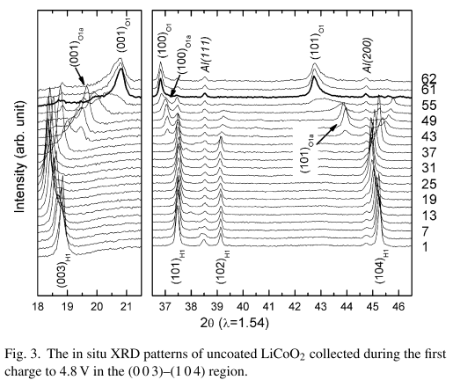
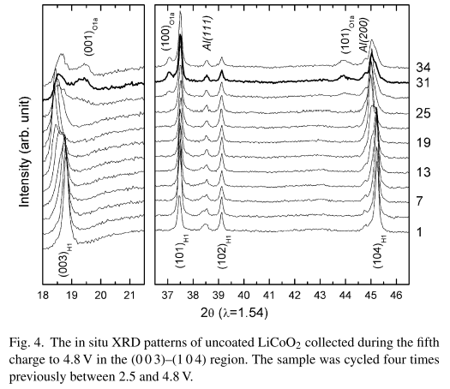

Slide 18
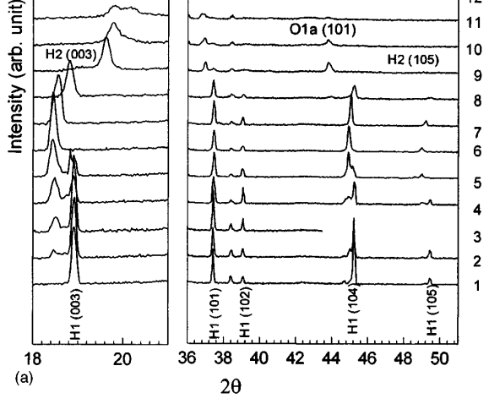
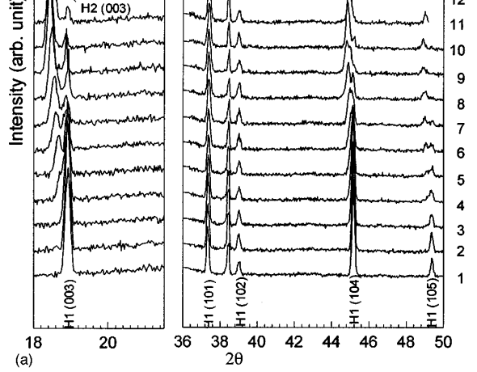
Pristine LiCoO2
Al2O3 coated LiCoO2

Slide 19
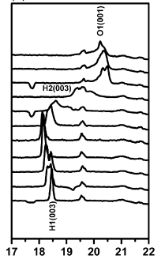
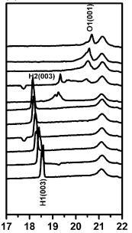
Pristine LiCoO2
ZrO2 coated LiCoO2

