Slide 2
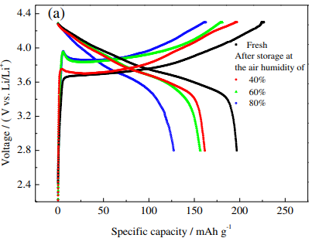
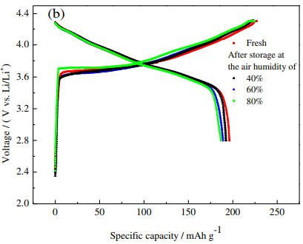
Fig. 2. Initial charge-discharge curves of LiNi_{0.8}Co_{0.15}Al_{0.05}O₂ (a) and LiCoO2-coated LiNi0.8Co0.15Al0.05O2 (b) before and after storage in air at different relative humidities.

Slide 3
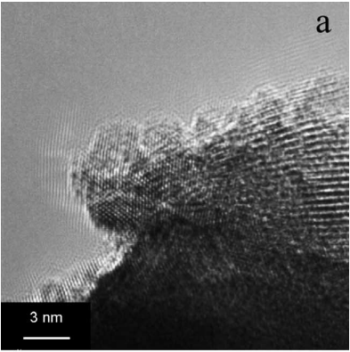
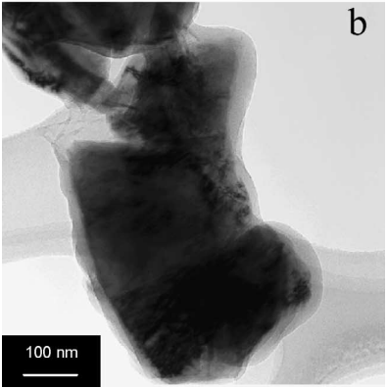
Fig. 3. TEM images of (a) fresh LixNi0.8Co0.15Al0.05O2 powder and (b) LixNi0.8Co0.15Al0.05O2 grain from air-exposed electrode.

Slide 4
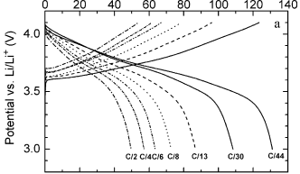
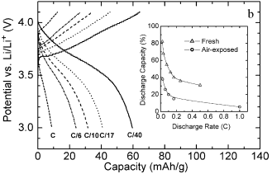
Fig. 4. Charge and discharge profiles for (a) fresh cathode and (b) air-exposed cathode. Inset: discharge capacity vs. rate.

