Slide 1
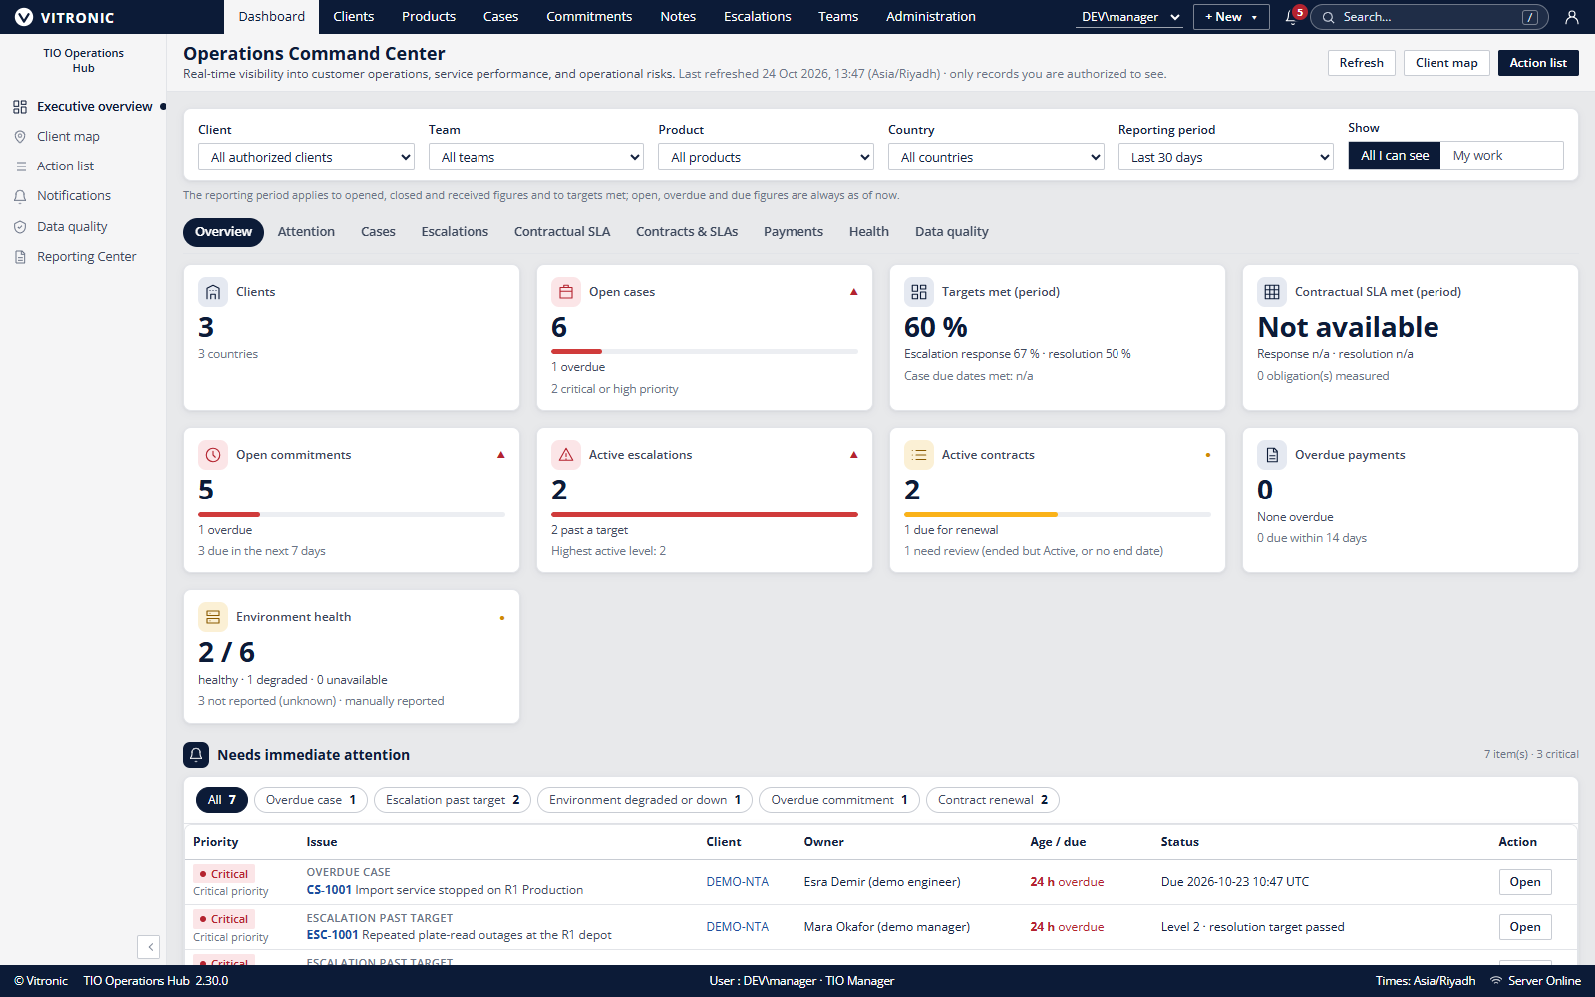
TIO HUB
Operational context
in one workspace
Client records, technical context and operations work, connected for review.
INTERNAL MARKETING DRAFT | 24 OCT 2026
Fictional local data. Reference branding shown; external use requires brand approval.
01
Notes:
Introduce TIO Hub as an internal operational record and workflow application. The screenshot is a direct capture from a local 2.30.0 development build using fictional data. The captured interface includes reference VITRONIC branding. Obtain brand owner approval or use approved replacement artwork before external distribution. Sources: README.md, docs/RELEASE-NOTES-2.30.0.md, docs/portfolio/product-screenshots.md.

Slide 2
TIO HUB
The operational picture is spread across records
A support decision depends on more than the case title.
Client context
Technical context
Operational context
Which organization, project and environment is in scope?
What is installed, affected and due for review?
Who owns the next step and which terms apply?
Teams still need a shared record, accountable owners and a repeatable review.
TIO Operations Hub | Internal marketing draft | 24 Oct 2026
02
Notes:
This describes the product problem, not a quantified claim about a specific customer. Use discovery to confirm the audience recognizes these handoffs.
Evidence sources: README.md; docs/IMPLEMENTATION-PLAN.md. Confirm the exact deployed version and obtain relevant Product, Security, Legal and Brand approvals before external publication.

Slide 3
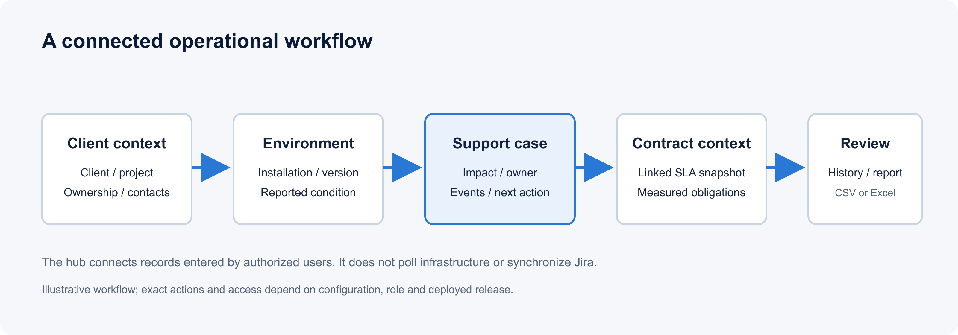
TIO HUB
Connected records support a clearer review
Follow context
Start with the client and affected environment.
Assign the work
Review owner, next action and due time.
Review the record
Use history and reports to validate the picture.
TIO Operations Hub | Internal marketing draft | 24 Oct 2026
03
Notes:
Evidence sources: docs/portfolio/product-pack.md; docs/ORGANIZATION-HIERARCHY.md. Confirm the exact deployed version and obtain relevant Product, Security, Legal and Brand approvals before external publication.

Slide 4
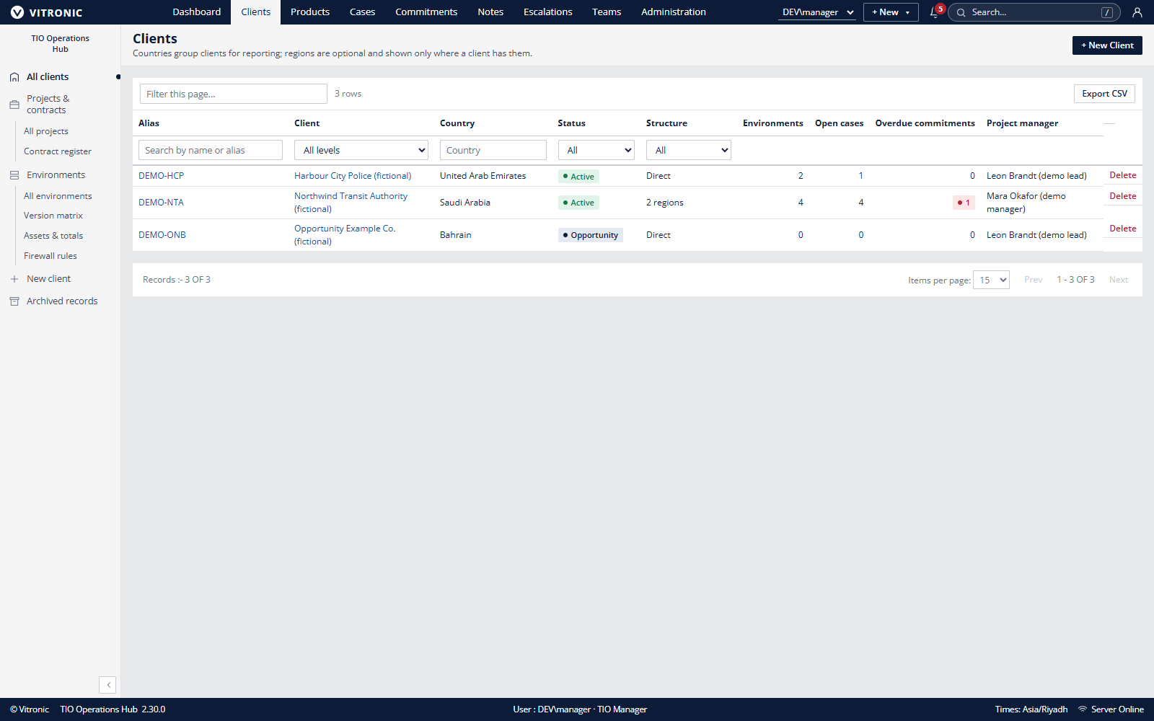
TIO HUB
Client and environment context
Keep related records together
Clients, projects and environments
Products, versions and infrastructure
Reported condition with evidence date
Contacts and responsibility boundaries
Records are maintained by users; the system does not discover or monitor infrastructure.
TIO Operations Hub | Internal marketing draft | 24 Oct 2026
04
Notes:
Evidence sources: docs/portfolio/user-manual.md; docs/portfolio/product-pack.md. Confirm the exact deployed version and obtain relevant Product, Security, Legal and Brand approvals before external publication.

Slide 5
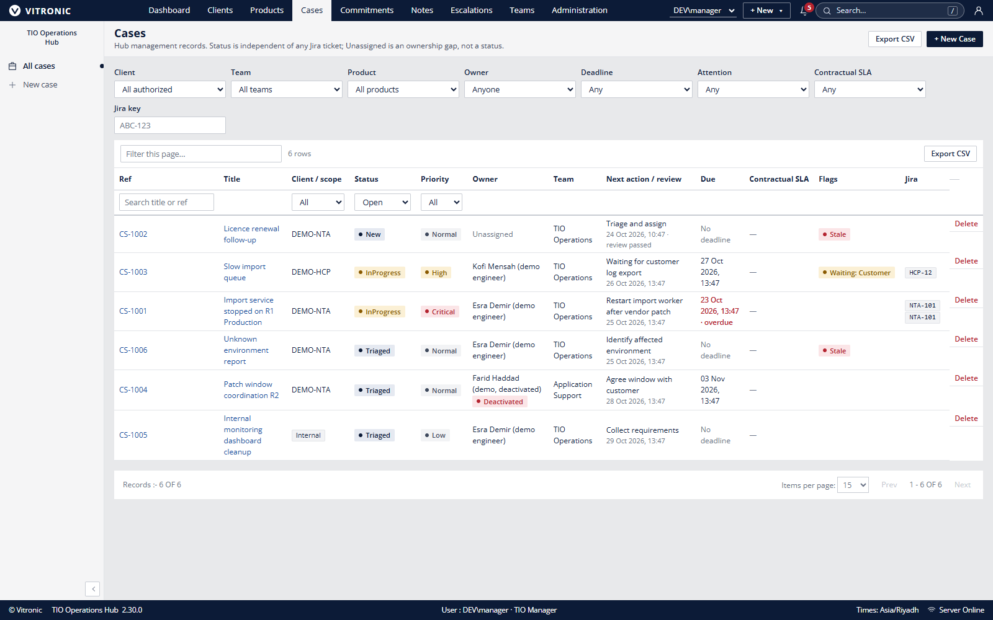
TIO HUB
Cases and commitments make work visible
Case context
Affected records
Owner and priority
Next action and due date
Status and event history
Manual Jira reference
Handover and coverage help teams transfer context.
TIO Operations Hub | Internal marketing draft | 24 Oct 2026
05
Notes:
Evidence sources: docs/portfolio/user-manual.md; docs/DECISIONS.md. Confirm the exact deployed version and obtain relevant Product, Security, Legal and Brand approvals before external publication.

Slide 6
TIO HUB
Contract measures follow recorded terms
1 Confirm coverage
2 Record the terms
3 Review the result
Contract, effective dates and case applicability.
The case keeps a snapshot of applicable targets.
Check response, resolution and recorded events.
Penalty assessments support operational review; they do not issue credits or payments.
Public holiday calendars are not modeled in the documented calculation baseline.
TIO Operations Hub | Internal marketing draft | 24 Oct 2026
06
Notes:
Emphasize eligible contract-linked cases and snapshots of terms. Penalty assessments are indicative; they do not create payments or credits.
Evidence sources: docs/DECISIONS.md; docs/OPERATIONS.md; docs/RELEASE-NOTES-2.30.0.md. Confirm the exact deployed version and obtain relevant Product, Security, Legal and Brand approvals before external publication.

Slide 7
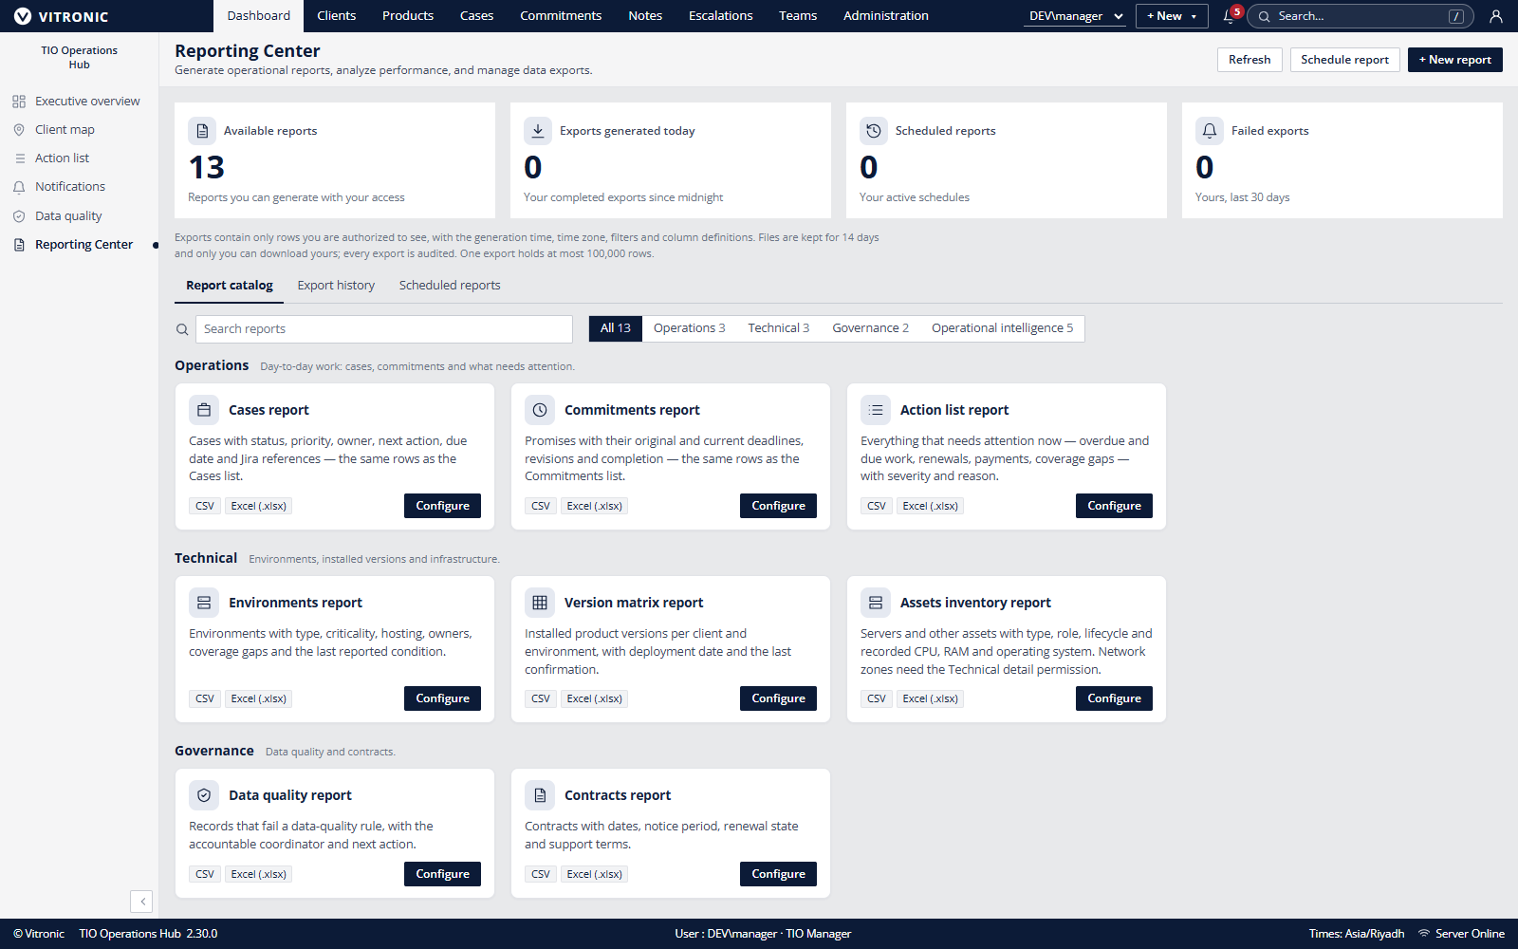
TIO HUB
Reporting Center
Preview, filter and export
Server-validated filters
Access-scoped preview
CSV and Excel exports
Export history and schedules
In-hub notifications
Example data only. No customer or performance claim.
TIO Operations Hub | Internal marketing draft | 24 Oct 2026
07
Notes:
The editable chart shows local fictional seed counts. Categories have different meanings and must not be treated as a comparative score, benchmark or customer result.
Evidence sources: docs/DECISIONS.md A62; docs/portfolio/technical-pack.md. Confirm the exact deployed version and obtain relevant Product, Security, Legal and Brand approvals before external publication.

Slide 8
TIO HUB
A controlled application and data boundary
DOCUMENTED PRODUCTION SHAPE
IIS and ASP.NET Core
SQL Server
File storage
One web application serves the React interface and API.
Relational records, access data, audit and reporting metadata.
Attachments and exports need matching access and backup controls.
Release review
Match application and schema versions. DBA applies the reviewed script. Validate readiness, access, key workflows and recovery.
No hosted CI pipeline, tenant isolation, or safe horizontal scale-out is established by this design.
TIO Operations Hub | Internal marketing draft | 24 Oct 2026
08
Notes:
Evidence sources: docs/SYSTEM-DESIGN.md; docs/OPERATIONS.md. Confirm the exact deployed version and obtain relevant Product, Security, Legal and Brand approvals before external publication.

Slide 9
TIO HUB
Pilot fit depends on operating readiness
A useful candidate can
Resolve before proposal
Name record owners and review cadence
Approve a business visibility model
Operate the documented deployment
Agree measures and acceptance scenarios
Provide support, backup and recovery owners
Identity and MFA requirements
Data locations and retention
Integration expectations
Assurance evidence and legal roles
Support hours, RPO and RTO
A product demonstration is not a deployment approval or a customer outcome.
TIO Operations Hub | Internal marketing draft | 24 Oct 2026
09
Notes:
Evidence sources: docs/portfolio/product-pack.md; docs/portfolio/commercial-pack.md. Confirm the exact deployed version and obtain relevant Product, Security, Legal and Brand approvals before external publication.

Slide 10
TIO HUB
Evaluate TIO Hub against real operating scenarios
Discovery
Fit review
Pilot definition
Identify the workflow and data boundary.
Confirm identity, hosting, recovery and support.
Agree users, measures, acceptance and exit.
Review the workflow against your operational requirements.
Product boundaries and approval requirements are recorded in the accompanying documentation.
TIO Operations Hub | Internal marketing draft | 24 Oct 2026
10
Notes:
Close by inviting a scoped discovery and technical fit review. Avoid implying a committed pilot date, service availability, or published customer outcome.
Evidence sources: docs/portfolio/commercial-pack.md; docs/portfolio/product-pack.md. Confirm the exact deployed version and obtain relevant Product, Security, Legal and Brand approvals before external publication.

