Slide 1
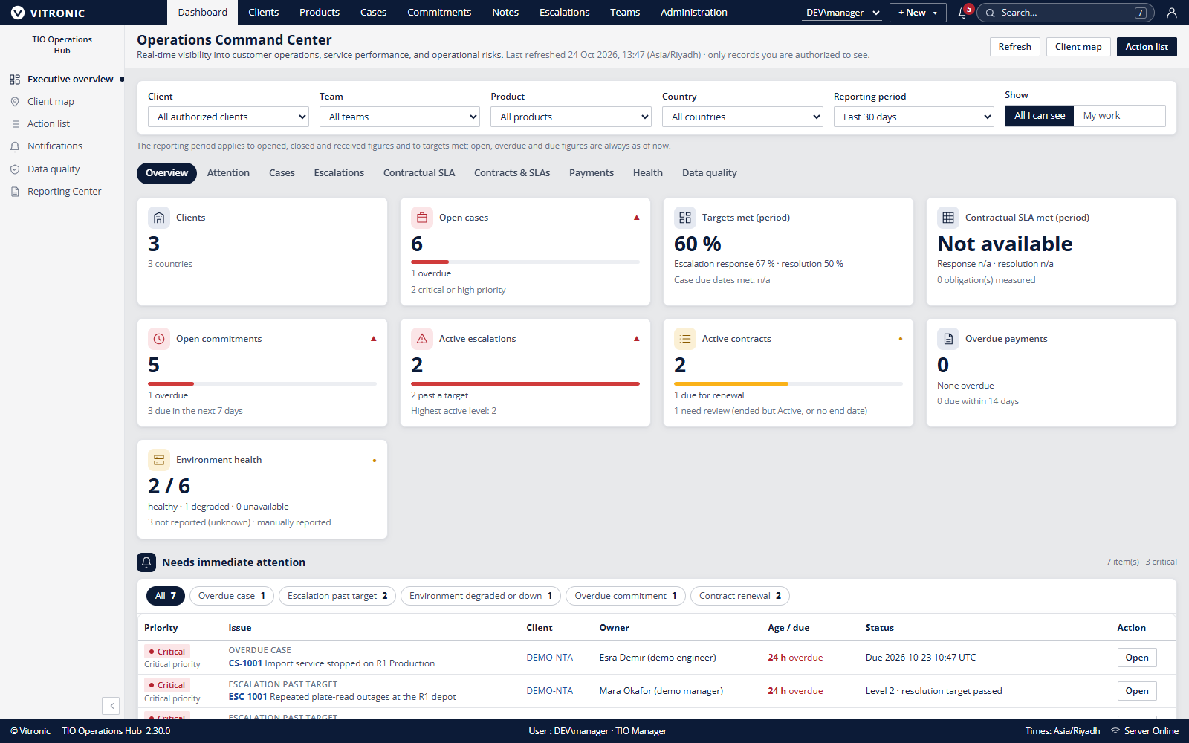
TIO HUB
Manage service obligations
with operational context
Connect contract terms, SLA case work, ownership and review in one operations workspace.
ADVANCED MARKETING DRAFT 2.2 | 24 OCT 2026
Fictional local data. Reference branding shown; external use requires brand approval.
01
Notes:
Introduce TIO Hub as an internal operational record and workflow application for managing contract-linked service work. The screenshot is a direct capture from a local 2.30.0 development build using fictional data. The captured interface includes reference VITRONIC branding. Obtain brand owner approval or use brand-safe replacement artwork before external distribution. Sources: README.md, docs/RELEASE-NOTES-2.30.0.md, docs/portfolio/product-screenshots.md.

Slide 2
TIO HUB
Service reviews need evidence across four records
A service decision connects obligation, work and review.
Contract
SLA case
ITSM work
Finance review
Which signed terms, dates and scope apply?
What target, event evidence and clock state apply?
Who owns response, next step, escalation and handover?
What exposure needs independent reconciliation?
TIO Hub connects records; authorized owners decide contract interpretation and financial disposition.
TIO Operations Hub | Advanced marketing draft 2.2 | 24 Oct 2026
02
Notes:
This is an operating requirement, not a quantified market claim. Local policy determines decision rights and customer commitments.
Evidence sources: docs/DECISIONS.md A61-A66; docs/portfolio/service-management-playbook.md. Confirm the exact deployed version and obtain relevant Product, Security, Legal and Brand approvals before external publication.

Slide 3
TIO HUB
A controlled contract-to-service lifecycle
Eight gates keep records, service decisions and finance review connected.
1 Intake
2 Verify
3 Configure
4 Associate
Executed source
Scope and terms
Independent check
Eligible case
5 Operate
6 Review
7 Reconcile
8 Amend / close
Events and owner
Metrics and exceptions
Finance approval
Transition plan
Gate exits require named evidence and an accountable role; local approval rules define authority thresholds.
TIO Operations Hub | Advanced marketing draft 2.2 | 24 Oct 2026
03
Notes:
The lifecycle is a proposed operating model around current product records. Contract execution and interpretation remain with authorized owners.
Evidence sources: docs/portfolio/service-management-playbook.md; docs/DECISIONS.md A61-A66. Confirm the exact deployed version and obtain relevant Product, Security, Legal and Brand approvals before external publication.

Slide 4
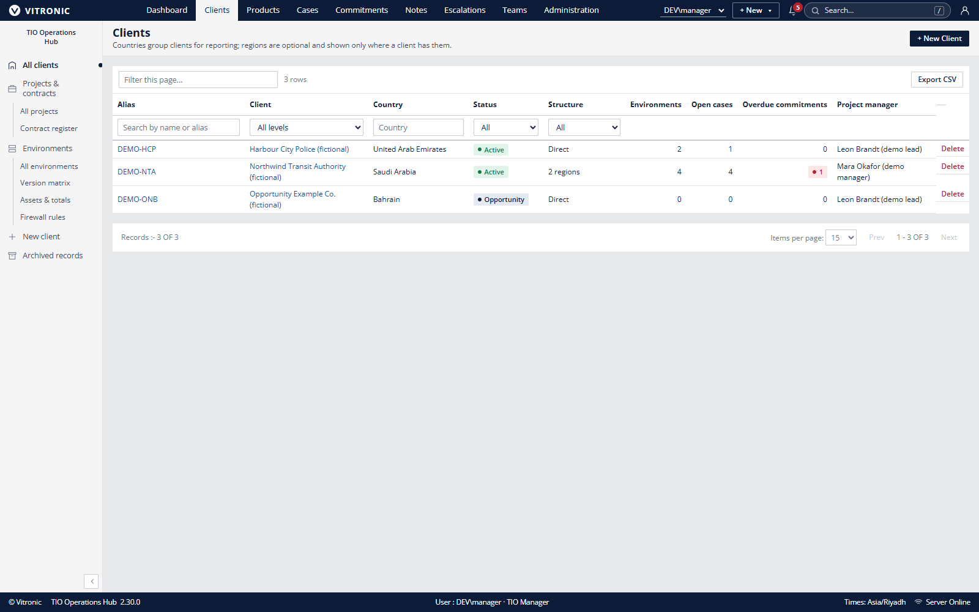
TIO HUB
Client and environment context
Keep related records together
Clients, projects and environments
Products, versions and infrastructure
Reported condition with evidence date
Contacts and responsibility boundaries
Records are maintained by users; the system does not discover or monitor infrastructure.
TIO Operations Hub | Advanced marketing draft 2.2 | 24 Oct 2026
04
Notes:
Evidence sources: docs/portfolio/user-manual.md; docs/portfolio/product-pack.md. Confirm the exact deployed version and obtain relevant Product, Security, Legal and Brand approvals before external publication.

Slide 5
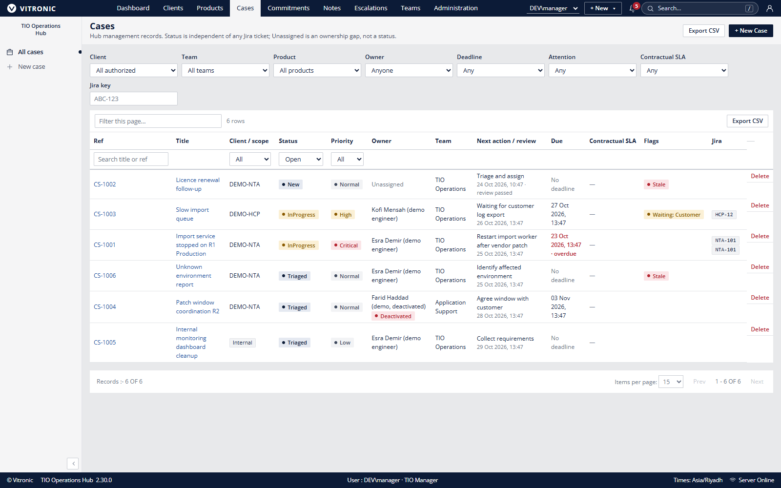
TIO HUB
ITSM work stays owned and reviewable
Work record
Affected service context
Owner, priority and impact
Next action and due time
Status and event history
Commitments and escalation
Manual Jira reference
Handover and coverage keep accountability visible.
TIO Operations Hub | Advanced marketing draft 2.2 | 24 Oct 2026
05
Notes:
TIO Hub provides operational records and workflows. Jira references are manual. Do not present this as a synchronized ITSM suite or monitoring service.
Evidence sources: docs/portfolio/user-manual.md; docs/DECISIONS.md A62. Confirm the exact deployed version and obtain relevant Product, Security, Legal and Brand approvals before external publication.

Slide 6
TIO HUB
Measure the obligation; review exposure separately
1 Verify the terms
2 Operate the case
3 Reconcile candidates
Same-client contract, dates, target, support window and pause rule.
Record actual response, resolution and customer-wait evidence.
Finance checks clause, term cohort, cap, corrections and approvals.
Rates exclude pending and not-measurable obligations; at-risk is a 24-hour warning.
Assessments are indicative only. No invoice, payment, credit or accounting settlement.
TIO Operations Hub | Advanced marketing draft 2.2 | 24 Oct 2026
06
Notes:
First response is explicitly recorded at actual send time; resolution is first move into Pending validation or Closed. Only customer waits pause where contract allows. Finance independently reconciles indicative candidates. No credits or accounting entries are created.
Evidence sources: docs/DECISIONS.md A61, A63, A66; docs/portfolio/service-management-playbook.md. Confirm the exact deployed version and obtain relevant Product, Security, Legal and Brand approvals before external publication.

Slide 7
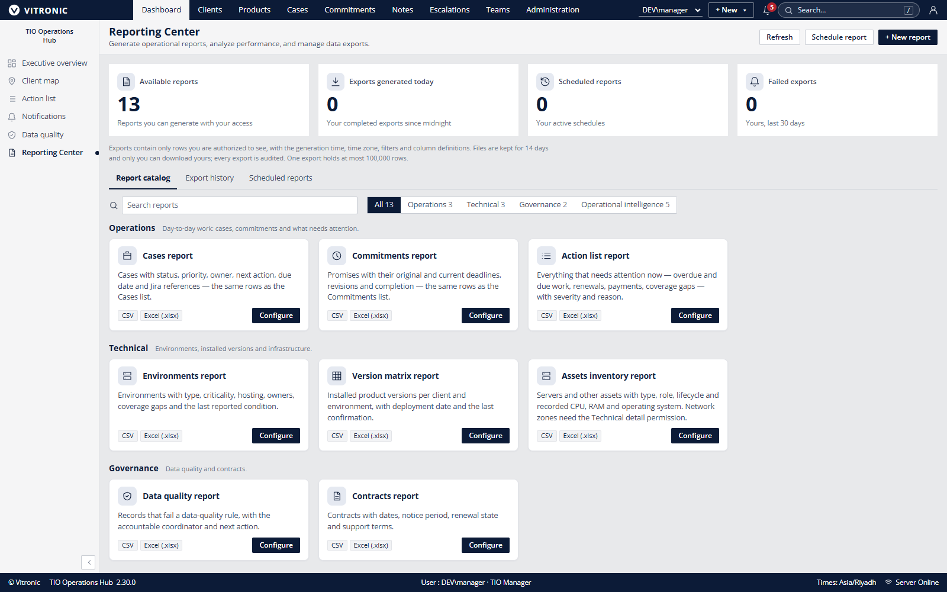
TIO HUB
Reporting Center
Preview, filter and export
Server-validated filters
Access-scoped preview
CSV and Excel exports
Export history and schedules
In-hub notifications
Example data only. No customer or performance claim.
TIO Operations Hub | Advanced marketing draft 2.2 | 24 Oct 2026
07
Notes:
The editable chart shows local fictional seed counts. Categories have different meanings and must not be treated as a comparative score, benchmark or customer result.
Evidence sources: docs/DECISIONS.md A62; docs/portfolio/technical-pack.md. Confirm the exact deployed version and obtain relevant Product, Security, Legal and Brand approvals before external publication.

Slide 8
TIO HUB
A controlled application and data boundary
DOCUMENTED PRODUCTION SHAPE
IIS and ASP.NET Core
SQL Server
File storage
One web application serves the React interface and API.
Relational records, access data, audit and reporting metadata.
Attachments and exports need matching access and backup controls.
Release review
Match application and schema versions. DBA applies the reviewed script. Validate readiness, access, key workflows and recovery.
No hosted CI pipeline, tenant isolation, or safe horizontal scale-out is established by this design.
TIO Operations Hub | Advanced marketing draft 2.2 | 24 Oct 2026
08
Notes:
Evidence sources: docs/SYSTEM-DESIGN.md; docs/OPERATIONS.md. Confirm the exact deployed version and obtain relevant Product, Security, Legal and Brand approvals before external publication.

Slide 9
TIO HUB
Adopt in evidence-based maturity stages
01 Controlled records
02 Repeatable reviews
03 Financial control
04 Optimized governance
Owners, signed-source references, minimum fields
Report pack, cadence, handovers, exceptions
Independent reconciliation, cap/cohort, approvals
Root-cause trends, renewal and quality controls
Advance only when source records reconcile and control owners accept the evidence.
A demo or maturity label does not establish customer performance, compliance or certification.
TIO Operations Hub | Advanced marketing draft 2.2 | 24 Oct 2026
09
Notes:
Stages are proposed local adoption milestones, not a product rating, certification, or customer outcome.
Evidence sources: docs/portfolio/service-management-playbook.md. Confirm the exact deployed version and obtain relevant Product, Security, Legal and Brand approvals before external publication.

Slide 10
TIO HUB
Evaluate TIO Hub against real operating scenarios
Discovery
Fit review
Pilot definition
Identify the workflow and data boundary.
Confirm identity, hosting, recovery and support.
Agree users, measures, acceptance and exit.
Review the workflow against your operational requirements.
Product boundaries and approval requirements are recorded in the accompanying documentation.
TIO Operations Hub | Advanced marketing draft 2.2 | 24 Oct 2026
10
Notes:
Close by inviting a scoped discovery and technical fit review. Avoid implying a committed pilot date, service availability, or published customer outcome.
Evidence sources: docs/portfolio/commercial-pack.md; docs/portfolio/product-pack.md. Confirm the exact deployed version and obtain relevant Product, Security, Legal and Brand approvals before external publication.

