Slide 1

MY ANIME LIST DATA VISUALIZATION REPORT
BY GAJJAR LAJJA BRIJESH
FROM GTU-SET

Slide 2
ABOUT MY ANIME LIST
MyAnimeList is the world's largest anime and manga social networking and database website. It lets you track what you're watching, rate shows, discover new titles, and connect with other fans.
Key Features of MyAnimeList
Track Your Progress
Ratings and Reviews
Huge Database
Community

Slide 3
ABOUT MY DATASET
This dataset contains the Top 10,000 anime scraped from MyAnimeList (MAL) and normalized into 7 relational tables following 3NF (Third Normal Form) database design.
The dataset includes detailed information about anime titles, genres, characters, staff, voice actors, and production companies — making it ideal for exploratory data analysis, recommendation systems, and machine learning projects.
https://www.kaggle.com/datasets/udaykumar025/anime-dataset-top-10k-normalized

Slide 4
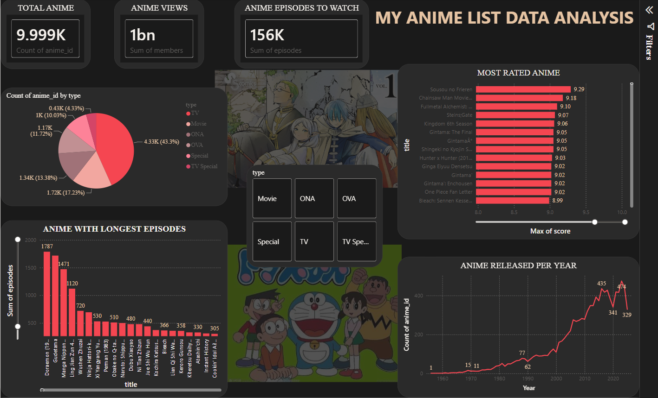

Slide 5
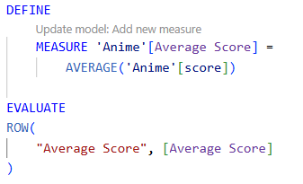
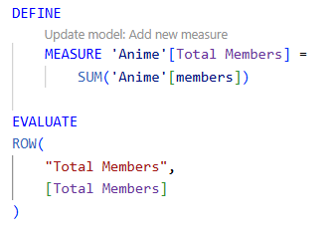


DAX QUERIES
AVERAGE SCORE
TOTAL MEMBERS

Slide 6
INSIGHTS IN THE DATASET
The dashboard analyzes nearly 10,000 anime titles from MyAnimeList to identify trends in production, popularity, ratings, and episode counts.
The yearly release trend shows a gradual increase from the 1960s, followed by rapid growth after 2000. The highest production levels occur around 2020, reflecting the global expansion of the anime industry.
Only a small number of anime achieve scores above 9.0, highlighting the competitive nature of user ratings. Titles such as Sousou no Frieren and Fullmetal Alchemist: Brotherhood rank among the highest-rated series.
While most anime are produced in seasonal formats, a few titles such as Doraemon and Sazae-san contain exceptionally high episode counts, making them clear outliers.

Slide 7
THANK YOU

