Slide 1
Dangeti Lakesh Kumar
Final Project
3/21/2024 Annual Review

Slide 2

KEYLOGGER AND SECURITY
Keyloggers can help organizations monitor and detect unauthorized or suspicious activity on their networks. By capturing keystrokes, security teams can identify potential security breaches early and take action to prevent data theft or other malicious activities.
In the aftermath of a security incident, keyloggers can provide crucial data for forensic investigations. They can help trace the actions leading up to the breach, identify the perpetrators, and understand how the attack was executed, which is vital for preventing future incidents.
3/21/2024 Annual Review

Slide 3
Keyloggers can be used in security audits to assess the strength and security of passwords and other sensitive data. By analyzing how users interact with systems, security professionals can identify weaknesses and implement stronger security measures.
In environments where security is paramount, such as financial institutions or defense contractors, keyloggers can help monitor user activity to detect unauthorized access or suspicious behavior. This can prevent insider threats and ensure compliance with security protocols.

Slide 4

SOFTWARE KEYLOGGERS
During software development, keyloggers can be used to gather data on how users interact with new features, helping developers identify usability issues and improve the user experience.
Technical support teams can use keyloggers to understand user behavior and reproduce errors, facilitating faster and more accurate troubleshooting.
Ensure that users are aware of the keylogging software and have given their explicit consent.

Slide 5


AGENDA
A keylogger is a key stroker/keyboard capturing is a form of malware or hardware that keeps track of and records your keystrokes as you type.
It takes the information and sends it to a hacker using a command-and-control (C&C) server.
The hacker then analyzes the keystrokes to locate usernames and passwords and uses them to hack into otherwise secure systems.
3/21/2024 Annual Review

Slide 6

PROBLEM
STATEMENT
Keyloggers, often seen as malicious tools, can serve several beneficial purposes when used ethically and with proper consent. The primary challenge is to harness the potential of keyloggers for productivity, security, and usability improvements while maintaining privacy and ethical standards.
3/21/2024 Annual Review

Slide 7

Keyloggers, when used positively and transparently, can address these needs by offering comprehensive data on keystroke patterns, application usage, and user interactions. The challenge lies in designing and implementing keylogger solutions that are ethical, secure, and compliant with legal standards, ensuring they provide valuable insights without infringing on user privacy.

Slide 8
Compliance and Governance :
Ensure the keylogger complies with all relevant legal and regulatory requirements.
Provide tools for administrators to manage and enforce compliance policies
Advanced Analytics and Reporting ;
Use machine learning and behavioral analysis to provide deep insights into productivity and security.

Slide 9
PROJECT OVERVIEW
Keylogger is a program that monitors device activity by recording every key that is pressed and saving that data to a file.
Sometimes keyloggers can be used for legitimate purposes. For example, high-security employers might use keylogging programs to monitor employee activity around sensitive files. In other cases, organizations might use a keylogger to decrease the risk of data theft.
When used illegally or without the user’s knowledge, a keylogger is a form of spyware. Covert keyloggers maliciously monitor a user’s activity to steal personal information, including payment details, passwords and login credentials.
3/21/2024 Annual Review

Slide 10
Advantages Of Keyloggers
Employee Monitoring :
Parental Control :
Companies can use keyloggers to monitor employee activity to ensure productivity, enforce company policies, and protect against data breaches by tracking unauthorized access to sensitive information.
Parents can use keyloggers to monitor their children's online activities to protect them from potential dangers such as cyberbullying, online predators, and inappropriate content.

Slide 11

Recover Lost Data :
Keyloggers can help recover lost data due to system crashes, accidental deletions, or other issues by keeping a log of all keystrokes and inputs.

Slide 12
Disadvantages Of Keybloggers
Privacy Invasion :
Keyloggers can capture sensitive information such as passwords, credit card numbers, personal messages, and other confidential data without the user's consent.
Security Risks :
By collecting sensitive data, keyloggers can facilitate identity theft, financial fraud, and unauthorized access to personal and corporate accounts.

Slide 13

Resource Consumption :
Some keyloggers can consume significant system resources, leading to slower performance and decreased efficiency of the monitored device.

Slide 14

WHO ARE THE END USERS ?
Parents:
Parents may use keyloggers to monitor their children's online activities to protect them from cyberbullying, inappropriate content, and online predators. This can help ensure a safer online environment for minors.
Researchers:
Academics studying human-computer interaction or cybersecurity might use keyloggers to gather data on user behavior. This information can be valuable in developing more secure and user-friendly software systems.
3/21/2024 Annual Review

Slide 15

Law Enforcement and Intelligence Agencies:
These agencies may use keyloggers as part of their investigative tools to monitor suspects involved in criminal activities, terrorism, or espionage. The use of keyloggers in this context is usually governed by strict legal frameworks and requires authorization.

Slide 16

YOUR SOLUTION AND ITS VALUE PROPOSITION
Anti-Key-logger – As the name suggest these are the software which are anti / against key loggers and main task is to detect key-logger from a computer system.
Anti-Virus – Many anti-virus software also detect key loggers and delete them from the computer system. These are software anti-software so these can not get rid from the hardware key-loggers.
3/21/2024 Annual Review

Slide 17
Automatic form filler – This technique can be used by the user to not fill forms on regular bases instead use automatic form filler which will give a shield against key-loggers as keys will not be pressed .
One-Time-Passwords – Using OTP’s as password may be safe as every time we login we have to use a new password.
Patterns or mouse-recognition – On android devices used pattern as a password of applications and on PC use mouse recognition, mouse program uses mouse gestures instead of stylus.

Slide 18

Voice to Text Converter – This software helps to prevent Keylogging which targets a specific part of our keyboard.

Slide 19

THE WOW IN YOUR SOLUTION
Instant Notification: Users receive
immediate alerts when a potential keylogger is detected, allowing for swift action
Multi-Layered Security: Our solution
includes multiple layers of defense, such as network monitoring, application control, and system integrity checks, ensuring all-round protection.
3/21/2024 Annual Review
19

Slide 20
Define Keylogger Function :
MODELLING
Create a function to capture and log keystrokes.
Use the keyboard.on_press() method to register a callback function to capture each key press event.
Main Function :
Create a main function to start the keylogger and keep it running indefinitely.

Slide 21

Testing and Deployment:
Test the keylogger program to ensure it captures keystrokes correctly.
Deploy the keylogger on target systems if necessary, ensuring compliance with legal and ethical considerations.

Slide 22
Import Required Modules :
Use Python's keyboard module to capture keystrokes.
Optionally, use other modules for logging, encryption, or network communication.
Set Up Logging:
Configure logging settings to specify the format and destination of log files.

Slide 23

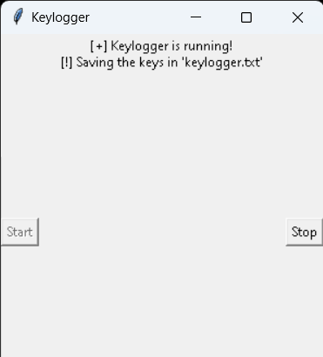
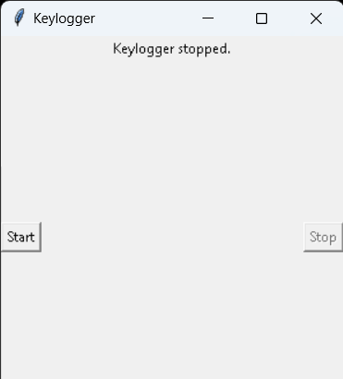
RESULTS
The result of a keylogger program typically involves capturing and logging keystrokes entered by a user on a keyboard. In the realm of cybersecurity, keyloggers can be instrumental in identifying and analyzing malicious activities by capturing unauthorized access attempts.These logged keystrokes can then be used for various purposes, depending on the intent of the keylogger user. The covert nature of keyloggers allows them to capture sensitive information, including passwords, personal messages, and financial details, without the user's knowledge or consent.
3/21/2024 Annual Review
23

Slide 24
PROJECT LINK
https://github.com/Lakesh-project/Lakesh-KeyProject.git

