Slide 1
Bank loan default Prediction
Team Members-
Ravi Joon
Upasana Sehrawat
Samarth Behl
Ramesh Dadheech
Lakesh Kumar

Slide 2
Problem Statement
Loan lending has been playing a significant role in the financial world throughout the years. Although it is quite profitable and beneficial for both the lenders and the borrowers. It does, however, carry a great risk, which in the domain of loan lending is referred to as Credit risk. Industry experts and Researchers around the world assign individuals with numerical scores known as credit scores to measure the risk and their creditworthiness. Throughout the years’ machine learning algorithms have been used to calculate and predict credit risk by evaluating an individual’s historical data. This case study reviews the present literature on models predicting risk assessment that use machine algorithms.
While in the past, the financial institutes focused on employing highly professional individuals whose sole purpose was to evaluate whether a candidate was eligible for receiving a loan based on two factors. For risk evaluation which help in verifying the worthiness of a candidate for loan approval or rejection based on a numerical score [8]. The process of credit scoring, though in the past required experts alongside statistical algorithms to accurately predict the worthiness of a candidate for loan approval or rejection. Quite recently, however, the researchers and institutes have opted for training classifiers based on machine learning algorithms and neural networks to automatically predict the credit score of an individual based on their historical data and sift through credit defaulters from the lot before the loan is approved.

Slide 3
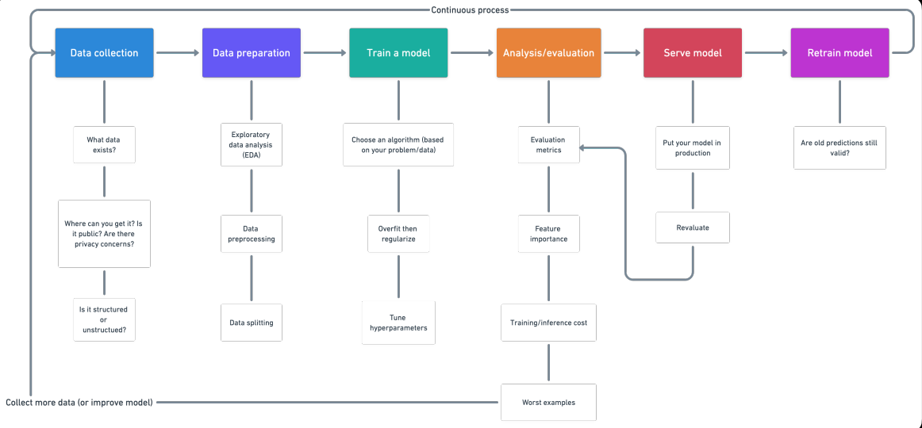
Steps to follow

Slide 4
Data Understanding:
The dataset contains information about loan applicants. Banks, globally, use this kind of dataset containing informative data to create models which help in deciding on whom to accept/refuse for a loan.
Before moving forward with machine learning modeling, a few steps were required to familiarize ourselves with the Loan Default Prediction dataset. The first important step was to import the necessary libraries and data files required for the model. And the second step was to do an exploratory data analysis (EDA) of the given data to examine its features and answer the following questions.
1. What are the characteristics of each loan?
2. What features make them different or similar?
3.How to best explain the data?
4. What are the most important characteristics for classification purposes?
5.Which method would be the most effective to clean the dataset as per our needs?.

Slide 5
EXPLORATORY DATA ANALYSIS
Exploratory Data Analysis (EDA) played an integral part in understanding the Lending Club dataset. It was vital to get familiar with different relationships within the data through different types of plots before moving towards classification. Analysing these relationships helped us with interpreting the outcomes of the models. Asking questions about these relationships provided us with additional knowledge about relationships that we may not have known existed. This section will further investigate data distribution and ask specific questions about the data lying within the dataset.

Slide 6
Missing Values
In real data, there are some variables where a particular element is missing because of various reasons, such as corrupt data, failure to load the information.
We can not use the data with missing values for model building they require proper treatment.
There are different ways of treating the null values.
Ways of missing values imputation-
1.Drop Data
2. Replace data.
It depends upon the situation which option to go for while treating missing values.
In our dataset we went for dropping variables having more than 40% of the values as null while for other variables we went for imputation of the null values.

Slide 7
Numerical Variables: For numerical values, we opted for imputation through the median.
Categorical Variables: For Categories, we did the imputation by replacing the missing values by the mode of the variable.
We noted that after dropping the columns we were left with 73 columns for further analysis.
Outliers Analysis:
There were a few columns in current application data named AMT_ANNUITY, AMT_CREDIT, AMT_GOODS_PRICE,CNT_CHILDREN and more which have abundance amount of outliers and required treatment.
AMT_INCOME_TOTAL has many outliers which indicate that few of the loan applicants have high income as compared to the others.
DAYS_BIRTH has no outliers which means the data available is reliable.
DAYS_EMPLOYED has outlier values around 350000(days) which is around 958 years which is impossible .

Slide 8
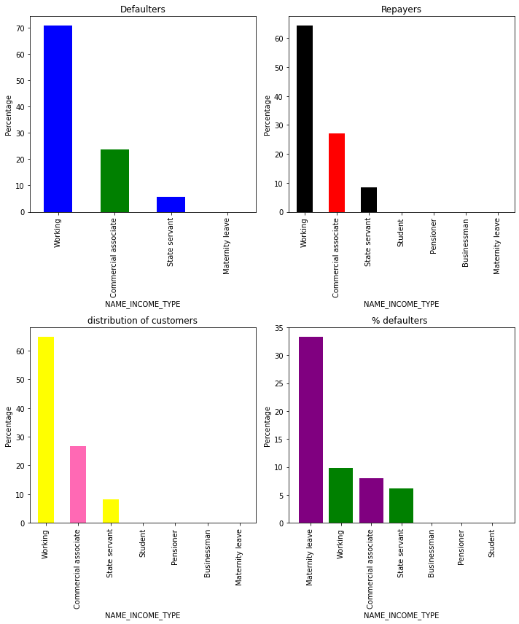

Slide 9
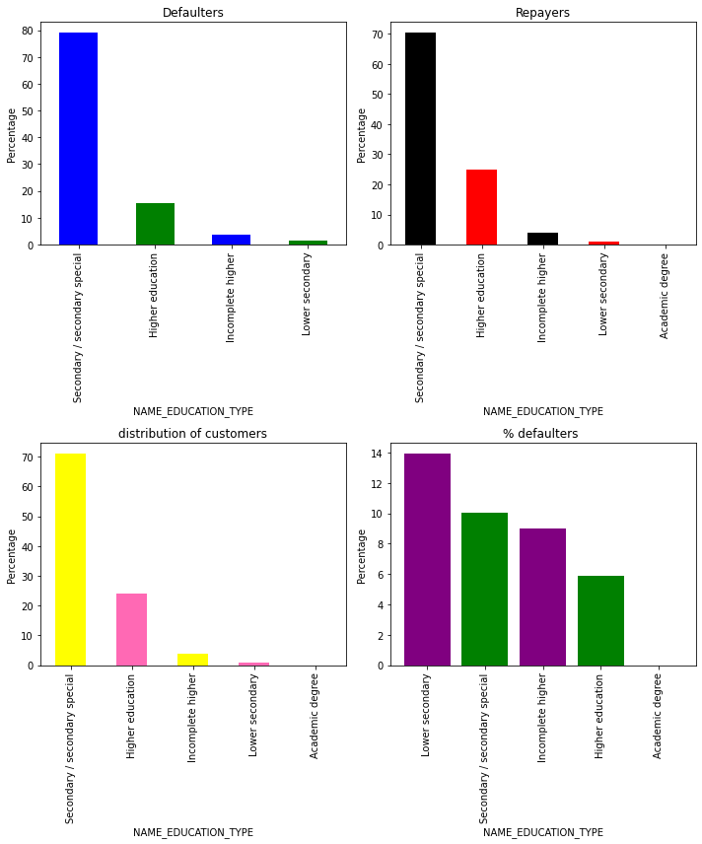

Slide 10
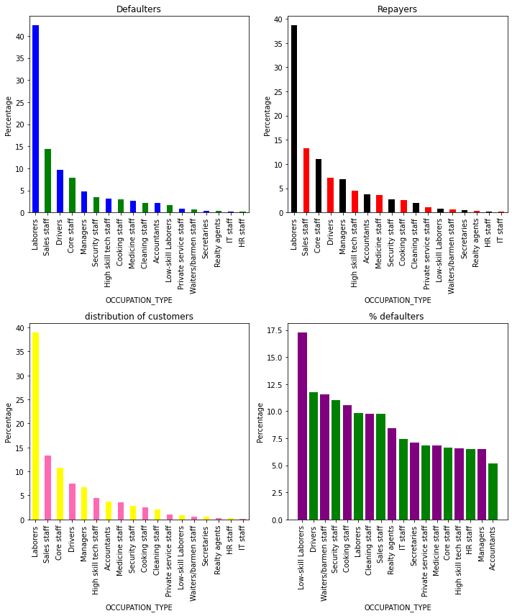

Slide 11
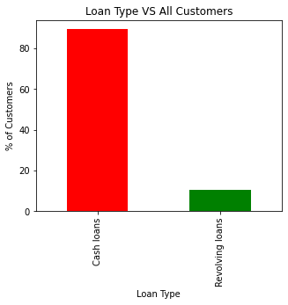
Univariate And Bivariate Analysis:
Inferences:
1. Most of people prefer to take cash loans(89.42%) rather than revolving loans(10.57%).
Clients who own a car are half in number(142773) of the clients who don’t own a car(78437). But it is seen that owning a car does not cause any impact on the person defaulting on his/her loan as the default percentage is almost the same of around 64-68%.

Slide 12
No correlation was found between the columns related to the exit sources and the target hence we decided to drop them.
Checked the flag document columns -Except for FLAG_DOCUMENT_3, no document proved to be significantly important. Data shows if the borrower has submitted FLAG_DOCUMENT_3 then he/she is less likely to default the loan so we dropped all (19) flag_columns except FLAG_DOCUMENT_3.
People who are working since a long time prefer to take very less loans as compared to ones who have started working recently.
Our Analysis also conveyed that most of the loan applicants have an experience of 0-5 years.
There is no relation between features related to the applicant’s contact details with TARGET so we dropped the columns related to contacts.
Around 32% of the loan applicants were more than the age of 50.
82% of the loan applicants are more than the age of 50. 30.55% of the loan applicants were more than the age of 40. There are a few in the category of less than 20 years of age group but those are negligible.
92% of the applicants have an income of less than 3,00,000.

Slide 13
It has been observed in our analysis that most of the applicants do not have children. Very few clients have more than 3 children.
The clients who own real estate are more than double the ones that do not have one. Although it has been observed that owning a real estate property does not have any significant impact on the person defaulting on his loan.
90% of the applicants have an income of less than 300,000.
Applicants with an income less than 3,00,000 are more likely to default while applicants with an income more than 7,00,000 are least likely to default.
Most of the applicants for loans have income type as Working, followed by Commercial associate, Pensioner, and State servant.

Slide 14
.
Student pensioners, Businessmen, although fewer in number do not have any default record. Thus these two categories are safest to be provided with a loan.
Majority of the applicants have Secondary/secondary special education (Post Graduation) followed by clients with Higher education.
Most of the applicants are married, followed by Single/not married and civil marriage. People under the category of Civil Marriage have the highest probability of default.

Slide 15
Majority of people live in House/apartment.
People living in office apartments have the lowest default rate while people living with parents (~11.5%) and those living in rented apartments(>12%) have a higher probability of default.
Majority of the loans are given to the 30-40 years age group while the lowest loans are given to the 0-20 age group.
People in the age group of 20-30 years have the highest probability of default.
Most of the loan applicants were Laborers, followed by Sales staff.
Applicants belonging to the IT department applied the least for the loan.
Organizations with highest percent of loans defaulters are Transport: type 3 , Industry: type 13 , Industry: type 8 and Restaurant.

Slide 16
Adding previous application data.
For each client we have data related to his/her previous application which he/she must have provided while applying for a loan in the past.
This previous application dataset contained relevant information about the clients which could help us in better prediction of their probability of default.
We were able to merge the dataset on the basis of unique SKIDs assigned to each client
After merging we were left with 554538 rows and 79 columns to move ahead with.
No Null values and Outliers are present in our dataset.

Slide 17
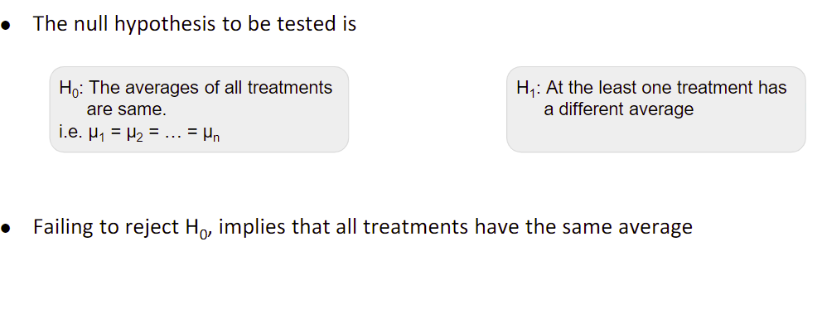
Statistical Tests
Statistical Tests are said to be one of the most appropriate methods for gauging the significance of our input variables.
In our analysis, we made use of Chi-Square and ANOVA tests to check the relevance of our variables.
We dropped all the columns which were not proven to be significant enough to carried forward for model building.

Slide 18
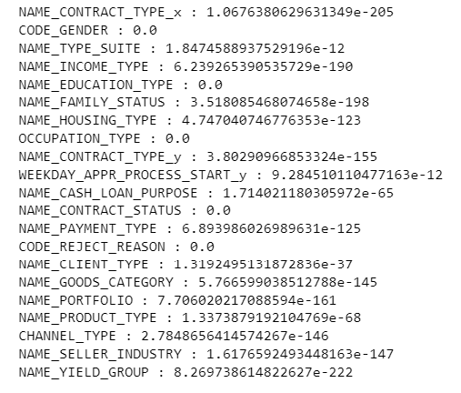
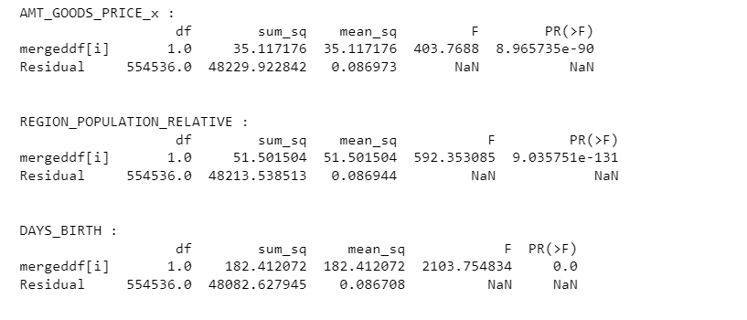
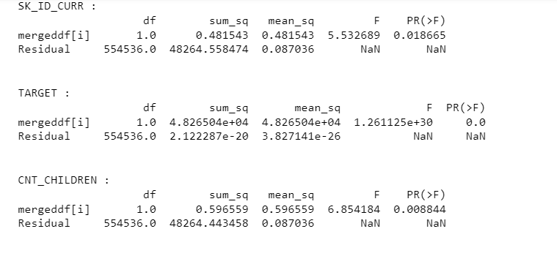
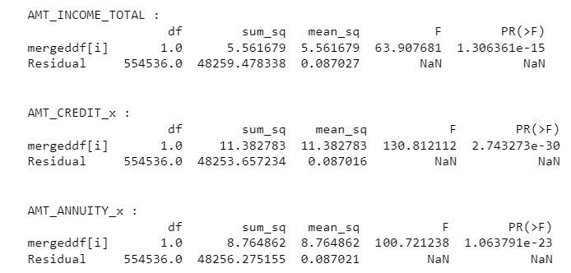
Anova Chi-Square
It is to be duly noted that all the tests were conducted at a significance level of 1%.
All the variables with p-values more than 1% were statistically insignificant and thus were dropped.

Slide 19
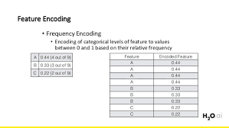
Handling Non-Numerical Data
As we are well aware that the algorithms only work with numerical data so we need to convert our categorical data into numerical data.
There are many ways to encode the categorical variables:
●N-1 Dummy encoding●One-hot encoding●Label encoding●Ordinal encoding●Frequency encoding●Target encoding.
Frequency Encoding
In our dataset the types of encoding we used were N-1 and Frequency encoding. If a categorical variable contains too many levels, then using one-hot encoding will increase the number of features drastically, as a result, we went for frequency encoding, which replaces each sub category of the categorical variable by the count of that particular sub category.

Slide 20
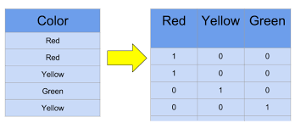
N-1 Encoding
It is used to create dummy variables from a categorical variable●
For a categorical variable that can take n values, n-1 dummy variables are created.

Slide 21
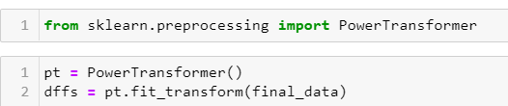
Transformation
Transformation is a common pre-processing step in machine learning that involves converting or mapping data from one representation to another. There are several reasons why transformation might be necessary:
We noticed that the distribution of our variables was moderately skewed as a result we opted to go for transformation.
Power Transformer is one of the most common types of transformation techniques which uses the method of yeo-johnson to transform the values of the variable.
After using power transformation we noticed that almost all the distributions became quite normal.

Slide 22
Dimensionality Reduction
We are well aware of the fact that adding too many features into the model leads to overfitting and data also becomes quite scattered i.e. the “Distance Concentration” in the data increases.
The techniques used in dimensionality reduction reduce the training time of the model by neglecting the noise in the data and taking into consideration only those variables which explain the maximum variance.
Principal Component Analysis(PCA) is one of the known techniques used to reduce the dimension of the dataset.
It transforms the large set of features into a small set such that it will contain the maximum information in the original data

Slide 23
After applying PCA to our final dataset we checked for the components which were explaining around 91% of the variance in our data.
The number of components came out to be 43.
After applying PCA, we went to split the data without giving any value to the random state so that new samples could be generated at each iteration.

Slide 24

Imbalanced Data
There is an imbalance in the dataset ,when there is a huge difference in the proportion of the two classes in binary classification.
SMOTE (Synthetic Minority Oversampling Technique) is one of the most used techniques to deal with an imbalanced data
●It generates the synthetic samples for the minority class
●Python provides a library that provides different techniques to deal with an imbalanced dataset.

Slide 25
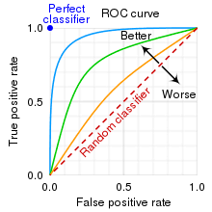
Performance metrics for the model
1. ROC curve
2. Confusion Matrix
ROC curve-ROC curve is the plot of TPR against the FPR values obtained at all possible threshold values.
Confusion Matrix- It is a performance measure for classification problem used to compare predicted and actual values of the target variable.

Slide 26
Model Deployment
The Algorithms used for fitting the model to the data with their respective accuracy scores are as follows-
1.Logistic Regression(62%)
2.Random Forest Classifier(97%)
3.AdaBoost Classifier(66%)
4.XGBoost Classifier(76%)

Slide 27

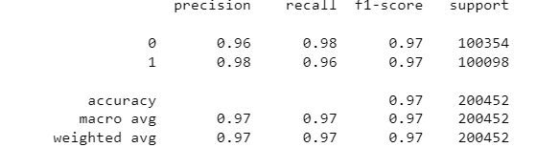
.
Best Algorithm outperforming all the other algorithms came out to be Random Forest Classifier
Accuracy Score-97%
Confusion Matrix
Classification Report-

Slide 28
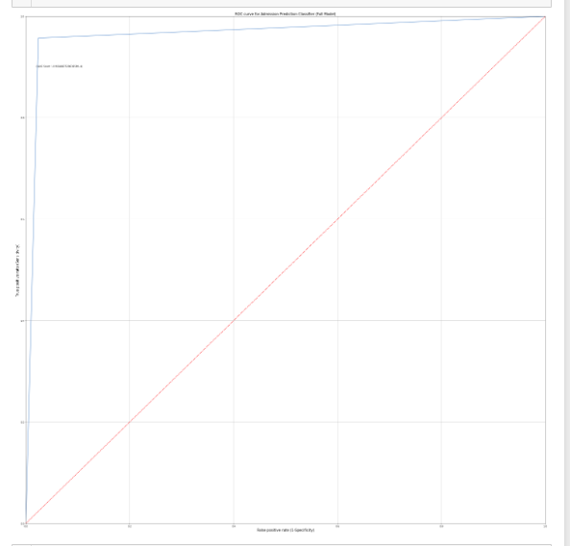
ROC PLOT
ROC Curve of Random Forest Classifier.

Slide 29
1.Precision-It is the proportion of actual positives/negatives out of those predicted as positive/negatives.
2. Recall-It is the proportion of positive/negative cases that were correctly predicted.
3. F1-score-It is used to find a balance between precision and recall or if there is an uneven distribution of classes.
4. Accuracy-It is the fraction of predictions that our model got correct.

Slide 30
THANK YOU

